Slide 1
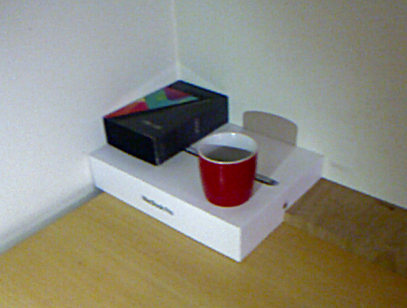
Albedo
Reflection
Shadow
Specular

