Slide 1
Convolutional Vision Transformer (Hybrid CNN Transformer Network)
Nishit Mayasandra Vishwanath
Neha Tyagi
Piyush Dewnani
Pankaja Hosamani

Slide 2
Difference between CNN, ViT and CvT
CNN | ViT | CViT / CvT
Uses convolution filters | Uses self-attention | Mixes convolution with attention
Local feature extraction | Global attention from start | Local conv + global attention
Fixed receptive field | Flexible receptive field | Adaptive receptive field
Needs more inductive bias | Less inductive bias | Moderate inductive bias
Good for small datasets | Needs large datasets | Works better on medium datasets
Hard to capture global info | Captures global info easily | Captures both effectively
Fast inference | Slower inference | Balanced speed

Slide 3
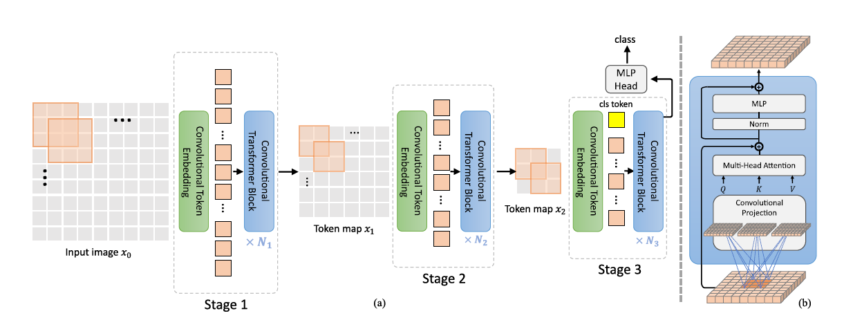
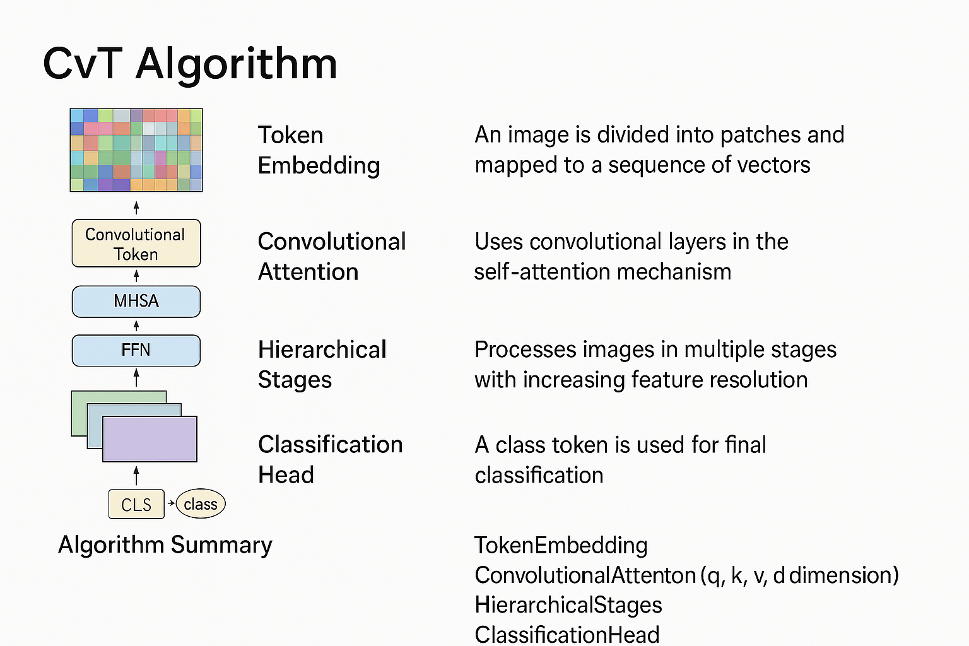
Convolutional Vision Transformer

Slide 4
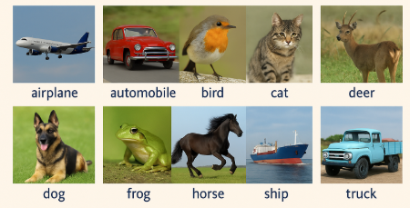
CIFAR-10 dataset
CIFAR-10 is a widely used benchmark dataset in computer vision.
Contains 60,000 color images (32×32 pixels).
50,000 training images and 10,000 test images.
10 balanced classes:
airplane, automobile, bird, cat, deer,
dog, frog, horse, ship, truck.
All classes have 6,000 images each (balanced dataset).
Includes diversity in pose, color, and background.

Slide 5
Experiments with CVT
Transformations to improve accuracy ( Random Augment)
Change of Optimizer
Positional Embedding vs Class Token vs Global Average Pooling
Warmup, Scheduling & Weight Decay
Stride changes for K and V in Convolutional Block in CVT

Slide 6
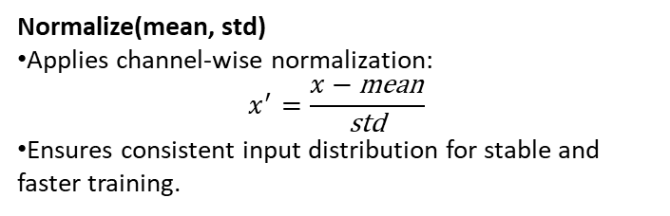
Transformations
CIFAR-10 Mean:
Represents the average pixel intensity of the dataset across the 3 RGB channels.
R = 0.4914, G = 0.4822 and B = 0.4465
CIFAR-10 Std:
Represents the variation of pixel values for each RGB channel.
Important for scaling the input so all features contribute equally.
Prevents unstable gradients during training.
RandomCrop (32, padding=4)
Randomly crops a 32×32 section of the image after padding the edges by 4 pixels.
Helps the model become robust to shifts and spatial variations.
RandomHorizontalFlip ()
Flips images left-right with a 50% probability.
Useful for recognizing objects regardless of mirroring.
RandAugment (num_ops=2, magnitude=9)
Automatically applies two random augmentations (e.g., rotation, color jitter, shear).
Magnitude = 9 controls the augmentation strength.
Greatly increases data diversity without manual tuning.
ToTensor()
Converts the image from a PIL/NumPy format into a PyTorch tensor.
Scales pixel values from 0–255 to 0–1.
Normalize(mean, std)
Applies channel-wise normalization:
$$x^{′}=\frac{x−\text{mean}}{\text{std}}$$
Ensures consistent input distribution for stable and faster training.

Slide 7
Optimizer
AdamW (Adam with decoupled weight decay, decouples weight decay from gradient update):
Adaptive optimizer with per-parameter learning rates.
Uses momentum-like moving averages of gradients and squared gradients.
Decouples weight decay from adaptive updates for correct L2 regularization.
LION (Evolved Sign Momentum , sign-based momentum-style optimizer):
Uses the sign of the gradient and a momentum-like running state.
Simple update rule, fewer state variables, strong generalization.
Why skipping warmup causes errors with LION Optimizer:
Early gradients are noisy → large updates → exploding activations.
Causes loss spikes, NaNs, or divergence.
Warmup stabilizes training by gradually increasing learning rate.

Slide 8
Model Hyperparameters
Hyperparameter | Value
BATCH_SIZE | 128
EPOCHS | 10
LEARNING_RATE | 3e-4
LION_LEARNING_RATE | 1e-4
PATCH_SIZE | 4
NUM_CLASSES | 10 (CIFAR-10)
IMAGE_SIZE | 32
CHANNELS | 3
EMBEDDING_DIM | 384
NUM_HEADS | 8
DEPTH | 12 (Transformer Blocks)
MLP_DIM | 512
DROPOUT_RATE | 0.1

Slide 9
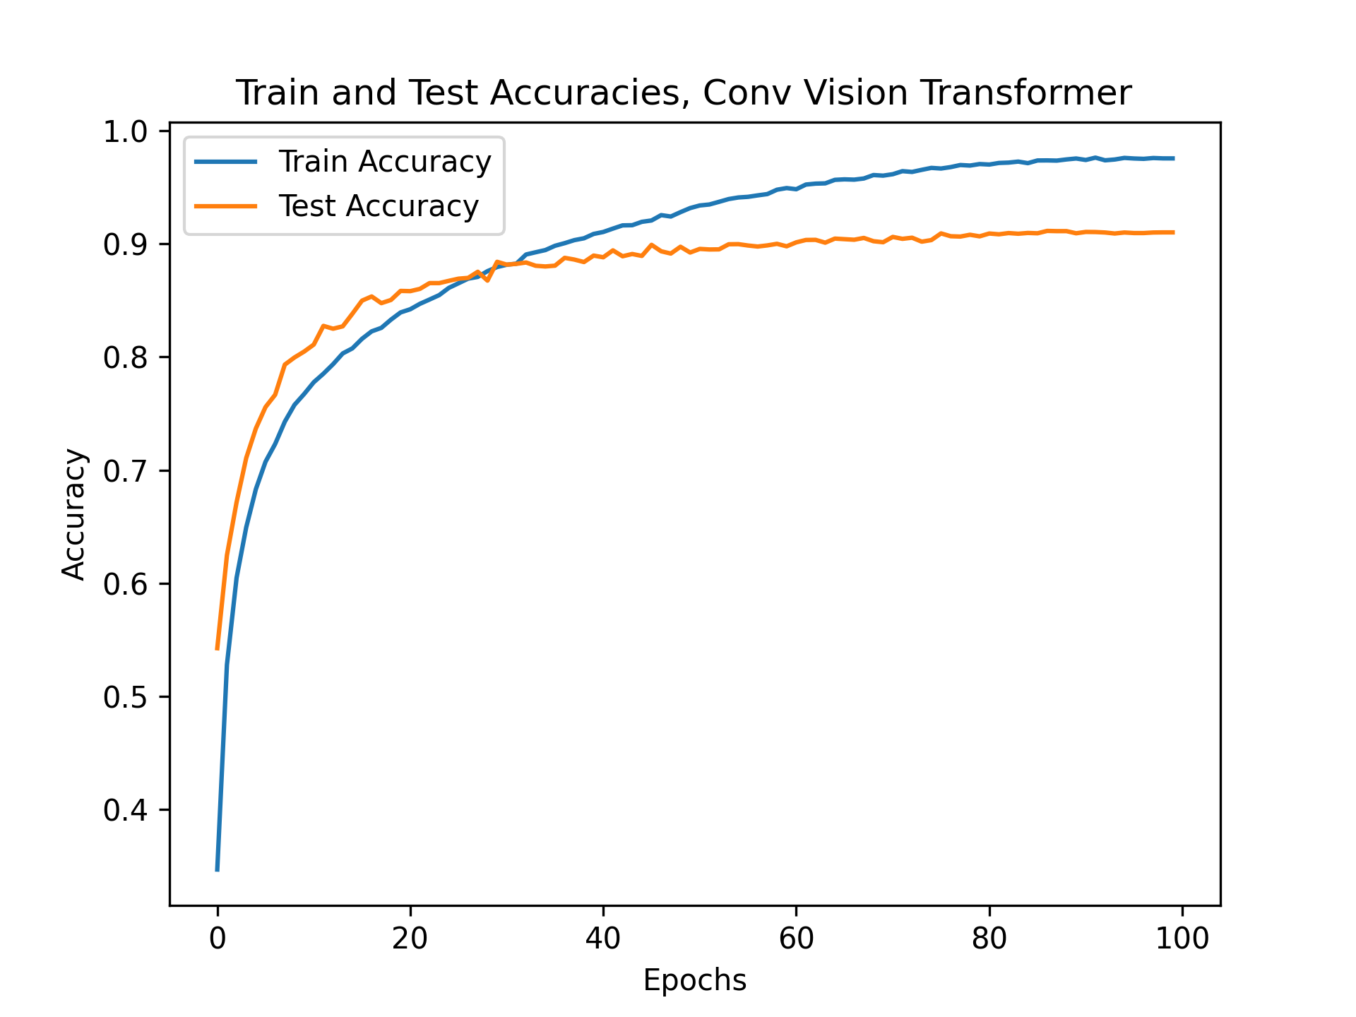
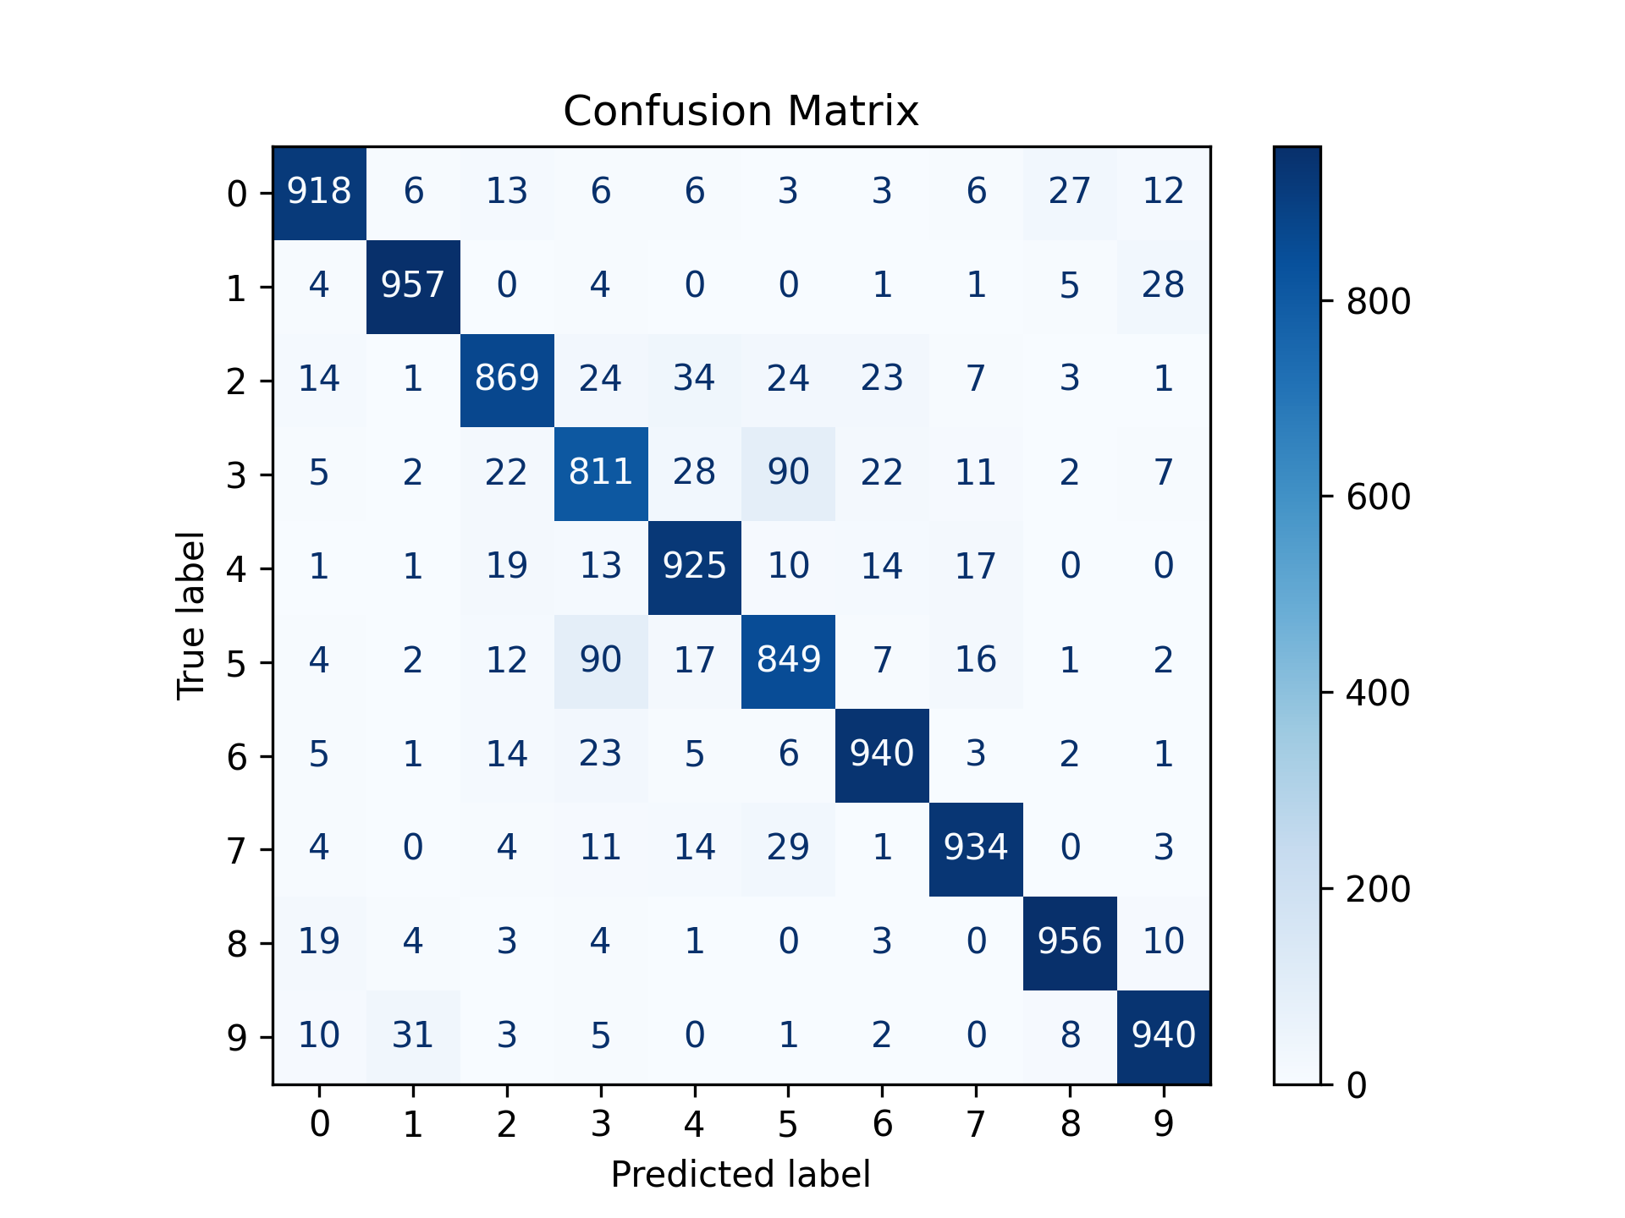
Result CVT ( As per Paper with GAP & no CLS Token)

Slide 10
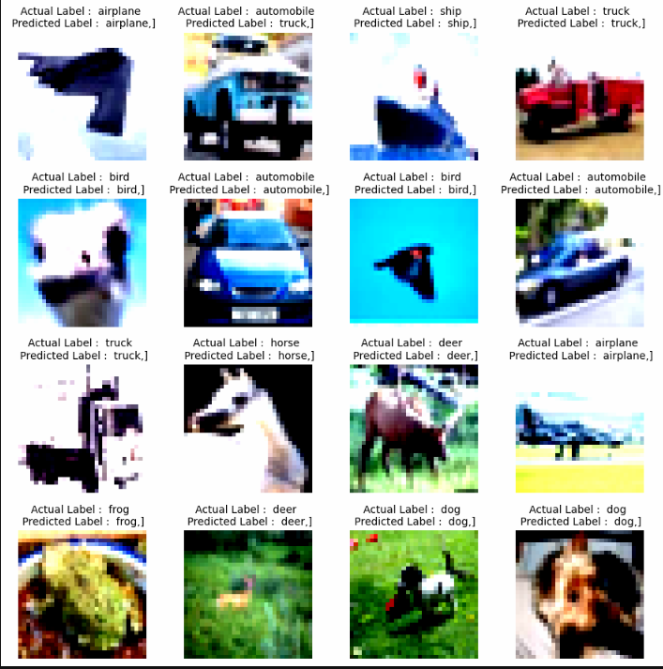

Slide 11
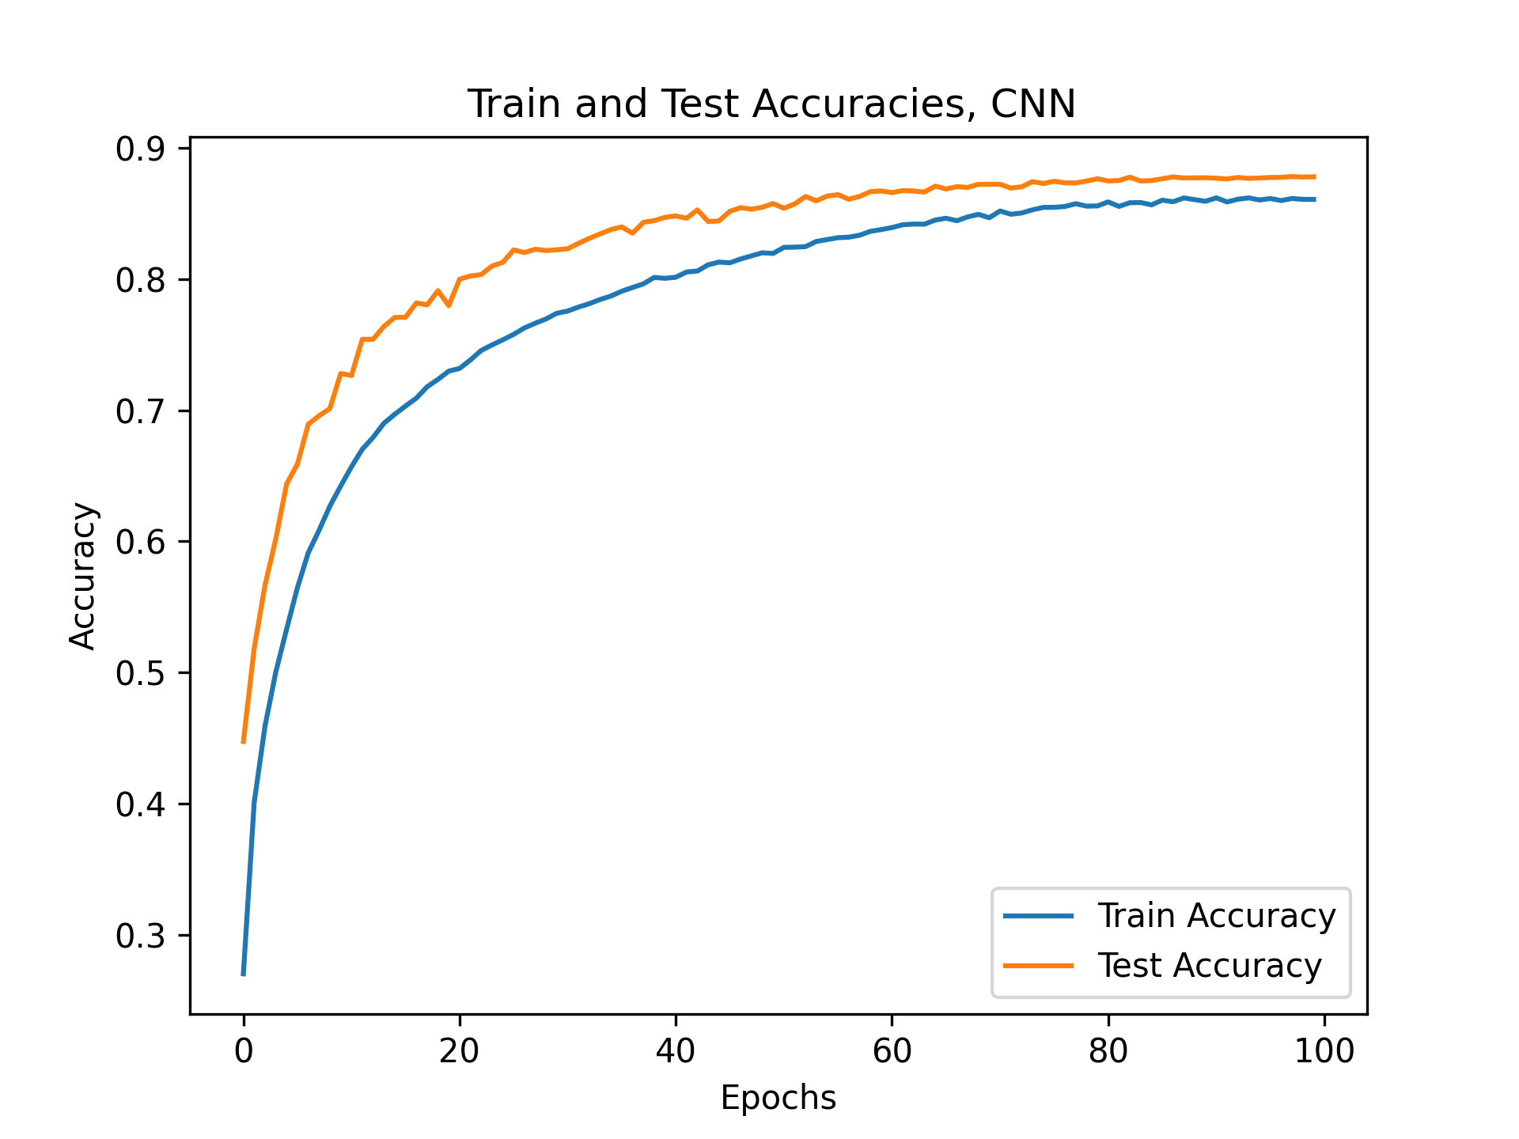
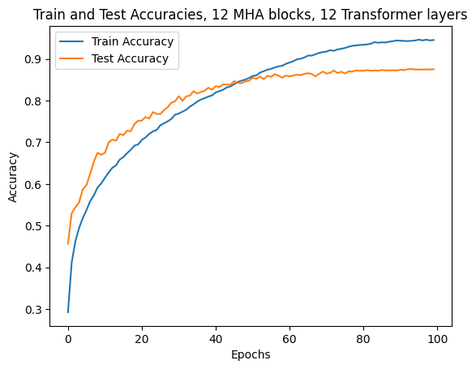
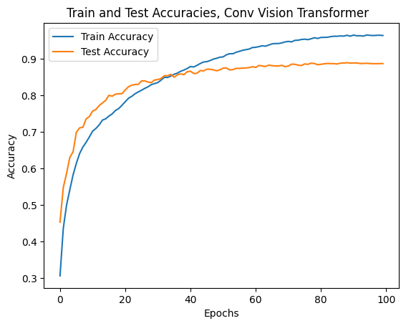
Results – AdamW optimizer
CNN
ViT
CvT Simplified

Slide 12
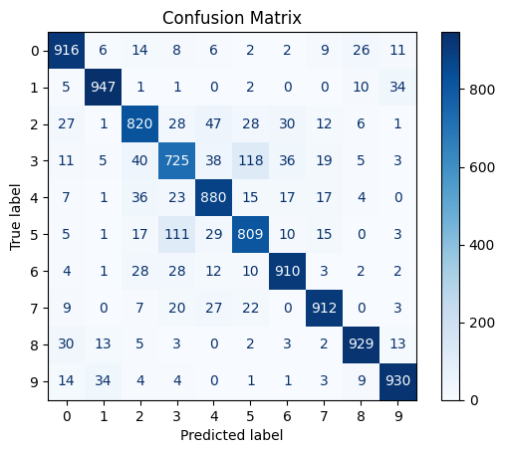


Results – AdamW optimizer
CNN
ViT
CvT Simplified
Test Accuracy: 88%
Precision: 0.88
Recall: 0.88
F1 Score: 0.88
Test Accuracy: 88%
Precision: 0.88
Recall: 0.88
F1 Score: 0.88
Test Accuracy: 89%
Precision: 0.89
Recall: 0.89
F1 Score: 0.89

Slide 13
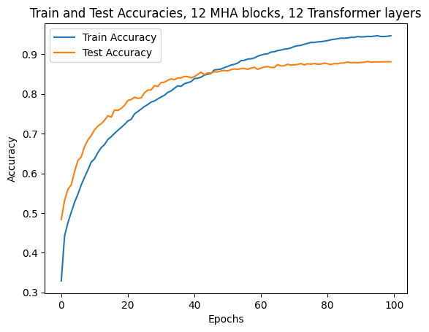
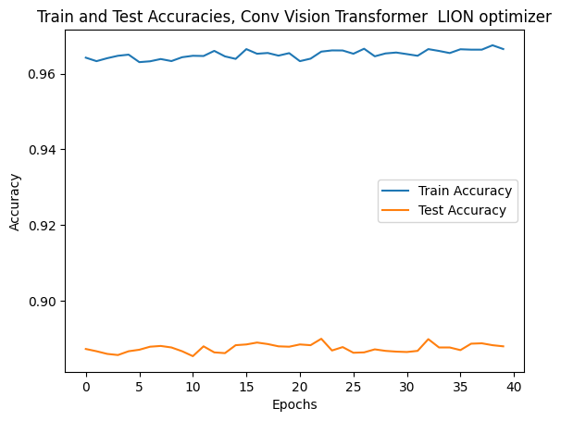
Results – Lion optimizer
ViT
CvT

Slide 14

Results – Lion optimizer
ViT
CvT
Test Accuracy: 89%
Precision: 0.89
Recall: 0.89
F1 Score: 0.89
Test Accuracy: 88%
Precision: 0.88
Recall: 0.88
F1 Score: 0.88

Slide 15
Observations about CVT
Setting Stride for K and V to 2 in the CNN 2D makes training faster but at a cost of 1% accuracy ( 88% vs 89% for K =V =1 , CLS Token used)
LION optimizer without Warmup doesn’t work and tends to have exploding activations as it uses sign of the gradient and not its magnitude hence can lead to aggressive steps that can overshoot .
AdamW works well with same level of accuracy as LION , but LION converges much faster ( <40 epochs vs 90+ for AdamW) .
Warmup does not have significant effect on AdamW.
Maximum possible accuracy for Cifar10 dataset observed to be 91% with GAP(Global Average Pooling) instead of Class Token
GAP forces a consensus from all spatial features, which aligns better with the convolutional inductive bias for CVT.
Positional Embedding did not have an impact on the accuracy with Class Token .

Slide 16
Summary
CNN: Strong local feature extraction; ViT: strong global attention; CvT: combines both for best balance.
CIFAR-10: 60k images, 10 balanced classes; transformations improve robustness.
Normalization ensures stable gradients and faster training.
AdamW: stable adaptive optimizer; Lion: lightweight, sign-based; warmup prevents divergence.
Hyperparameters tuned for CIFAR-10 stability and accuracy.
Results: CvT performs best.
Key takeaway: CvT offers best overall performance when combined with proper augmentation, normalization, and warmup.

