Slide 1

BNL, April 30, 2008
Collectivity in a Parton Cascade
Zhe Xu
with A. El, O. Fochler, C. Greiner and H. Stöcker

Slide 2
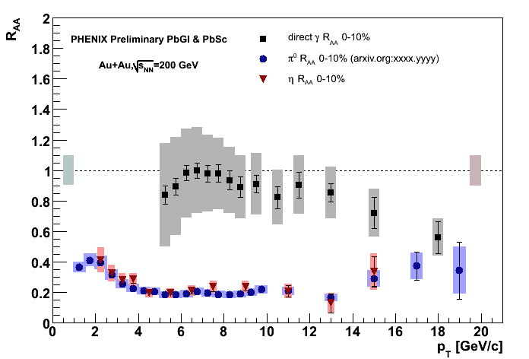
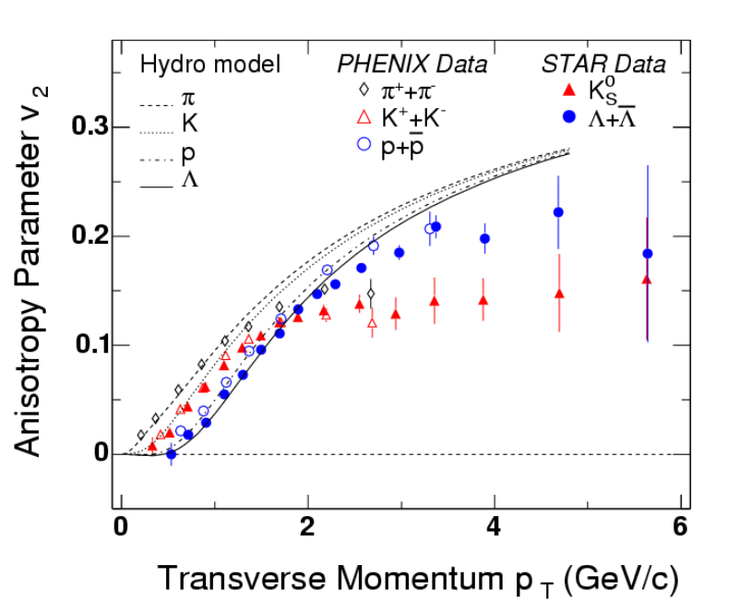
Motivation and Summary
Fast Thermalization from pQCD: 2-3 important
Equilibr. time: 1 fm/c
Elliptic flow v₂: high in 2-3
Viscosity: small ~ 0.08
Hard probe: R_{AA} ~ 0.1
collisional 2-2 vs. radiational 2-3 energy loss
P.Huovinen et al., PLB 503, 58 (2001)

Slide 3
Outline
Transport model
Results from simulations
Analytical calculations

Slide 4
Transport Model
BAMPS: Boltzmann Approach of MultiParton Scatterings
A transport algorithm solving the Boltzmann-Equations for on-shell partons with pQCD interactions
(Z)MPC, VNI/BMS, AMPT
new development ggg gg
Elastic scatterings are ineffective in thermalization !
Inelastic interactions are needed !

Slide 5
Old collision algorithm
(ZPC, MPC, VNI/BMS, AMPT)
collision criterion:
BUT, difficult to 3 −> 2 !

Slide 6
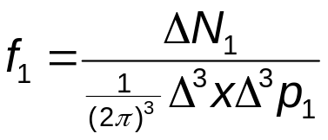
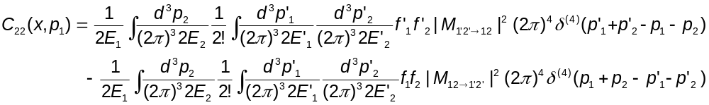
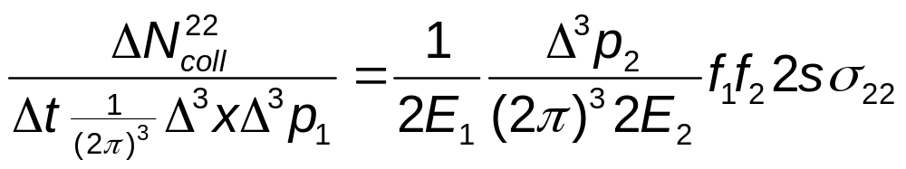
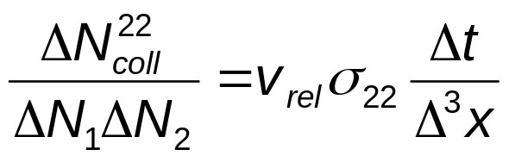
Stochastic algorithm
P.Danielewicz, G.F.Bertsch, Nucl. Phys. A 533, 712(1991)
A.Lang et al., J. Comp. Phys. 106, 391(1993)
Space has to be divided
into small cells !
Δ³x
collision rate per unit phase space for incoming
particles p₁ and p₂ with Δ³p₁ and Δ³p₂:
collision probability (Monte Carlo)

Slide 7
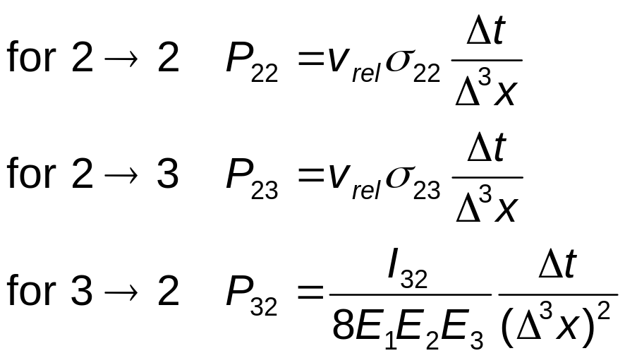
Interaction Probability
Z. Xu and C. Greiner, PRC 71, 064901 (2005)

Slide 8
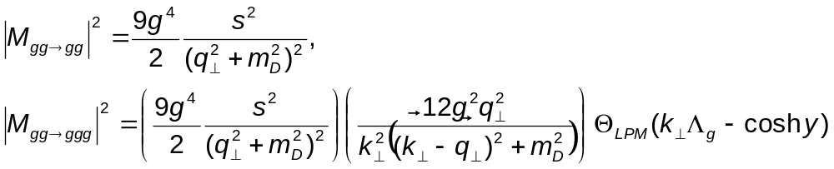
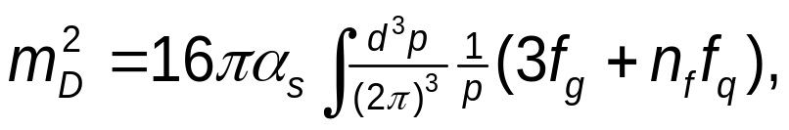
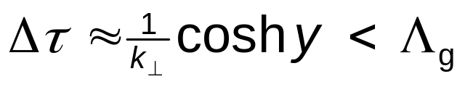
screened partonic interactions in leading order pQCD
J.F.Gunion, G.F.Bertsch, PRD 25, 746(1982)
T.S.Biro at el., PRC 48, 1275 (1993)
S.M.Wong, NPA 607, 442 (1996)
screening mass:
LPM suppression: the formation time
Λ_{g}: mean free path
Gluons freeze out at local energy density = 1 GeV/fm³.

Slide 9
Results from
the parton cascade BAMPS
thermalization
transverse energy
elliptic flow
shear viscosity
jet quenching

Slide 10
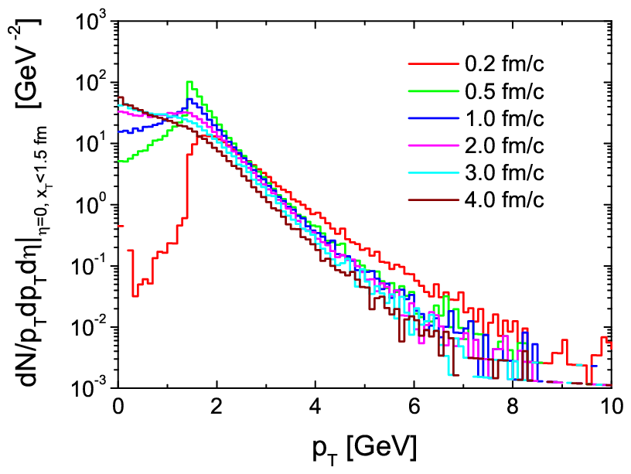
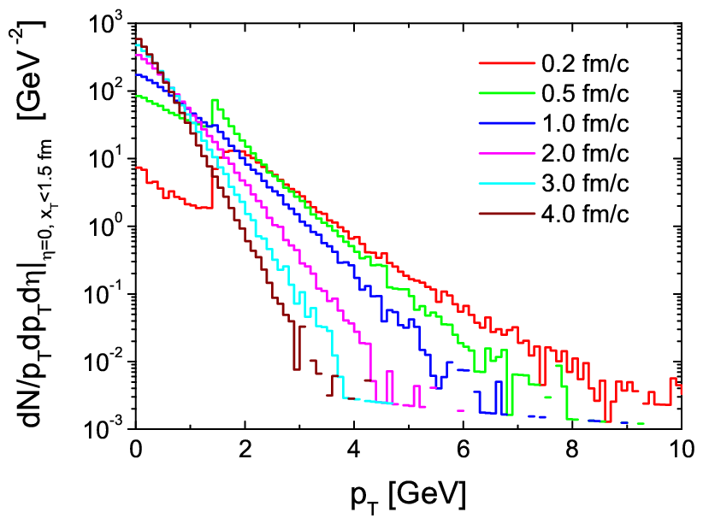
p_{T} spectra
at collision center: x_{T}<1.5 fm, Δz < 0.4 t fm of a central Au+Au at s^{1/2}=200 GeV
Initial conditions: minijets p_{T}>1.4 GeV; coupling α_{s}=0.3
simulation pQCD, only 2-2
simulation pQCD 2-2 + 2-3 + 3-2
3-2 + 2-3: thermalization!
Hydrodynamic behavior!
2-2: NO thermalization

Slide 11
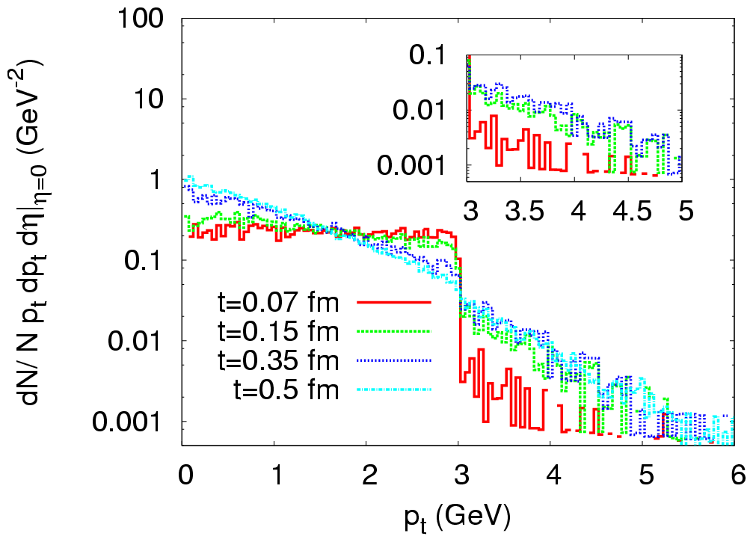
p_{T} spectra
Initial conditions: Color Glass Condensate Q_{s}=3 GeV; coupling α_{s}=0.3
A,El, ZX and C.Greiner, arXiv: 0712.3734 [hep-ph], published in NPA
ggg gg !
This 3-2 is missing in
the Bottom-Up scenario
(Baier et al.).

Slide 12
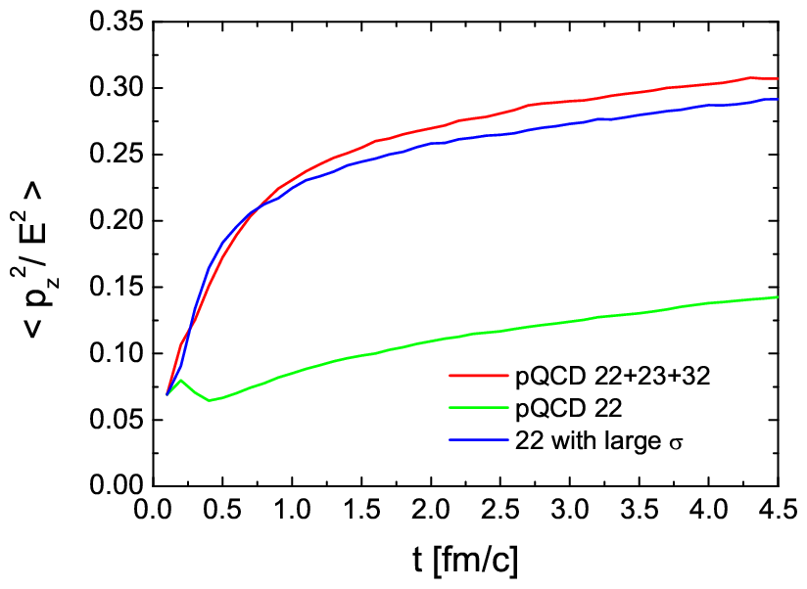

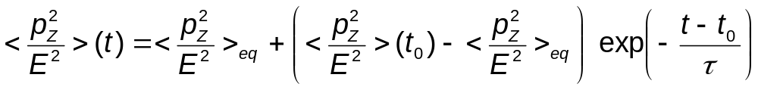
time scale of thermalization
Theoretical Result !
τ = time scale of kinetic equilibration.

Slide 13
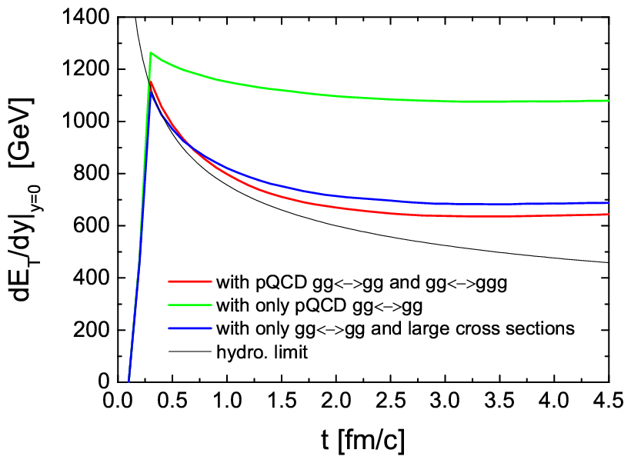
total transverse energy per rapidity at midrapidity y=0

Slide 14
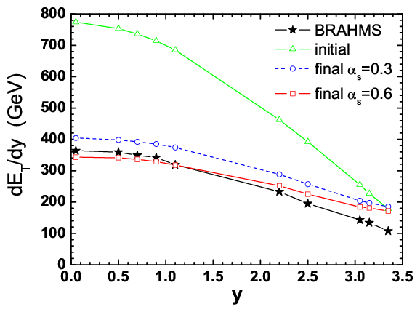
Rapidity dependence of total transverse energy

Slide 15
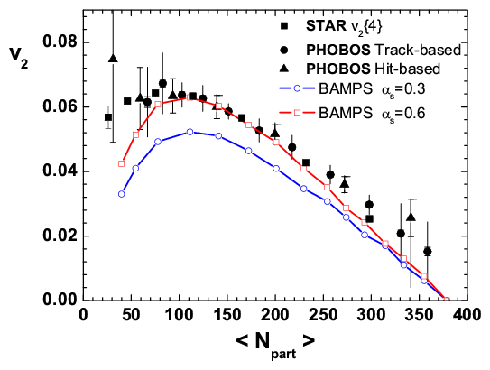
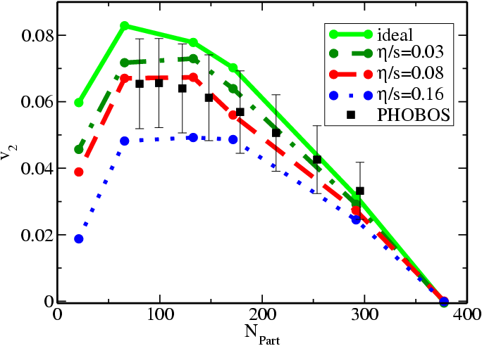
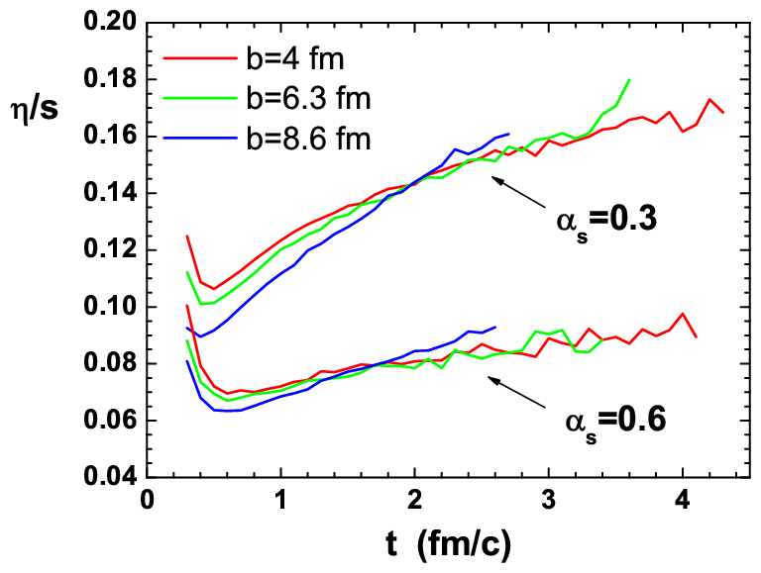
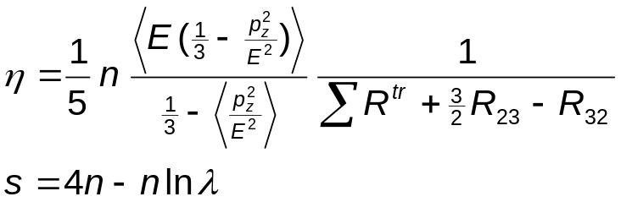
Elliptic Flow and Shear Viscosity in 2-3 at RHIC
2-3 Parton cascade BAMPS
ZX, Greiner, Stöcker, arXiv: 0711.0961 [nucl-th]
viscous hydro.
Romatschke, PRL 99, 172301,2007
η/s at RHIC > 0.08

Slide 16
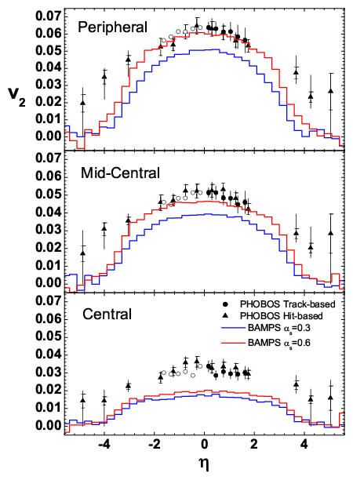
Rapidity Dependence of v₂: Importance of 2-3! BAMPS ZX,G,S

Slide 17
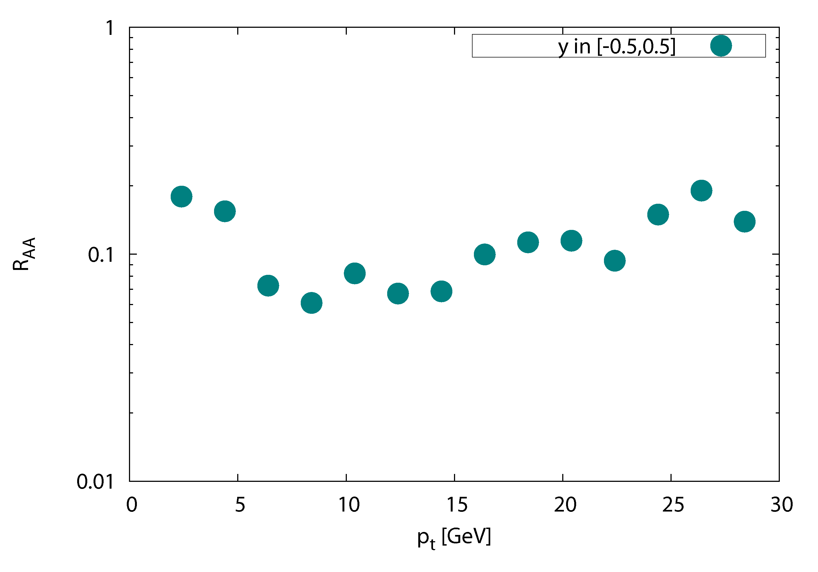

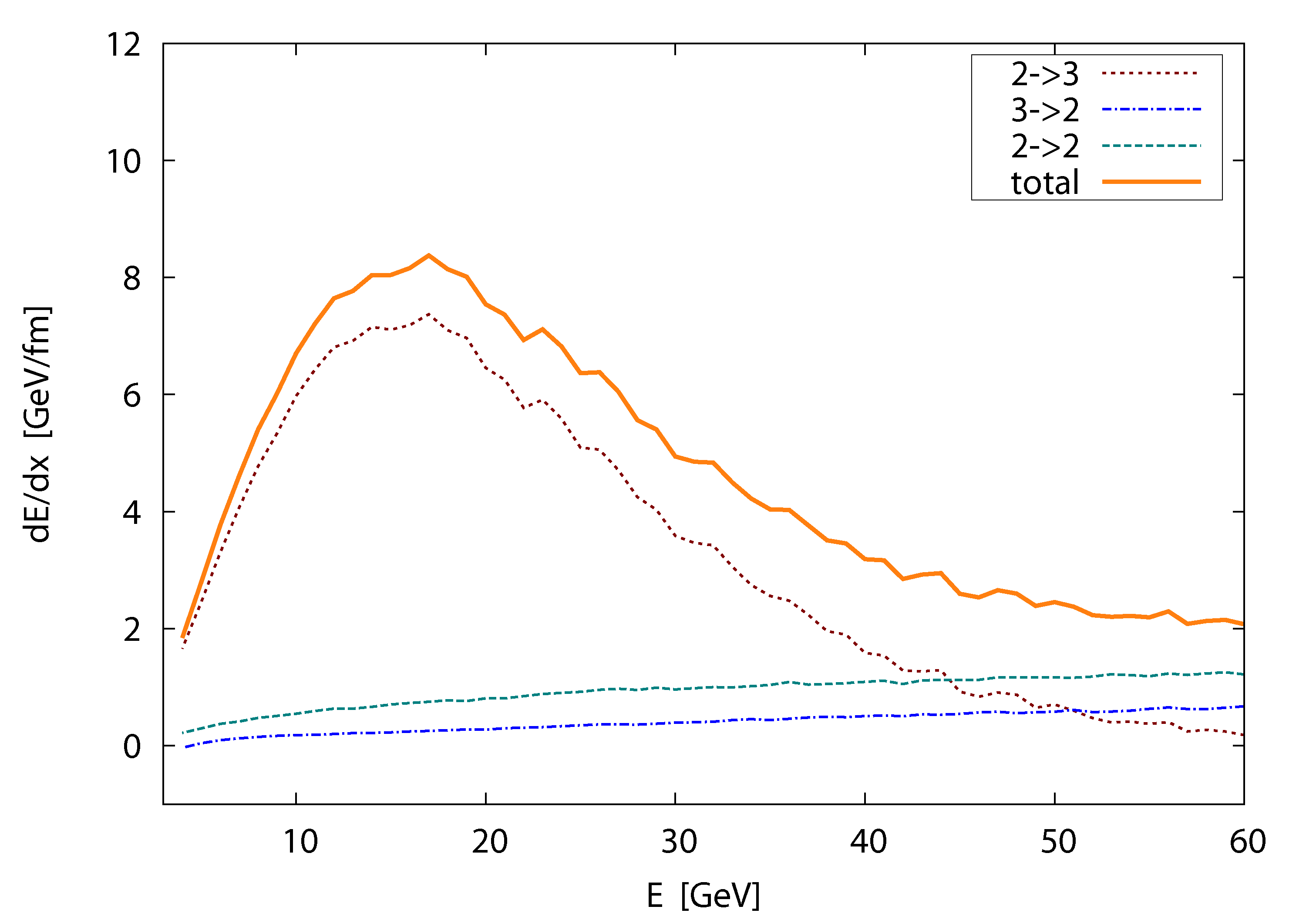
first realistic 3d results on jet-quenching with BAMPS
nuclear modification factor
central (b=0 fm) Au-Au at 200 AGeV
R_{AA} ~ 0.1
cf. S. Wicks et al.
Nucl.Phys.A784, 426
O. Fochler
2-3
dE/dx, static medium (T = 400 MeV)
2-2

Slide 18
Inelastic pQCD interactions (23+32) explain:
Fast Thermalization
Large Collective Flow
Small shear Viscosity of QCD matter at RHIC
Part of energy loss (for very high energy parton collisional energy loss due to 2-2 dominates.)
Initial conditions, hadronization and afterburning determine
how imperfect the QGP at RHIC & LHC can be.

Slide 19
Analytical Calculations for a Gluon Gas

Slide 20
screened partonic interactions in leading order pQCD
J.F.Gunion, G.F.Bertsch, PRD 25, 746(1982)
T.S.Biro at el., PRC 48, 1275 (1993)
S.M.Wong, NPA 607, 442 (1996)
screening mass:
LPM suppression: the formation time
Λ_{g}: mean free path

Slide 21
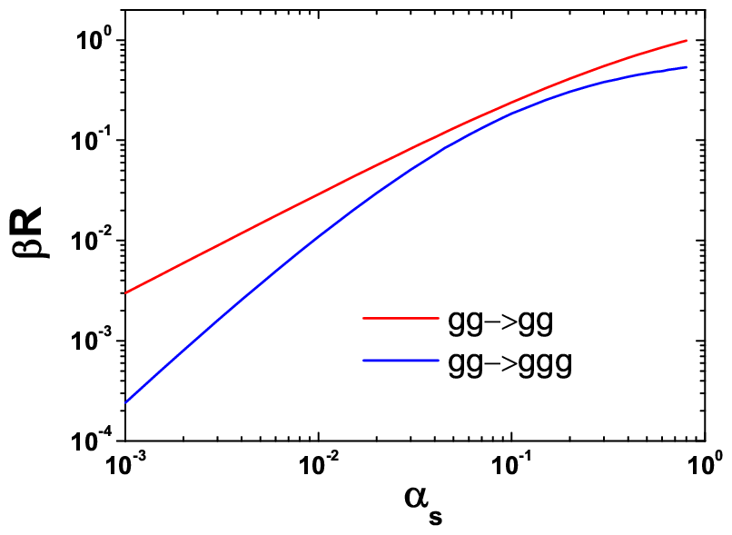
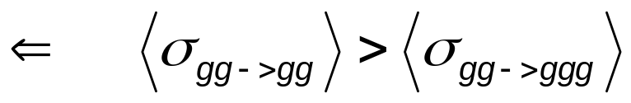
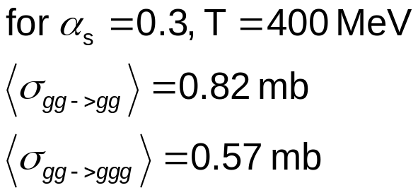
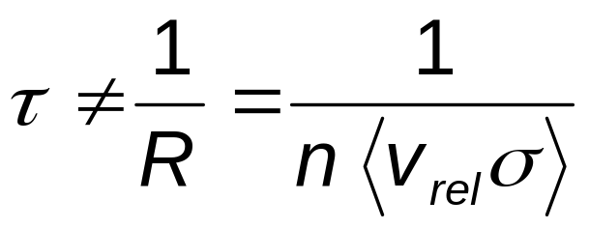
Collision Rate
Cross section does not determine τ!

Slide 22
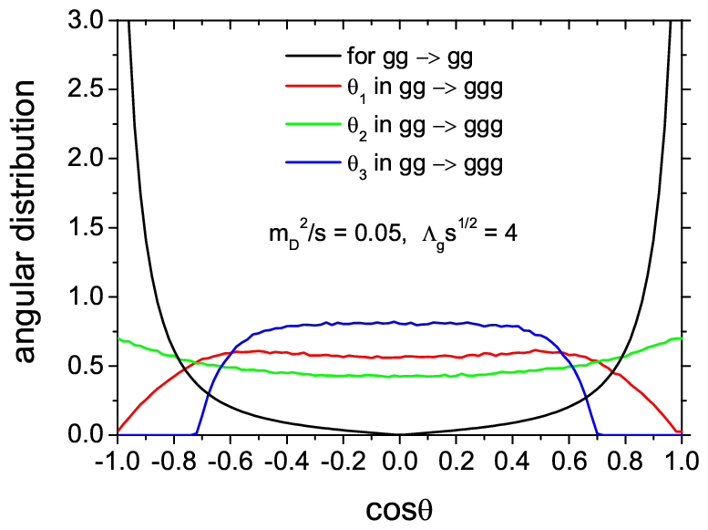
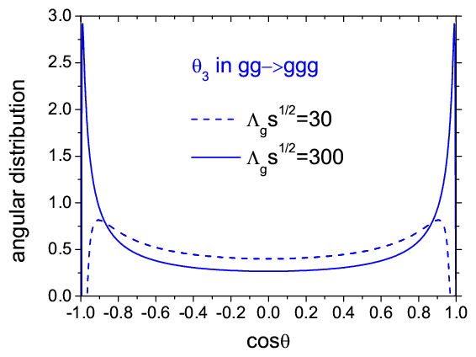
distribution of collision angles
at RHIC energies
gg gg: small-angle scatterings
gg ggg: large-angle bremsstrahlung

Slide 23
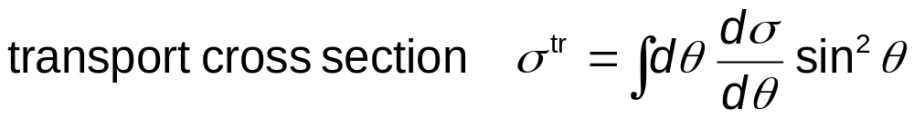
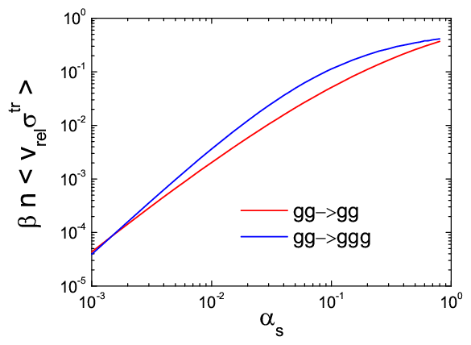
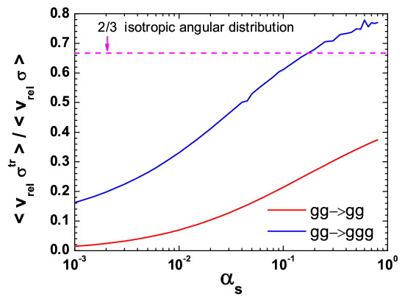
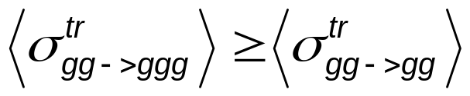
BUT, this is not the full story !

Slide 24
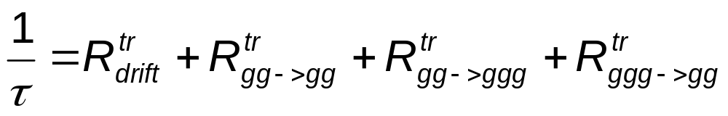
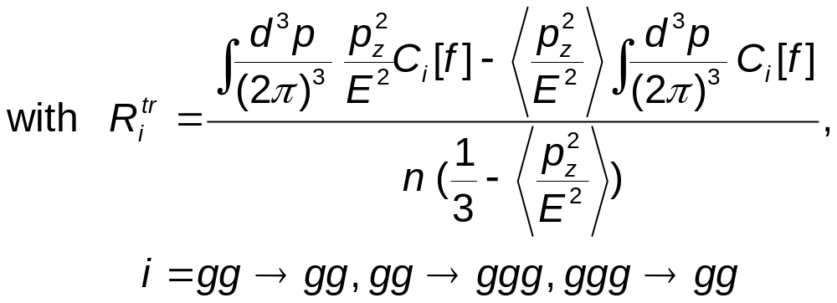
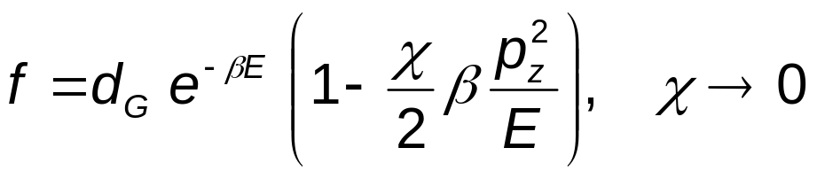
Transport Rates
ZX and C. Greiner, PRC 76, 024911 (2007)
Transport rate is the correct quantity describing kinetic
equilibration.
Transport collision rates have an indirect relationship
to the collision-angle distribution.
assume

Slide 25
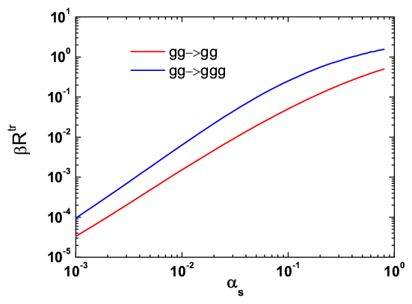
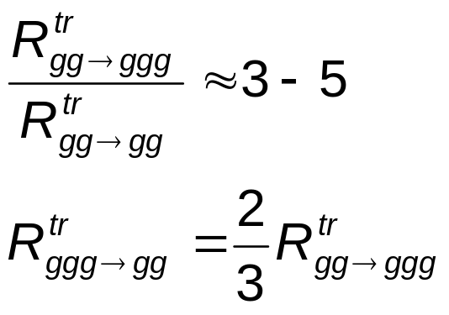
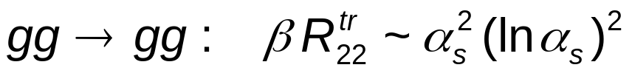
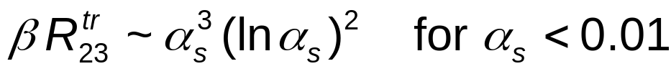
Transport Rates
Large Effect of gg->ggg !

Slide 26
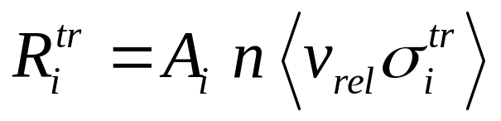
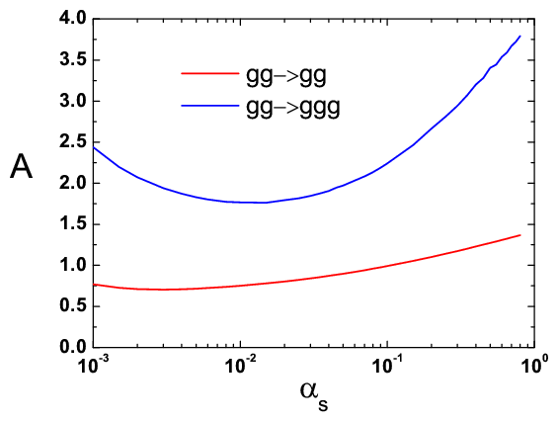
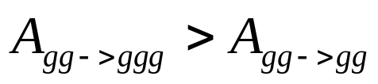
due to the fact that a 2->3 process brings one more particle
toward isotropy than a gg->gg process.

Slide 27
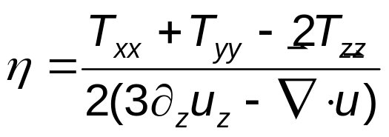
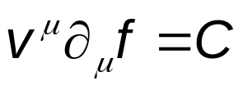
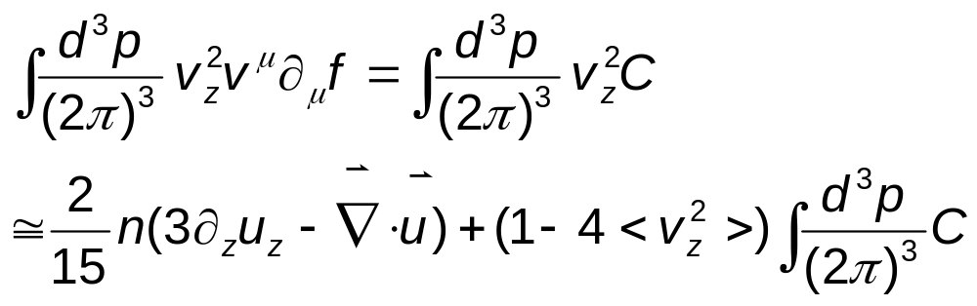
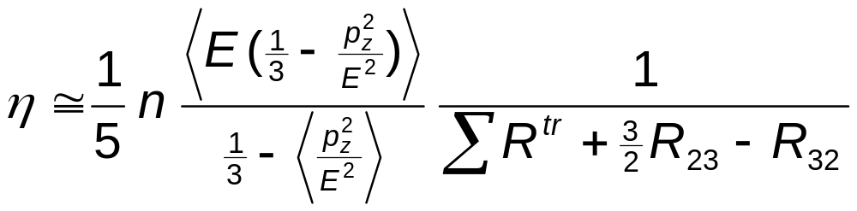
Shear Viscosity η
From Navier-Stokes approximation
From Boltzmann-Eq.
relation between η and R^{tr}

Slide 28
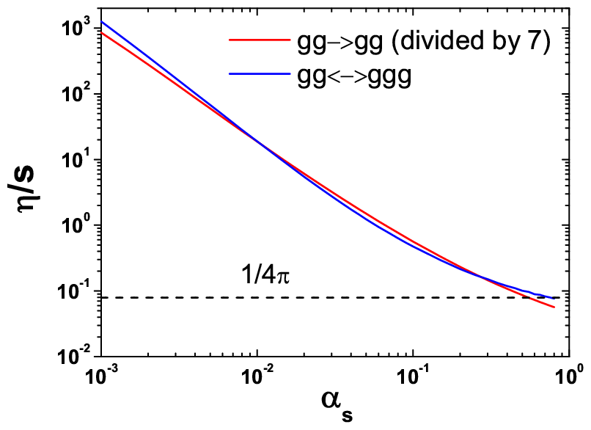
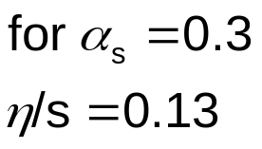

Ratio of shear viscosity to entropy density in 2-3
AdS/CFT
RHIC
ZX and C.Greiner, arXiv: 0710.5719 [nucl-th], to be published in PRL.

Slide 29
Elliptic Flow and Shear Viscosity in 2-3 at RHIC
2-3 Parton cascade BAMPS
ZX, Greiner, Stöcker, arXiv: 0711.0961 [nucl-th]
viscous hydro.
Romatschke, PRL 99, 172301,2007
η/s at RHIC > 0.08

Slide 30
Conclusion
Inelastic pQCD interactions (23 + 32) explain:
Fast Thermalization
Large Collective Flow
Small shear Viscosity of QCD matter at RHIC
Part of energy loss (for very high energy parton collisional energy loss due to 2-2 dominates.)
Initial conditions, hadronization and afterburning determine
how imperfect the QGP at RHIC & LHC can be.

Slide 31
Outlook
Collective Flow v₂,v₄,v₆ (Zhe Xu)
Jet Quenching (Oliver Fochler)
Mach Cone (Ioannis Bouras)
Dependence on initial conditions (Luan Cheng)
Transport coefficients (Felix Reining)
Parton Cascade vs. Viscous Hydrodynamics (Andrej El)
Hadronization and afterburning (Petersen, Burau, Xu)
HBT
Ridge
Quarks, Heavy Quarks, Direct Photon
Entropy production
LHC predictions
Many body interactions: 3 −> 3, 2 <−> 4, ...
Including fields, coherent effects (Björn Schenke, Xu)

Slide 32


Slide 33



Initial conditions in heavy ion collisions
Glauber-type: Woods-Saxon profile, binary nucleon-nucleon collision
minijets production with p_{t} > p₀
for a central Au+Au collision at RHIC
at 200 AGeV using p₀=1.4 GeV

Slide 34



The drift term is large.
gg<−>ggg interactions are essential for kinetic equilibration!

