Slide 1
Introduction to HIV/AIDS
M O D U L E 1

Slide 2
Module 1: Objectives
Describe the global and local impact of the epidemic.
Answer basic questions about HIV/AIDS in women, children, and families.
Discuss the natural history of HIV infection.
Present information about HIV transmission.

Slide 3
Introduction to HIV/AIDS
Session 1
Scope of the HIV/AIDS Pandemic

Slide 4
Scope of the HIV/AIDS Pandemic

Slide 5
Scope of the HIV/AIDS Pandemic
Global HIV/AIDS in 2003
40 million people are living with HIV/AIDS.
2.5 million are children under 15 years.
14,000 new infections each day

Slide 6
Impact of Global HIV
  Negative economic impact on countries
  Overwhelmed healthcare systems
  Decreasing life expectancy
  Deteriorating child survival rates
  Increasing numbers of orphans

Slide 7
National Epidemiology
Insert national HIV/AIDS information.

Slide 8
National Epidemiology
Insert national HIV/AIDS information on
antenatal seroprevalence rates, MTCT.

Slide 9
National Epidemiology
Insert national information on
paediatric AIDS.

Slide 10
HIV and AIDS
Human Immunodeficiency Virus
 | H | = | Human
 | I | = | Immunodeficiency
 | V | = | Virus

Slide 11
HIV and AIDS
Acquired ImmunoDeficiency Syndrome
A | = | Acquired, not inherited
I | = | Weakens the Immune system
D | = | Deficiency of certain white blood cells in the immune system
S | = | Syndrome, a group of symptoms or illnesses as a result of HIV infection

Slide 12
HIV and AIDS
When the immune system becomes weakened by HIV, the illness progresses to AIDS.
Some blood tests, symptoms or infections indicate progression of HIV to AIDS.

Slide 13
HIV-1 and HIV-2
HIV-1 and HIV-2
  Transmitted through the same routes
  Associated with similar opportunistic infections
HIV-1 is more common worldwide.
HIV-2 is found primarily in West Africa, Mozambique and Angola.

Slide 14
HIV-1 and HIV-2
Differences between HIV-1 and HIV-2
HIV-2 is less easily transmitted.
HIV-2 develops more slowly.
MTCT is relatively rare with HIV-2.

Slide 15
Introduction to HIV/AIDS
Session 2
Natural History and Transmission of HIV

Slide 16
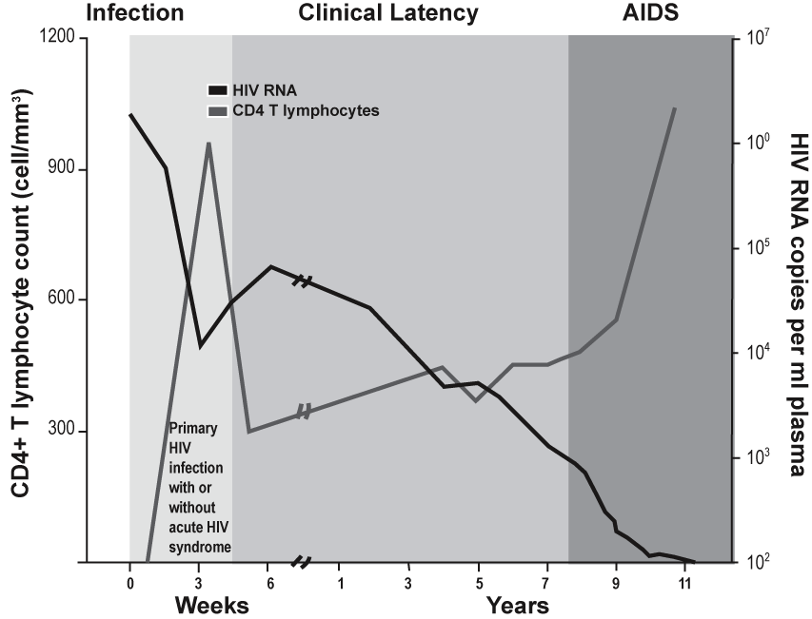
Natural History of HIV Infection

Slide 17
Natural History of HIV Infection
HIV can be transmitted during each stage
Seroconversion
    Infection with HIV, antibodies develop
Asymptomatic
    No signs of HIV, immune system controls virus production
Symptomatic
    Physical signs of HIV infection, some immune suppression
AIDS
    Opportunistic infections, end-stage disease

Slide 18
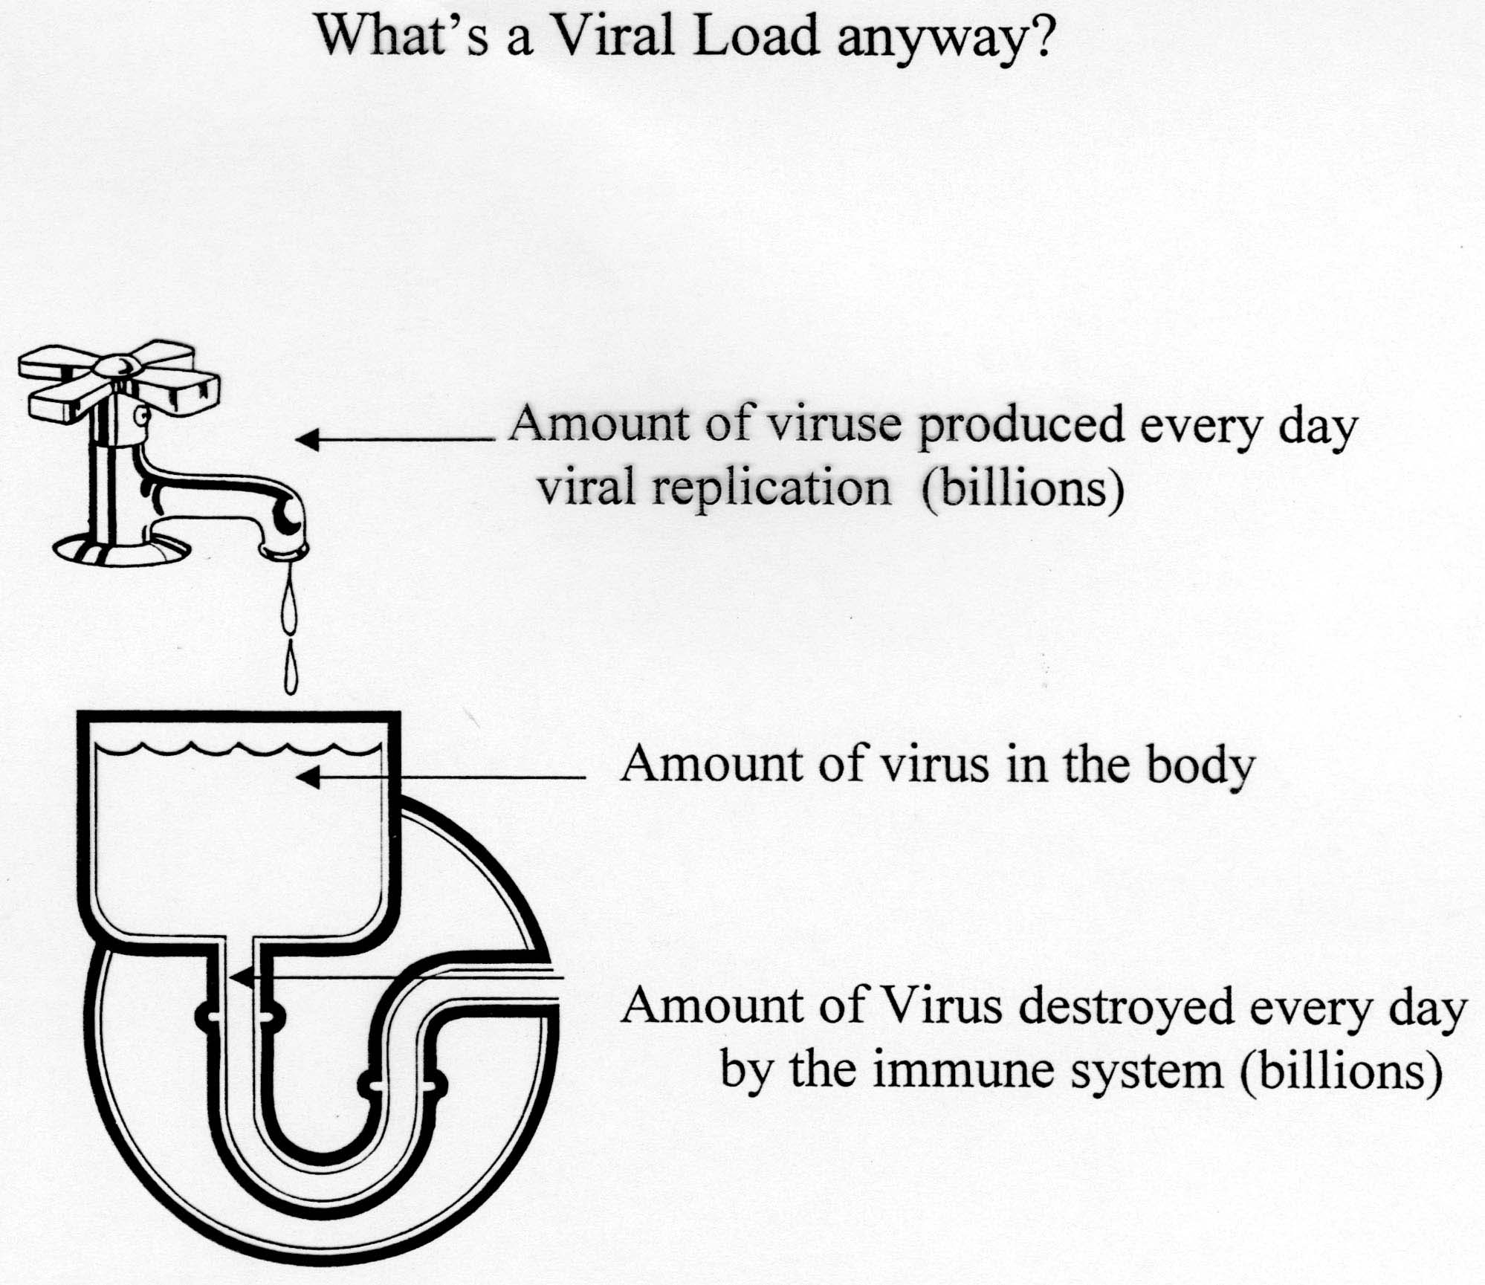
Natural History of HIV Infection
Severity of illness is determined by amount of virus in the body (increasing viral load) and the degree of immune suppression (decreasing CD4 counts).
Higher the viral load, the sooner immune suppression occurs.

Slide 19
Natural History of HIV Infection
Immune suppression
HIV attacks white blood cells, called CD4 cells, that protect body from illness.
Over time, the body’s ability to fight common infections is lost.
Opportunistic infections occur.

Slide 20
Natural History of HIV Infection
Direct infection of organ systems
  Brain (HIV dementia)
  Gut (wasting)
  Heart (cardiomyopathy)

Slide 21
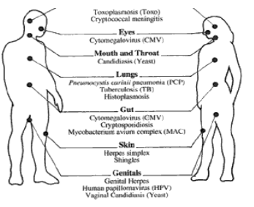
HIV-Related Opportunistic Infections
_______________Head__________________
Toxoplasmosis (Toxo)
Cryptococcal meningitis
_______________Eyes__________________
Cytomegalovirus (CMV)
___________Mouth and Throat__________
Candidiasis (Yeast)
________________Lungs________________
Pneumocystis carinii pneumonia (PCP)
Tuberculosis (TB)
Histoplasmosis
_________________Gut_________________
Cytomegalovirus (CMV)
Cryptosporidiosis
Mycobacterium avium complex (MAC)
________________Skin_________________
Herpes simplex
Shingles
_______________Genitals______________
Genital herpes
Human papillomavirus (HPV)
Vaginal candidiasis (Yeast)

Slide 22
Progression of HIV Infection
HIGH viral load (number of copies of HIV in the blood)
LOW CD4 count (type of white blood cell)
Increasing clinical symptoms (such as opportunistic infections)

Slide 23
Natural History of HIV Infection
Summary
HIV multiplies inside the CD4 cells, destroying them.
As CD4 cell count decreases and viral load increases, the immune defences are weakened.
People infected with HIV become vulnerable to opportunistic infections.
HIV is a chronic viral infection with no known cure.
Without ARV treatment, HIV progresses to symptomatic disease and AIDS.

Slide 24
Transmission of HIV
HIV is transmitted by
Direct contact with infected blood
Sexual contact: oral, anal or vaginal
Direct contact with semen or vaginal and
cervical secretions
Mothers infected with HIV to infants during
pregnancy, delivery and breastfeeding

Slide 25
Transmission of HIV
HIV cannot be transmitted by:
Coughing, sneezing
Insect bites
Touching, hugging
Water, food
Kissing
Public baths
Handshakes
Work or school contact
Using telephones
Sharing cups, glasses,
plates, or other utensils

Slide 26
Prevention of
HIV Transmission
Public health strategies to prevent HIV transmission
Screen all blood and blood products.
Follow universal precautions.
Educate in safer sex practises.
Identify and treat STIs.
Provide referral for treatment of drug dependence.
Apply the comprehensive PMTCT approach to prevent perinatal transmission of HIV.

Slide 27
Module 1: Key Points
HIV is a global pandemic.
The number of people living with HIV worldwide continues to increase.
The HIV epidemic is especially severe in many resource-constrained countries.
HIV is a virus that destroys the immune system, leading to opportunistic infections.
The progression from initial infection with HIV to end-stage AIDS varies from person to person and can take more than 15 years.

Slide 28
Module 1: Key Points
The most common route of HIV transmission worldwide is heterosexual transmission.
Women of childbearing age are at particular risk for acquiring HIV. The main behaviour that places them at risk is unprotected sex with an infected male partner.
Pregnant women who are HIV-infected are at risk of passing HIV infection to their newborn.
Risk of HIV transmission from mother-to-child can be greatly reduced through effective PMTCT programmes.

