Slide 1
DIGITAL COMPUTER
ORGANIZATION
-Nishma Godha
IIPS , MCA IIIsem
IC-2k18-47

Slide 2
UNIT - 1

Slide 3
Introduction to Computer Organization
Computer organization refers to the operational units and their interconnections that realize the architectural specifications
Examples of architectural attributes include the instruction set, the number of bits used to represent various data types (e.g., numbers, characters), I/O mechanisms, and techniques for addressing memory.
Organizational attributes include those hardware details transparent to the programmer, such as control signals; interfaces between the computer and peripherals; and the memory technology used.

Slide 4
Computer organization differs from architecture in many ways. For example, it is an architectural design issue whether a computer will have a multiply instruction. It is an organizational issue whether that instruction will be implemented by a special multiply unit or by a mechanism that makes repeated use of the add unit of the system. The organizational decision may be based on the anticipated frequency of use of the multiply instruction, the relative speed of the two approaches, and the cost and physical size of a special multiply unit

Slide 5
Historically, and still today, the distinction between architecture and organization has been an important one.
Many computer manufacturers offer a family of computer models, all with the same architecture but with differences in organization. Consequently, the different models in the family have different price and performance characteristics.
Furthermore, a particular architecture may span many years and encompass a number of different computer models, its organization changing with changing technology.
A prominent example of both these phenomena is the IBM System/370 architecture. This architecture was first introduced in 1970

Slide 6
Class of computers called microcomputers, the relationship between architecture and organization is very close.
Changes in technology not only influence organization but also result in the introduction of more powerful and more complex architectures.
Generally, there is less of a requirement for generation-to-generation compatibility for these smaller machines. Thus, there is more interplay between organizational and architectural design decisions.

Slide 7
Structure and function :
The hierarchical nature of complex systems is essential to both their design and their description. The designer need only deal with a particular level of the system at a time. At each level, the system consists of a set of components and their interrelationships . The behaviour at each level depends only on a simplified, abstracted characterization of the system at the next lower level.

Slide 8
At each level, the designer is concerned with structure and function:
■ Structure: The way in which the components are interrelated.
■ Function: The operation of each individual component as part of the structure

Slide 9
Function: Both the structure and functioning of a computer are, in essence, simple. In general terms, there are only four basic functions that a computer can perform:
■ Data processing - Data may take a wide variety of forms, and the range of processing requirements is broad. However, we shall see that there are only a few fundamental methods or types of data processing.
■ Data storage - Even if the computer is processing data on the fly (i.e., data come in and get processed, and the results go out immediately), the computer must temporarily store at least those pieces of data that are being worked on at any given moment..

Slide 10
■ Data movement - The computer’s operating environment consists of devices that serve as either sources or destinations of data. When data are received from or delivered to a device that is directly connected to the computer, the process is known as input– output (I/O), and the device is referred to as a peripheral. When data are moved over longer distances, to or from a remote device, the process is known as data communications.
■ Control - Within the computer, a control unit manages the computer’s resources and orchestrates the performance of its functional parts in response to instructions.

Slide 11
Structure : We now look in a general way at the internal structure of a computer. We begin with a traditional computer with a single processor that employs a micro-programmed control unit, then examine a typical multi-core structure.
Simple single-processor computer : There are four main structural components:
■ Central processing unit (CPU): Controls the operation of the computer and performs its data processing functions; often simply referred to as processor.
■ Main memory: Stores data.

Slide 12
■ I/O: Moves data between the computer and its external environment.
■ System interconnection: Some mechanism that provides for communication among CPU, main memory, and I/O. A common example of system interconnection is by means of a system bus, consisting of a number of conducting wires to which all the other components attach

Slide 13
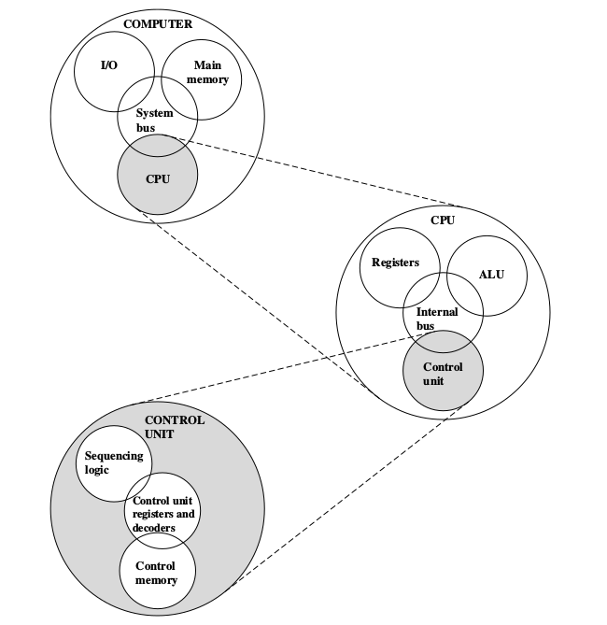
Computer top level structure

Slide 14
2. Multi-core computer structure : As was mentioned, contemporary computers generally have multiple processors. When these processors all reside on a single chip, the term multi-core computer is used.
■ Central processing unit (CPU): That portion of a computer that fetches and executes instructions. It consists of an ALU, a control unit, and registers. In a system with a single processing unit, it is often simply referred to as a processor.

Slide 15
■ Core: An individual processing unit on a processor chip. A core may be equivalent in functionality to a CPU on a single-CPU system. Other specialized processing units, such as one optimized for vector and matrix operations, are also referred to as cores.
■ Processor: A physical piece of silicon containing one or more cores. The processor is the computer component that interprets and executes instructions. If a processor contains multiple cores, it is referred to as a multi-core processor.

Slide 16
Von Neumann Architecture
In 1946, von Neumann and his colleagues began the design of a new stored program computer, referred to as the IAS. computer, at the Princeton Institute for Advanced Studies . It consists of
■ A main memory, which stores both data and instructions5
■ An arithmetic and logic unit (ALU) capable of operating on binary data
■ A control unit, which interprets the instructions in memory and causes them to be executed
■ Input–output (I/O) equipment operated by the control unit

Slide 17
This structure was outlined in von Neumann’s earlier proposal as follows
First : Since the device is primarily a computer, it will have to perform the elementary operations of arithmetic most frequently like addition, subtraction.
Second: The logical control of the device, that is, the proper sequencing of its operations, can be most efficiently carried out by a central control organ.

Slide 18
Third: Any device that is to carry out long and complicated sequences of operations (specifically of calculations) must have a considerable memory
- At any rate, the total memory constitutes the third specific part of the device: M.
Fourth: The device must have organs to transfer information from R into its specific parts C and M. These organs form its input, the fourth specific part: I

Slide 19
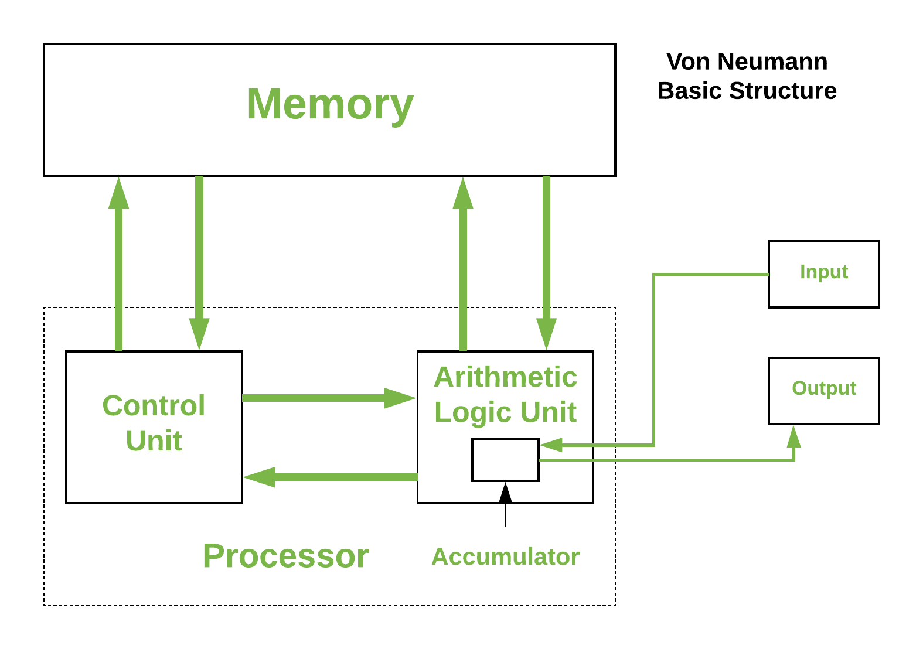
Fifth : The device must have organs to transfer from its specific parts C and M into R. These organs form its output, the fifth specific part: O.

Slide 20
COMPUTER COMPONENTS
The term 'computer hardware' or 'computer parts' is used to describe computer components that can be seen and touched. The major components of general-purpose computer system are :
1. Input Unit 2. Main/internal Memory or Storage Unit
3. Output Unit
4. Central Processing unit.

Slide 21
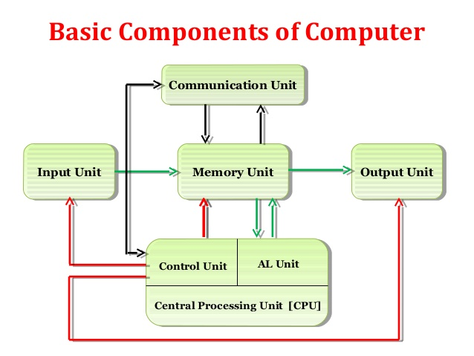

Slide 22

Input Unit
Input unit is used for transfers’ raw Data and control signals into the information processing system by the user before processing and computation. All the input unit devices provide the instructions and data are transformed into binary codes that is the primary memory acceptable format.
Example of Input unit devices: keyboard, mouse, scanner, joystick, MICR, Punched cards, Punched paper tape, Magnetic tape etc.

Slide 23
Memory or Storage Unit
Memory or Storage unit is used for storing Data during before and after processing. The capacity of storage is expressed in terms of Bytes. The difference between memory and storage is :
Memory
This unit retains temporarily results till further processing, For example, Random Access Memory (RAM).This memory is volatile, which means data is disappears when the power is lost.
Storage
The storage or "secondary storage" is used for retain digital data after processing for permanently. For example hard drive. The Storage is non-volatile in nature. CPU does not access directly to secondary storage memories, instead they accessed via input-output unit

Slide 24

Output Unit
Output Unit receives information from the CPU and then delivers it the external storage or device in the soft or hard processed form. The devices which are used to display output to the user are called output devices. The Monitor or printer is common output device.

Slide 25
Central Processing Unit
The main chip in a computer is the microprocessor chip, which is also known as the CPU (central processing unit).
The CPU is mounted on a printed circuit board called the main board or mother board.
This chip is considered to be the controlling chip of a computer system since it controls the activities of other chips as well as outside devices connected to the computer

Slide 26
The internal structure of a typical CPU consists of circuits which form a number of registers (the typical number is 16), an arithmetic unit for carrying out arithmetic operations, a logic unit, and a control unit.
Arithmetic logic unit (ALU)
Arithmetic Logical Unit is used for processing data after inputting data is stored into primary unit. The major operations of Arithmetic Logical Unit are addition, subtraction, multiplication, division, logic and comparison. Control unit (CU)
It is like a supervisor, that checks ordaining operations or check sequence in which instructions are executed.

Slide 27
BUS INTERCONNECTIONS
The bus was the dominant means of computer system component interconnection for decades
A bus is a communication pathway connecting two or more devices. A key characteristic of a bus is that it is a shared transmission medium.
Multiple devices connect to the bus, and a signal transmitted by any one device is available for reception by all other devices attached to the bus

Slide 28
Types Of Bus Connections
A bus that connects major computer components (processor, memory, I/O) is called a system bus .
The data lines provide a path for moving data among system modules. These lines, collectively, are called the data bus .
The address bus are used to designate the source or destination of the data on the data bus .
The control bus are used to control the access to and the use of the data and address lines

Slide 29
UNIT - 2

Slide 30
Input/Output Interface
Peripherals connected to a computer need special communication links for interfacing with CPU.
In computer system, there are special hardware components between the CPU and peripherals to control or manage the input-output transfers.
These components are called input-output interface units because they provide communication links between processor bus and peripherals. They provide a method for transferring information between internal system and input-output devices.

Slide 31
Modes Of I/O Data Transfer
Data transfer between the central unit and I/O devices can be handled in generally three types of modes which are given below:
Programmed I/O
Interrupt Initiated I/O
Direct Memory Access

Slide 32
Programmed I/O
Programmed I/O instructions are the result of I/O instructions written in computer program. Each data item transfer is initiated by the instruction in the program.
Usually the program controls data transfer to and from CPU and peripheral.
Transferring data under programmed I/O requires constant monitoring of the peripherals by the CPU.

Slide 33
Interrupt Initiated I/O
In the programmed I/O method the CPU stays in the program loop until the I/O unit indicates that it is ready for data transfer.
This is time consuming process because it keeps the processor busy needlessly.
This problem can be overcome by using interrupt initiated I/O. In this when the interface determines that the peripheral is ready for data transfer, it generates an interrupt. After receiving the interrupt signal, the CPU stops the task which it is processing and service the I/O transfer and then returns back to its previous processing task.

Slide 34
Direct Memory Access
Removing the CPU from the path and letting the peripheral device manage the memory buses directly would improve the speed of transfer. This technique is known as DMA.
In this, the interface transfer data to and from the memory through memory bus. A DMA controller manages to transfer data between peripherals and memory unit.

Slide 35
Many hardware systems use DMA such as disk drive controllers, graphic cards, network cards and sound cards etc
It is also used for intra chip data transfer in multicore processors
.
In DMA, CPU would initiate the transfer, do other operations while the transfer is in progress and receive an interrupt from the DMA controller when the transfer has been completed.

Slide 36
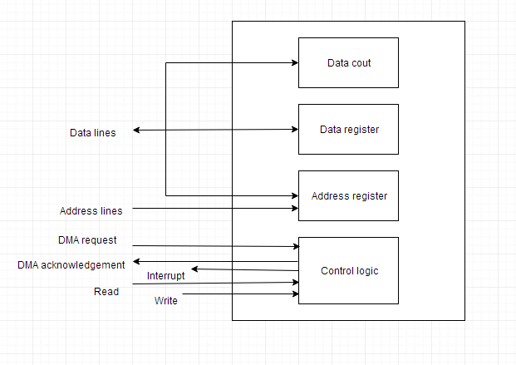
Above figure shows block diagram of DMA

Slide 37
Interrupt Driven I/O
The interrupt driven I/O data transfer method is very efficient because no microprocessor time is wasted in waiting for an I/O device to be ready
. In this interrupt driven I/O data transfer method the I/O device informs the microprocessor for the data transfer whenever the I/O device is ready.
This is achieved by interrupting the microprocessor. As we know that the interrupt is hardware facilities provided on the microprocessor.

Slide 38
WORKING
The microprocessor initiates data transfer by requesting the I/O device ‘to get ready’ and then continue executing its original program rather wasting its time by checking the status of I/O device.
Whenever the device is ready to accept or supply data, it informs the processor through a control signal. This control signal known as interrupt (INTR) signal. In response to this interrupt signal, the microprocessor sends back an interrupt acknowledge signal to the I/O device

Slide 39
By sending acknowledgement it indicating that it received the request. It then suspends its job after executing the current instruction. It saves the contents and status of program counter to stack and jumps to the subroutine program.
This subroutine program is called Interrupt Service Subroutine (ISS) program. The ISS saves the processor status into stack; and after executing the instruction for the data transfer, it restores the processor status and then returns to main program.

Slide 40
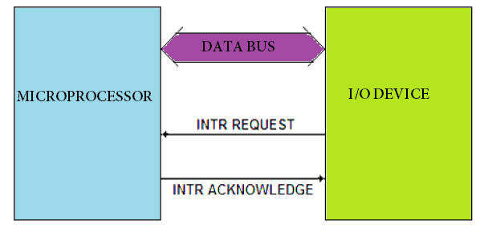

Slide 41
Priority Interrupt
Priority Interrupt are systems, that establishes a Priority over the various sources(interrupt devices) to determine which condition is to be serviced first when two or more requests arrive simultaneously . This system may also determine which condition are permitted to interrupt to the computer while another interrupt is being serviced. Usually, in Priority Systems, higher-priority interrupt levels are served first, as if they delayed or interrupted, could have serious consequences . And the devices with high-speed transfer such as magnetic disks are given high-priority, and slow devices such as keyboards receives low-priority.

Slide 42
The priority of simultaneous interrupts can be established either by software method or hardware.
The software method which gives priority to simultaneous interrupt is:
i) Polling
And the hardware method which gives priority to simultaneous interrupt is:
ii) Daisy-Chaining Priority
Notes:
The priority of simultaneous interrupts can be established either by software method or hardware.
The software method which gives priority to simultaneous interrupt is:
Polling
And the hardware method which gives priority to simultaneous interrupt is:
Daisy-Chaining Priority

Slide 43
Polling:
Polling is the software method of establishing priority of simultaneous interrupt . In this method, when the processor detects an interrupt, it branches to an interrupt service routine whose job is to pull each I/O module to determine which module caused the interrupt.
The poll could be in the form of separate command line(e.g., Test I/O).In this case, the processor raises the Test I/O and places the address of particular I/O module on the address line . If it has interrupt that is, if interrupt is identified in it.

Slide 44
Daisy-Chaining Priority:
The Daisy–Chaining method of establishing priority on interrupt sources uses the hardware i.e., it is the hardware means of establishing priority.
In this method, all the device, whether they are interrupt sources or not, connected in a serial manner . Means the device with highest priority is placed in the first position, which is followed by lowest priority device . And all device share a common interrupt request line, and the interrupt acknowledge line is daisy chained through the modules.

Slide 45
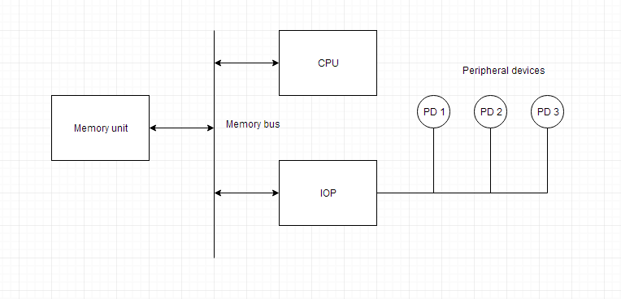
memory.
I/O Processor

Slide 46
The block diagram of a computer along with various I/O Processors. The memory unit occupies the central position and can communicate with each processor.
The CPU processes the data required for solving the computational tasks. The IOP provides a path for transfer of data between peripherals and memory.
The CPU assigns the task of initiating the I/O program.
The IOP operates independent from CPU and transfer data between peripherals and memory.

Slide 47
Serial Communication
A data communication processor is an I/O processor that distributes and collects data from numerous remote terminals connected through telephone and other communication lines to the computer. It is a specialized I/O processor designed to communicate with data communication networks.
Such a communication network consists of variety of devices such as printers, display devices, digital sensors etc. serving many users at once. The data communication processor communicates with each terminal through a single pair of wire. It also communicates with CPU and memory in the same manner as any I/O processor does.

Slide 48
A modem converts digital signal into audio tones to be transmitted over telephone lines and also converts audio tones into digital signal for machine use.
The communication lines, modems and other devices used in any transmission are collectively called a Data Link. The orderly transmission of data in a data link can be accomplished by a protocol.
A Protocol is a set of rules that are followed by interconnecting devices to ensure that all data is passed correctly without any error

Slide 49
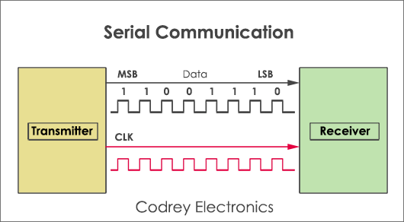
A channel is an independent hardware component that co-ordinate all I/O to a set of controllers.
Computer systems that use I/O channel have special hardware components that handle all I/O operations.

Slide 50
Synchronous Data Transfer
In Synchronous data transfer, the sending and receiving units are enabled with same clock signal. It is possible between two units when each of them knows the behaviour of the other.
The master performs a sequence of instructions for data transfer in a predefined order. All these actions are synchronized with the common clock.
The master is designed to supply the data at a time when the slave is definitely ready for it. Usually, the master will introduce sufficient delay to take into account the slow response of the slave, without any request from the slave.

Slide 51
:
Advantages –
The design procedure is easy. The master does not wait for any acknowledges signal from the slave through the master waits for a time equal to slave’s response time.
The slave does not generate acknowledge signal, though it obeys the timing rules as per the protocol set by the master or system designer.
Disadvantages –
If a slow speed unit connected to a common bus, it can degrade overall rate of transfer in the system.
If the slave operates at a slow speed, the master will be idle for some time during data transfer and vice versa.

Slide 52
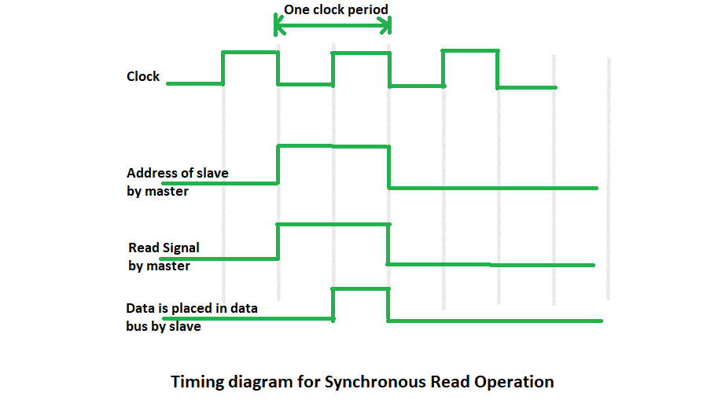

Slide 53
Asynchronous Data Transfer
The internal timing in each unit is independent from each other in such a way that each uses its own private clock for its internal registers . In that case, the two units are said to be asynchronous to each other, and if data transfer occur between them this data transfer is said to be Asynchronous Data Transfer.
But, the Asynchronous Data Transfer between two independent units requires that control signals be transmitted between the communicating units so that the time can be indicated at which they send data.

Slide 54
This asynchronous way of data transfer can be achieved by two methods:
One way is by means of strobe pulse which is supplied by one of the units to other unit . When transfer has to occur . This method is known as “Strobe Control”.
Another method commonly used is to accompany each data item being transferred with a control signal that indicates the presence of data in the bus . The unit receiving the data item responds with another signal to acknowledge receipt of the data . This method of data transfer between two independent units is said to be “Handshaking”.

Slide 55
Strobe Control
The Strobe Control method of asynchronous data transfer employs a single control line to time each transfer.
This control line is also known as strobe and it may be achieved either by source or destination, depending on which initiate transfer.

Slide 56
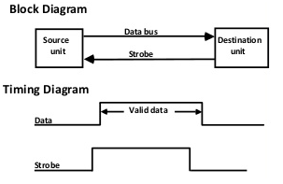

Slide 57
Source initiated strobe for data transfer:
The block diagram and timing diagram of strobe initiated by source unit is shown in the previous slide:
In block diagram we see that strobe is initiated by source, and as shown in timing diagram, the source unit first places the data on the data bus . After a brief delay to ensure that the data settle to a steady value, the source activates a strobe pulse . The information on data bus and strobe control signal remain in the active state for a sufficient period of time to allow the destination unit to receive the data . Actually, the destination unit, uses a falling edge of strobe control to transfer the contents of data bus to one of its internal registers . The source removes the data from the data bus after it disables its strobe pulse . New valid data will be available only after the strobe is enabled again.

Slide 58
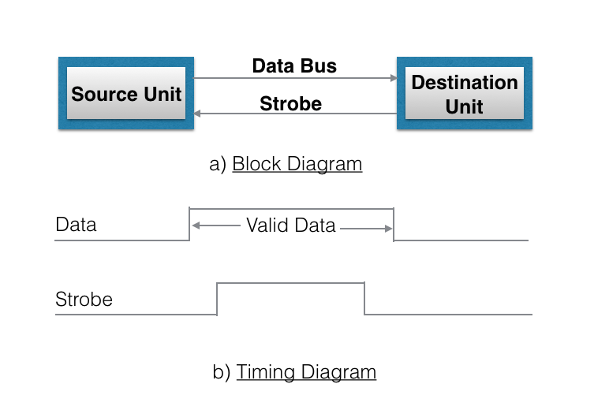

Slide 59
Destination-initiated strobe for data transfer:
The block diagram and timing diagram of strobe initiated by destination is shown in previous slide:
In block diagram, we see that, the strobe initiated by destination, and as shown in timing diagram, the destination unit first activates the strobe pulse, informing the source to provide the data . The source unit responds by placing the requested binary information on the data bus.The data must be valid and remain in the bus long enough for the destination unit to accept it.The falling edge of strobe pulse can be used again to trigger a destination register.The destination unit then disables the strobe.And source removes the data from data bus after a per determine time interval.

Slide 60
Handshaking
The disadvantage of strobe method is that source unit that initiates the transfer has no way of knowing whether the destination has actually received the data that was placed in the bus.
This problem can be solved by handshaking method. Hand shaking method introduce a second control signal line that provides a replay to the unit that initiates the transfer.
In it, one control line is in the same direction as the data flow in the bus from the source to destination.It is used by source unit to inform the destination unit whether there are valid data in the bus.The other control line is in the other direction from destination to the source.It is used by the destination unit to inform the source whether it can accept data.And in it also, sequence of control depends on unit that initiate transfer.Means sequence of control depends whether transfer is initiated by source and destination.Sequence of control in both of them are described below:

Slide 61
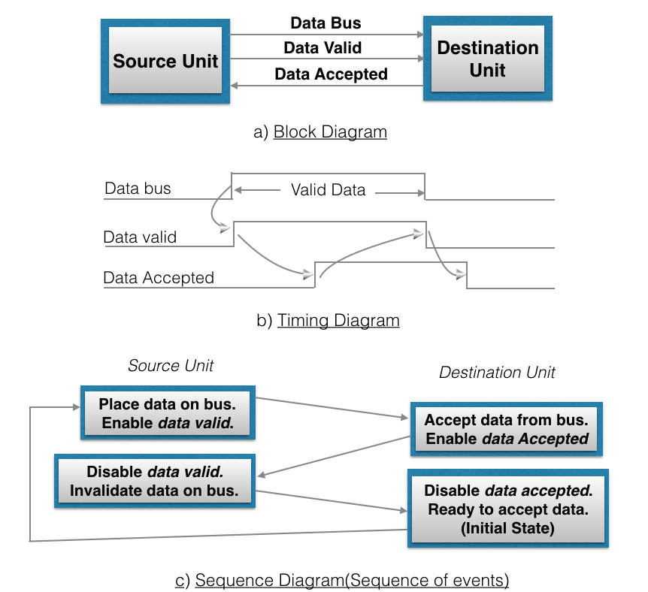

Slide 62
Source initiated Handshaking:
In its block diagram, we se that two handshaking lines are "data valid", which is generated by the source unit, and "data accepted", generated by the destination unit. The timing diagram shows the timing relationship of exchange of signals between the two units.Means as shown in its timing diagram, the source initiates a transfer by placing data on the bus and enabling its data valid signal.The data accepted signal is then activated by destination unit after it accepts the data from the bus.The source unit then disable its data valid signal which invalidates the data on the bus.After this, the destination unit disables its data accepted signal and the system goes into initial state.
This sequence of events described in its sequence diagram, which shows the above sequence in which the system is present, at any given time.

Slide 63
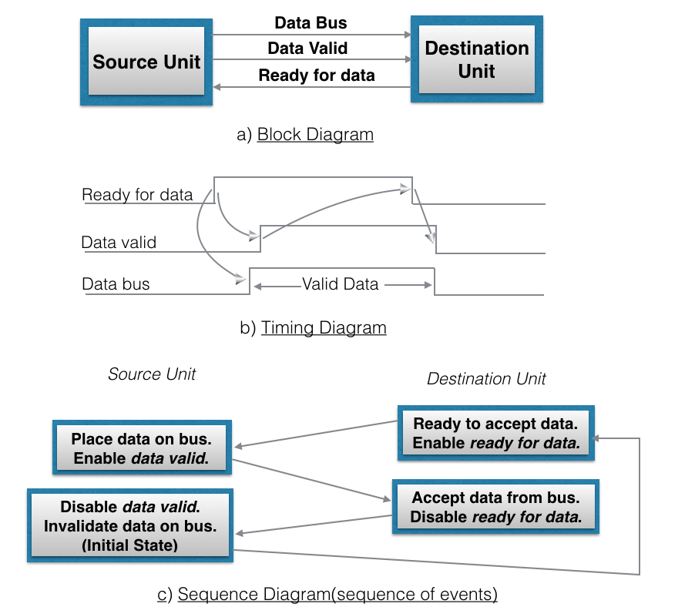

Slide 64
Destination initiated handshaking:
In its block diagram, we see that the two handshaking lines are "data valid", generated by the source unit, and "ready for data" generated by destination unit.Note that the name of signal data accepted generated by destination unit has been changed to ready for data to reflect its new meaning. In it, transfer is initiated by destination, so source unit does not place data on data bus until it receives ready for data signal from destination unit.After that, hand shaking process is some as that of source initiated. The sequence of event in it are shown in its sequence diagram and timing relationship between signals is shown in its timing diagram.

Slide 65
Destination initiated handshaking:
In its block diagram, we see that the two handshaking lines are "data valid", generated by the source unit, and "ready for data" generated by destination unit.Note that the name of signal data accepted generated by destination unit has been changed to ready for data to reflect its new meaning. In it, transfer is initiated by destination, so source unit does not place data on data bus until it receives ready for data signal from destination unit.After that, hand shaking process is some as that of source initiated. The sequence of event in it are shown in its sequence diagram and timing relationship between signals is shown in its timing diagram.

Slide 66
UNIT - 3

Slide 67
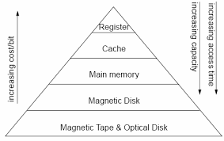
Memory Hierarchy

Slide 68
Internal and External Memory
Internal memory typically refers to main memory (RAM), but may also refer to ROM and flash memory. In either case, internal memory generally refers to chips rather than disks or tapes. Types of Internal Memory RAM ,ROM.
External memory typically refers to storage in an external hard drive or on the Internet. The main “memory” in the computer is the computer work-space, not its storage facility. Types of External Memory’s:
Magnetic Tapes, Hard disk ,Magnetic Disk ,Optical Drives (CD-R/W, CD-ROM).

Slide 69
Internal Memory :
In a computer, all of the storage spaces that are accessible by a processor without the use of the computer input-output Internal memory usually includes several types of storage, such as main storage, cache memory, and special registers, all of which can be directly accessed by the processor.
Primary storage (or main memory or internal memory), often referred to simply as memory, is the only one directly accessible to the CPU. The CPU continuously reads instructions stored there and executes them as required. Any data actively operated on is also stored there in uniform manner.
It’s also called ( Primary /Main/Temporary/Semiconductor) Memory type.

Slide 70
External Memory :
External memory which is sometimes called backing store or secondary memory, allows the permanent storage of large quantities of data. Some method of magnetic recording on magnetic disks or tapes is most commonly used
The capacity of external memory is high, usually measured in hundreds of megabytes or even in gigabytes
The most common form of external memory is a hard disc which is permanently installed in the computer and will typically have a capacity of hundreds of megabytes

Slide 71
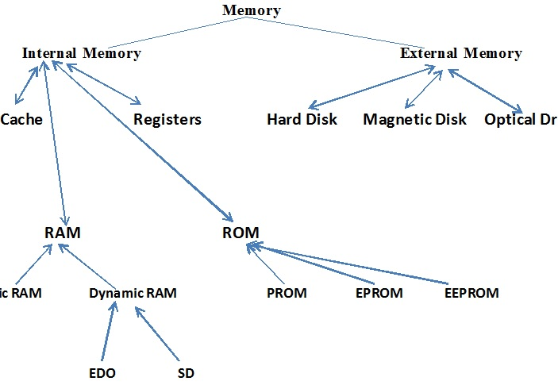

Slide 72
Types Of Memory
ROM (Read only Memory)
Sometimes can be erased for reprogramming, but might have odd requirements such as UV light or erasure only at the block level
Sometimes require special device to program, i.e., processor can only read, not write.
Data are written into a ROM when it is manufactured.
ROM is mask programmed by the manufacturer in the factory with the contents ordered by the customers.
The contents are fixed by metal masks used during chip fabrication.
Once programmed, the contents cannot be erased.
Even a single bit wrongly programmed the ROM chip is useless

Slide 73
PROM (Programmable Read Only Memory)
PROM is a field programmable device.
The customer buy a blank PROM and store desired data using PROM programmer(burner).
Programmability achieved by inserting a fuse at point P.
Before programmed, the memory contains all 0s
The user can insert 1 by burning out the fuse in the particular cell using high current pulse.
The PROM chip can be programmed only once and its contents cannot be erased.
PROM are flexible, faster and less expensive because they can be programmed directly by the user.

Slide 74
EPROM (Erasable Programmable Read Only Memory )
A rewritable chip that holds its contents without power. Previous data can be erased and new data can be inserted
EPROM chips are written on an external programming device before being placed on the circuit board. Capable of retaining stored information for a long time.
This reason EPROM packaged with transparent window.
Disadvantages: Entire EPROM is erased as a whole and selective erasing is not possible.
Should be removed from the chip for reprogramming.
Unlike the PROM, EPROM contents can be deleted after being programmed. Elimination is done by using ultraviolet light.

Slide 75
4. EEPROM (Electrically Erasable Programable Read Only Memory)
EEPROM can store data permanently, but its contents can still be erased electrically through the program. One type EEPROM is Flash Memory. Flash Memory commonly used in digital cameras, video game consoles, and the BIOS chip.
It can be both programmed and erased electrically ( flashed back to Zero).
They do not need to removed when the chip content erasure.
Also, erase selected content in the chip.
Erasing and programming dynamically without removing the EEPROM from the circuit.
Different voltages are required for erasing, reading and writing the data.

Slide 76
5. RAM (Random Access Memory)
Random access memory, or RAM, is memory storage on a computer that holds data while the computer is running so that it can be accessed quickly by the processor. RAM holds the operating system, application programs and data that is currently being used.
RAM data is much faster to read than data stored on the hard disk. RAM is stored in microchips and contains much less data than the hard disk. RAM can never run out of memory, but the processor must overwrite old data if the RAM is filled, which results in slower computer function. Any file stored in RAM can be accessed directly if the user knows the row and column where the data is stored.

Slide 77
Random access memory is used to store temporary but necessary information on a computer for quick access by open programs or applications.
RAM, is a volatile yet fast type of memory used in computers. RAM is more expensive to incorporate.
RAM allows reading and writing (electrically) of data at the byte level
RAM is the Volatile memory.

Slide 78
Types of RAM
Static RAM
Dynamic RAM
Static RAM
Static RAM stores a bit of information in a flip-flop. Static RAM is usually used for applications that do not require large capacity RAM memory.Static(RAM) is a memory technology based on flip-flops. SRAM has an access time of 2 – 10 nanoseconds. All of main memory can be viewed as fabricated from SRAM
Dynamic RAM
Dynamic RAM data store one bit of information as a payload. Dynamic RAM using a substrate capacitance gate MOS transistors as memory cells shut. To keep dynamic RAM stored data remains intact, the data should be refreshed again by reading and re-write the data into memory. Dynamic RAM is used for applications that require large RAM capacity

Slide 79
Cache memory organization
A cache memory is a fast random access memory where the computer hardware stores copies of information currently used by programs (data and instructions), loaded from the main memory. The cache has a significantly shorter access time than the main memory due to the applied faster but more expensive implementation technology.
The cache has a limited volume that also results from the properties of the applied technology. If information fetched to the cache memory is used again, the access time to it will be much shorter than in the case if this information were stored in the main memory and the program will execute faster.

Slide 80
Time efficiency of using cache memories results from the locality of access to data that is observed during program execution. We observe here time and space locality:
Time locality consists in a tendency to use many times the same instructions and data in programs during neighbouring time intervals,
Space locality is a tendency to store instructions and data used in a program in short distances of time under neighbouring addresses in the main memory.
Due to these localities, the information loaded to the cache memory is used several times and the execution time of programs is much reduced. Cache can be implemented as a multi-level memory.

Slide 81
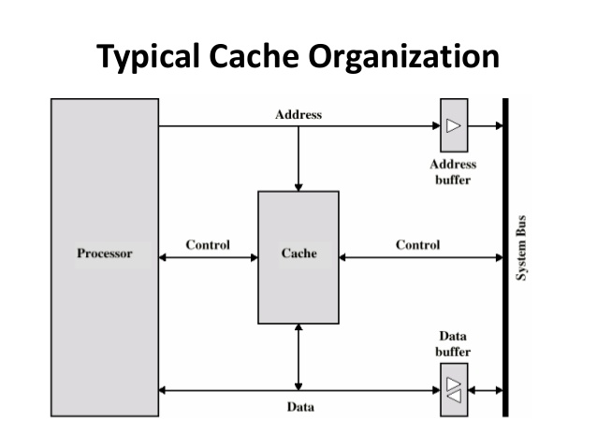

Slide 82
Mapping
There are three basic methods used for mapping of information fetched from the main memory to the cache memory:
associative mapping
direct mapping
set-associative mapping.

Slide 83
Cache memory with associative mapping
With the associative mapping of the contents of cache memory, the address of a word in the main memory is divided into two parts: the tag and the byte index (offset). Information is fetched into the cache in blocks.
The byte index determines the location of the byte in the block whose address is generated from the tag bits, which are extended by zeros in the index part (it corresponds to the address of the first byte in the block.
In the number of bits in the byte index is n then the size of the block is a power of 2 with the exponent n. The cache is divided into lines. In each line one block can be written together with its tag and usually some control bits.

Slide 84
2. Cache memory with direct mapping
The name of this mapping comes from the direct mapping of data blocks into cache lines.
With the direct mapping, the main memory address is divided into three parts: a tag, a block index and a byte index.
In a given cache line, only such blocks can be written, whose block indices are equal to the line number. Together with a block, the tag of its address is stored.

Slide 85
3. Cache memory with set associative mapping
With this mapping, the main memory address is structured as in the previous case. We have there a tag, a block index and a byte index.
The block into line mapping is the same as for the direct mapping. But in a set associative mapping many blocks with different tags can be written down into the same line (a set of blocks).
Access to blocks written down in a line is done using the associative access principle, i.e. by comparing the requested tag with all tags stored in the selected line. From both mentioned features, the name of this mapping is derived.

Slide 86
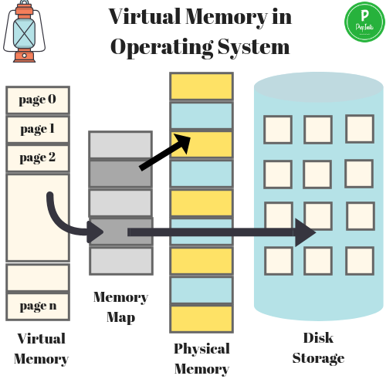
Virtual Memory
Virtual Memory is a space where large programs can store themselves in form of pages while their execution and only the required pages or portions of processes are loaded into the main memory. This technique is useful as large virtual memory is provided for user programs when a very small physical memory is there.

Slide 87
Benefits of having Virtual Memory
Large programs can be written, as virtual space available is huge compared to physical memory.
Less I/O required, leads to faster and easy swapping of processes.
More physical memory available, as programs are stored on virtual memory, so they occupy very less space on actual physical memory.

Slide 88
Magnetic Disk
Primary computer storage device.
One or more platters in the form of disks covered with magnetic media.
Each disk platter has a flat circular shape.
Each platter has two working surfaces that stores data.
Digital information is stored on magnetic disks in the form of microscopically small, magnetized needles.
Data is stored on either or both surfaces of discs in concentric rings called tracks.
Each track is divided into a number of sectors.
To read information, the arm is positioned over the correct track.
Data is read and written by a disk drive which rotates the discs and positions the read/write heads over the desired track.

Slide 89
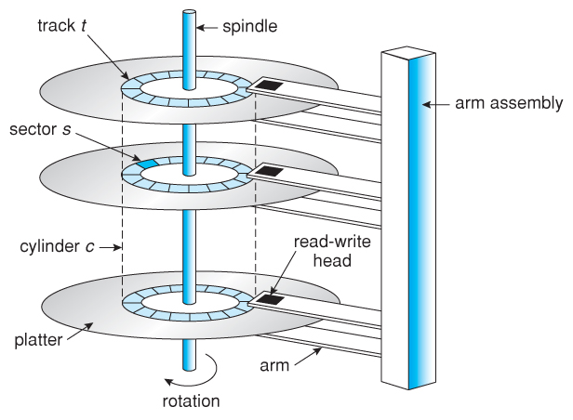
Magnetic Disk

Slide 90
Magnetic Tape
Magnetic Tapes were introduced in 1928, earlier used as a secondary storage medium. Magnetic tape is a thin long narrow plastic strip coated with the magnetizable substance.
The tape is wounded over a spool, and it is wounded or unwounded past a read-write head to read from or write data to the tape.
Magnetic Tapes are non-volatile in nature and hence it holds the large quantity of data permanently.

Slide 91
Used for backup, and storage of less frequently used information.
Plastic thin, long, narrow strip coated with magnetic material.
Idle for sequential access.
Slower in data accessing.
Once data is fed, it can't be updated. If the tape is damaged, the data is lost.
Typically stores from 20 GB to 200 GB.
Magnetic tapes are less expensive.

Slide 92
UNIT - 4

Slide 93
General Register based CPU Organisation
When we are using multiple general purpose registers, instead of single accumulator register, in the CPU Organization then this type of organization is known as General register based CPU Organization. In this type of organization, computer uses two or three address fields in their instruction format.
Each address field may specify a general register or a memory word.If many CPU registers are available for heavily used variables and intermediate results, we can avoid memory references much of the time, thus vastly increasing program execution speed, and reducing program size.

Slide 94
Advantages and Disadvantages of General Register based CPU Organisation
The advantages of General register based CPU organization –
Efficiency of CPU increases as there are large number of registers are used in this organization.
Less memory space is used to store the program since the instructions are written in compact way.

Slide 95
The disadvantages of General register based CPU organization –
Care should be taken to avoid unnecessary usage of registers. Thus, compilers need to be more intelligent in this aspect.
Since large number of registers are used, thus extra cost is required in this organization.

Slide 96
Types of General Register CPU Organisation
General register CPU organisation of two type:
Register-memory reference architecture (CPU with less register)– In this organisation Source 1 is always required in register, source 2 can be present either in register or in memory.Here two address instruction format is the compatible instruction format.
Register-register reference architecture(CPU with more register)– In this organisation ALU operations are performed only on a register data. So operands are required in the register. After manipulation result is also placed in register.Here three address instruction format is the compatible instruction format.

Slide 97
Stack based CPU Organisation
The computers which use Stack-based CPU Organization are based on a data structure called stack. The stack is a list of data words. It uses Last In First Out (LIFO) access method which is the most popular access method in most of the CPU.
A register is used to store the address of the topmost element of the stack which is known as Stack pointer (SP).
In this organisation, ALU operations are performed on stack data. It means both the operands are always required on the stack. After manipulation, the result is placed in the stack.
PDP-11, Intel’s 8085 and HP 3000 are some of the examples of the stack organized computers.

Slide 98
The main two operations that are performed on the operators of the stack are Push and Pop. These two operations are performed from one end only.
Push – This operation results in inserting one operand at the top of the stack and it decrease the stack pointer register. It inserts the data word at specified address to the top of the stack.
Pop – This operation results in deleting one operand from the top of the stack and it increase the stack pointer register. It deletes the data word at the top of the stack to the specified address.

Slide 99
Advantages and Disadvantages
The advantages of Stack based CPU organization –
Efficient computation of complex arithmetic expressions.
Execution of instructions is fast because operand data are stored in consecutive memory locations.
Length of instruction is short as they do not have address field.
The disadvantages of Stack based CPU organization –
The size of the program increases.
Note:Stack based CPU organisation uses zero address instruction.

Slide 100
Single Accumulator based CPU Organisation
The computers, present in the early days of computer history, had accumulator based CPUs. In this type of CPU organization, the accumulator register is used implicitly for processing all instructions of a program and store the results into the accumulator. The instruction format that is used by this CPU Organisation is One address field. Due to this the CPU is known as One Address Machine.

Slide 101
The main points about Single Accumulator based CPU Organisation are:
In this CPU Organization, the first ALU operand is always stored into the Accumulator and the second operand is present either in Registers or in the Memory.
Accumulator is the default address thus after data manipulation the results are stored into the accumulator.
One address instruction is used in this type of organization.

Slide 102
Types of Operations in Single Accumulator based CPU Organisation
Mainly two types of operation are performed in single accumulator based CPU organization:
Data transfer operation – In this type of operation, the data is transferred from a source to a destination.
For ex: LOAD X, STORE Y
Here LOAD is memory read operation that is data is transfer from memory to accumulator and STORE is memory
write operation that is data is transfer from accumulator to memory.

Slide 103
ALU operation – In this type of operation, arithmetic operations are performed on the data.
For ex: MULT X
where X is the address of the operand. The MULT instruction in this example performs the operation,
AC <-- AC * M[X]
AC is the Accumulator and M[X] is the memory word located at location X.
This type of CPU organization is first used in PDP-8 processor and is used for process control and laboratory applications. It has been totally replaced by the introduction of the new general register based CPU.

Slide 104
Advantages and Disadvantages
Advantages –
One of the operands is always held by the accumulator register. This results in short instructions and less memory space.
Instruction cycle takes less time because it saves time in instruction fetching from memory.
Disadvantages –
When complex expressions are computed, program size increases due to the usage of many short instructions to execute it. Thus memory size increases.
As the number of instructions increases for a program, the execution time increases.

Slide 105
INSTRUCTION FORMATS
Computer perform task on the basis of instruction provided. A instruction in computer comprises of groups called fields. These field contains different information as for computers every thing is in 0 and 1 so each field has different significance on the basis of which a CPU decide what so perform. The most common fields are:
Operation field which specifies the operation to be performed like addition.
Address field which contain the location of operand, i.e., register or memory location.
Mode field which specifies how operand is to be founded.
A instruction is of various length depending upon the number of addresses it contain. Generally CPU organization are of three types on the basis of number of address fields:
Single Accumulator organization
General register organization
Stack organization
In first organization operation is done involving a special register called accumulator. In second on multiple registers are used for the computation purpose. In third organization the work on stack basis operation due to which it does not contain any address field.

Slide 106
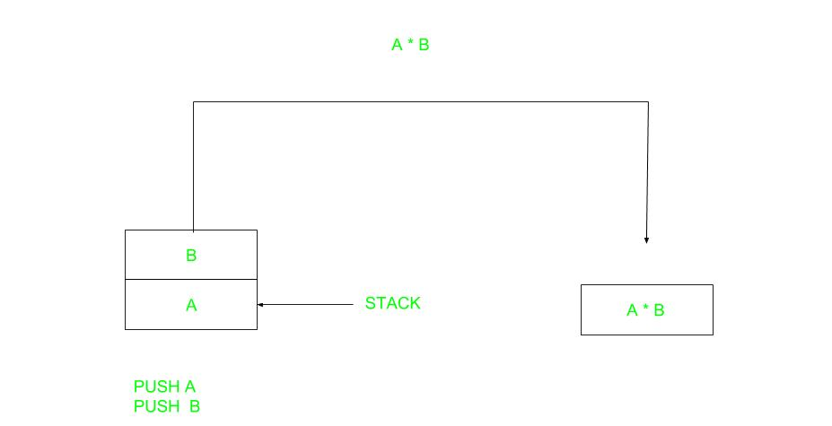
1.ZERO ADDRESS INSTRUCTION SET
We will use X = (A+B)*(C+D) expression to
showcase the procedure.

Slide 107
Procedure Mechanism
A stack based computer do not use address field in instruction.To evaluate a expression first it is converted to revere Polish Notation i.e. Post fix Notation.
Expression: X = (A+B)*(C+D)
Postfixed : X = AB+CD+*
TOP means top of stack
M[X] is any memory location
PUSH A TOP = A
PUSH B TOP = B
ADD TOP = A+B
PUSH C TOP = C
PUSH D TOP = D
ADD TOP = C+D
MUL TOP = (C+D)*(A+B)
POP X M[X] = TOP

Slide 108

2.ONE ADDRESS INSTRUCTIONS SET
One Address Instructions – This use a implied ACCUMULATOR register for data manipulation.One operand is in accumulator and other is in register or memory location.Implied means that the CPU already know that one operand is in accumulator so there is no need to specify it.

Slide 109
Expression: X = (A+B)*(C+D)
AC is accumulator
M[] is any memory location
M[T] is temporary location
LOAD A AC = M[A]
ADD B AC = AC + M[B]
STORE T M[T] = AC
LOAD C AC = M[C]
ADD D AC = AC + M[D]
MUL T AC = AC * M[T]
STORE X M[X] = AC

Slide 110
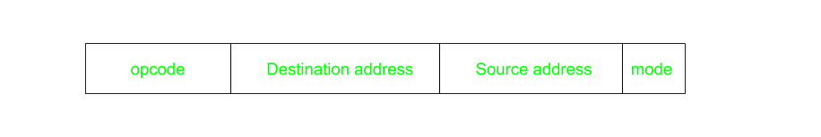
3.TWO ADDRESS INSTRUCTION SET
Two Address Instructions –
This is common in commercial computers. Here two address can be specified in the instruction. Unlike earlier in one address instruction the result was stored in accumulator here result cab be stored at different location rather than just accumulator, but require more number of bit to represent address.
Here destination address can also contain operand.

Slide 111
Expression: X = (A+B)*(C+D)
R1, R2 are registers
M[] is any memory location
MOV R1, A R1 = M[A]
ADD R1, B R1 = R1 + M[B]
MOV R2, C R2 = C
ADD R2, D R2 = R2 + D
MUL R1, R2 R1 = R1 * R2
MOV X, R1 M[X] = R1

Slide 112
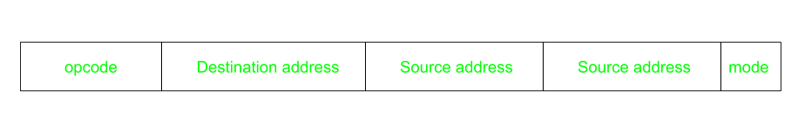
4.THREE ADDRESS INSTRUCTION SET
Three Address Instructions – This has three address field to specify a register or a memory location. Program created are much short in size but number of bits per instruction increase. These instructions make creation of program much easier but it does not mean that program will run much faster because now instruction only contain more information but each micro operation (changing content of register, loading address in address bus etc.) will be performed in one cycle only.

Slide 113
Expression: X = (A+B)*(C+D)
R1, R2 are registers
M[] is any memory location
ADD R1, A, B R1 = M[A] + M[B]
ADD R2, C, D R2 = M[C] + M[D]
MUL X, R1, R2 M[X] = R1 * R2

Slide 114
ADDRESSING MODES
Addressing Modes–
The term addressing modes refers to the way in which the operand of an instruction is specified. The addressing mode specifies a rule for interpreting or modifying the address field of the instruction before the operand is actually executed.

Slide 115
TYPES OF ADDRESSING MODES
Implied / Implicit Addressing Mode
Stack Addressing Mode
Immediate Addressing Mode
Direct Addressing Mode
Indirect Addressing Mode
Register Direct Addressing Mode
Register Indirect Addressing Mode
Relative Addressing Mode
Indexed Addressing Mode
Base Register Addressing Mode
Auto-Increment Addressing Mode
Auto-Decrement Addressing Mode

Slide 116
1.IMPLIED ADDRESSING MODE
Implied Addressing Mode-
In this addressing mode,
The definition of the instruction itself specify the operands implicitly.
It is also called as implicit addressing mode.
Examples-
The instruction “Complement Accumulator” is an implied mode instruction.
In a stack organized computer, Zero Address Instructions are implied mode instructions. (since operands are always implied to be present on the top of the stack)

Slide 117
2.STACK ADDRESSING MODE
Stack Addressing Mode-
In this addressing mode,
The operand is contained at the top of the stack.
Example-
ADD
This instruction simply pops out two symbols contained at the top of the stack.
The addition of those two operands is performed.
The result so obtained after addition is pushed again at the top of the stack.

Slide 118
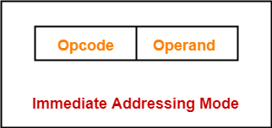
3.IMMEDIATE ADDRESSING MODE
Immediate Addressing Mode-
In this addressing mode,
The operand is specified in the instruction explicitly.
Instead of address field, an operand field is present that contains the operand.
Examples-
ADD 10 will increment the value stored in the accumulator by 10.
MOV R #20 initializes register R to a constant value 20.

Slide 119
4.DIRECT ADDRESSING NODE
Direct Addressing Mode-
In this addressing mode,
The address field of the instruction contains the effective address of the operand.
Only one reference to memory is required to fetch the operand.
It is also called as absolute addressing mode.
Example-
ADD X will increment the value stored in the accumulator by the value stored at memory location X.
AC ← AC + [X]

Slide 120
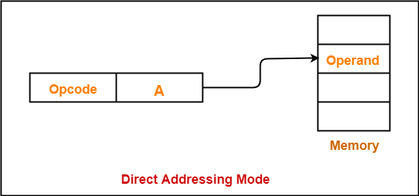

Slide 121
5. INDIRECT ADDRESSING MODE
Indirect Addressing Mode-
In this addressing mode,
The address field of the instruction specifies the address of memory location that contains the effective address of the operand.
Two references to memory are required to fetch the operand.

Slide 122
UNIT - 5

Slide 123
Instruction Word Format
An instruction is normally made up of a combination of an operation code and some way of specifying an operand, most commonly by its location or address in memory though non memory reference instructions can exist. Some operation codes deal with more than one operand; the locations of these operands may be specified using any of the many addressing schemes.

Slide 124
A instruction is of various length depending upon the number of addresses it contain. Generally CPU organization are of three types on the basis of number of address fields:
Single Accumulator organization
General register organization
Stack organization
In first organization operation is done involving a special register called accumulator. In second on multiple registers are used for the computation purpose. In third organization the work on stack basis operation due to which it does not contain any address field.

Slide 125
Zero Address Instructions – A stack based computer do not use address field in instruction . To evaluate a expression first it is converted to revere Polish Notation i.e. Post fix Notation.
One Address Instructions – This use a implied ACCUMULATOR register for data manipulation . One operand is in accumulator and other is in register or memory location. Implied means that the CPU already know that one operand is in accumulator so there is no need to specify it.
Two Address Instructions – This is common in commercial computers . Here two address can be specified in the instruction . Unlike earlier in one address instruction the result was stored in accumulator here result cab be stored at different location rather than just accumulator, but require more number of bit to represent address.

Slide 126
Fetch and Execution Cycle
The fetch execute cycle is the basic operation (instruction) cycle of a computer (also known as the fetch decode execute cycle).
During the fetch execute cycle, the computer retrieves a program instruction from its memory. It then establishes and carries out the actions that are required for that instruction.
The cycle of fetching, decoding, and executing an instruction is continually repeated by the CPU whilst the computer is turned on.

Slide 127
Step | Fetch execute cycle steps | Simplified description
1 | The PC contains the address of the memory location that has the next instruction which has to be fetched | PC has address of next instruction
2 | This address is then copied from the PC to the MAR via the address bus | PC copied to the MAR
3 | The contents (instruction) at the memory location (address) contained in MAR are then copied into the MDR | Lookup MAR and get contents. Copy contents into the MDR
4 | The contents (instruction) in the MDR is then copied and placed into the CIR | Copy MDR contents into the CIR
5 | The value in the PC is then incremented by 1 so that it now points to the next instruction which has to be fetched | PC is then incremented by 1
6 | The instruction is finally decoded and then executed by sending out signals (via control bus) to the various components of the computer | The instruction is decoded and then executed
7 | Repeat

Slide 128
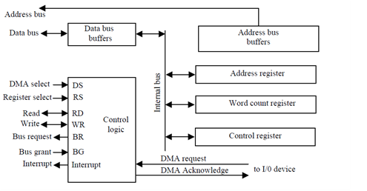
Sequence Of Operation Of
Control Registers

Slide 129
Control Of Arithmetic Operations
Arithmetic Logical Unit is the part of control processing unit that controls the arithmetic operations. It is the function of Arithmetic logical unit to check for the arithmetic and logical operations.
The inputs to an ALU are the data to be operated on, called operands, and a code indicating the operation to be performed; the ALU's output is the result of the performed operation. In many designs, the ALU also has status inputs or outputs, or both, which convey information about a previous operation or the current operation, respectively, between the ALU and external status registers.

Slide 130
An ALU has a variety of input and output nets, which are the electrical conductors used to convey digital signals between the ALU and external circuitry. When an ALU is operating, external circuits apply signals to the ALU inputs and, in response, the ALU produces and conveys signals to external circuitry via its outputs.
Data
A basic ALU has three parallel data buses consisting of two input operands (A and B) and a result output (Y). Each data bus is a group of signals that conveys one binary integer number. Typically, the A, B and Y bus widths (the number of signals comprising each bus) are identical and match the native word size of the external circuitry (e.g., the encapsulating CPU or other processor).

Slide 131
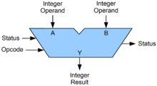
Opcode
The opcode input is a parallel bus that conveys to the ALU an operation selection code, which is an enumerated value that specifies the desired arithmetic or logic operation to be performed by the ALU. The opcode size (its bus width) determines the maximum number of different operations the ALU can perform; for example, a four-bit opcode can specify up to sixteen different ALU operations. Generally, an ALU opcode is not the same as a machine language opcode, though in some cases it may be directly encoded as a bit field within a machine language opcode.

Slide 132
Microprogramming Concepts
Micro-programmed Control Unit –
The control signals associated with operations are stored in special memory units inaccessible by the programmer as Control Words.
Control signals are generated by a program are similar to machine language programs.
Micro-programmed control unit is slower in speed because of the time it takes to fetch microinstructions from the control memory.

Slide 133
Some Important Terms –
Control Word : A control word is a word whose individual bits represent various control signals.
Micro-routine : A sequence of control words corresponding to the control sequence of a machine instruction constitutes the micro-routine for that instruction.
Micro-instruction : Individual control words in this micro-routine are referred to as microinstructions.
Micro-program : A sequence of micro-instructions is called a micro-program, which is stored in a ROM or RAM called a Control Memory (CM).
Control Store : the micro-routines for all instructions in the instruction set of a computer are stored in a special memory called the Control Store.

Slide 134
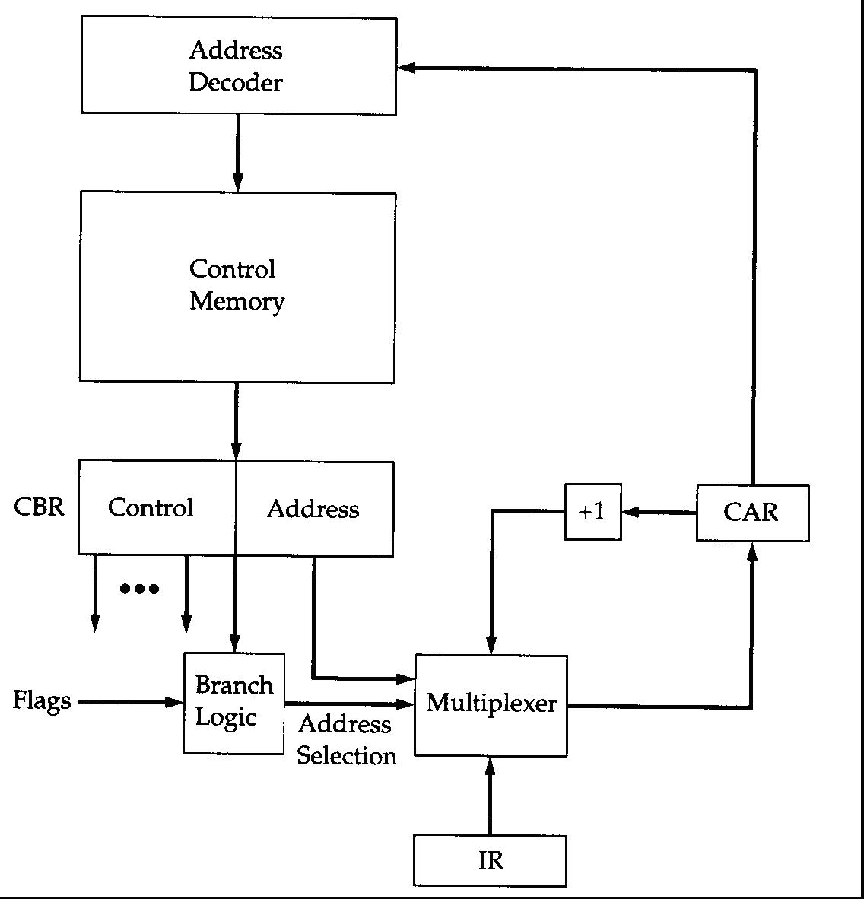
Microprogram Unit

