Slide 1

Sentiment Analysis — Final Year Project
Ramrao Adik Institute of Technology
Department of Computer Science and Engineering
On
“Sentari: An Earnings-Call & Filings Intelligence
Platform for Retail Investors”
By
Roll No. Name of Student
23AM1031
Nishant Narudkar
Guided by : [Faculty Guide Name]
Notes:
Sentari: aspect-level sentiment on earnings calls and filings, with grounded multi-agent briefs. Research and decision-support only - not investment advice.

Slide 2

OUTLINE
01
Problem & Objectives
06
Website Walkthrough
02
System Architecture
07
Real-Data Pilot & Signal Study
03
Aspect-Based Sentiment Pipeline
08
Conclusion & Future Work
04
Model Ladder & Lexicon Failure
09
References
05
Grounded Multi-Agent Briefs
Sentari
sentiment × aspects × grounded agents
2
Notes:
Nine sections; the last content slide summarises limitations honestly.

Slide 3
PROBLEM & OBJECTIVES
The problem
Objectives
A retail investor following 15–20 stocks cannot read every earnings call (10,000+ words each) and 10-K/10-Q filing.
Document-level “positive / negative” scores miss what matters: softer guidance, margin pressure, hedging in the Q&A.
General sentiment lexicons misread finance: “costs fell” is good news; “liabilities decreased” is not negative.
G1
Aspect-level sentiment on 6 aspects: guidance, margins, demand, litigation, management tone, liquidity
G2
Show empirically where general lexicons fail on financial language
G3
Bull / bear / skeptic / judge agents whose every claim is grounded and cited
G4
A working service: ingestion, storage, dashboard, digest, drift monitoring
Core question
Can we measure what management says about each financial aspect — and trace every claim to its source sentence?
G5
An honest evaluation — including null results
3
Notes:
Scope: US and NSE/BSE listed companies, daily batch pipeline. Out of scope: real-time trading, trade execution, any guarantee of predictive accuracy.

Slide 4
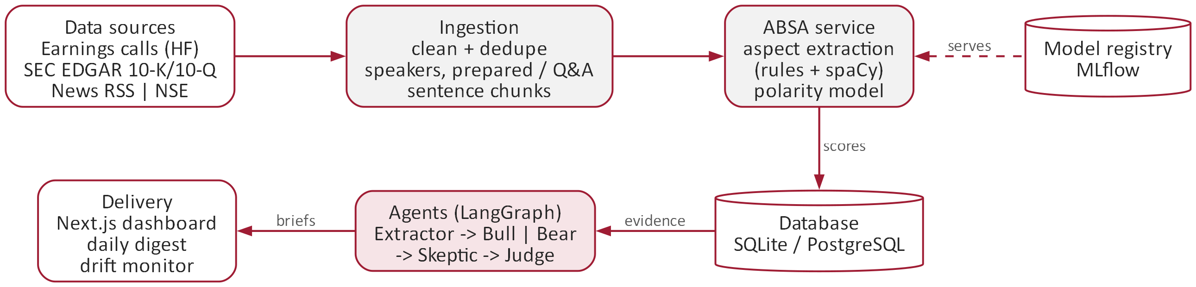
SYSTEM ARCHITECTURE
Technology stack
Python 3.13
FastAPI
spaCy
scikit-learn
PyTorch
Hugging Face (FinBERT)
LangGraph
SQLAlchemy · SQLite / PostgreSQL
MLflow · DagsHub
DuckDB
Next.js 16
Docker · Cloud Run
Idempotent daily run
re-runs never duplicate data
Every claim traceable
brief → cited sentence → model
80 automated tests
fully offline, ~30 s
4
Notes:
Daily pipeline: ingest -> score -> briefs -> drift -> digest (POST /run/daily). The registry decides which sentiment model serves. Docker/Cloud Run files are written but not yet deployed.

Slide 5
ASPECT-BASED SENTIMENT PIPELINE
Clean &
deduplicate
Split speakers &
prepared vs Q&A
Find aspects
(rules + spaCy)
Negation &
hedge handling
Score each
aspect (−1…+1)
Guidance
outlook, forecasts, targets
Margins
profitability, costs, pricing
Demand
orders, volumes, backlog
Litigation
lawsuits, regulation
Management tone
confidence vs caution
Liquidity
cash, debt, covenants
Worked example — the same sentences scored by two models
Sentence | Aspect | Rules (LM) | FinBERT
Gross margin expanded 180 basis points on favorable mix. | margins | +0.90 | +0.99
Demand held up in automation, but aerospace orders declined. | demand | 0.00 | 0.00
We are lowering our full-year guidance. | guidance | −0.50 | −1.00
We repaid 200 million dollars of debt and our leverage ratio improved. | liquidity | +0.40 | +0.99
We are unable to quantify the litigation exposure. | litigation | −0.50 | −1.00
5
Notes:
Mixed sentence: one positive and one negative demand clause average to neutral - a known simplification. Scores from `python -m absa_service.cli analyze` with lm_directional (official Loughran-McDonald dictionary) and fine-tuned FinBERT.

Slide 6
MODEL LADDER & LEXICON FAILURE
Error on “trap” sentences
26 sentences where finance inverts everyday polarity
61.5%
VADER (general lexicon)
61.5%
Loughran-McDonald word counts
11.5%
FinBERT fine-tuned
“Customer churn decreased to its lowest level in three years.”
VADER: negative · truth: positive
Test set is small and self-written; trained models learn from template labels, so these scores are optimistic. A 300-sentence human-labelled set from real calls is in progress.
6
Notes:
Lexicon rows use the official Loughran-McDonald dictionary (1993-2025). lm_directional's rules were written with sight of the test set, so 0.805 is optimistic. Source: results/model_ladder.json and the official-dictionary re-evaluation.

Slide 7
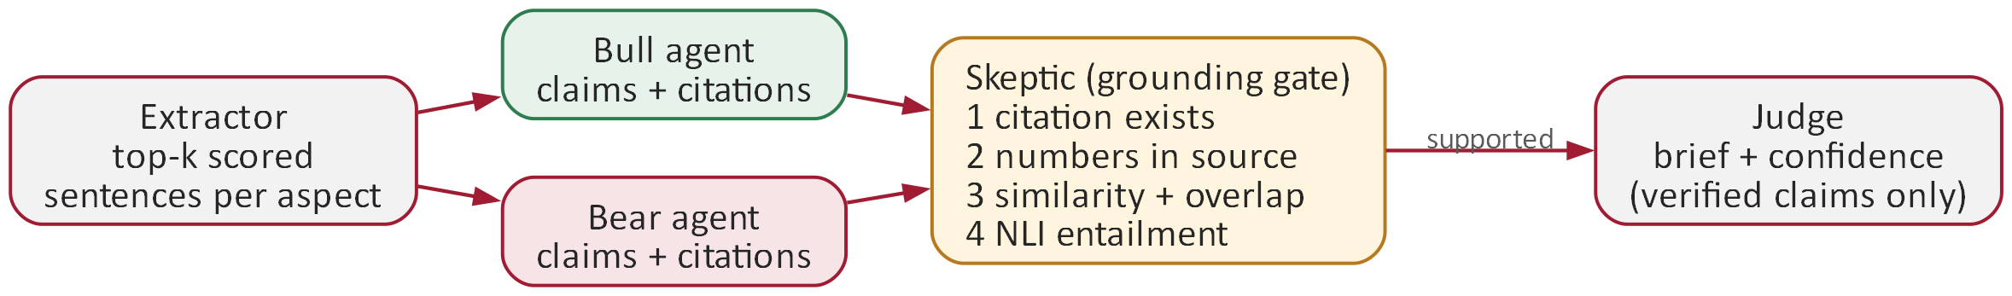
GROUNDED MULTI-AGENT BRIEFS
Only claims the Skeptic marks supported reach the brief.
Every brief sentence cites its source sentence; the full audit trail is stored.
Faithful claims wrongly rejected: 0 of 43.
The NLI model is needed: word checks miss flipped polarity.
LLM optional (Claude API); runs offline by default.
7
Notes:
Adversarial audit: 43 faithful claims corrupted five ways. 'Caught' = rejected or flagged unverified. Synthetic corruptions of verbatim claims are the easy case; a human audit of LLM-written claims is not yet done.

Slide 8
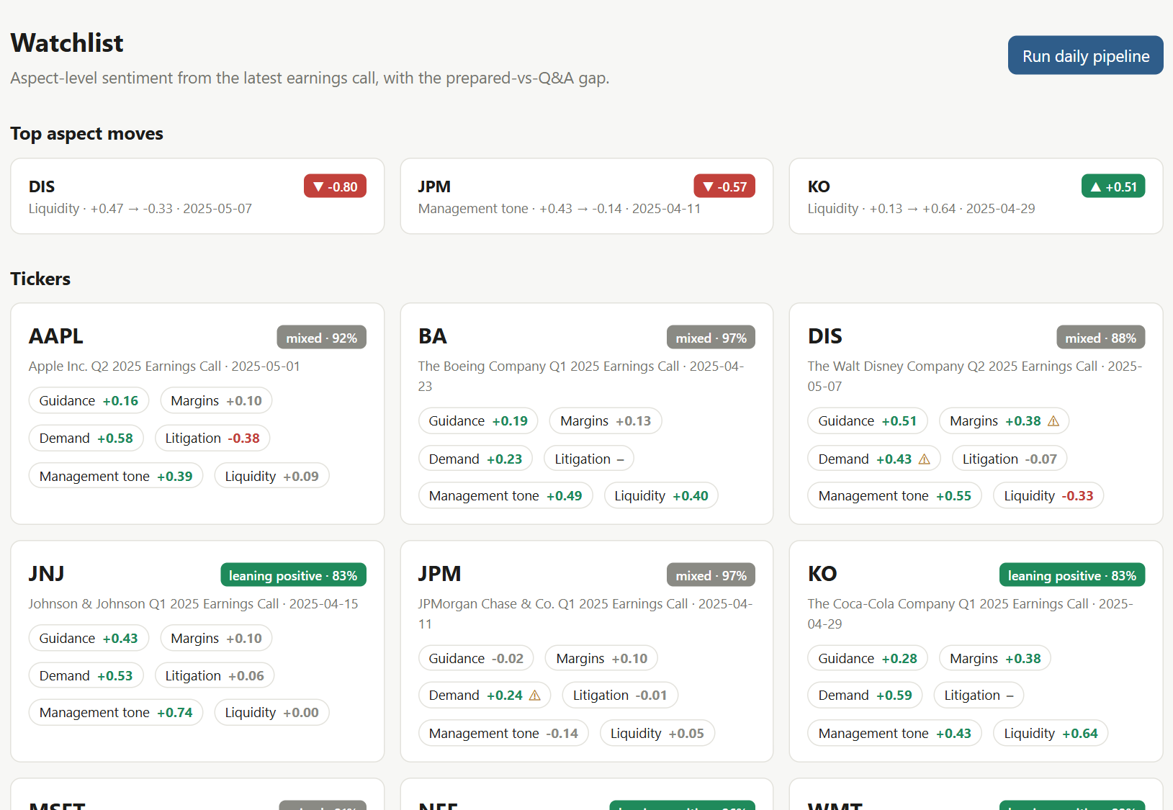
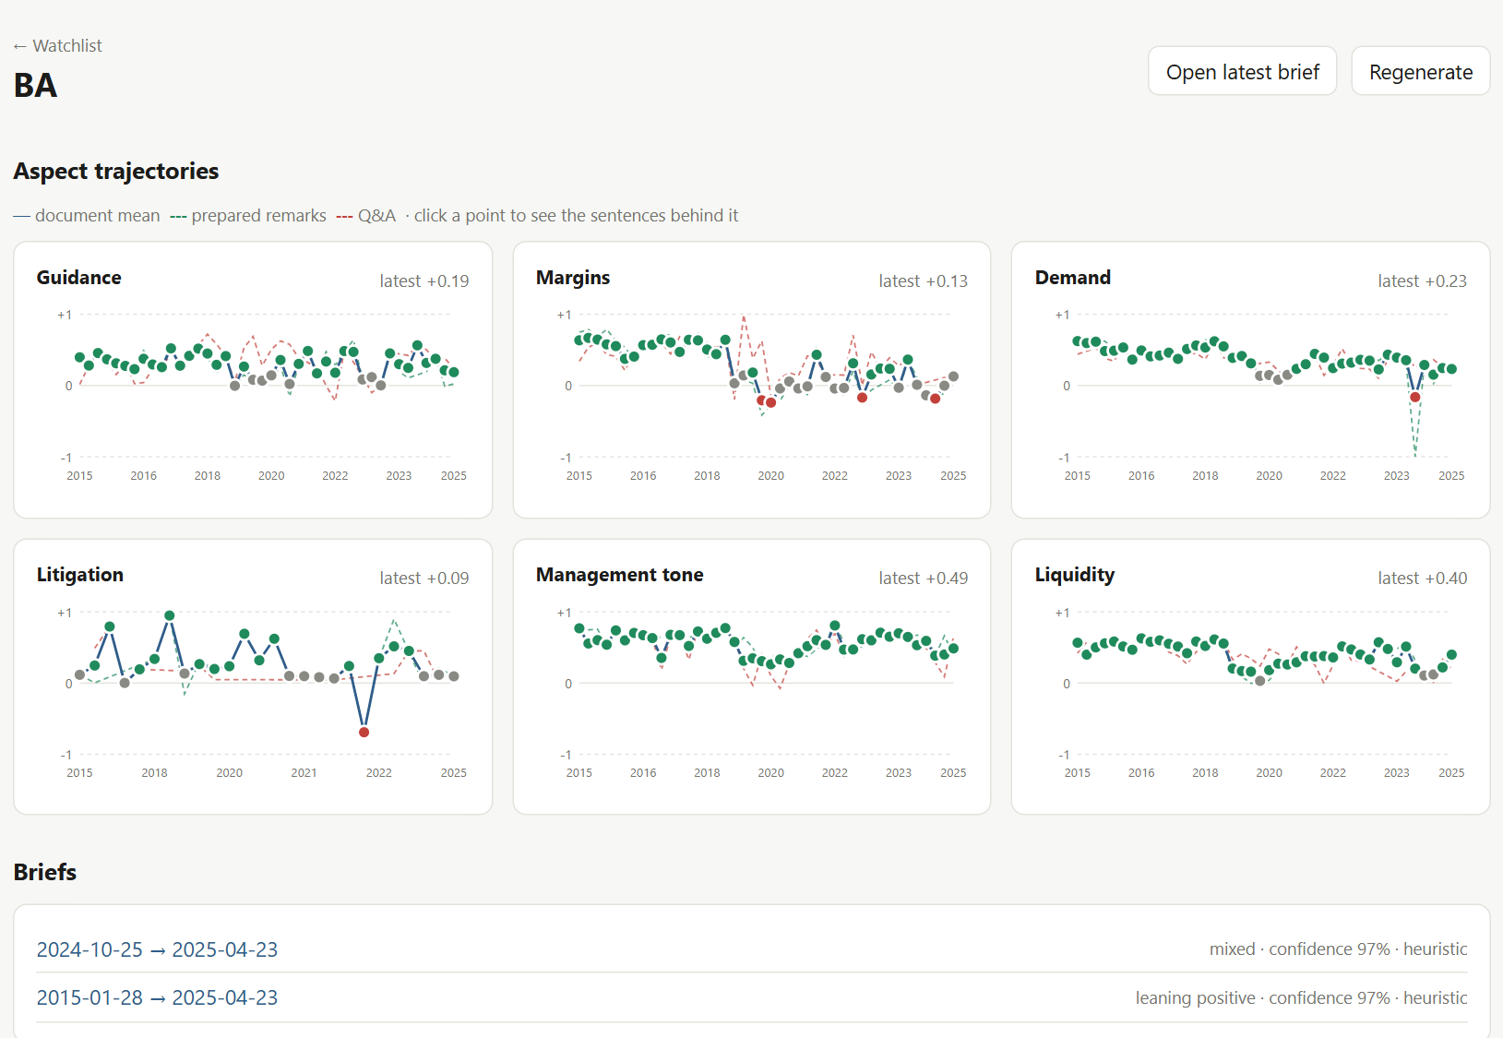
WEBSITE: WATCHLIST & TRENDS
Watchlist — 10 real companies
Company view — Boeing, 2015–2025
Latest call per company: six aspect scores and the brief's stance
Top aspect moves across the watchlist
⚠ marks aspects where the Q&A ran well below the script
One chart per aspect across ~40 quarterly calls
Green / red dashed lines: prepared remarks vs Q&A
Click any point to see the sentences behind it
8
Notes:
Live screenshots of the Next.js dashboard running on the real pilot database (414 calls). Every page carries the not-investment-advice notice.

Slide 9
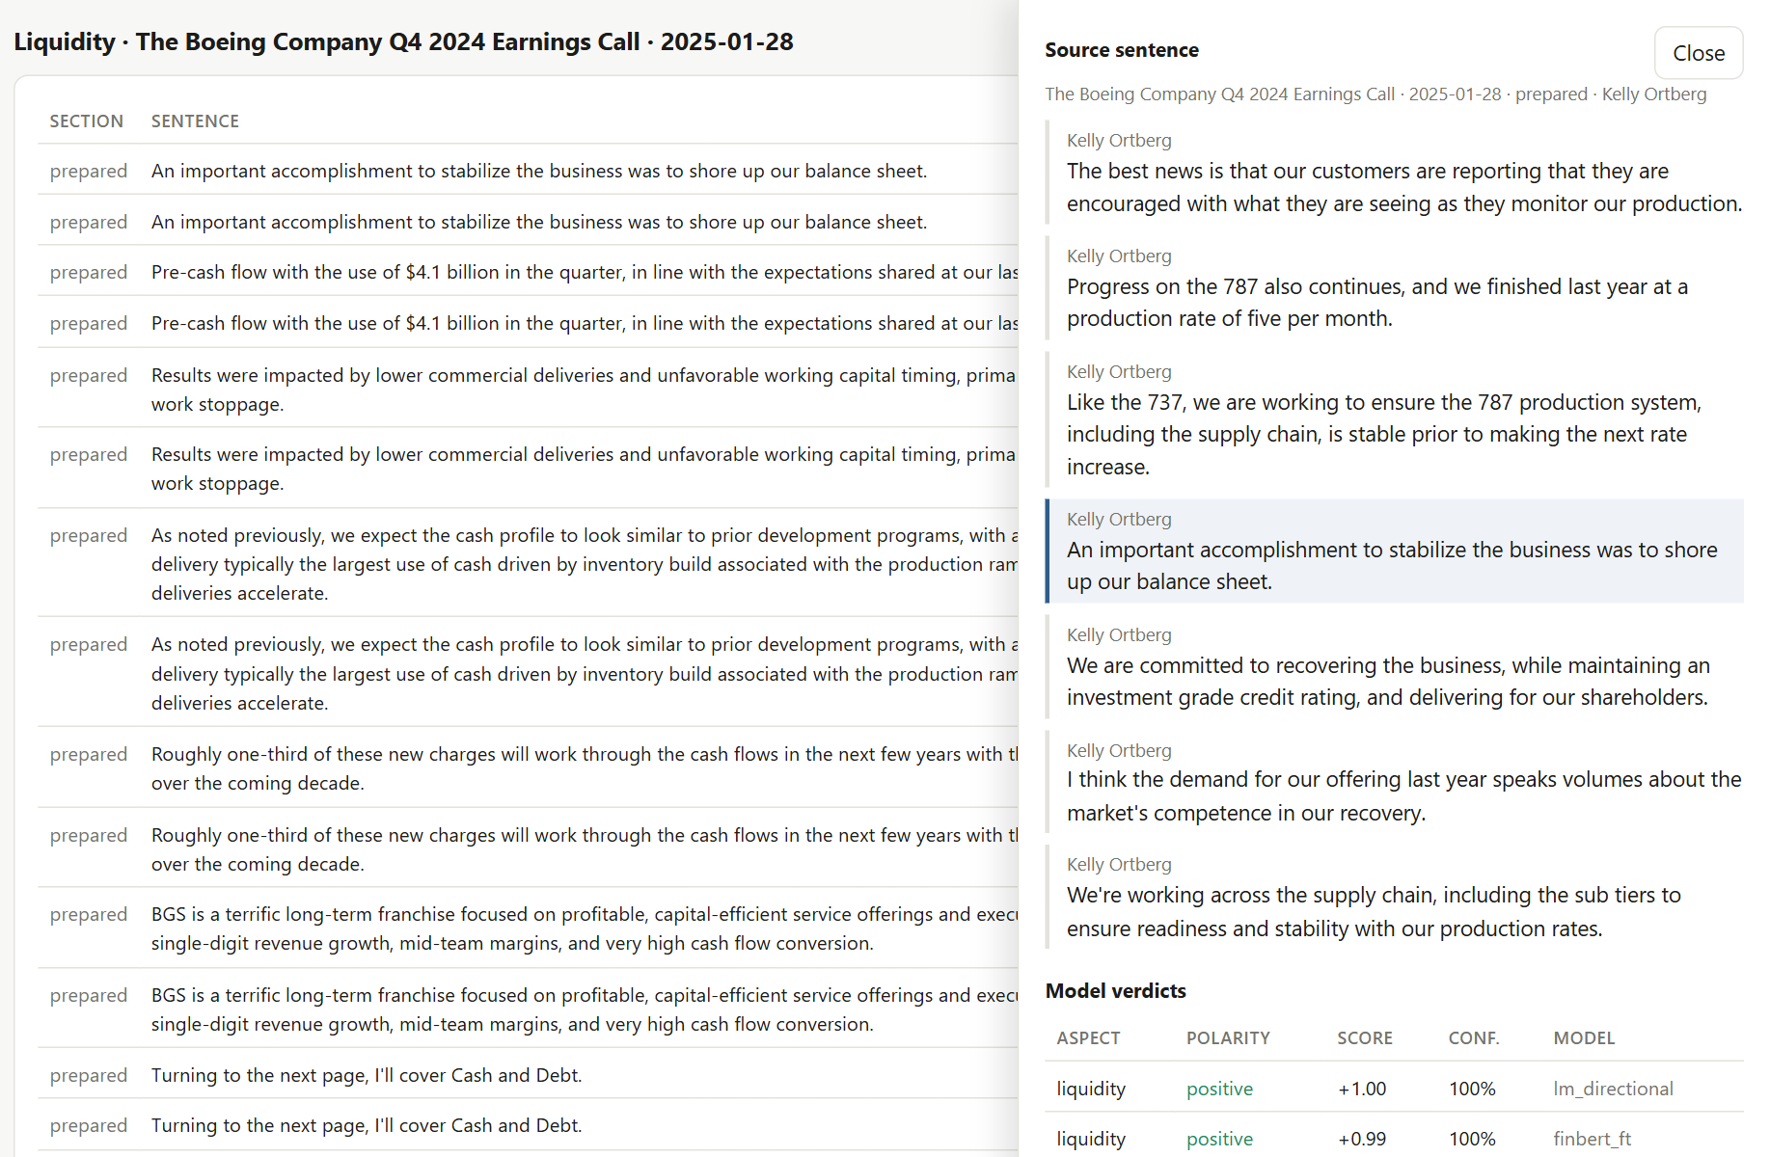
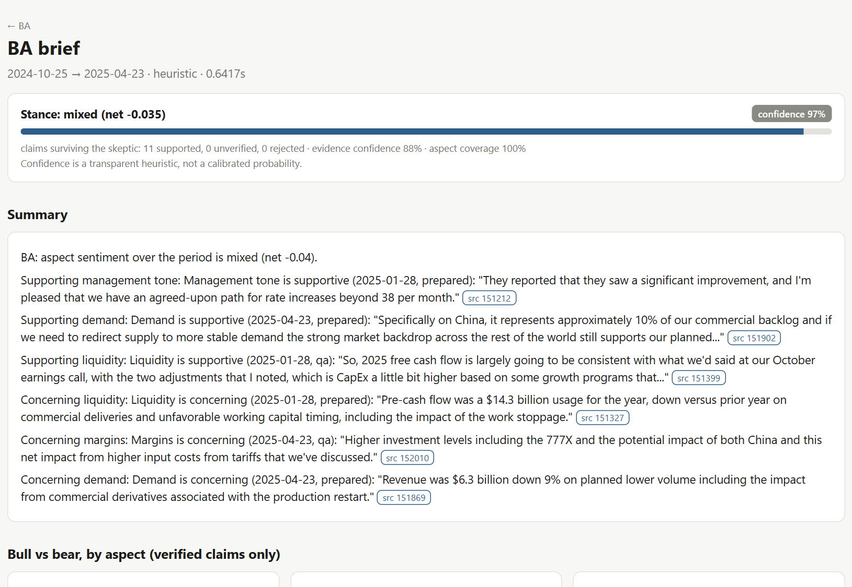
WEBSITE: DRILL-DOWN & BRIEF
From chart point to source sentence
Brief for Boeing (Oct 2024 – Apr 2025)
Scored sentences from both models for that call
The sentence in context, with its speaker
Every stored model verdict for the sentence
Stance and a transparent confidence breakdown
Bull and bear claims, each citing its source (src chips)
Cash burn, 777X costs and tariffs surface from real calls
9
Notes:
Drill-down example: Boeing liquidity, Q4 2024 call. The brief uses the latest call plus the one before; only claims the Skeptic marks supported appear.

Slide 10
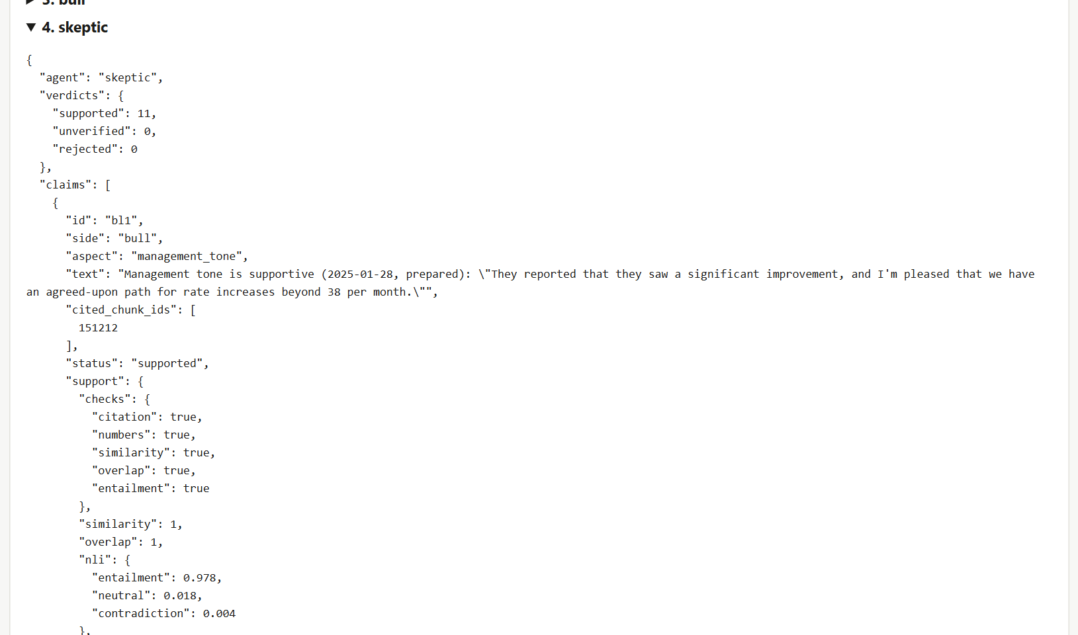
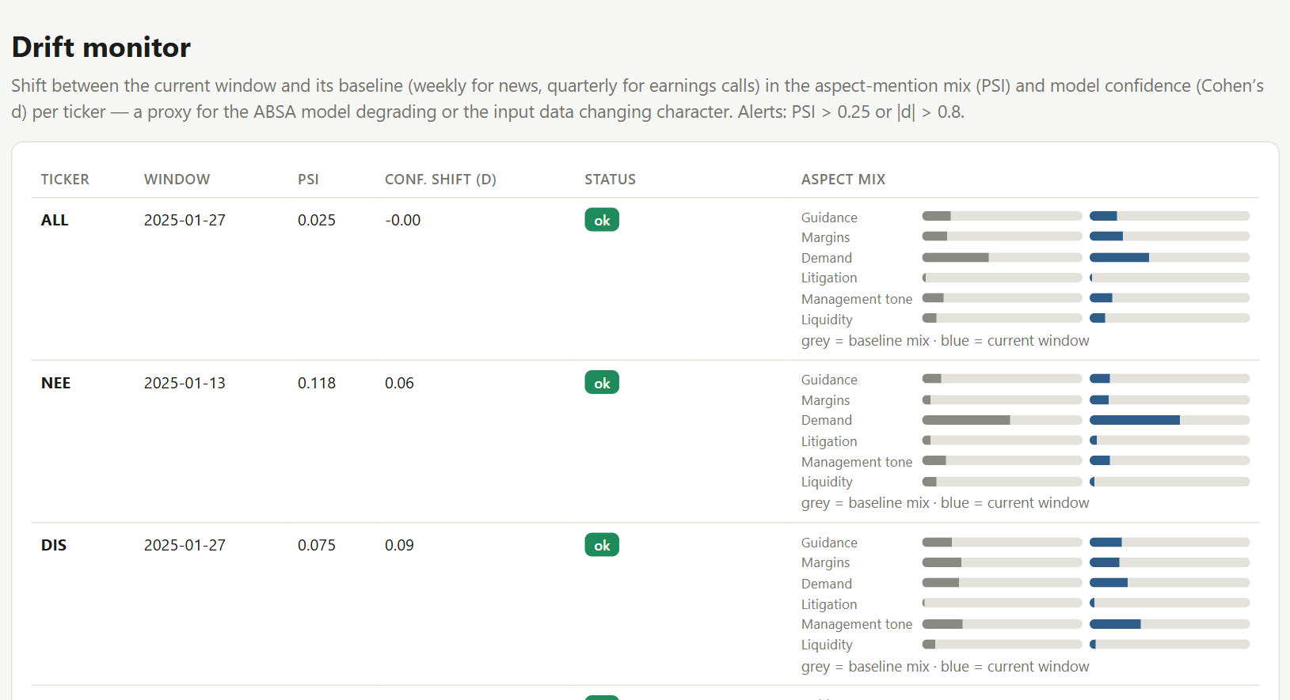
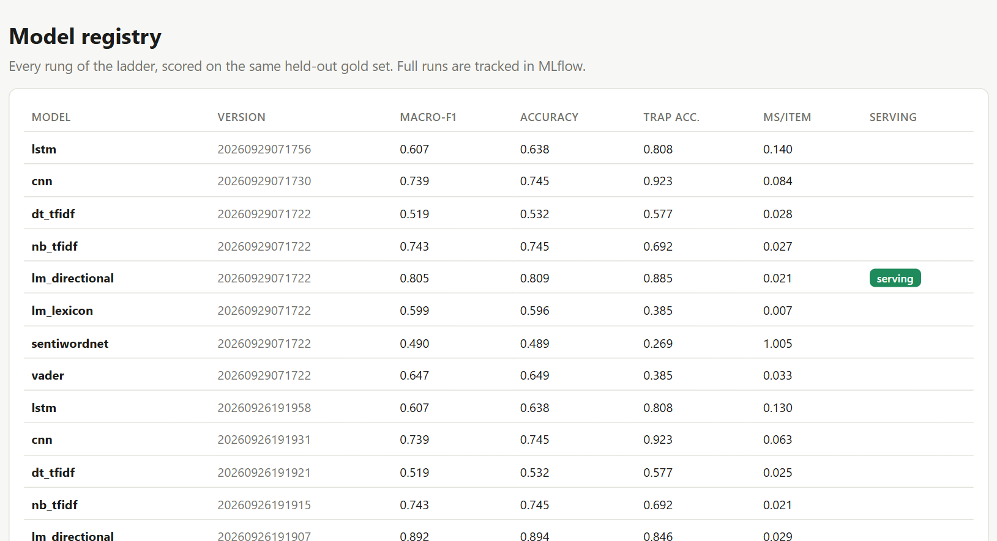
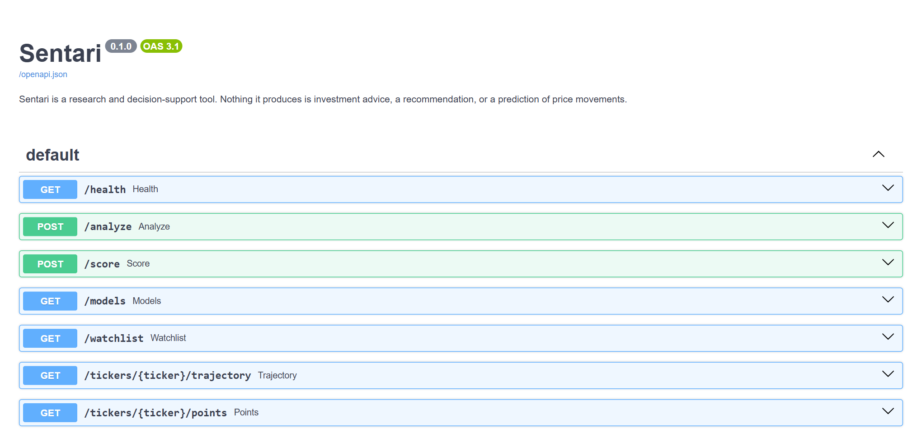
WEBSITE: AUDIT, MONITORING & API
Agent audit trail: Skeptic checks + NLI probabilities
Drift monitor: quarterly aspect-mix shift (PSI) per company
Model registry: every model, its test scores, which one serves
FastAPI endpoints (interactive docs at /docs)
10
Notes:
Audit trail: every agent step is stored per brief - here the Skeptic's per-claim checks (citation, numbers, similarity, overlap, NLI entailment 0.978). Drift is measured per company on quarterly windows.

Slide 11
REAL-DATA PILOT & SIGNAL STUDY
10
companies, 10 sectors
414
earnings calls, 2015–2025
206k
sentences parsed
45.7k
aspect scores
What real calls showed
Does sentiment move with returns?
The two best models agree on only 65% of real aspect mentions (7.7% opposite polarity).
“Management sounds weaker in Q&A”: 64% of calls with the rule model, 49% with FinBERT — not robust.
Both agree only that demand and liquidity are discussed slightly more negatively in Q&A.
Predictor (374 calls) | Days 0–4 ρ | p
Q&A − prepared gap (FinBERT) | −0.03 | 0.58
Q&A − prepared gap (rules) | −0.07 | 0.19
Whole-call sentiment (FinBERT) | +0.17 | 0.001
Whole-call sentiment (rules) | +0.15 | 0.004
Drift, days 2–11 (both) | ≈ 0 | n.s.
Data: kurry/sp500_earnings_transcripts (Hugging Face, pinned) · prices: Alpaca market data
Preliminary: a 300-sentence human-labelled set will decide which model to trust.
Returns are market-adjusted (Alpaca prices), with company fixed effects and analyst-EPS controls. The Q&A gap is a null result; whole-call sentiment co-moves with the reaction but does not predict later drift.
11
Notes:
Pilot data: kurry/sp500_earnings_transcripts (Hugging Face, pinned revision). Scores: lm_directional and finbert_ft. Study is PRELIMINARY until the human-labelled real gold set picks the model. Bonferroni over 6 tests: no Q&A-gap coefficient survives. Source: results/pilot/signal_validity_preliminary.json

Slide 12
CONCLUSION & FUTURE WORK
Conclusion
Limitations
Future work
Aspect-level sentiment and grounded, cited briefs work end-to-end on 414 real earnings calls.
General lexicons fail on finance (61.5% error on trap sentences); domain models fix most of it.
The Skeptic stops fabricated numbers and citations; NLI is needed for flipped polarity.
The Q&A-gap signal is a null result — reported honestly.
Test set small and self-written; models trained on template labels.
Models disagree on 35% of real sentences — no model yet validated on real text.
Rule-based aspect detection can mis-file sentences.
Not yet deployed; no LLM-written briefs audited by humans.
Finish the 300-sentence human-labelled set; pick the model on evidence.
Re-run the signal study with the validated model.
Learned aspect tagger and calibrated confidence.
Deploy on Cloud Run; add NSE/BSE transcripts.
12
Notes:
Research and decision-support only; nothing here is investment advice or a trading signal.

Slide 13
REFERENCES
[1] T. Loughran and B. McDonald, “When is a liability not a liability? Textual analysis, dictionaries, and 10-Ks,” J. Finance, 66(1), 2011.
[2] C. J. Hutto and E. Gilbert, “VADER: A parsimonious rule-based model for sentiment analysis of social media text,” ICWSM, 2014.
[3] S. Baccianella, A. Esuli and F. Sebastiani, “SentiWordNet 3.0,” LREC, 2010.
[4] D. Araci, “FinBERT: Financial sentiment analysis with pre-trained language models,” arXiv:1908.10063, 2019.
[5] J. Devlin et al., “BERT: Pre-training of deep bidirectional transformers for language understanding,” NAACL, 2019.
[6] C. Sun, L. Huang and X. Qiu, “Utilizing BERT for aspect-based sentiment analysis via constructing auxiliary sentence,” NAACL, 2019.
[7] M. Pontiki et al., “SemEval-2014 Task 4: Aspect based sentiment analysis,” SemEval, 2014.
[8] Y. Kim, “Convolutional neural networks for sentence classification,” EMNLP, 2014.
[9] S. Hochreiter and J. Schmidhuber, “Long short-term memory,” Neural Computation, 9(8), 1997.
[10] Z. Ji et al., “Survey of hallucination in natural language generation,” ACM Computing Surveys, 55(12), 2023.
[11] N. Reimers and I. Gurevych, “Sentence-BERT: Sentence embeddings using Siamese BERT-networks,” EMNLP, 2019.
[12] kurry, “sp500_earnings_transcripts” dataset, Hugging Face, 2025 (MIT licence; research use).
[13] Loughran-McDonald Master Dictionary (1993–2025), Notre Dame Software Repository for Accounting and Finance.
[14] Alpaca Market Data API; LangGraph, FastAPI, spaCy and MLflow documentation.
13
Notes:
Full citations and tool versions are in the project repository README and requirements.

Slide 14

Thank You
Notes:
Questions.

