Slide 1
M
C
G
O
R
A
E
V
M
D
I
E
I
E
T
S
S
S
EXIT
INSTRUCTIONS

Slide 2
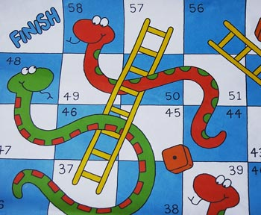

M
E
N
U
SNAKES & LADDERS
TIC TAC TOE
EXIT
INSTRUCTIONS

Slide 3
INSTRUCTIONS
USE LEFT CLICK TO CHOOSE
DONOT DOUBLE CLICK
CLICK ON THE CENTRE OF THE BUTTONS
YOU CAN RETURN BACK TO THE MENU FROM ANY OF THE OTHER MENUS
TO EXIT THE INSTRUCTIONS AND CREDITS PRESS “ENTER”

Slide 4
INSTRUCTIONS
TIC TAC TOE
LEFT CLICK TO PLACE ‘X’ OR ‘O’
CLICK IN THE CENTRE OF THE BOX
AFTER GAME IS OVER PRESS “ENTER” TO GO BACK TO THE GAMES MENU
PRESS ENTER

Slide 5
INSTRUCTIONS
SNAKES AND LADDERS
CLICK ON THE BUTTON TO ROLL THE DICE
MAKE THE NEXT CLICK ONLY AFTER THE POINTER STOPS MOVING
AFTER GAME IS OVER PRESS “ENTER” TO GO BACK TO THE GAMES MENU

Slide 6

PLAYER 1:- X
PLAYER 2:-O
PLAYER 1:-
PLAYER 2:-

Slide 7
CREDITS
THIS PROJECT IS MADE BY
NISHANT
NIKHEEL
AKSHARAN
VICKY
OF
GRADE XII ‘B’

