Slide 1

DSC VIT
RecOmax Recommendation platform

Slide 2
DSC VIT
Problem Statement
Creating a product recommendation system
With the help of Machine Learning increase sales
Reduce time spent by Sales Representatives

Slide 3
DSC VIT
Solution
Create a Product to Store based recommendation system that is Centrally controlled
Recommendations made based on previous sales history of the product
Integrate Online sales trends to provide better real time product recommendation

Slide 4
DSC VIT
Recomendation engine
This engine works on the provided data set.
It aims to recommend to the end user similar items based on the current selection.
The data set provided looks minimal, but we used data analysis to generate features for each individual item from the given data.
As this is an online data set, the trend analysis of this data is integrated into the Prediction engine also.

Slide 5
DSC VIT
Prediction engine
This engine works off a Kaggle data set.
The main aim of the engine to is predict the sales of a specific item in a specific store location for the next month.
The engine makes two types of predictions
When historical sales data is present
When historical sales data is absent.

Slide 6
DSC VIT
Prediction engine contd.
This engine works off a Kaggle data set.
When historical sales data is present, that is when we have sales data of a particular item from particular shop and
When historical sales data is absent, the engine analyses trends in item sales based on factors such as store locations, date-time features and various other measures.

Slide 7
DSC VIT
Data Dashboard
A fully interactive dashboard to present our final platform to the client with data visualizations and information regarding the working of various features in the platform.
We used the professional Business Intelligence tool Power BI to prepare the client end report (dashboard)

Slide 8
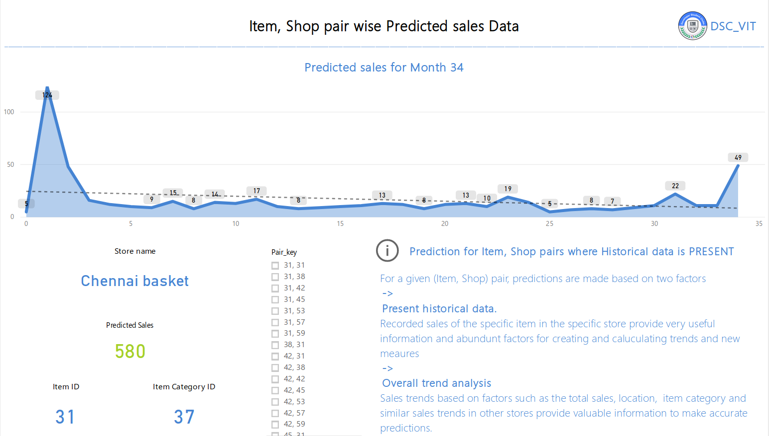
DSC VIT
Report

Slide 9
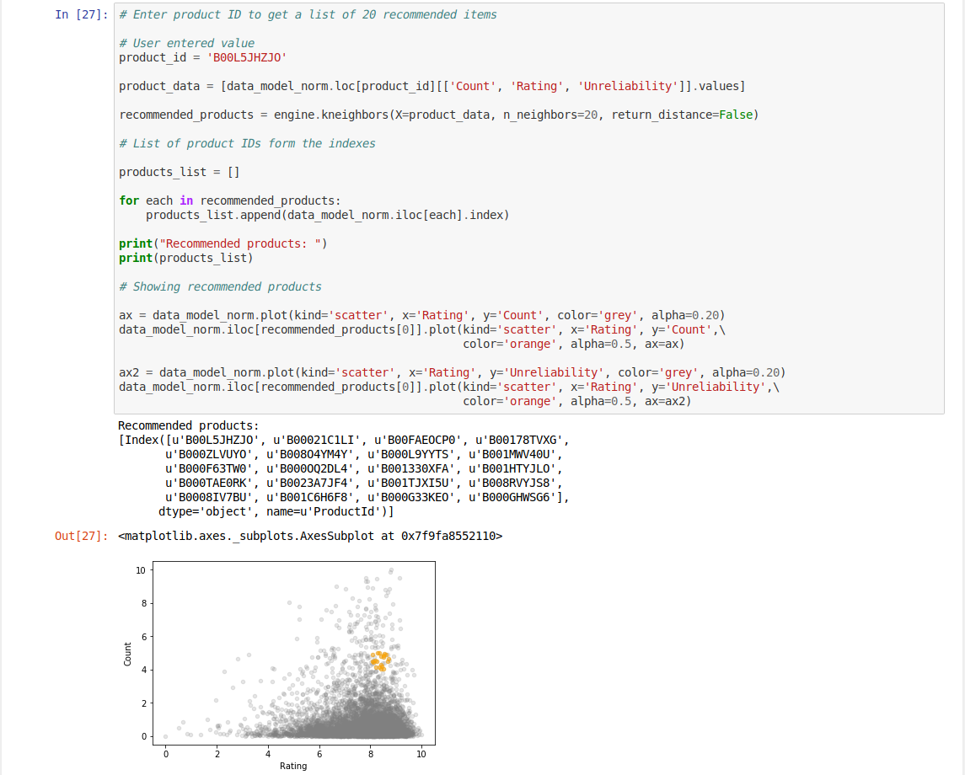
DSC VIT
Notebooks

Slide 10
DSC VIT
Product roadmap
Overtime we have planned on making this project in to a full fledged tools with big data integration and real time online data integration.
Using big data tool such as Hadoop and Mapreduce, we want to take this project one notch higher by computing tremendous amounts of data.
Another plan is to based on the fact that online sales data is available almost immediately. This means that using that data will give the engine an edge over any older historical data prediction model.

Slide 11
DSC VIT
THANKS!
Team DSC_VIT powered by Google Developers
Any questions?
You can find me at -
+91 9945120209
rohan.rodrigues2016@vitstudent.ac.in

