Slide 1

DSC VIT
RecOmax Recommendation platform

Slide 2
DSC VIT
Problem Statement
Creating a product recommendation system
With the help of Machine Learning increase sales
Reduce time spent by Sales Representatives
1

Slide 3
DSC VIT
Solution
Create a Product to Store based recommendation system that is Centrally controlled
Recommendations made based on previous sales history of the product
Integrate Online sales trends to provide better real time product recommendation
1

Slide 4
DSC VIT
Recomendation engine
Product recommendations are made separately for each and every store depending on the sales history
Features include quantity of products sold, time of the year (monthly or weekly)
Location based features such as temperature and climate
1

Slide 5
DSC VIT
Recomendation engine contd.
Products sold together are recommended to the store by the distributor
Integration with e-commerce websites to provide a real time trend analysis
This will help analyse market position for each product separately
1

Slide 6
DSC VIT
Recomendation engine contd.
Online reviews work as a bonus factor to promote products
Incase of poor online performance of a product, it provides a range of factors to grade the competition
Integrating this complete platform will provide an edge over current traditional methods
<number>

Slide 7
DSC VIT
Expected output
Recommendation system with store based product recommendation
Distributors get sales information on each and every product sold to the store
Overall sales as a Key Performance Indicator (KPI)
<number>

Slide 8
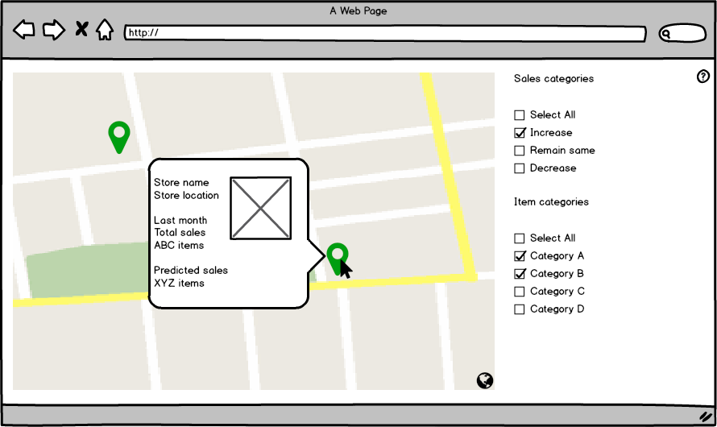
DSC VIT
Wireframes
<number>

Slide 9
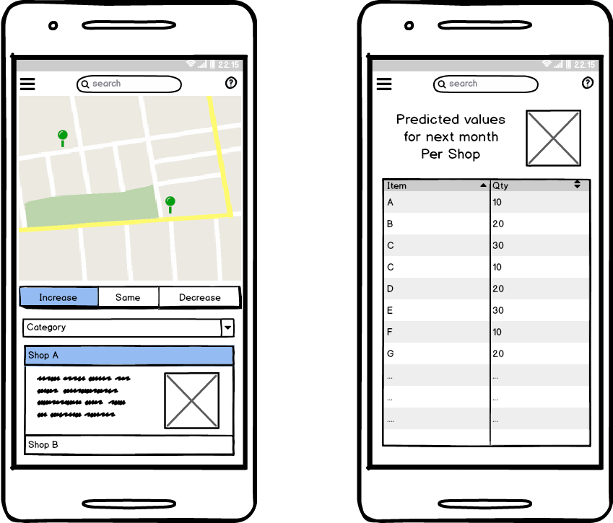
DSC VIT
Wireframes
<number>

Slide 10
DSC VIT
THANKS!
Team DSC_VIT powered by Google Developers
Any questions?
You can find me at -
+91 9945120209
rohan.rodrigues2016@vitstudent.ac.in
<number>

