Slide 1
siDBa
Statistical Database Analysis

Slide 2
Problems
CSV files are easy to import into excel.
Easy for users to understand and interact.
Database structure is not maintained.
No available statistical analysis on data bases.

Slide 3
Solution
Let users directly interact with CSV files using excel and other productivity tools.
Simple and easy to use software to export the csv file to a database (MongoDB)
Provides statistical data about the database to help understand it.

Slide 4
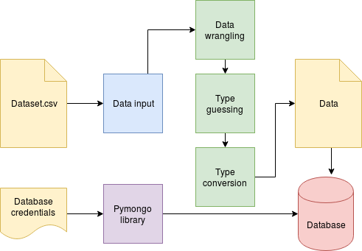
Software design

Slide 5
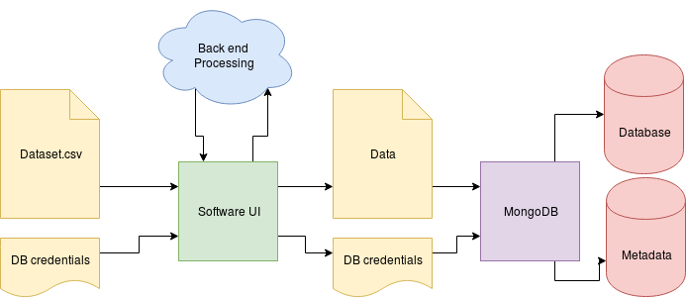
Software design contd.

Slide 6
Tools and Platforms
Python libraries
Pymongo
Unicodecsv
Tkinter
MongoDB and mLabs
MongoDB Compass

Slide 7
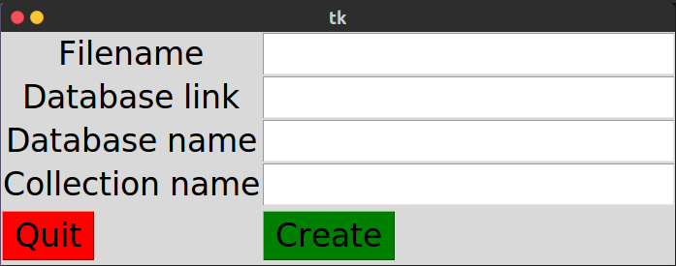
User Interface

Slide 8
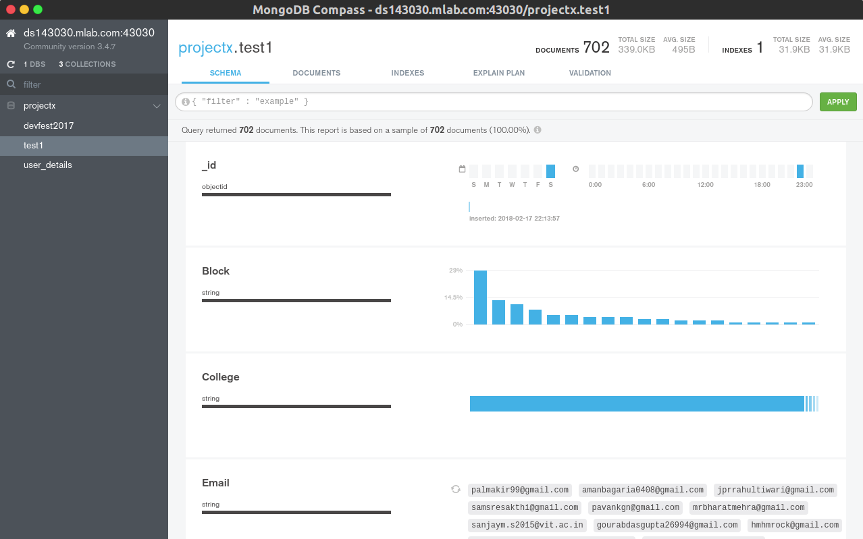
User Interface contd.

Slide 9
Developement
Open Source software
Easy to integrate and fully modular
Complete Admin portal to have a look at the backend

Slide 10
Team
Nishant Rohan Rodrigues | 16BCE0098
Annam Sai Kaushik | 16BCE0527
Shubham Vishwakarma | 15BCE0334

