Slide 1

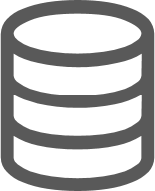



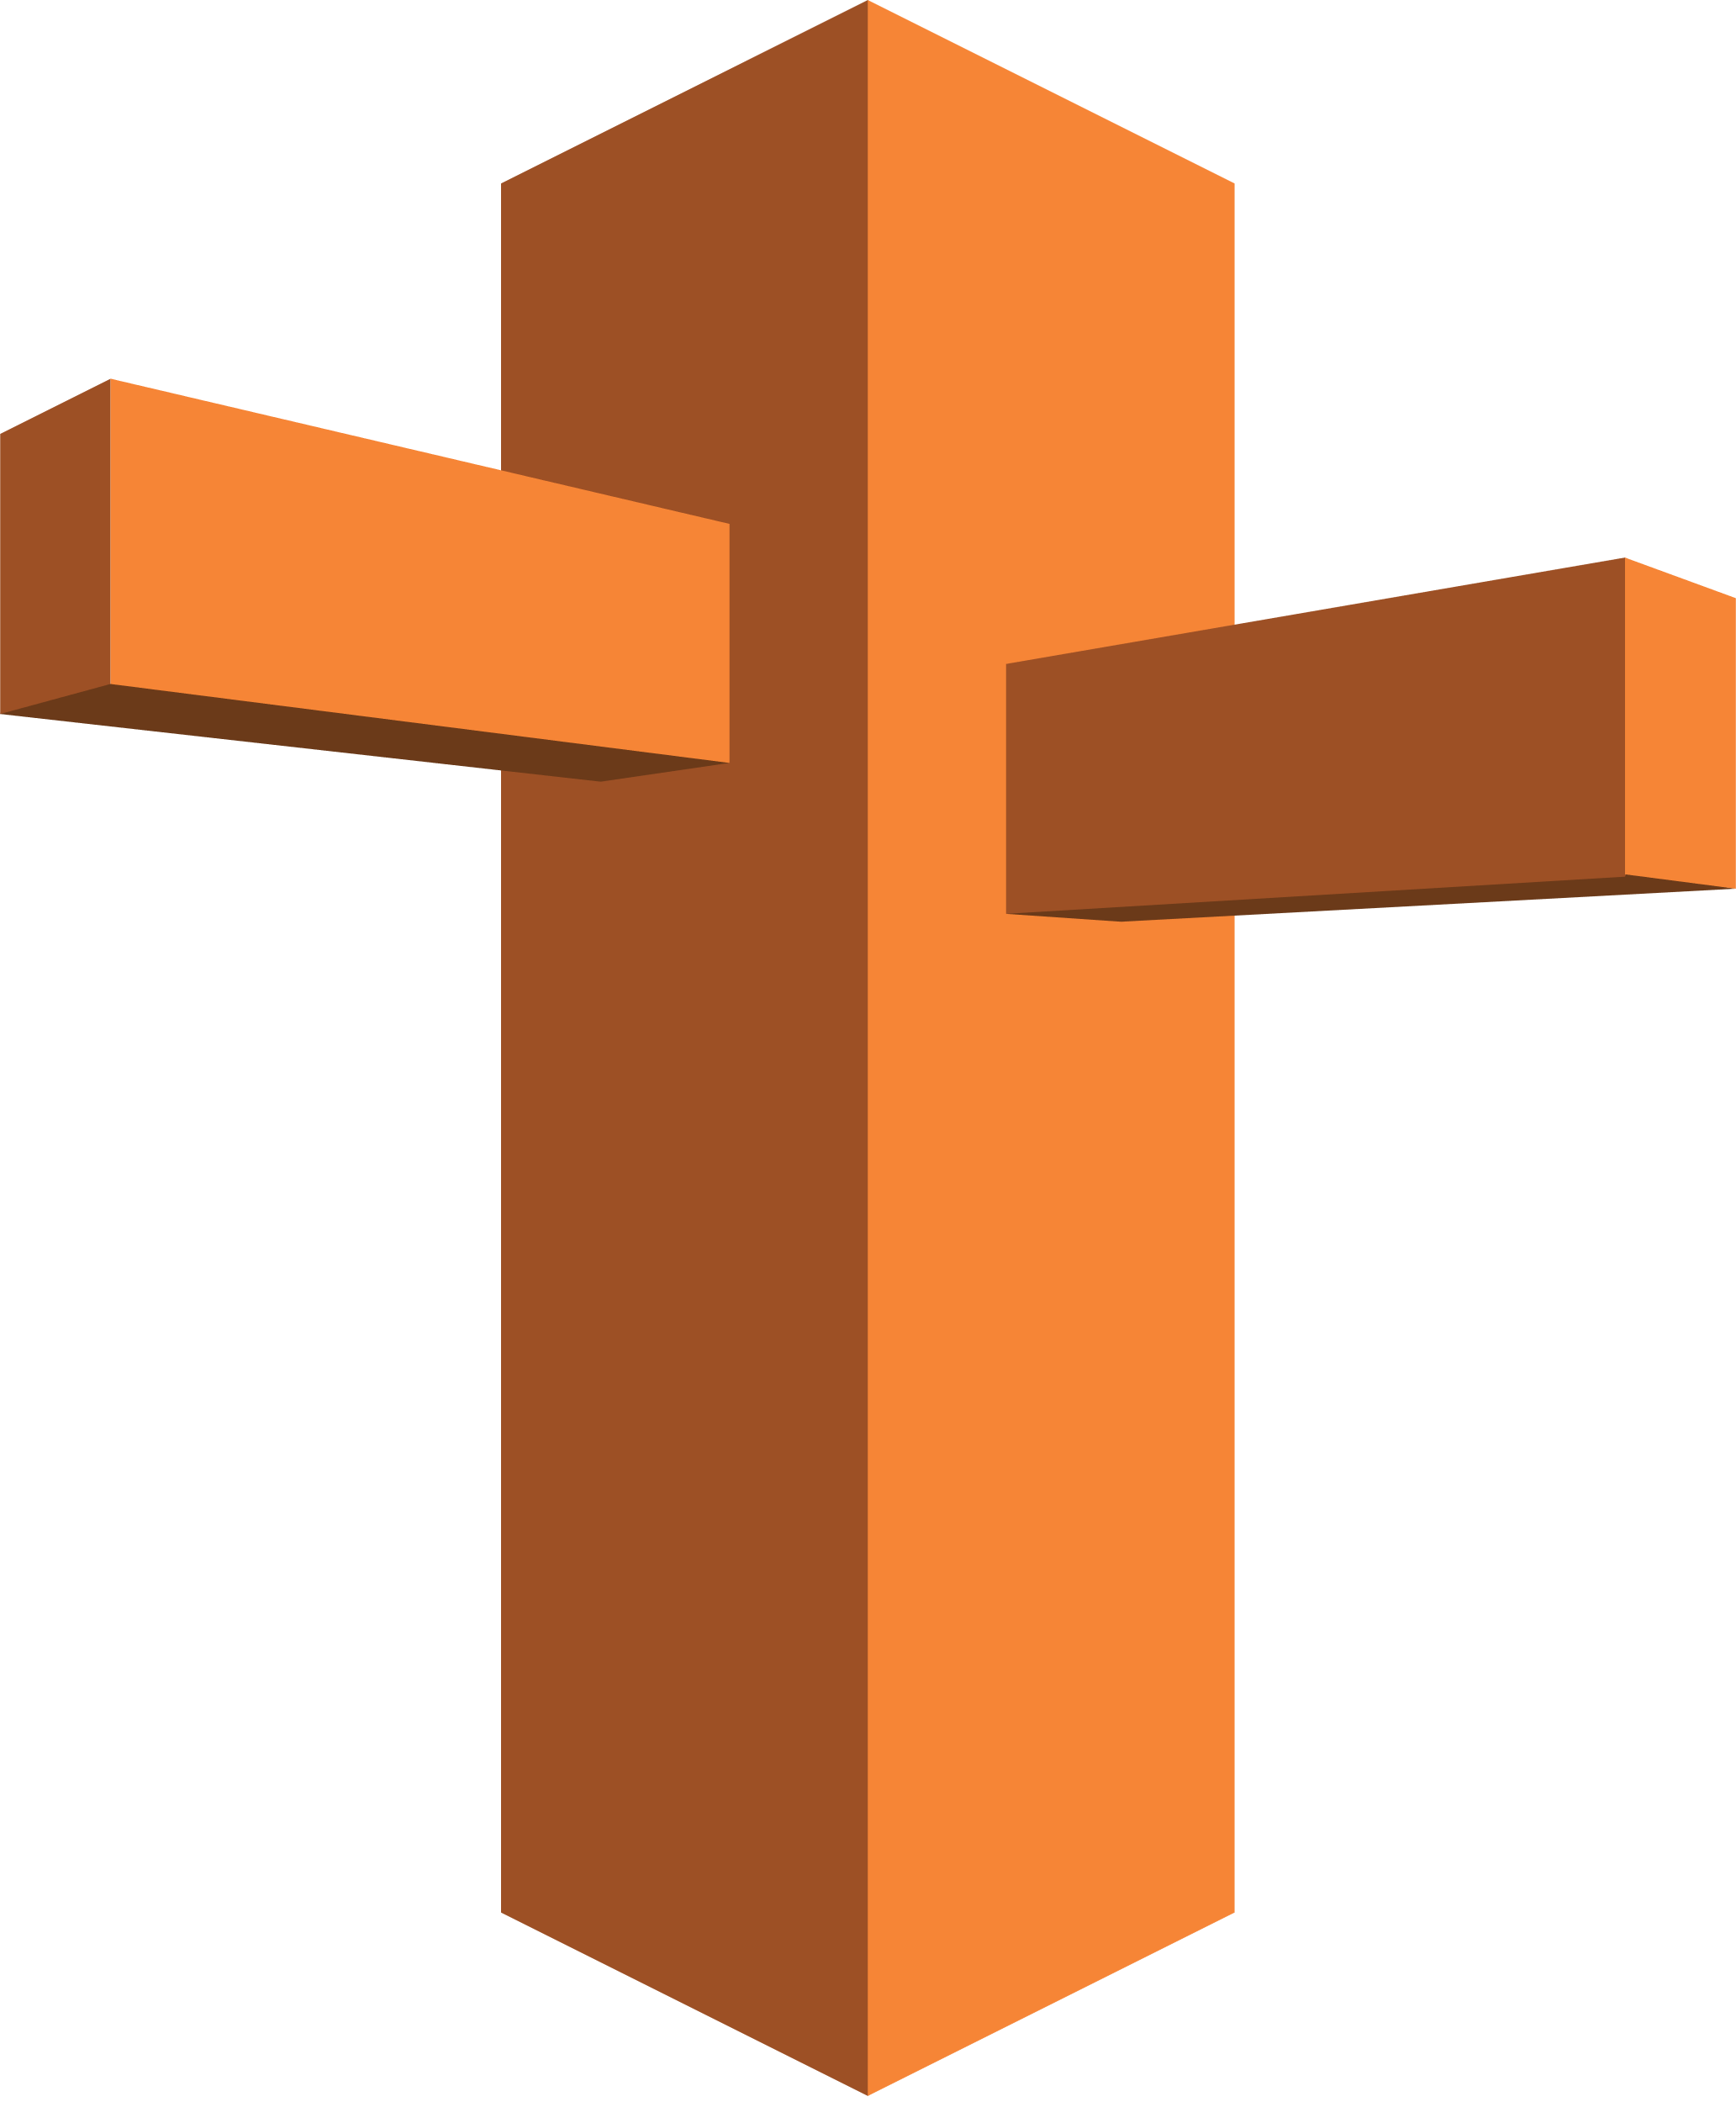
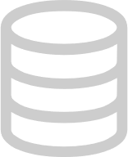

MongoDB Failover
SAP Business Technology Platform
Mongo DB Replica Set (AWS)
Azure Cloud Foundry (Asia Pacific)
Write
AWS (Sydney)
User
Read
Node.js Application
heartbeat
primary
Desktop
AWS (Europe)
heartbeat
iOS
Azure Cloud Foundry (N. Virginia)
primary
AWS
(N.Virginia)
Android
Write
heartbeat
Node.js Application
Geoproximity and Failover rule
Read
secondary
Windows

