Slide 1



SMART INDIA HACKATHON 2026
Problem Statement ID – 26083
Problem Statement – Extreme Heatwave Early Warning and Human Thermal Stress Index
Theme – Disaster Management
PS Category – Software
Team ID – 90043
Team Name – TEAM SYNERGY2025
Solution – HeatLens

Slide 2
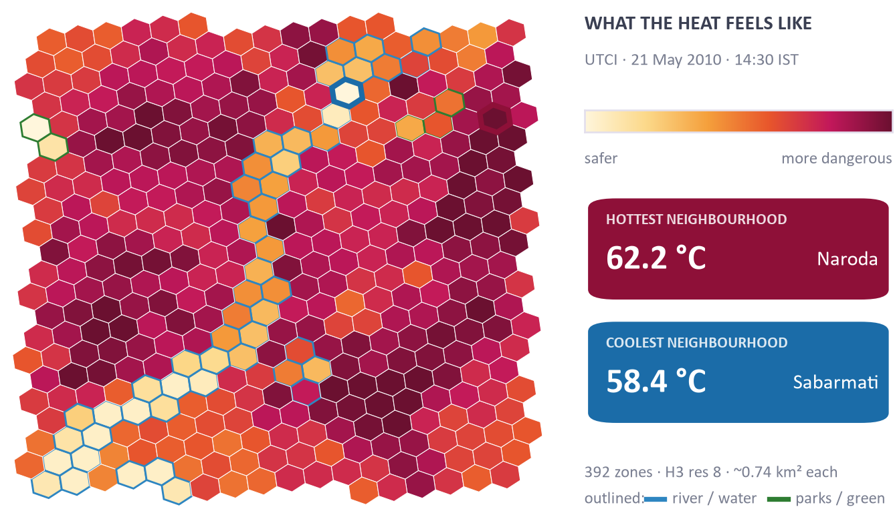
HeatLens: Neighbourhood Heat Warnings
SMART INDIA
HACKATHON
2026
The Problem
What Makes It Different
India's official heatwave call is based on maximum air temperature and issued for a whole district.
Air temperature alone cannot tell dry 40 °C from humid 40 °C, and says nothing about hot nights.
Ahmedabad, May 2010: about 1,344 excess deaths in a single heatwave [1].
 | Today's heatwave warning | HeatLens
Based on | Maximum air temperature | WBGT + UTCI + Heat Index
Area | Whole district | 0.7 km² zone
Hot nights | Not part of the criteria | Night recovery tracked per zone
Output | Warning colour | Safe work minutes + advisory
Proposed Solution
Split the city into small zones – 392 zones of 0.7 km² in Ahmedabad.
Every hour, compute three heat-stress indices (WBGT, UTCI, Heat Index) from temperature, humidity, wind and sunlight.
Turn them into safe outdoor-work minutes per worker type, a colour-coded map and advisories in English, Hindi and Gujarati – 6 days ahead, even offline.
Our output for 21 May 2010, 14:30 IST: “feels-like” heat (UTCI) differs by 3.88 °C across one city at the same moment.
@SIH Idea submission- Template
2

Slide 3






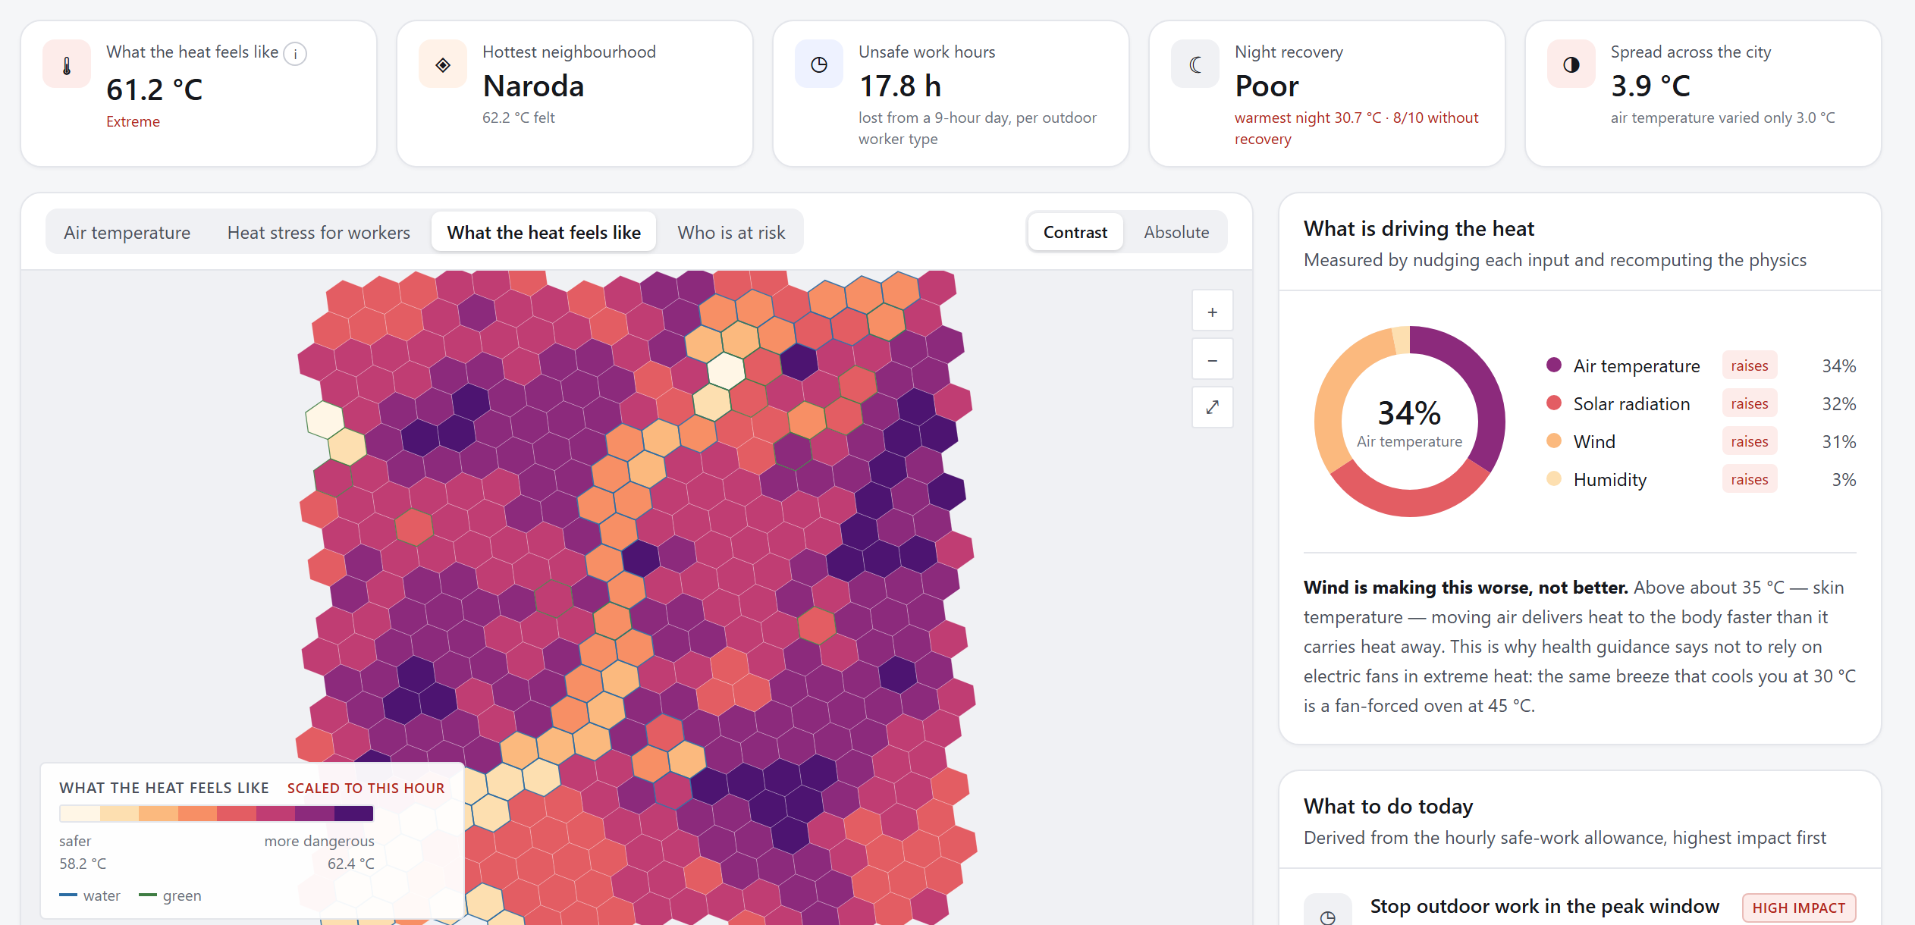
TECHNICAL APPROACH
SMART INDIA
HACKATHON
2026
Tech Stack
Weather + city map
1. Split into zones
2. Heat on the body
3. Safe work minutes
4. Relative risk
5. Map + alert
Data:
Open-Meteo weather · OpenStreetMap
Open-Meteo, OpenStreetMap
392 H3 cells, 0.7 km² each
WBGT · UTCI · Heat Index
ISO 7243 + ACGIH tables
hazard × exposure × vulnerability
offline HTML file, CAP 1.2 alert
Processing:
Python 3.12 · NumPy · thermofeel · h3
Weather is fetched hourly, 6 days ahead; the published copy refreshes automatically every 6 hours.
The dashboard is one self-contained HTML file – it opens from a USB stick with no internet.
The same numbers are served by a read-only FastAPI backend for other government systems.
Backend:
FastAPI (read-only API)
Working Prototype
208 tests pass
Frontend:
React + TypeScript + Vite
formulas checked against published reference values
0.005 °C
Storage:
JSON files – no database needed
agreement with ECMWF's thermofeel library (radiant temperature)
@SIH Idea submission- Template
3

Slide 4
FEASIBILITY AND VIABILITY
SMART INDIA
HACKATHON
2026
Technical Feasibility
Economic Viability
The core pipeline is already built and runs on an ordinary laptop.
Heat formulas are checked against the NOAA Heat Index chart and ISO 7243 limits in 208 automated tests.
Before building the map, we set a pass mark: zones must differ by at least 3 °C UTCI. Measured: 3.88 °C.
Inputs are public: Open-Meteo weather and OpenStreetMap.
Demo needs no server; a city deployment needs one small server for the API.
A new city is one config file (area and dates) – no retraining.
Open-Meteo is free for non-commercial use; a government roll-out would use its paid plan or IMD data.
Potential Challenges and How We Handle Them
Challenge | Our approach
No local death or hospital records | Risk is shown as relative only and labelled “not calibrated”; a calibrate() hook is ready for IHIP / hospital data.
How much hotter built-up areas are is assumed (3 °C, from literature) | Tested 2–5 °C: spread stays above 3 °C from 3 °C upward, drops to 2.57 °C at 2 °C. Next: measure it with Landsat surface temperature.
Hindi and Gujarati advisories are machine-drafted | Native-speaker review before any public release.
A test alert could be mistaken for a real one | Alerts are marked “Exercise”; sending stays off until the city's alert owner approves.
@SIH Idea submission- Template
4

Slide 5
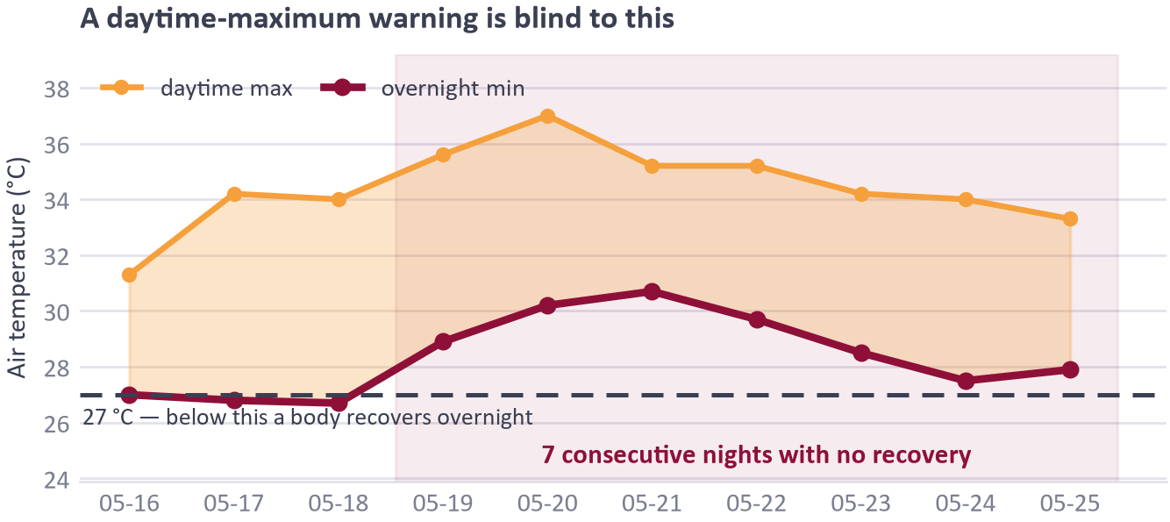




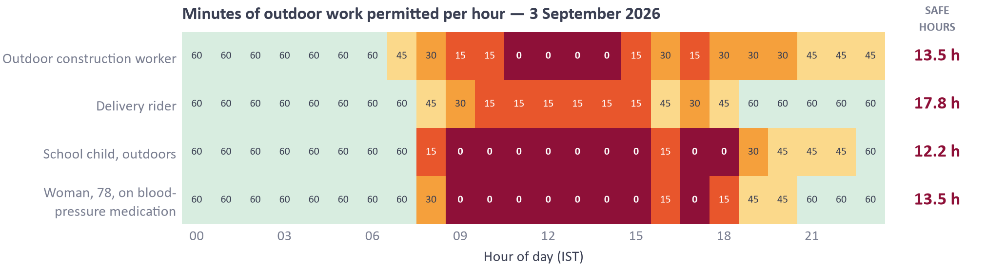
IMPACT AND BENEFITS
SMART INDIA
HACKATHON
2026
Primary Stakeholders
What the Data Already Shows
Municipal Commissioner – zones ranked by heat risk, days ahead, to send water tankers and open cooling centres first.
Health Officer – which zones and hours to plan staff and ORS stock for.
Labour Department – safe outdoor-work minutes, hour by hour, to shift working hours.
Outdoor Workers and Elderly – plain advisories in English, Hindi and Gujarati.
Ahmedabad, May 2010: 7 nights in a row stayed above 27 °C. A warning based on the daytime maximum misses this.
Benefits
Social: help goes to the zones and hours that need it.
Economic: work is shifted, not stopped – 13.5 h/day stay workable for construction (3 Sep 2026).
Pilot measure: heat-illness cases in pilot zones vs similar zones.
@SIH Idea submission- Template
5

Slide 6
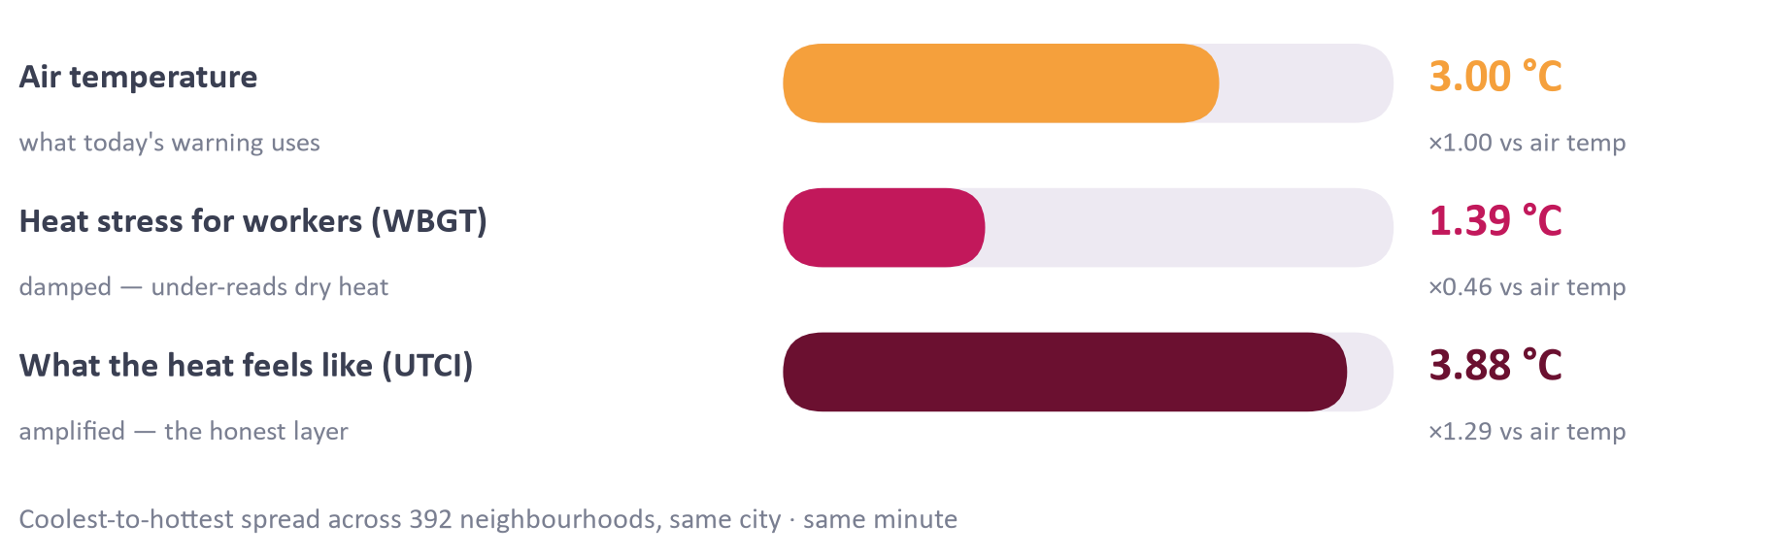
RESEARCH AND REFERENCES
SMART INDIA
HACKATHON
2026
Azhar G.S. et al. (2014). Heat-related mortality in India: excess all-cause mortality associated with the 2010 Ahmedabad heat wave. PLOS ONE 9(3): e91831.
Hess J.J. et al. (2018). Building resilience to climate change: pilot evaluation of the impact of India's first heat action plan on all-cause mortality. J. Environmental and Public Health.
Liljegren J.C. et al. (2008). Modeling the wet bulb globe temperature using standard meteorological measurements. J. Occupational and Environmental Hygiene 5(10).
Bröde P. et al. (2012). Deriving the operational procedure for the Universal Thermal Climate Index (UTCI). Int. J. Biometeorology 56.
Brimicombe C. et al. (2022). thermofeel: a Python thermal comfort indices library. SoftwareX.
ISO 7243:2017 – Ergonomics of the thermal environment: assessment of heat stress using the WBGT index.
India Meteorological Department – heatwave criteria (FAQ on heat wave), imd.gov.in.
Try It
Live demo
nishok22-max.github.io/HeatLens
Source code
github.com/nishok22-max/Heatblast_wave
Why One Index Is Not Enough
Spread between coolest and hottest zone, same city, same minute. WBGT under-reads dry heat; UTCI shows it.
@SIH Idea submission- Template
6

