Slide 1

SMART INDIA HACKATHON 2026
Heat warnings measured per neighbourhood, per body, per hour
Problem Statement ID –
26083
Problem Statement Title-
Extreme Heatwave Early Warning and
Human Thermal Stress Index
Theme-
Disaster Management
PS Category- Software
Team Name (Registered on portal)
HeatLens
A heatwave warning tells you the air temperature. It does not tell you what that heat does to a person.
Prototype: 392 neighbourhoods · 135 passing physics tests · runs offline

Slide 2
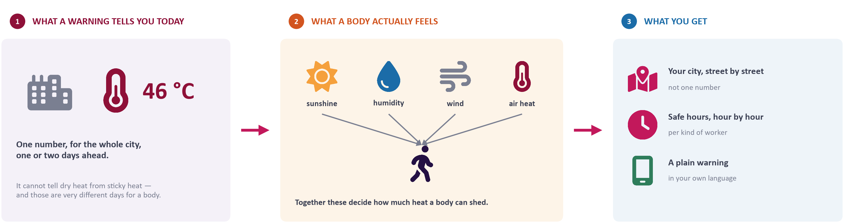
HeatLens
HeatLens
A heatwave warning measured on the body, not the thermometer
Proposed Solution (Describe your Idea/Solution/Prototype)
Detailed explanation of the proposed solution
How it addresses the problem
Innovation and uniqueness of the solution
We cut the city into 392 small zones, each about the size of a neighbourhood.
For every zone and every hour we work out what the heat does to a body — using the limits doctors and safety inspectors already use.
That becomes one plain number: how many minutes it is safe to be outside.
The whole thing is a single file that opens with no internet.
Today a whole district gets one temperature, one or two days ahead.
That number cannot tell a dry 40 °C from a sticky 40 °C — and only one of those is workable outdoors.
We answer street by street, five days ahead, in the language people actually speak.
We pick the right measure for the weather that day. In May 2010 the usual worker index hid the danger; the “feels like” one showed it.
We count the nights. Seven in a row never dropped below 27 °C — no daytime warning can see that.
We print what we do not know on the face of the tool.

Slide 3
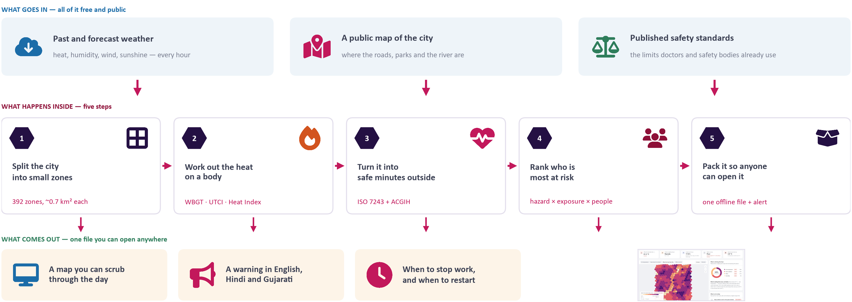
TECHNICAL APPROACH
HeatLens
Technologies to be used (e.g. programming languages, frameworks, hardware)
CORE Python 3.12 · NumPy · PyYAML
PHYSICS thermofeel (ECMWF) · Liljegren · UTCI
PHYSIOLOGY ISO 7243 · ACGIH TLV · ISO 7726
GEOSPATIAL Uber H3 v4 · OpenStreetMap / Overpass
WEATHER Open-Meteo ERA5 archive + forecast
FRONTEND React 18 · TypeScript · Vite · SVG map
DELIVERY one inlined index.html · CAP 1.2 XML
QUALITY pytest ×135 · GitHub Actions, 6-hourly
Methodology and process for implementation (Flow Charts/Images/ working prototype)

Slide 4
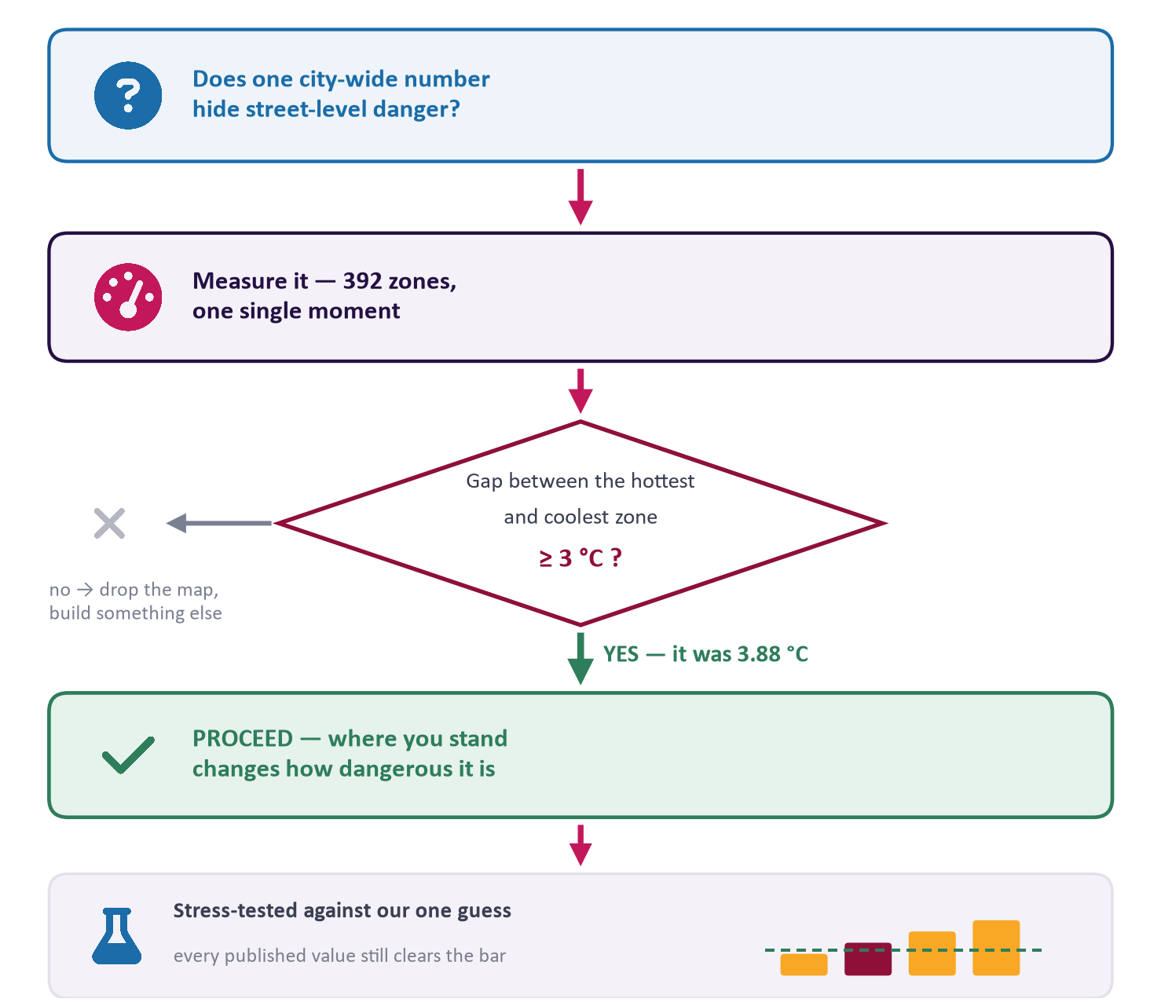
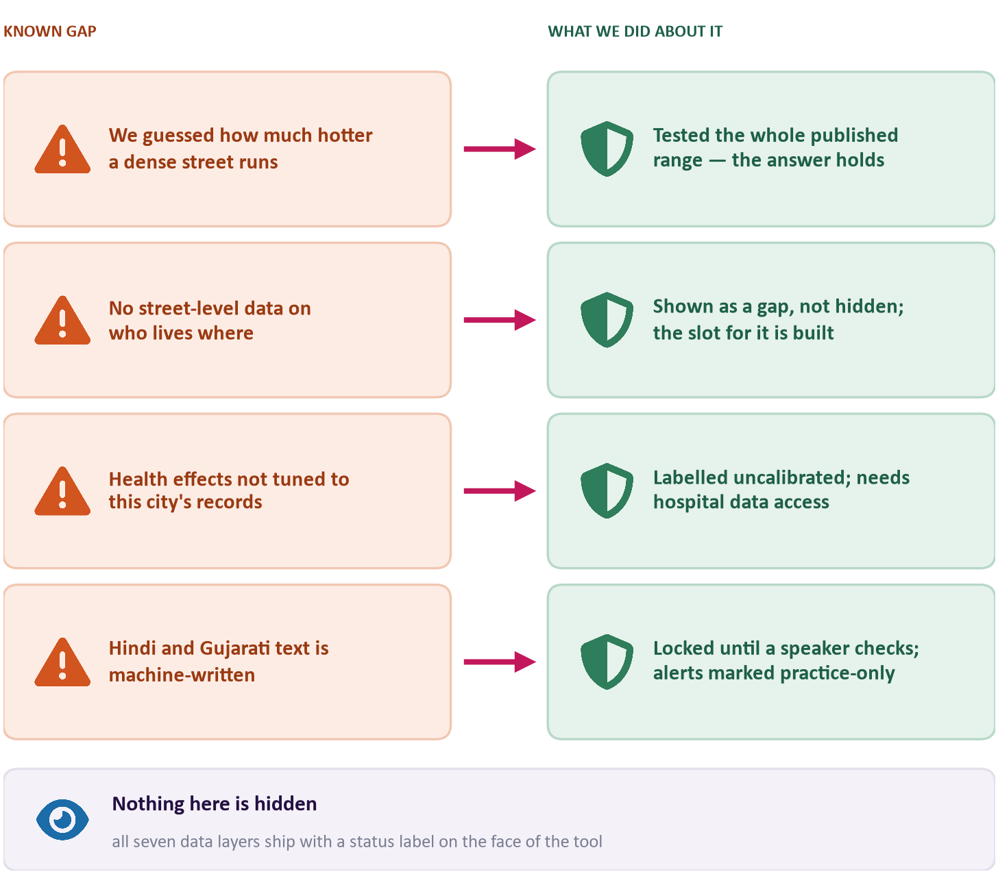
FEASIBILITY AND VIABILITY
HeatLens
Analysis of the feasibility of the idea
Potential challenges and risks
Before building the product we tested whether the idea was true.
Strategies for overcoming these challenges

Slide 5
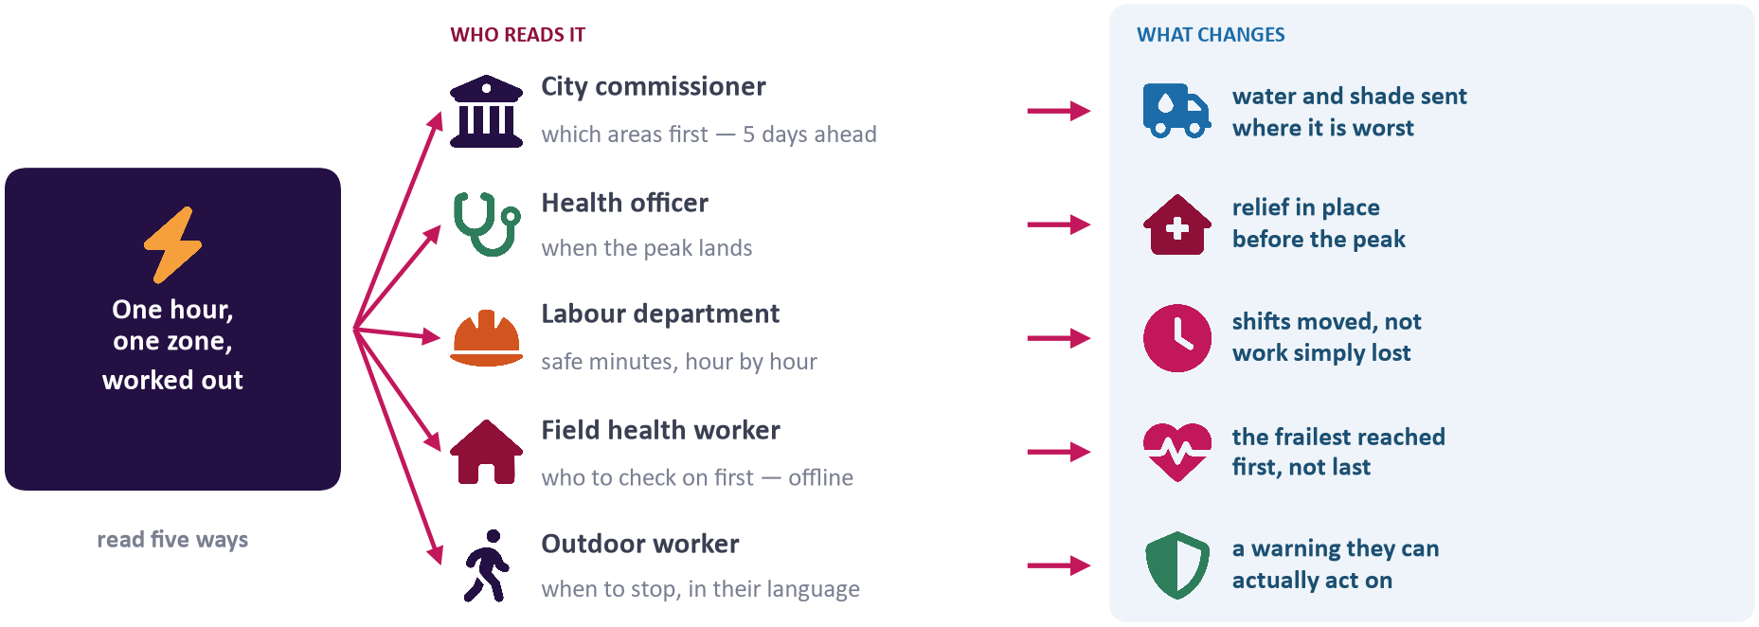




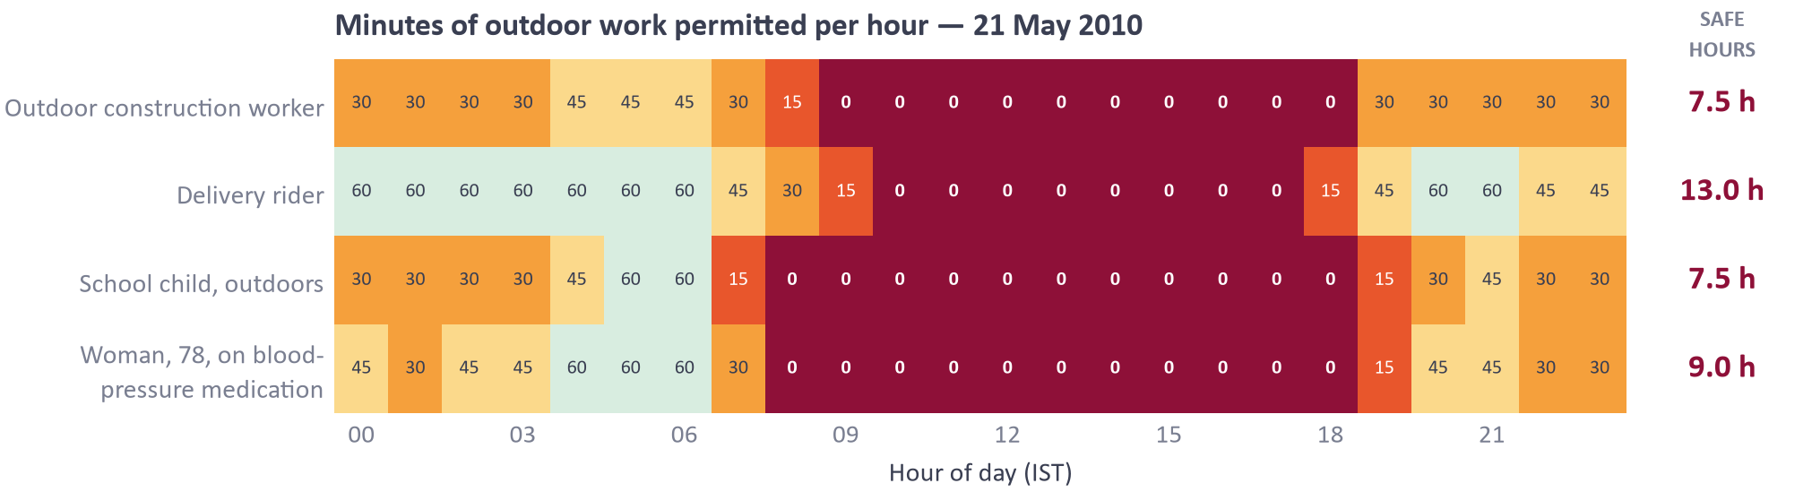
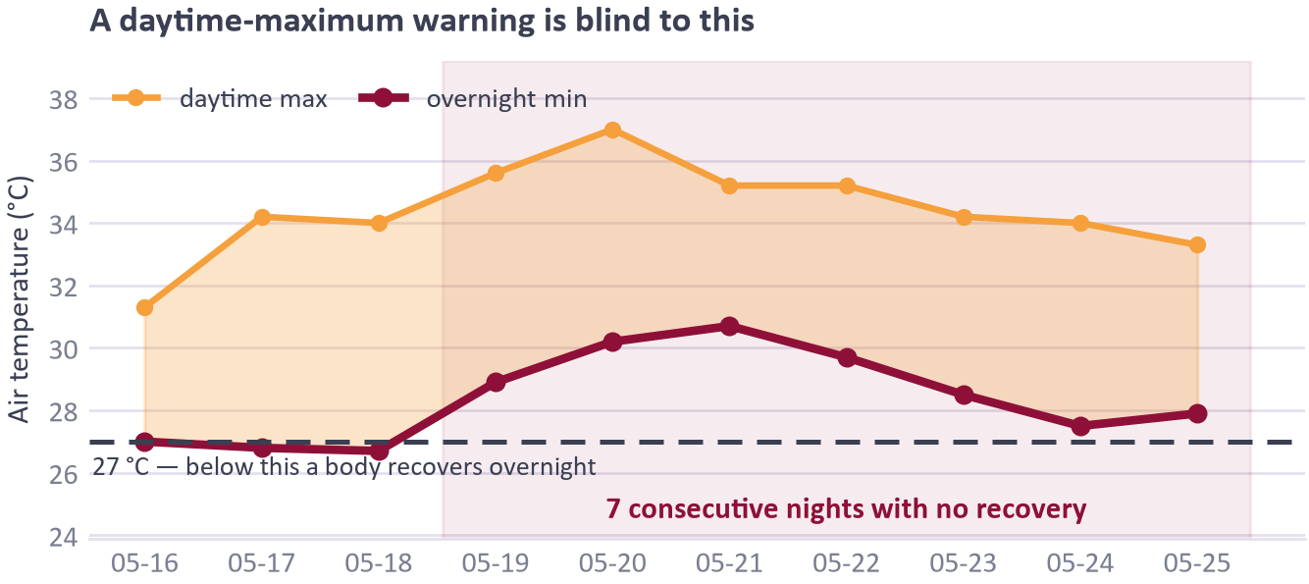
IMPACT AND BENEFITS
HeatLens
Potential impact on the target audience
Benefits of the solution (social, economic, environmental, etc.)
Social
Protects people who cannot simply stay indoors.
Economic
Moving hours saves work a blanket stop-work order loses.
Environmental
Shows where trees and cool roofs buy the most.
Institutional
Speaks the national alert format already in use.
Eight hours straight, on 21 May 2010, when no one could safely work outdoors at all.
The part of a heatwave a daytime warning never sees.

Slide 6
RESEARCH AND REFERENCES
HeatLens
Details / Links of the reference and research work
Physics & standards implemented
Data sources — free, global, no institutional access
Evidence base for the problem
Liljegren et al. (2008), J. Occup. Environ. Hyg.
Solar-corrected WBGT; used via thermofeel (ECMWF).
Open-Meteo
ERA5 hourly archive and forecast API: temperature, humidity, wind, GHI/DNI/DHI.
Azhar et al. (2014), PLoS ONE
Excess mortality in the May 2010 Ahmedabad heatwave.
Bröde et al. (2012), Int. J. Biometeorol.
The operational UTCI polynomial.
OpenStreetMap via Overpass API
Road, green and water cover per H3 cell.
Knowlton et al. (2014), IJERPH
Design of South Asia's first Heat Action Plan.
Stull (2011), J. Appl. Meteorol. Climatol.
doi:10.1175/JAMC-D-11-0143.1 — wet-bulb from T and RH.
Uber H3 v4
Resolution-8 discrete global grid, ~0.74 km² cells.
Hess et al. (2018)
Pilot evaluation of the Ahmedabad Heat Action Plan.
Rothfusz (1990) / NOAA NWS
Heat Index regression and adjustments.
thermofeel (ECMWF)
Operational reference implementation we validate against.
IMD heatwave criteria
The district-scale, dry-bulb baseline this improves on.
ISO 7243:2017 · ISO 7726 · ISO 8996
WBGT limits, mean radiant temperature, metabolic rate.
OASIS CAP 1.2
Alert interchange format; NDMA SACHET compatible.
NDMA, National Guidelines: Heat Wave (2019)
The action framework our outputs are shaped to feed.
ACGIH TLV®
Work/rest allocation tables per metabolic class.
Primary-source verification
Casualty figures are checked against the source papers before any are quoted on stage.
Provenance of every layer we ship — stated in the UI and in web/data/meta.json, because a number without its status is not evidence.
Past weather
Open-Meteo ERA5
Urban form
OpenStreetMap
Heat-stress indices
thermofeel / ECMWF
Safe limits for a body
ISO 7243 + ACGIH
Urban-heat amplitude
literature, 3.0 °C
Vulnerability
city-wide constant
Health risk
literature-shaped
MEASURED
MEASURED
MEASURED
PUBLISHED STANDARD
ASSUMED
NOT FITTED
NOT CALIBRATED

