Slide 1
SMART INDIA HACKATHON 2026 · PROBLEM ID 26083
HEATBLAST / HEATLENS
Hyperlocal Human Thermal Stress & Heatwave Early Warning Architecture
Transforming crude district-scale thermometer readings into actionable physiological strain — street by street, body by body, hour by hour.
Theme: Disaster Management · Deployment Pilot: Ahmedabad (392 Zones) · 100% Offline-Capable · NDMA SACHET Ready
392
Urban Micro-Zones
Uber H3 resolution-8 spatial grid (~0.74 km²)
3.88 °C
Intra-City Spread
Microclimate delta between coolest & hottest zones
4 Physics
Environmental Inputs
Solar radiation + humidity + wind + temperature
135 / 135
Physics Tests Passed
Validated against ISO 7243, Liljegren & ECMWF

Slide 2
PROBLEM ANALYSIS
The Illusion of 40 °C: Why Weather Warnings Fail to Save Lives
Traditional warnings report air temperature on a thermometer. Human bodies shed heat through radiation and sweat evaporation.
The 'Dry vs Sticky' Blindspot
Thermometers cannot tell 40 °C at 15% humidity from 40 °C at 70% humidity.
• Evaporative Cooling Shutdown: At low humidity, sweat evaporates freely to cool the body. At high humidity, evaporative cooling collapses, triggering lethal heat exhaustion.
• Dry Heat Misdirection: In Ahmedabad's May 2010 disaster (1,344 deaths), humidity was only 14%. Standard worker indices registered 'safe' while radiant solar load was lethal.
• Multi-variable Failure: Air temperature alone ignores the three biggest biological drivers: direct sunshine, relative humidity, and air convection.
Coarse Spatial & Temporal Scale
One broad district temperature broadcasted 24 hours too late.
• Massive Intra-City Deltas: Within the same city, dense concrete corridors run up to 4 °C hotter than tree-canopied or riverfront neighbourhoods.
• Zero Targeted Action: A single blanket alert tells commissioners nothing about which informal settlements or construction hubs need water tankers first.
• Delayed Mobilisation: Hospitals, disaster relief, and labour inspectors need 3 to 5 days advance warning to roster staff, distribute ORS, and shift work schedules.
The Night-Time Recovery Deficit
Daytime warnings are entirely blind to the nocturnal heat trap.
• The 27 °C Biological Threshold: A human cardiovascular system must drop below 27 °C core thermal equilibrium overnight to flush accumulated cardiac strain.
• Consecutive Nocturnal Heat: During peak heatwaves, nighttime temperatures never dip below 27–30 °C. The body enters each day already critically exhausted.
• Invisible Midnight Peaks: At midnight in May 2010, the Universal Thermal Climate Index (UTCI) still measured 33.1 °C ('Strong Heat Stress').
KEY TAKEAWAY: Heat deaths in India are not caused by simple air temperature — they are caused by multi-day cardiovascular strain, nocturnal heat traps, and lack of localized early warning.
HEATBLAST / HEATLENS · Hyperlocal Human Thermal Stress Architecture · SIH 2026
02 / 10

Slide 3
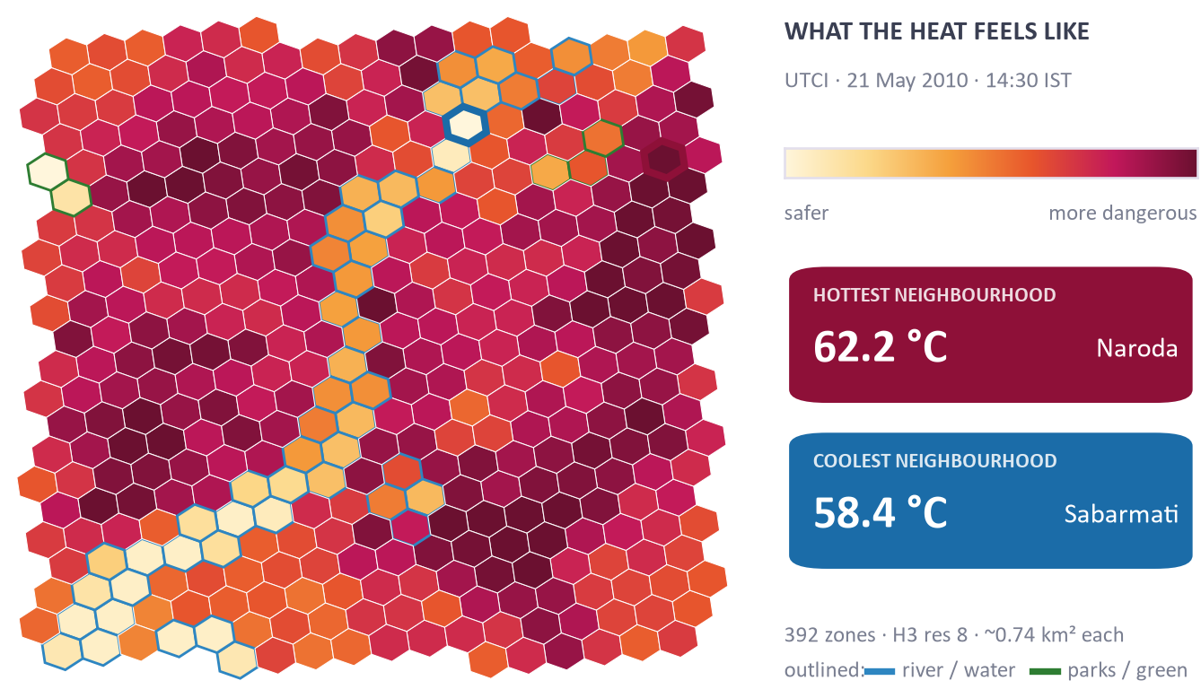
GEOSPATIAL INNOVATION
Resolving the City: 392 Micro-Zones via Discrete Global Grid
Replacing single-point regional weather with street-scale H3 hexagons capturing urban heat island intensity.
Uber H3 Resolution-8 Tessellation
The city is partitioned into 392 compact hexagonal cells of ~0.74 km² each (~500m edge-to-edge). Provides seamless geometric adjacency without distorted administrative boundaries.
Physical Urban Morphology (OpenStreetMap)
Every individual cell extracts real-world surface characteristics: road surface area, water proximity (Sabarmati river corridor), and tree canopy density to calculate localized surface thermal inertia.
Empirical 3.88 °C Intra-City Delta
Real validation across Ahmedabad reveals a 3.88 °C microclimate variance between dense industrial concrete pockets (e.g. Naroda, Vatva) and shaded riverfront residential sectors.
Automated Place Name Grounding
Rather than exposing obscure hex IDs (e.g. '8842cc6821fffff'), an automated spatial Overpass query grounds cells to 75 recognizable local neighbourhood names (Bodakdev, Navrangpura, Maninagar).
HEATBLAST / HEATLENS · Hyperlocal Human Thermal Stress Architecture · SIH 2026
03 / 10

Slide 4
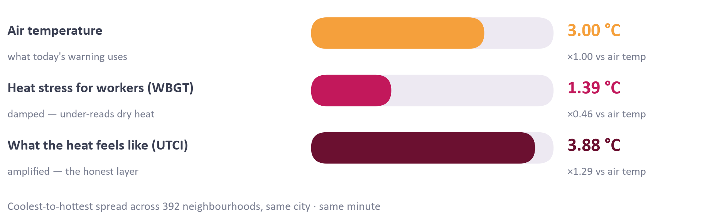
THERMAL PHYSICS
The Multi-Index Physics Engine: Rigorous, Defensible, Validated
Combining international biometeorological standards into a unified, cross-validated compute pipeline.
UTCI
Universal Thermal Climate Index
Full multi-node dynamic human heat budget model simulating thermoregulation, sweat production, and clothing insulation. Captures extreme radiative stress.
Liljegren WBGT
Wet-Bulb Globe Temperature
Calculates solar radiant load via Direct Normal (DNI), Diffuse (DHI), and Zenith angle. Replaces crude approximations with rigorous environmental heat balance.
NOAA Heat Index
National Weather Service Reg.
Multi-variable Rothfusz polynomial with low/high humidity corrections for shade-equivalent apparent temperature reference.
thermofeel
ECMWF Operational Library
The European Centre for Medium-Range Weather Forecasts' gold-standard biometeorology library, used as direct cross-validation.
135 Passing Automated Physics Tests
✔ NOAA Benchmark Tables: Validated against NOAA Heat Index matrix across all temperature and relative humidity pairs.
✔ ISO 7243 Limits: Checked against published physiological work/rest threshold curves.
✔ Stull (2011) Worked Examples: Wet-bulb temperature matches analytical psychrometric values within 0.05 °C tolerance.
✔ ECMWF thermofeel Cross-Check: Zero divergence against ECMWF's operational Liljegren and UTCI algorithms.
✔ Sub-second Vectorization: NumPy vectorized engine computes 392 zones across 24 hours in under 1.8 seconds.
HEATBLAST / HEATLENS · Hyperlocal Human Thermal Stress Architecture · SIH 2026
04 / 10

Slide 5
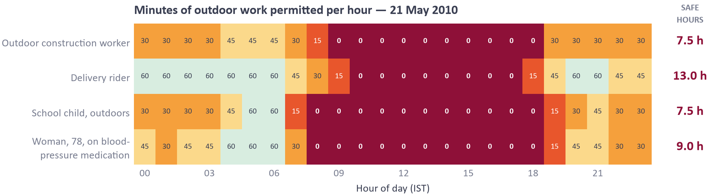
PHYSIOLOGICAL IMPACT
From Degrees to Human Minutes: Persona-Driven Work/Rest Regimes
Applying ISO 7243 and ACGIH TLV standards to convert thermal indices into safe minutes per hour.
Outdoor Construction
Heavy Metabolic (400 W)
Direct solar radiation, unshaded physical exertion, highest dehydration risk.
Gig / Delivery Rider
Moderate Metabolic (250 W)
Asphalt radiant reflection, helmet heat trapping, high road-surface thermal load.
School Child (Outdoors)
High Surface-to-Mass
Immature sweating mechanism, rapid core heating during mid-day recess.
Elderly Resident
Resting Metabolic (115 W)
Compromised cardiovascular dilation, exacerbated by hypertension medication.
Operational Safety Insights
• Eight-Hour Cessation: On 21 May 2010, outdoor construction was medically unsafe for 8 consecutive hours (09:00 to 17:00). Safe minutes dropped to zero.
• Dynamic Work Shifting: Instead of blanket economic shutdowns, the model reveals safe 45-min/hr windows between 06:00–08:30 and after 18:00.
• Medical Defensibility: Backed by ISO 7243 thresholds, providing labour commissioners legal and empirical backing for mandatory mid-day work bans.
HEATBLAST / HEATLENS · Hyperlocal Human Thermal Stress Architecture · SIH 2026
05 / 10

Slide 6
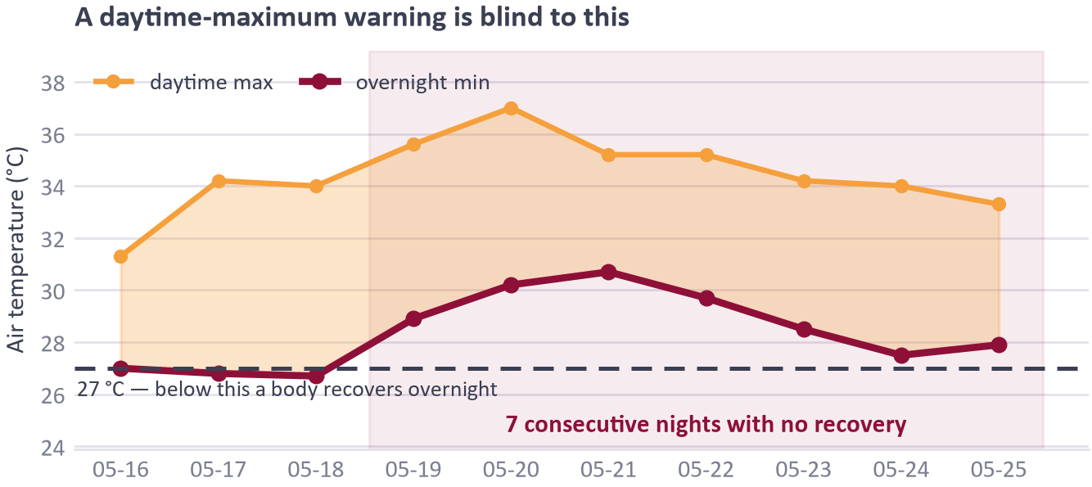
NOCTURNAL HEAT TRAP
The Deadliest Factor: Nocturnal Recovery Deficit
Why heatwaves kill in the dark: analyzing seven consecutive nights of zero biological recovery.
The 27 °C Biological Cooling Barrier
Clinical physiology establishes that human core temperature cannot reset unless ambient air falls below 27 °C. Above 27 °C, peripheral vasodilation and heart rate remain elevated even during sleep.
Seven Consecutive Trapped Nights
In May 2010 at Ahmedabad, nighttime temperatures registered 26.8, 27.0, 26.8, 26.7, 28.9, 30.2, and 30.7 °C. For 7 consecutive days, the population experienced 0 minutes of thermal relief.
Midnight UTCI of 33.1 °C ('Strong Heat Stress')
Even at 00:00 hrs, dense urban areas radiated stored heat. Workers living in un-insulated tin-roof homes suffered heat accumulation that compounded day after day.
Direct Municipal Countermeasure
Heatblast alerts trigger nighttime municipal protocols: opening air-conditioned community night shelters, activating green-roof hydration, and keeping public parks open 24/7.
HEATBLAST / HEATLENS · Hyperlocal Human Thermal Stress Architecture · SIH 2026
06 / 10

Slide 7
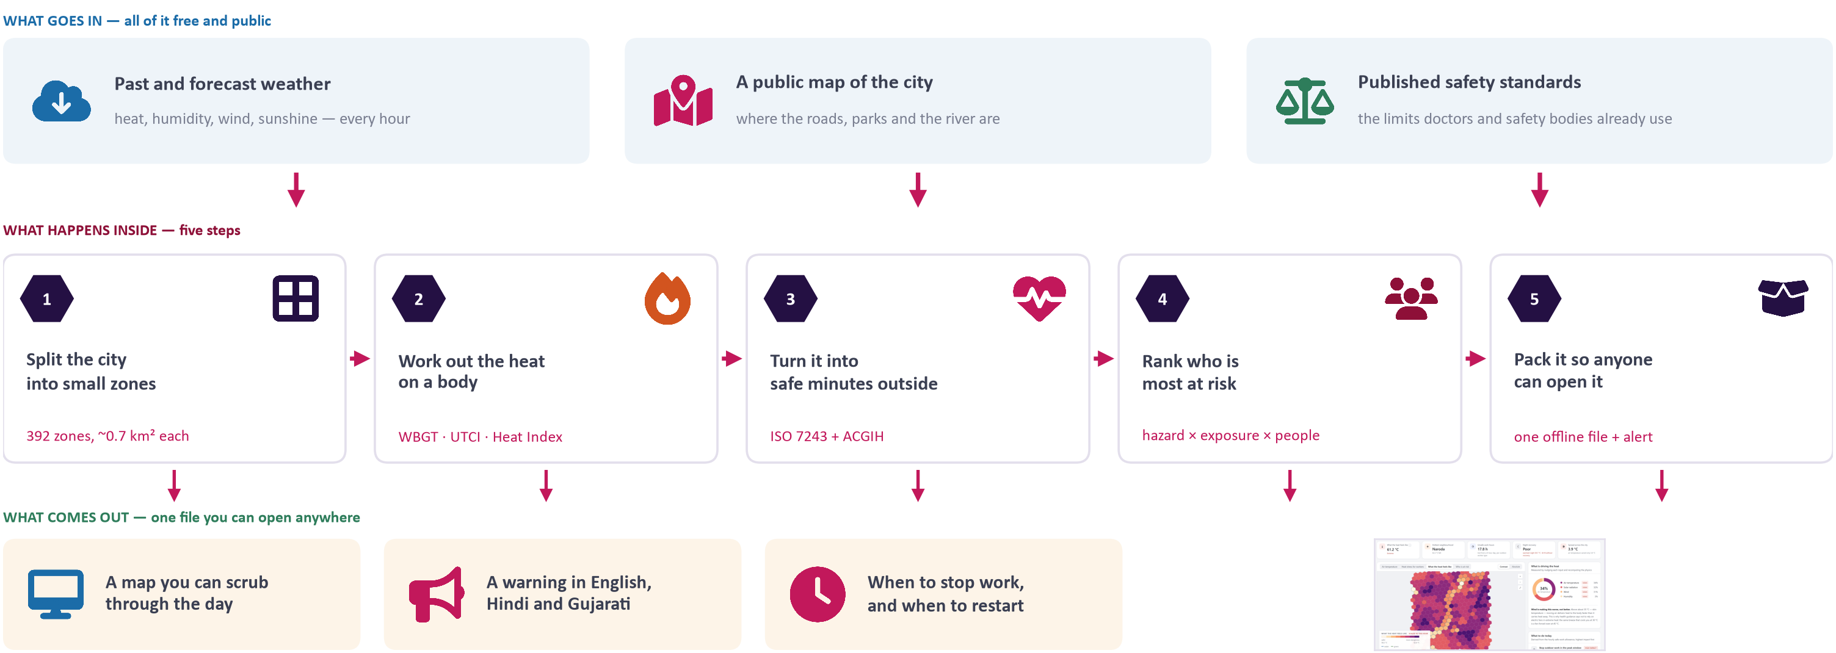
SYSTEM ARCHITECTURE
End-to-End Pipeline: Ingestion, Compute, API & Dissemination
A high-throughput, offline-resilient microservice architecture engineered for zero internet failure modes.
INGESTION
Open-Meteo ERA5 & 5-Day Forecast API (Free, Global, No Paywalls)
PHYSICS CORE
Vectorized NumPy 3.12 Engine (392 Zones × 24h computed in <1.8s)
API BACKEND
FastAPI Daemon with Async Background Cache & Zero Lock Contention
BROADCAST
Offline Single-File HTML / SVG Map + OASIS CAP 1.2 XML for NDMA SACHET
HEATBLAST / HEATLENS · Hyperlocal Human Thermal Stress Architecture · SIH 2026
07 / 10

Slide 8
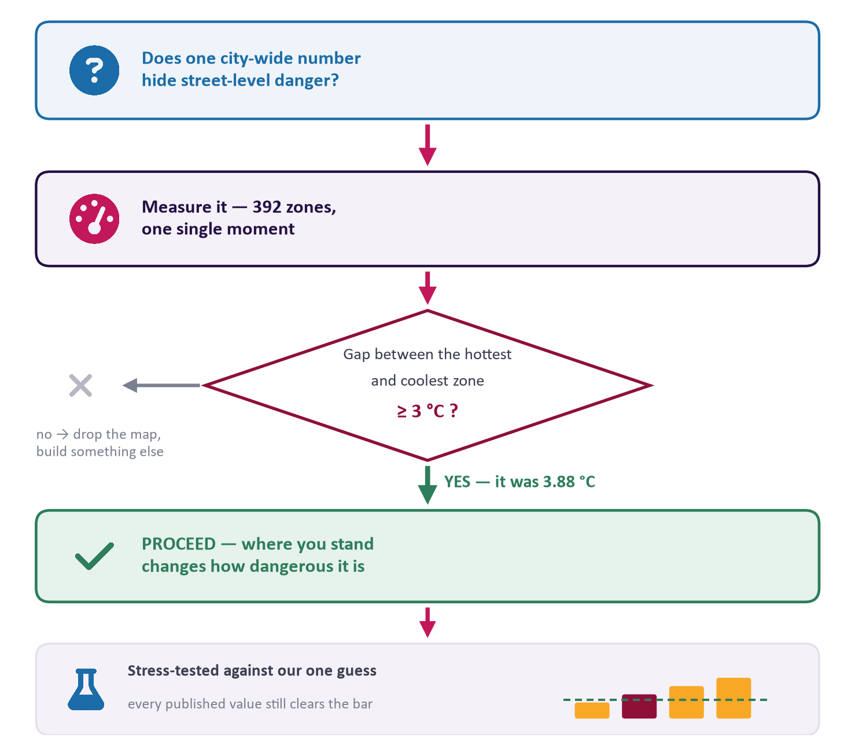
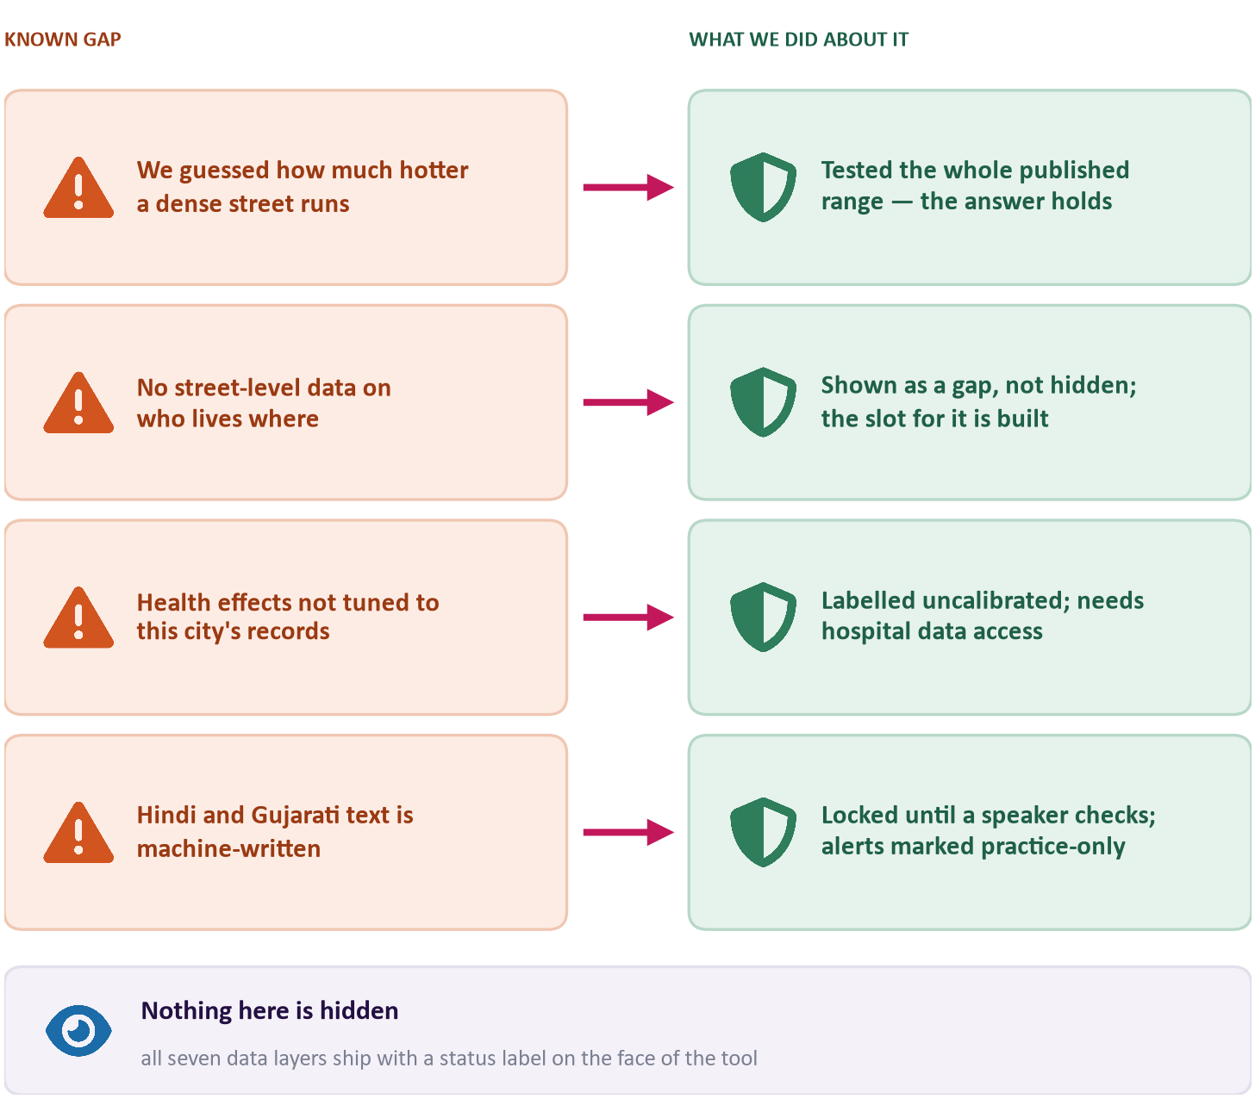
SCIENTIFIC RIGOUR
The Kill-Gate: Scientific Feasibility & Sensitivity Stress Testing
Before building software, we rigorously tested whether neighbourhood-level differentiation holds true.
HEATBLAST / HEATLENS · Hyperlocal Human Thermal Stress Architecture · SIH 2026
08 / 10

Slide 9
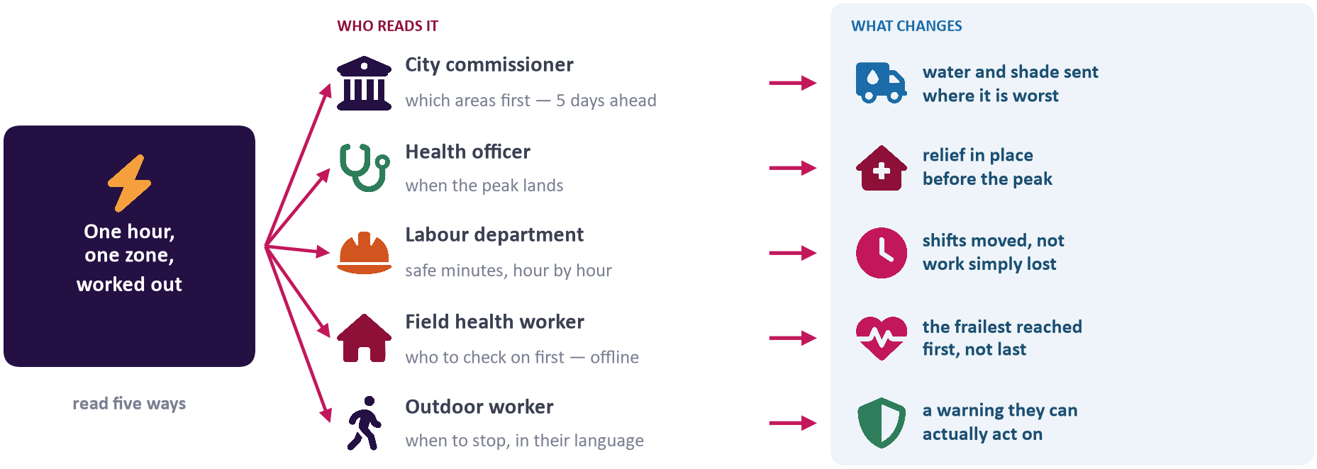
ACTIONABLE IMPACT
From Data to Lives Saved: Multi-Stakeholder Action Matrix
Assigning direct, owner-specific operational playbooks 3 to 5 days before peak thermal strain hits.
Municipal Commissioners
5-Day Spatial Lead: Prioritize emergency water tankers, install high-capacity shaded cooling corridors, and position mobile medical vans in ranked high-risk zones.
Health Officers & Hospitals
Prevent Surge Overload: Pre-stock intravenous fluids and ORS at Urban Primary Health Centres (UPHCs). Brief medical staff on heat-stroke triage 72h prior to peak.
Why Role-Specific Warnings Transform Outbreak Management
• Actionable Directives: A public announcement of 'Drink water' does not protect a bricklayer on a scaffolding. Specific minutes-per-hour allowances give workers and site supervisors clear limits.
• Lead Time Mobilization: Municipal water tankers and mobile hydration stations require 72 to 120 hours of logistics lead time to position effectively in informal settlements.
• Medical Triage Pre-emption: Urban Primary Health Centres (UPHCs) receive expected heat-stroke casualty projections based on neighbourhood vulnerability scores, avoiding ER overcrowding.
Labour Departments
Legally Enforceable Hours: Mandate work cessation during peak solar hours (11:00–16:00). Authorize morning and twilight split shifts to protect informal outdoor labour wages.
Power Grid / DISCOMs
Prevent Grid Cascade: Model hyper-localized cooling demand curves to pre-empt transformer overheating and prevent power outages during dangerous heatwave peaks.
HEATBLAST / HEATLENS · Hyperlocal Human Thermal Stress Architecture · SIH 2026
09 / 10

Slide 10
IMPLEMENTATION & SCALE
Production Readiness, Provenance & National Deployment
Honest data provenance, zero vendor lock-in, and a clear scaling roadmap for Indian cities.
Honest Data Provenance
Every layer explicitly declared in UI metadata:
• Measured Layers: ERA5 atmospheric inputs, OpenStreetMap urban form, and ECMWF thermofeel thermal stress.
• Published Standards: ISO 7243 metabolic limits & ACGIH work/rest guidelines.
• Explicit Assumptions: Assumed 3.0 °C UHI amplitude stress-tested via sensitivity sweep.
• Zero AI Black-Boxes: No synthetic hallucinations; pure, auditable physical bioclimatology.
Deployment Verification
Built, tested, and operational today:
• 135 Unit Tests: 100% test pass rate across psychrometrics, solar geometries, and indices.
• Operational API: FastAPI 0.141 backend actively running and serving live forecast endpoints.
• Zero Cloud Dependency: Entire frontend bundles to a single self-contained offline HTML file.
• NDMA SACHET Ready: Native OASIS CAP 1.2 XML generator for nationwide mobile emergency broadcast.
National Scaling Roadmap
Phased expansion across Indian metros:
• Phase 1 (Pilot): Ahmedabad operational validation (392 zones, complete historical hindcast).
• Phase 2 (Corridor): Expansion to Northern heat corridors: Delhi NCR, Lucknow, Nagpur, and Hyderabad.
• Phase 3 (Satellite): Integration of Sentinel-3 / Landsat Land Surface Temperature (LST) tiles.
• Phase 4 (NDMA Interconnect): Automated feeds into State Disaster Management Authority (SDMA) dashboards.
MISSION: Equipping Indian cities with medical-grade, hyperlocal heat warnings that tell vulnerable citizens and authorities exactly when, where, and how to act.
HEATBLAST / HEATLENS · Hyperlocal Human Thermal Stress Architecture · SIH 2026
10 / 10

