Slide 1

Recipe Data Analysis with Spoonacular API
Conway Yao
General Assembly
DC-DAT-9
Fall 2015

Slide 2
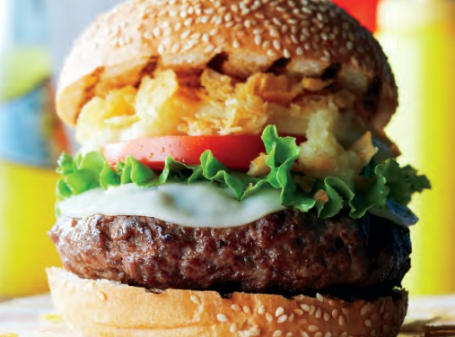
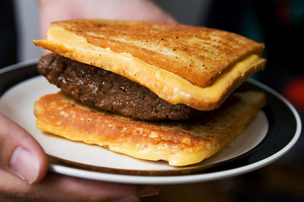
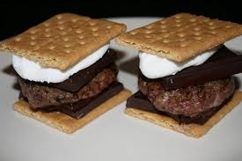
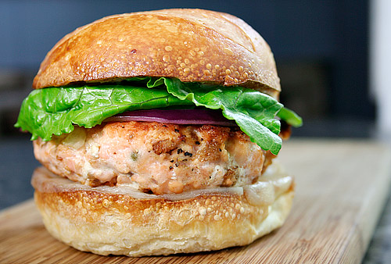
Question One
What are the most common ingredients across recipes for popular foods like burgers, pastas, and pizzas?
Given a set of ingredients, which foods can we make?
Gather
Parse
Visualize and analyze
Score each recipe’s similarity to other recipes
Predict food for a new set of ingredients

Slide 3

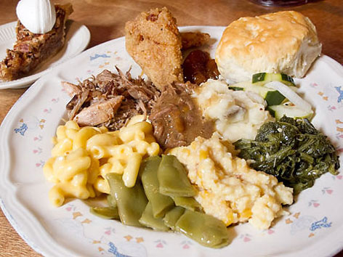
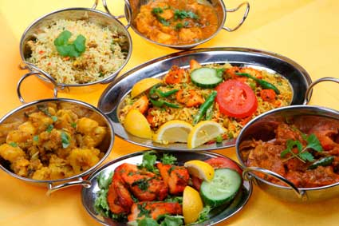
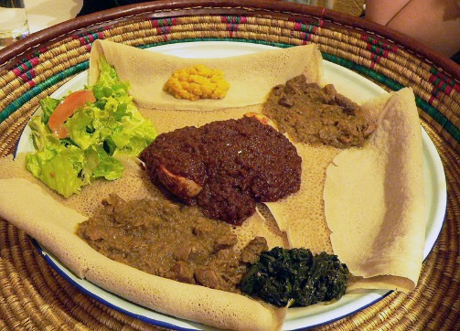
Question Two
Which ingredients are most indicative of a particular cuisine?
Given a set of ingredients, which cuisine’s foods can we make?
Gather
Parse
Visualize and analyze
Score each recipe’s similarity to other recipes within the cuisine
Predict cuisine for a new set of ingredients

Slide 4
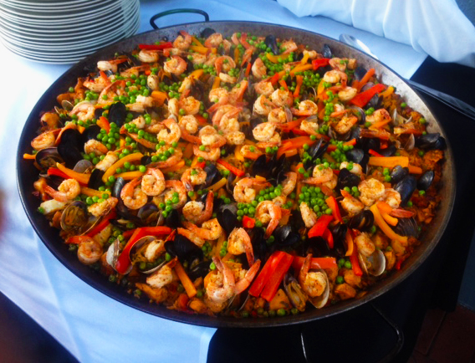
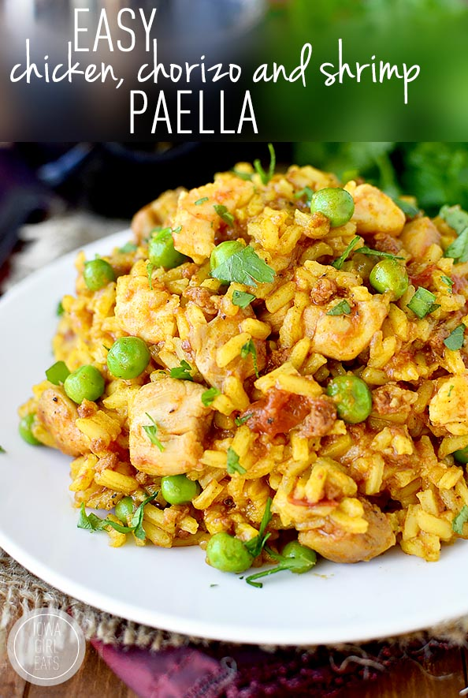
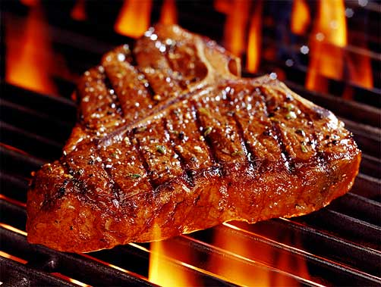
Question Three
Can we predict user ratings for a recipe based on the recipe’s complexity (by number of unique ingredients)?
Gather
Parse
Count ingredients
Regression modeling
Visualize
Vs.

Slide 5

Methods
Several APIs:
Food2Fork: 1m recipes, 500 free calls/day
Yummly: academic plan w/30k lifetime calls
BigOven: 350k recipes, $99/month
Edamam: 1.5m recipes, 1000 free calls total
Spoonacular: 350k recipes
Search recipes by keyword, cuisine, ingredient, or nutrition
Extract recipe from another site
Parse ingredients
Cons: no instructions, limited pricing information, very weak recipe scoring
Limited adoption of hRecipe microformat

Slide 6
Progress
Switched from Python 3.4 to 2.7
Learned how to query Spoonacular’s UniREST API
Wrote scripts to call API for Q1 and Q2
Stored Q1 and Q2 data as DataFrames
Sifting through resultant parsed ingredients to determine efficacy of Spoonacular’s natural-language ingredient parser
Collect and assess reliability of user ratings across different APIs (not just Spoonacular’s)
Tackle Q3
Write scoring and prediction engines for Q1 and Q2

