Slide 1
FEASIBILITY ASSESSMENT
Which New Online Program Should
Vanderbilt Launch Next
A Data-Driven Program Viability Assessment
Prepared for the Office of the Deputy Provost,
Office of Professional Education, and Office of Learning Innovation
August 2026
Independent portfolio project modeled on a real Vanderbilt University Office of the Deputy Provost job posting. Not commissioned by, conducted for, or reviewed by Vanderbilt University; does not represent an official Vanderbilt position or work product.

Slide 2
01
Move all five finalists into program-development review this cycle
Data Science, Applied Informatics, Quantitative Economics, Business Analytics, and Information Science all clear the same three checks.
Employer demand, national student demand, and a real gap in Vanderbilt's current online catalog — in that score order.
One field, Management Science, scored higher on paper but was set aside.
Its labor-demand number is inflated by a single job category broad enough to inflate several unrelated fields the same way. Detail on slide 09.
From here, the work is operational.
Two naming decisions, five school placements, and one competitive scan this assessment doesn't yet cover, all on slide 11.

Slide 3
02
Vanderbilt's online catalog is concentrated in three areas. This assessment covers everywhere else.
Vanderbilt's online and professional portfolio has grown quickly, almost entirely in three areas: education (Peabody College), computing and AI (College of Connected Computing), and nursing. Today's online catalog: 15 degree programs (11 master's, 4 doctoral) plus 12 standalone certificates.
This assessment answers three questions:
Which fields outside Vanderbilt's current online footprint show real, measurable national demand?
Do employers show sustained hiring demand for graduates in that field?
Are enough students nationally already completing degrees in it to suggest a real audience?
Every field considered is measured the same way: national labor projections (BLS) and national completions data (IPEDS¹) against the same criteria.
1. IPEDS — the Integrated Postsecondary Education Data System, the U.S. Department of Education's database of national degree completions.

Slide 4
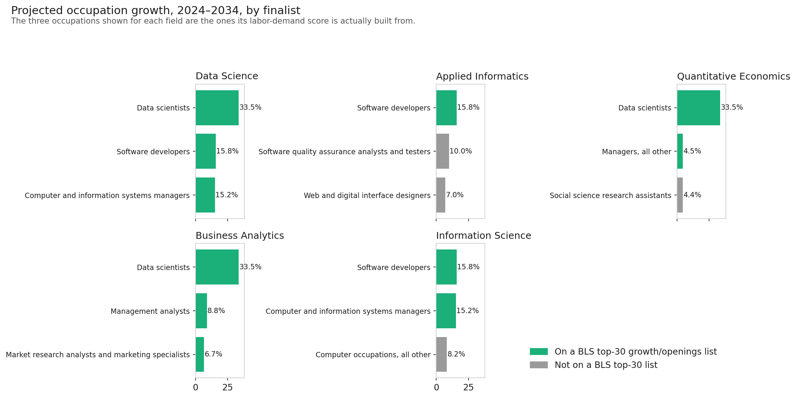
03
Employers are already hiring for all five fields, and the growth is concentrated
Data scientists are projected to grow 33.5% between 2024 and 2034. Information security analysts and medical and health services managers show up on the same federal list of fastest-growing occupations.
The three occupations (SOC¹ codes) behind each finalist's labor-demand score. Green = also on BLS's own fastest-growing / highest-volume lists.
1. SOC — Standard Occupational Classification, the federal system used to identify occupations. Source: U.S. Bureau of Labor Statistics, Employment Projections 2024–2034.

Slide 5
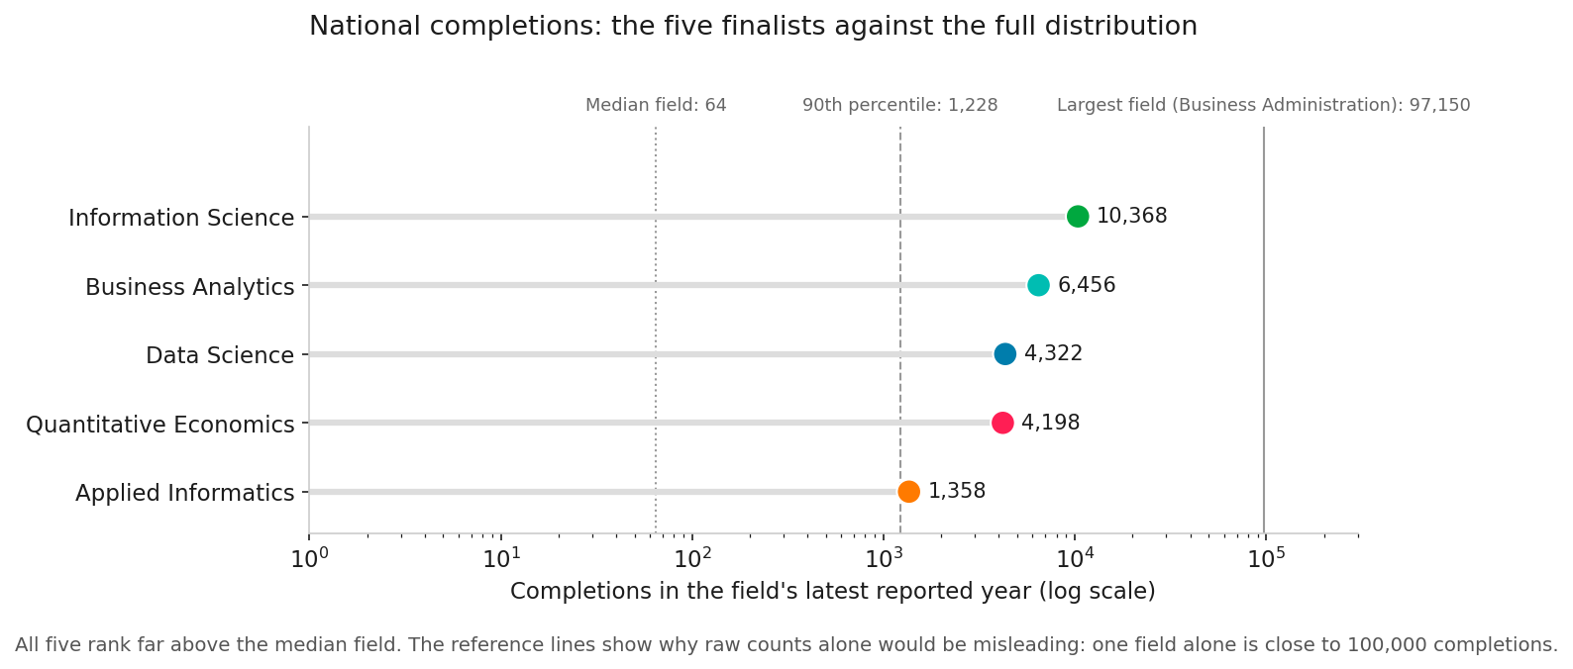
04
On a percentile basis, Data Science already outpaces 96% of all fields scored
A handful of catch-all fields dominate raw enrollment counts — General Business Administration alone runs close to 100,000 completions a year. Ranking on percentile rank¹ instead of raw counts keeps outsized fields from swamping the comparison.
All five sit far above the median field. Data Science and Business Analytics show only 5 years of history, not 13 — both were only added to the federal CIP² system in 2020.
1. Percentile rank — a field's standing against all 1,268 fields scored; 90th percentile beat 90 of every 100.
2. CIP — Classification of Instructional Programs, the federal code used to identify a field of study.

Slide 6
05
None of the five finalists overlaps a program Vanderbilt already teaches online
Vanderbilt's current 15-program online catalog, by school
Vanderbilt's 15 online degree programs cluster into three schools, with four more spread one apiece elsewhere. All five finalists sit outside every one of these areas.

Slide 7
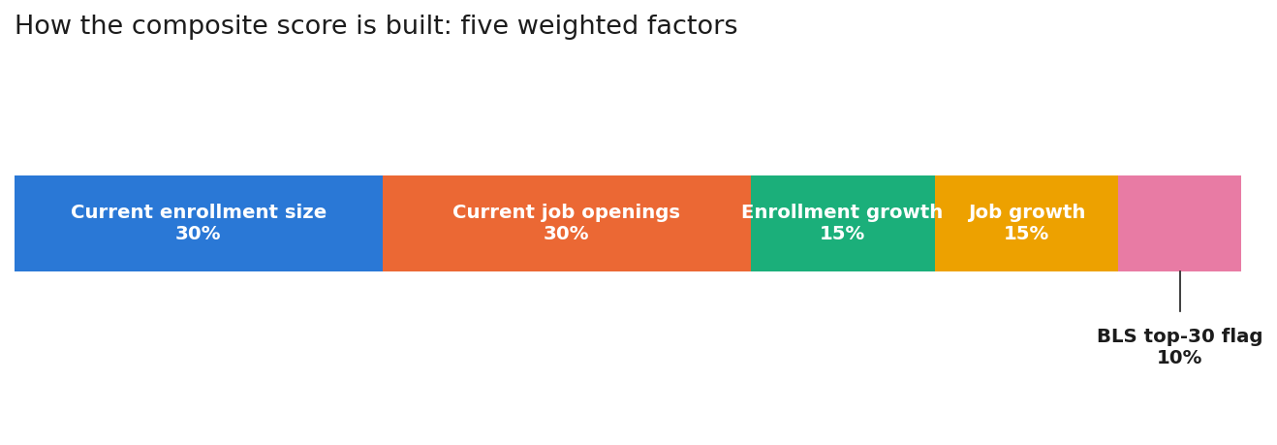
06
Every field is scored on five weighted factors, then sorted into Go, Test, or Pass
The five weighted factors behind every composite score¹. Current size (enrollment, job openings) counts most; growth counts less, since a small base can swing hard.
GO ≥ 75.3
126 fields — all five finalists land here
TEST 45.7 – 75.2
502 fields — worth a second look later
PASS < 45.7
626 fields — no near-term action
1. Composite score — the single 0–100 number blending all five weighted factors. Go / Test / Pass — the three tiers every field is sorted into by that score.

Slide 8
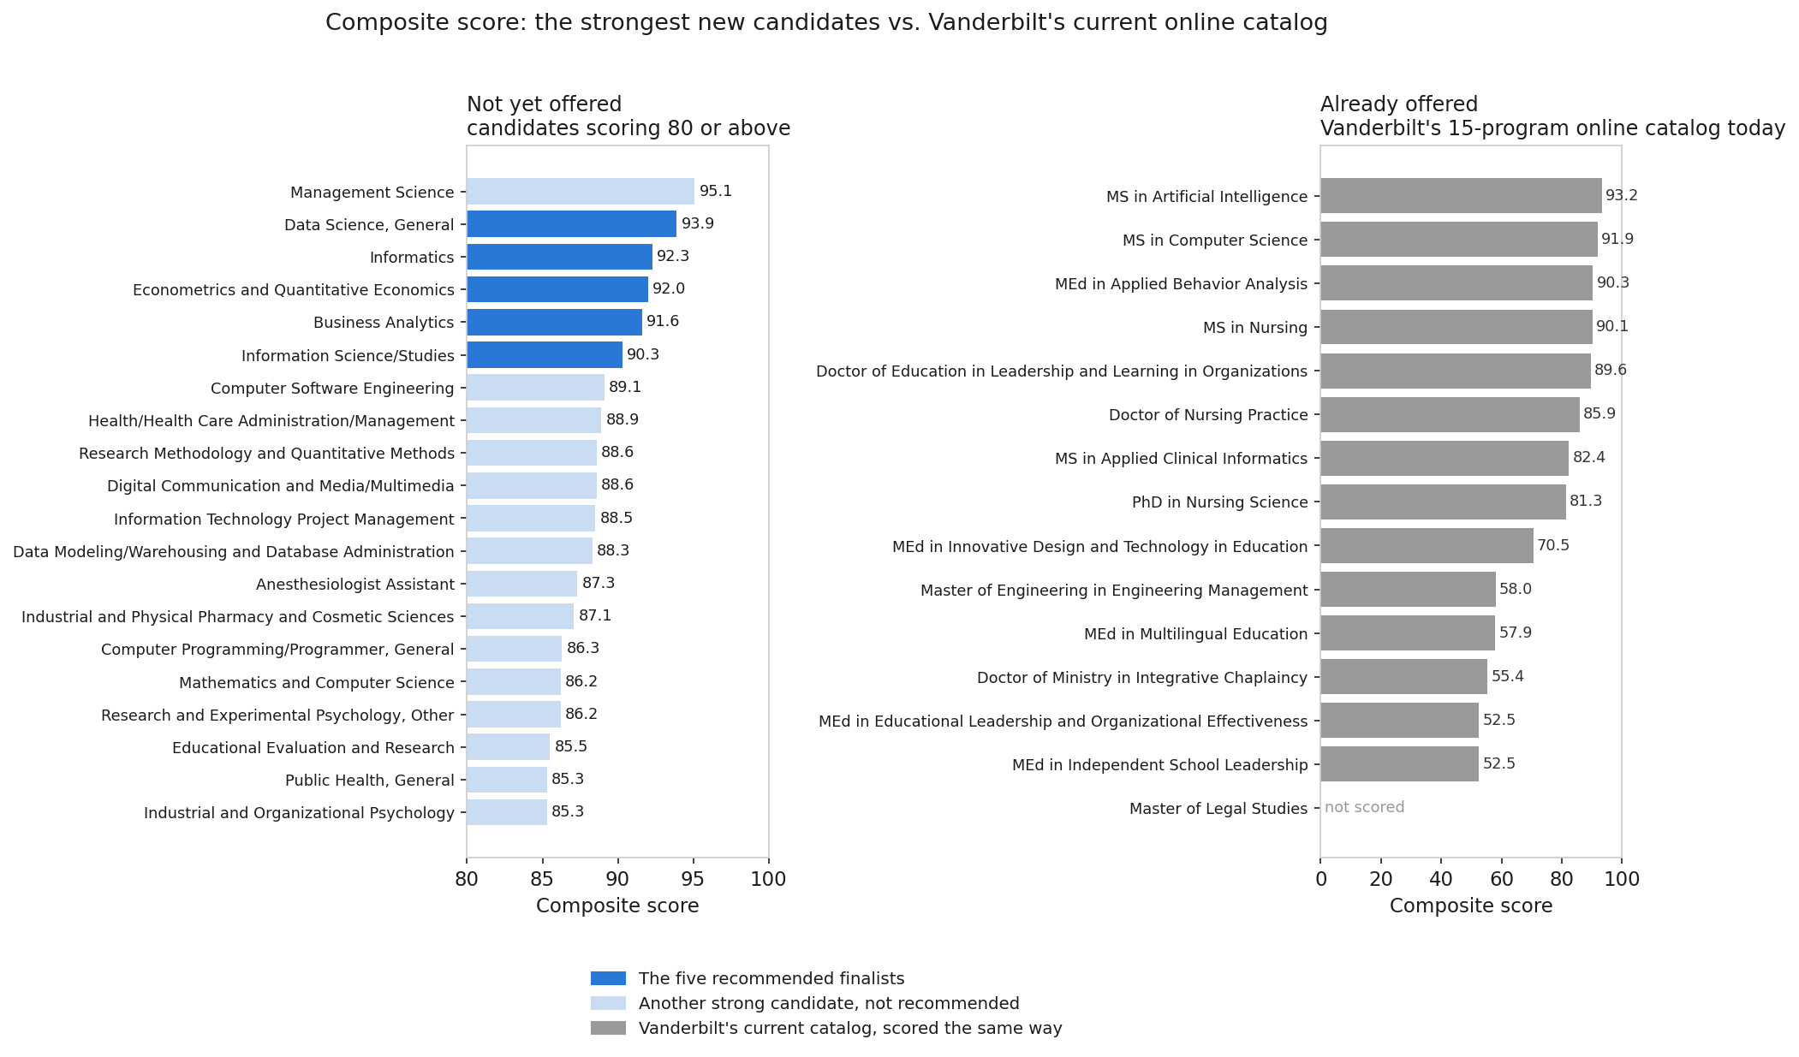
07
Five programs, ranked, none of them already in Vanderbilt's catalog
Field | Proposed Program Name | Score
Data Science | M.S. in Data Science | 93.9
Informatics | M.S. in Applied Informatics | 92.3
Econometrics & Quant. Economics | M.S. in Quantitative Economics | 92.0
Business Analytics | M.S. in Business Analytics | 91.6
Information Science | M.S. in Information Science | 90.3
1. Cluster — near-duplicate program codes representing the same real degree, collapsed into one ranked option; 126 raw Go-tier fields become 61 distinct choices this way.
2. Master of Legal Studies is coded at the CIP family level in Vanderbilt's official mapping, so it can't be matched to a scored row — shown as not scored.

Slide 9
08
Management Science scored highest of all 1,268 fields — and was set aside anyway
Its job-openings number is inflated by one broad occupation, “General and Operations Managers,” which inflates seven other unrelated fields the same way.
That occupation code is common enough across job categories that it isn't a reliable signal for any one field. Management Science was set aside because its top-line number doesn't reflect real demand for that specific degree.
95.1
highest of 1,268
fields evaluated

Slide 10
09
Two finalists share a name with an existing Vanderbilt program — neither is disqualifying
Data Science
Quantitative Economics
Vanderbilt's Data Science Institute already runs an on-campus master's under this exact name. That program is in-person only. Computer Science already runs online and on-campus under one name with separate admissions, so there's a direct precedent for this exact setup.
A closer call. Arts and Science's existing master's in Economics is filed under the exact same federal program code. Both programs are in-person only, and “Quantitative” is the word the classification uses to tell the two apart. This one needs a direct sign-off from the department before the name goes public.

Slide 11
10
Three moves get this from analysis to action
Next Steps
Limitations
Resolve the two naming questions.
Both need a decision before either program name goes public.
Every signal here is public, secondary data — no surveys or interviews with students, employers, or academic staff.
Labor demand reaches each field through a many-to-many crosswalk: about 3 occupations per field on average, up to 180 in extreme cases.
Wage isn't scored — median pay exists for only 60 of 832 occupations, too sparse to weight reliably.
Map each finalist to a school.
Identify who would house it and where faculty or coursework could be shared.
Research the competition.
Price, format, and enrollment at peer institutions — not yet covered here.
The companion feasibility report and interactive Tableau dashboard cover the full methodology, every limitation, and the underlying data sources in detail.

