Slide 1
Text data deanonymization
Sanjay Chari PES1201700278
Nishanth Shastry PES1201700115
UE17CS333 project submission

Slide 2
About the project
The objective of the project is to classify a given instance of textual data as originating from a known host, using natural language processing, along with machine learning and deep learning models.
The use case of this software could be :
Investigating Cyber Crime : Illegal conversations made over the dark web are performed under anonymity. In such cases, a classifier with good accuracy and training data could correctly identify the origin of the conversations.
Blocking a user based on malicious posts : Users who post hate speech on social media under the façade of anonymity can be tracked and blocked.

Slide 3
Uniqueness and analysis
Most of the research done in the domain of deanonymisation deal with the Computer Networks aspect of the work. This includes graph theory and network security implementations
We decided to experiment with a different approach, by utilizing Natural Language Processing instead of traditional methodology for this task.
We perform analysis on the most popular bigrams related to a given Twitter profile, in addition to using machine learning(Naïve Bayes, Logistic Regression, Stochastic Gradient Descent) and deep learning methods(Neural Network, Hybrid Model) to identify the source of a given instance of textual data.

Slide 4
Dataset source and preprocessing done
1. Dataset Source : https://drive.google.com/drive/folders/11w4geFB6p17hFlWseBpHJQbhARINvTOc
2. Preprocessing :
This dataset consists of 50 folders, with each folder containing 4 files : tweets.csv, images.csv, videos.csv, and analysis.pdf. Each folder represents a unique twitter profile. These are the top 50 most popular twitter profiles.
Since we are interested in the NLP aspect of the dataset, we combined all the data from tweets.csv into one single file dataset.csv, with the label for a given tweet as the twitter handle that posted the tweet.
In addition to the above steps, we performed the traditional pre processing steps involved in Natural Language Processing, namely lowercase conversion, followed by tokenization, followed by removal of stopwards, and lemmatization.

Slide 5
Literature Review
Serial Number | Paper and Conference | Authors | Summary
1 | De-anonymizing Web Browsing Data with Social Networks, 2017 ACM. ISBN TDB. | Jessica Su Stanford University jtysu@stanford.edu, Ansh Shukla Stanford University anshukla@stanford.edu, Sharad Goel Stanford University scgoel@stanford.edu, Arvind Narayanan Princeton University, arvindn@cs.princeton.edu | Each person has a distinctive social network, and thus the set of links appearing in one’s feed is unique. Assuming users visit links in their feed with higher probability than a random user, browsing histories contain tell-tale marks of identity. They formalize this intuition by specifying a model of web browsing behavior and then deriving the maximum likelihood estimate of a user’s social profile.
2 | Fast De-anonymization of Social Networks with Structural Information. Data Sci. Eng. 4, 76–92 (2019 | Shao, Y., Liu, J., Shi, S. et al. | They propose a fast and effective seedless network de-anonymization approach simply relying on structural information, named RoleMatch. RoleMatch equips with a new pairwise node similarity measure and an efficient node matching algorithm.

Slide 6
LITERATURE REVIEW
Serial Number | Paper and Conference | Authors | Summary
3 | Optimal Active Social Network De-anonymization Using Information Thresholds | F. Shirani, S. Garg, E. Erkip | In this problem, an anonymous victim visits the attacker's website, and the attacker uses the victim's browser history to query her social media activity for the purpose of de-anonymization using the minimum number of queries. A stochastic model of the problem is considered where the attacker has partial prior knowledge of the group membership graph and receives noisy responses to its real-time queries.
4 | De-identification in Natural Language Processing | Veronika Vincze, Richard Farkas | They discuss the questions of de-identification related to three NLP areas, namely, clinical NLP, NLP for social media and information extraction from resumes. They also illustrate how de-identification is related to named entity recognition and we argue that de-identification tools can be successfully built on named entity recognizers.

Slide 7
LITERATURE REVIEW
Serial Number | Paper and Conference | Authors | Summary
5 | An introduction to NLP-based textual anonymisation | Ben Madlock | They introduce the problem of automatic textual anonymisation and present a new publicly-available, pseudonymised benchmark corpus of personal email text for the task, dubbed ITAC (Informal Text Anonymisation Corpus). They discuss the method by which the corpus was constructed, and consider some important issues related to the evaluation of textual anonymisation systems. They also present some initial baseline results on the new corpus using a state of the art HMM-based tagger.

Slide 8
Quantity of work - High level block diagram of our implementation
Dataset Preprocessing :
Generating csv file, cleaning tweets using NLP methods
Tweet Analysis :
We analyzed the most common bigrams for each unique twitter profile
Feature Extraction :
Extraction of features from the generated tokens to prepare it for a machine learning model.
Deep Learning Classifiers :
We train a neural network and hybrid model on the features.
Machine Learning Classifiers :
We train the machine learning classifiers on the features.

Slide 9
Quantity of work – the main code modules ( what they do)
Serial no | Code module description | Status (% complete) | What it does ?
1. | Creation of dataset | 100 | Creation of single dataset.csv file from dataset consisting of 50 folders.
2. | Correlation of Unigrams and Bigrams for each user profile | 100 | Displays most correlated unigrams and bigrams for each user profile.
3. | Data Preprocessing | 100 | Lowercasing, Tokenization, Stopword Removal, Lemmatization
4. | Feature Extraction | 100 | Extraction of features from the generated tokens
5. | Machine Learning and Deep Learning Classifiers | 100 | Classifies a post as originating from a given user profile.

Slide 10
Quality of work – Milestones that are done and working
Serial no | Milestone description | Status (% complete) | Comments
1. | Dataset Creation and Refining | 100 | Creation of single dataset.csv file from dataset consisting of 50 folders.
2. | Data Analysis | 100 | Maximum Correlation of Unigrams and Bigrams for each user profile
3. | Data Preprocessing | 100 | Lowercasing, Tokenization, Stopword Removal, Lemmatization
4. | Feature Extraction | 100 | Extraction of features from the generated tokens
5. | Classification | 100 | Classifies a post as originating from a given user profile.

Slide 11
Results Obtained
Most Correlated Unigrams And Bigrams Per user profile :
# 'akshaykumar’:
. Most correlated unigrams: . thebalachallenge . thank .
Most correlated bigrams: . kareenakapoorkhan diljitdosanjh . diljitdosanjh advani_kiara
# 'arianagrande’:
. Most correlated unigrams: . thankunext . love .
Most correlated bigrams: . thank thankunext . love sm
# 'barackobama’:
. Most correlated unigrams: . president . obama .
Most correlated bigrams: . live president . president Obama
…………

Slide 12
RESULTS OBTAINED
Serial Number | Model | Accuracy | Precision | Recall | F1-Score
1 | Logistic Regression | 0.42 | 0.61 | 0.42 | 0.46
2 | Naïve Bayes | 0.40 | 0.66 | 0.40 | 0.44
3 | SGD | 0.39 | 0.55 | 0.39 | 0.42
4 | Word2Vec + Logistic Regression | 0.42 | 0.42 | 0.38 | 0.39
5 | Neural Network | 0.65 | 0.81 | 0.60 | 0.69
6 | Hybrid(NN+SVM) | 0.17 | 0.02 | 1.0 | 0.04

Slide 13
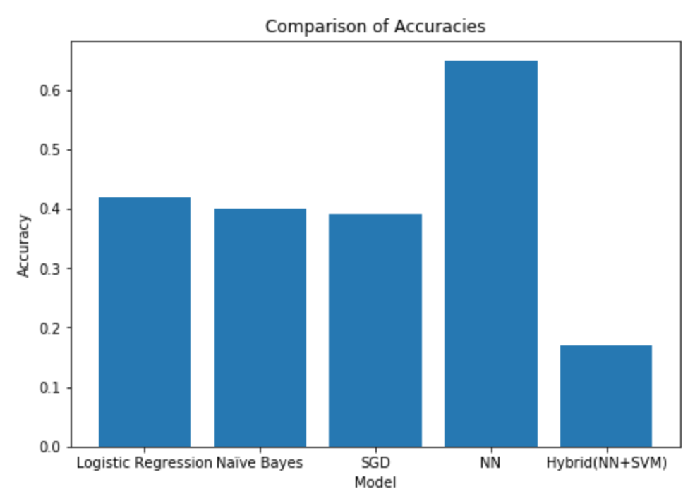
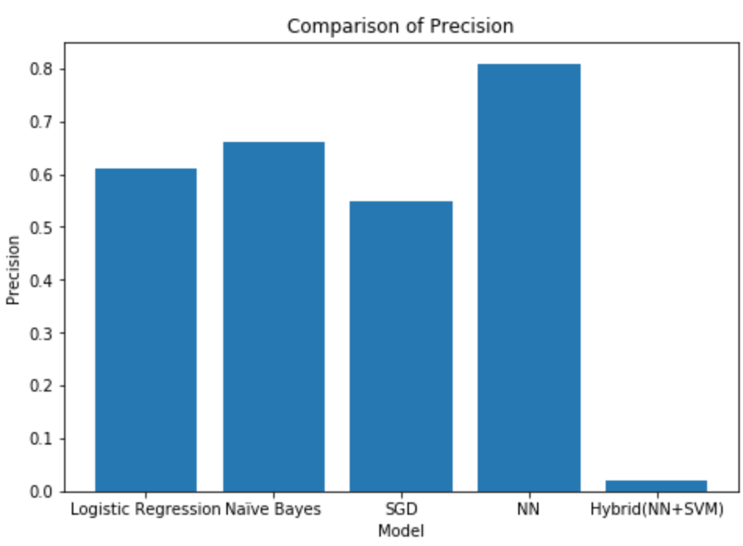
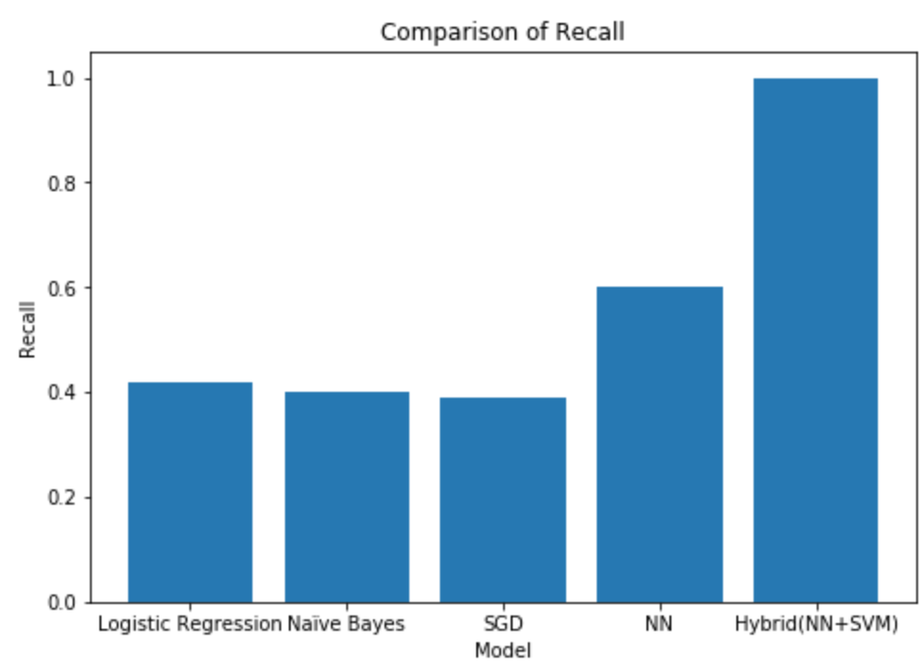
RESULTS OBTAINED

Slide 14
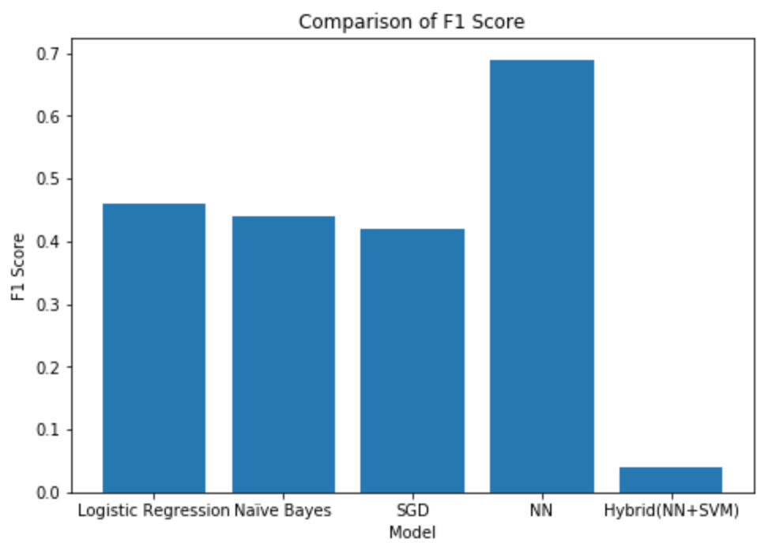
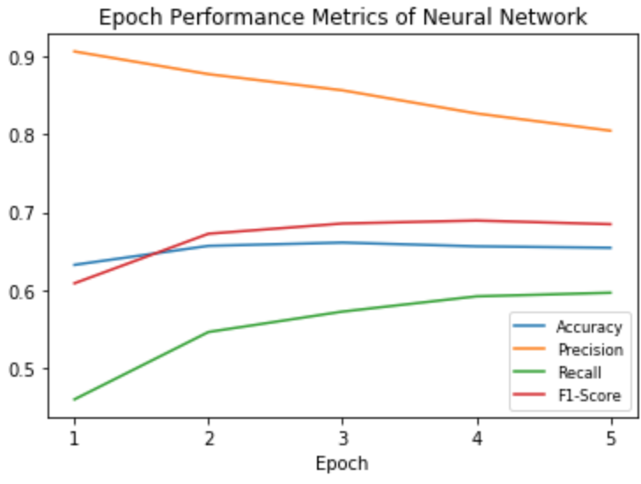
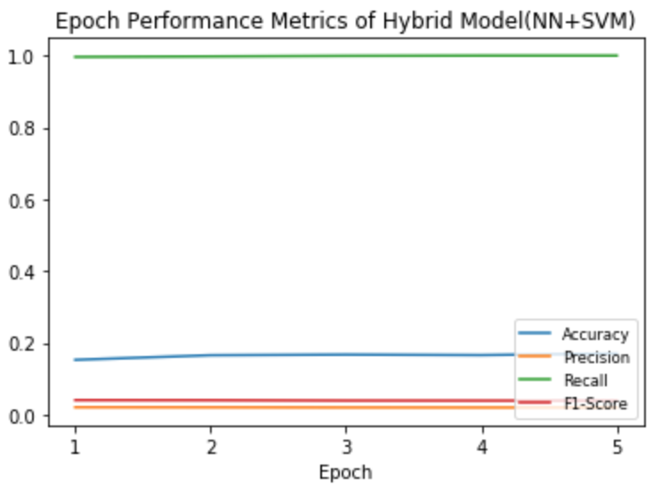
Results obtained

Slide 15
Our top three learning in this project
We learnt how to deal with data that comes in an undesirable format, and extracting information that can be used to build efficient software, using Natural Language Processing techniques.
We learnt the importance of pre processing and feature extraction in building a good classifier model for Natural Language Processing tasks.
We learnt how to deal with issues related to the improvement of the performance metrics of classification models.

Slide 16
Top Challenges unresolved so far
The hybrid model(NN+SVM) reports low accuracy, precision and F1 score.

Slide 17
Our Going forward plan
1. Improvement of the performance metrics of the hybrid model. (NN+SVM)

