Slide 1
Difference between Von Neumann and Harvard Architecture
BY:J PHANI KUMAR

Slide 2
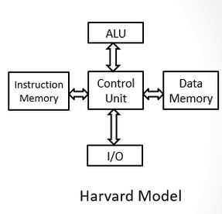
Harvard Architecture
In Harvard architecture, the CPU is connected with both the data memory (RAM) and program memory (ROM), separately.
Harvard Architecture

Slide 3
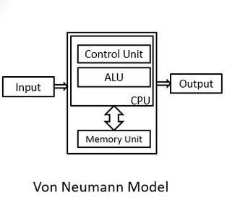
Von Neumann Architecture
In Von-Neumann architecture, there is no separate data and program memory. Instead, a single memory connection is given to the CPU.

Slide 4
HARDWARE COMPONENTS
HARVARD :It requires more hardware since it will be requiring separate data and address bus for each memory.
VON-NEUMANN:In contrast to the Harvard architecture, this requires less hardware since only a common memory needs to be reached.

Slide 5
Space requirements
HARVARD:This requires more space.
Von-Neumann Architecture requires less space.

Slide 6
Speed of execution
HARVARD:Speed of execution is faster because the processor fetches data and instructions simultaneously .
VON-NEUMANN:Speed of execution is slower since it cannot fetch the data and instructions at the same time.

Slide 7
Space usage
HARVARD:It results in wastage of space since if the space is left in the data memory then the instructions memory cannot use the space of the data memory and vice-versa.
VON-NEUMANN:Space is not wasted because the space of the data memory can be utilized by the instructions memory and vice-versa.

Slide 8
Controlling
HARVARD:Controlling becomes complex since data and instructions are to be fetched simultaneously.
VON-NEUMANN:Controlling becomes simpler since either data or instructions are to be fetched at a time.

Slide 9
THANKYOU

