Slide 1
N8N SUMMER SCHOOL '26 · CAPSTONE PROJECT
Smart University
Management Platform
An n8n-powered automation platform for student registration, attendance,
AI-assisted assignment evaluation, results, and certification.
Assignment 3 — Education Domain

Slide 2
Business Context
1
Universities manage thousands of students across multiple programs, making admissions, attendance, assignments, and exams difficult to run manually.
2
Faculty spend valuable time on repetitive admin work — updating records, collecting assignments, publishing grades — instead of teaching and mentoring.
3
The Smart University Management Platform automates the full academic lifecycle end-to-end using n8n, while keeping faculty in control of final decisions.
Smart University Management Platform — n8n Capstone
2

Slide 3
Stakeholders
S
F
A
Students
Faculty
Administrators
Register, mark attendance, submit assignments, receive grades, results, certificates and reminders.
Review AI-generated evaluations, approve or override final grades, receive attendance and performance alerts.
Receive recurring analytics on attendance, results and overall academic performance.
Smart University Management Platform — n8n Capstone
3

Slide 4
Pain Points — Current Manual Process
✕
Attendance tracked manually — hard to spot low-attendance students in time.
✕
Assignment grading is slow and inconsistent across faculty.
✕
Manual result calculation delays publication and risks errors.
✕
Certificates generated and issued manually, often with delays.
✕
No centralized reporting for administrators to track trends.
✕
Inconsistent, easy-to-miss student communication.
Smart University Management Platform — n8n Capstone
4

Slide 5
Objectives
1
Digitize academic administration end-to-end.
2
Automate attendance capture and low-attendance alerts.
3
Use AI to assist faculty in grading — with mandatory human approval.
4
Simplify and speed up result processing and publication.
5
Improve student-faculty communication through automated notifications.
6
Generate recurring academic performance reports for admins.
Smart University Management Platform — n8n Capstone
5

Slide 6
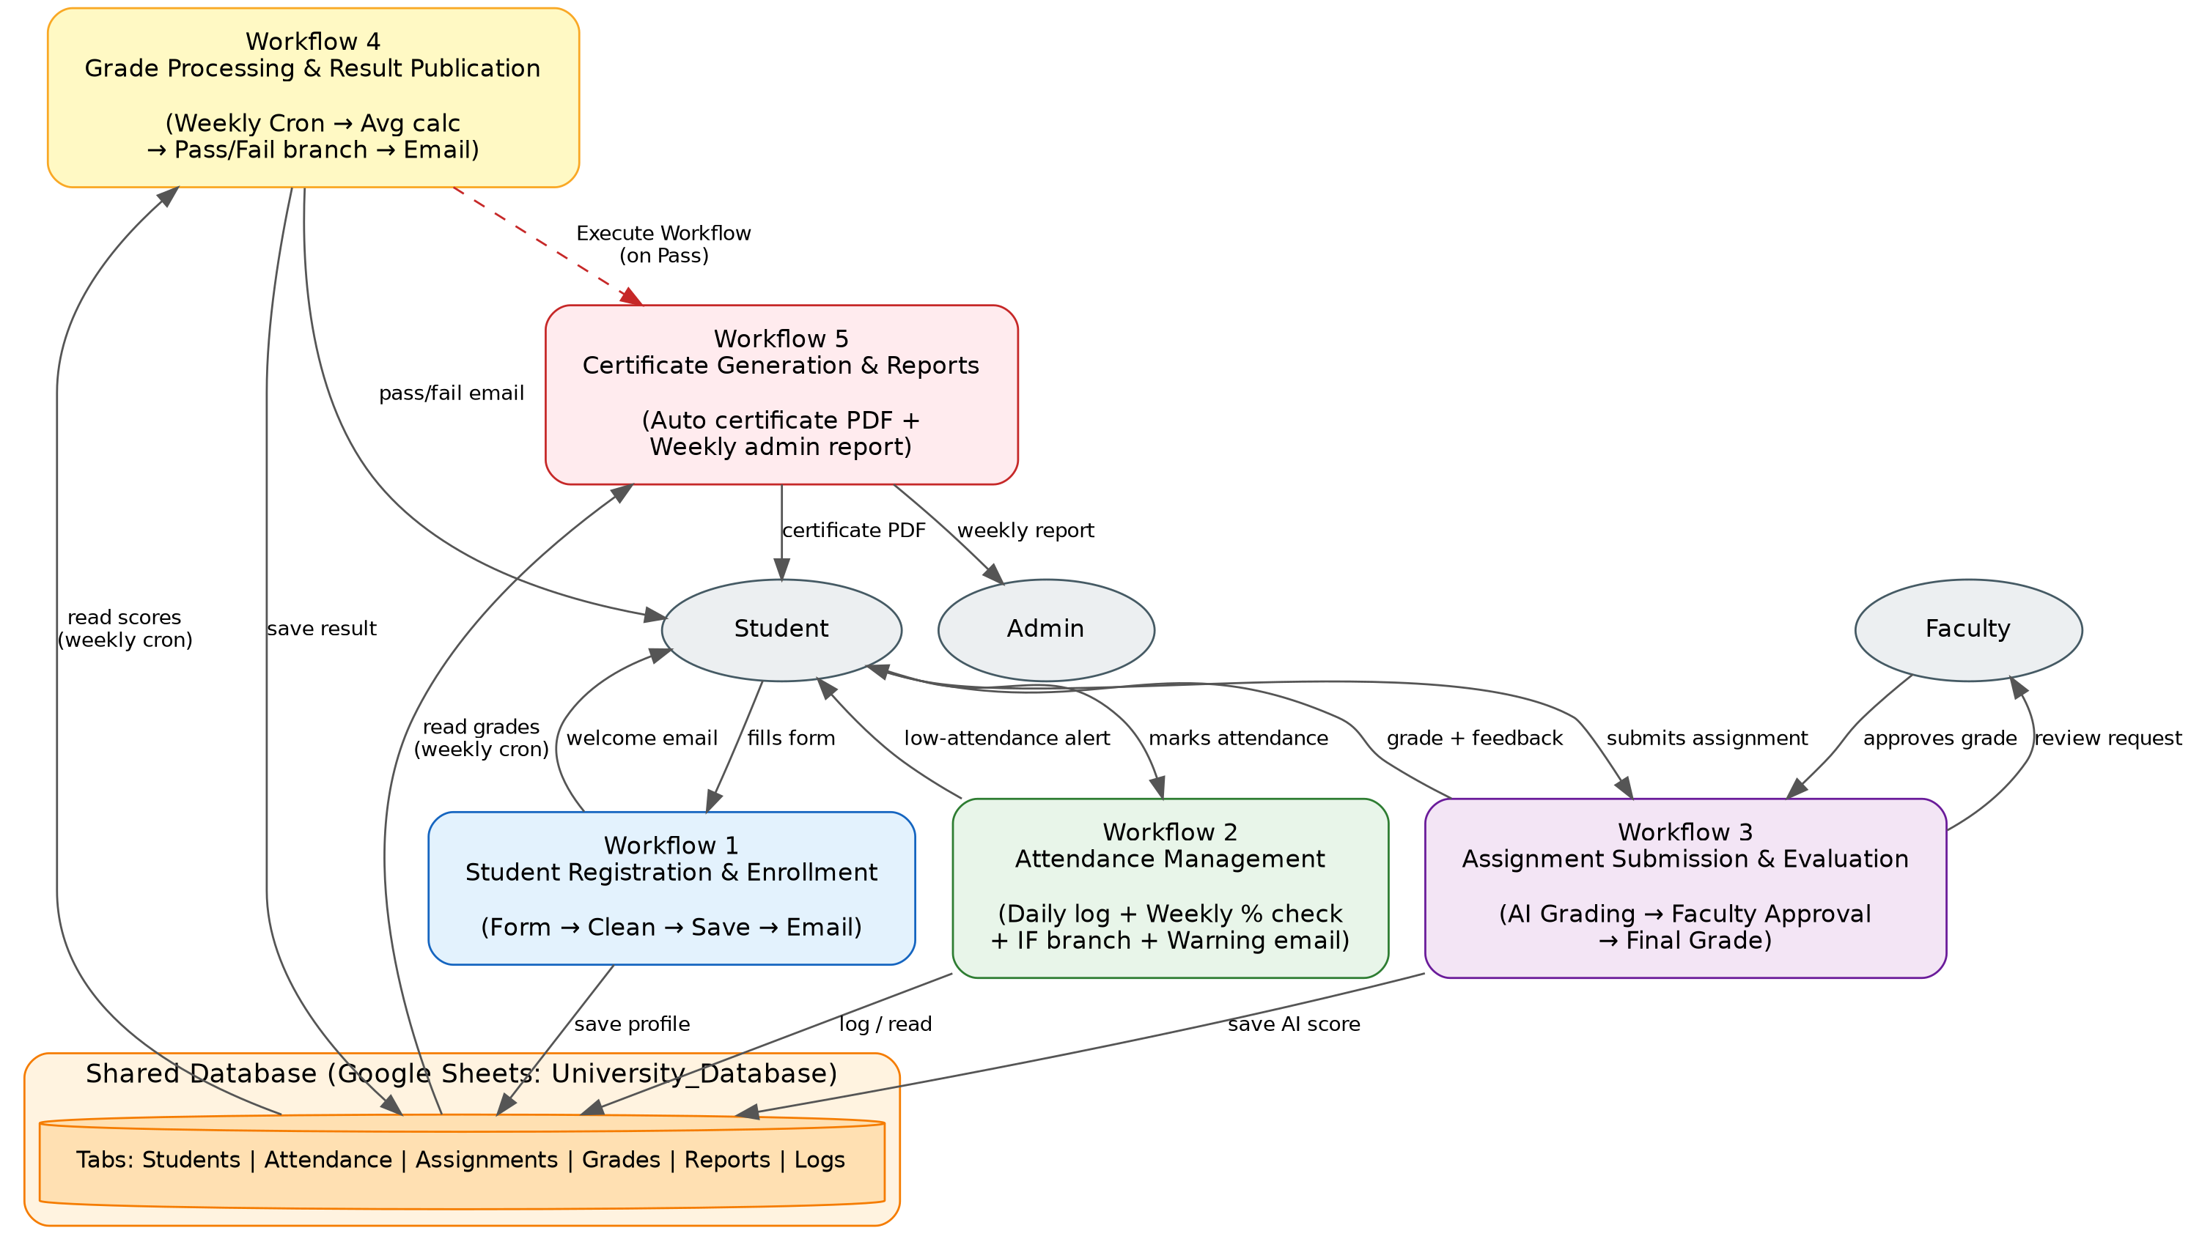
System Architecture — 5 Interconnected Workflows
Smart University Management Platform — n8n Capstone
6

Slide 7
WORKFLOW 1
Student Registration & Enrollment
Captures new student details and onboards them into the central database automatically.
Google Form trigger fires when a student submits registration details
1
Data is cleaned and standardized (Edit Fields node)
2
Row appended to the University_Database → Students sheet
3
Automated welcome email sent via Gmail
4
Smart University Management Platform — n8n Capstone
7

Slide 8
WORKFLOW 2
Attendance Management
Logs daily attendance and proactively flags students at risk of falling below the required threshold.
Daily attendance form logs Present/Absent per student per course
1
Weekly Cron job reads all attendance records
2
Code node calculates each student's attendance percentage
3
IF branch: below 75% → automatic warning email to the student
4
Smart University Management Platform — n8n Capstone
8

Slide 9
WORKFLOW 3
Assignment Submission & Evaluation
The core AI-powered workflow — combines automated grading with mandatory human approval.
1
Student submits assignment link via form; file is downloaded and text extracted
2
AI (Groq / Llama 3.3) evaluates the submission and generates a score + feedback
3
Result saved as 'pending review'; faculty notified by email
4
Faculty approves/overrides the grade via an approval form (human-in-the-loop)
5
Database updated and student notified of their final grade
Smart University Management Platform — n8n Capstone
9

Slide 10
WORKFLOW 4
Grade Processing & Result Publication
Periodically aggregates each student's performance and publishes a final result.
Scheduled (weekly) Cron trigger reads all graded assignments
1
Code node calculates each student's average grade
2
IF branch determines Pass / Fail based on threshold
3
Student is automatically notified of their final result
4
Smart University Management Platform — n8n Capstone
10

Slide 11
WORKFLOW 5
Certificate Generation & Reports
Closes the loop: rewards students who pass and keeps administrators informed.
Certificate Flow
Advanced Features Covered
• Triggered directly by Workflow 4 (Execute Workflow) when a student passes
✓ AI decision-making (Workflows 3 & 4)
✓ Human approval step (Workflow 3 — faculty review)
• Certificate template copied via Google Drive and personalized
✓ Scheduled / Cron workflows (Workflows 2, 4, 5)
• Placeholders replaced (name, course, grade, date) via Google Docs
✓ Webhook & form-triggered workflows (Workflows 2, 3, 5)
✓ Conditional branching (IF nodes — attendance, pass/fail)
• Exported as PDF and emailed to the student
✓ Cross-workflow orchestration (Execute Workflow: 4 → 5)
✓ Logging via central database sheets
Smart University Management Platform — n8n Capstone
11

Slide 12
Expected Outcomes
5
25+
6
Interconnected
Workflows
n8n Nodes
Implemented
Advanced Features
(AI, Human Approval, Cron...)
— Reduced manual administrative workload for faculty and staff
— Faster, more consistent feedback and grading turnaround
— Early, automated detection of attendance and performance issues
— Transparent, auditable academic records maintained automatically
Thank you

