Slide 1
ADOPTADOGGO
TEAM MEMBERS
KHUSHI GUPTA-2210990512
KASHVI SHARMA-2210990499
KESHAV WADHWA-2210990506
NISHTHA TANDON-2210990621
Under the supervision
of
Mr Vikas Patel
Ms Parul
Name of Department/School
Chitkara University, Punjab

Slide 2
Introduction
"Welcome to AdoptaDoggo: Your Ultimate Destination for Adopting Dogs!“
Welcome to AdoptaDoggo, where we believe that every dog deserves a loving home.
At AdoptaDoggo, we're passionate about connecting people with their perfect furry companions while promoting responsible pet ownership.
By adopting from AdoptaDoggo, you're giving a second chance to a dog in need. Each adoption not only changes the life of the dog but also opens up space for another dog to be rescued.

Slide 3
WHY?
User friendly interface: Our website is super easy to use! You can navigate around effortlessly and find your ideal furry friend in no time.
Diverse Selection: At AdoptaDoggo, we have a diverse selection of dogs from various breeds, ages, and backgrounds. Whether you're looking for a playful puppy or a loyal senior companion, we have the perfect match for you.
Support and Guidance: Our dedicated team is here to support you every step of the way, from finding the right dog to providing ongoing guidance and resources for a successful adoption journey.

Slide 4
PROBLEM STATEMENT
In many communities, street dogs face numerous challenges including hunger, disease, and mistreatment. While there are organizations dedicated to rescuing and rehabilitating these dogs, finding suitable adopters can be a significant challenge.
Furthermore, potential adopters often struggle to find reliable resources to facilitate the adoption process.
To address these issues, we aim to develop a website dedicated to street dog adoption using the React framework. The website will serve as a platform to connect rescue organizations, foster homes, and potential adopters, facilitating the adoption process and improving the lives of street dogs.

Slide 5
MOTIVATION OF RESEARCH
Companionship: Dogs provide loyal companionship and can become beloved members of the family.
Alleviating loneliness: Dogs can help alleviate feelings of loneliness and provide emotional support, especially for people living alone or experiencing difficult times.
Saving a life: Adopting from a shelter or rescue organization gives a dog a second chance at a happy life and helps reduce pet overpopulation.

Slide 6
Tools & Technologies
In this we have used :
React: Used for building user interfaces (UIs) for web applications. React allows developers to create reusable UI components and manage the state of these components efficiently.
HTML: It serves as the backbone of web development,providing the structure and content of web pages.
CSS: It is used to control the appearance of html elements,including colors,spaces etc.
JavaScript:Used for adding interactivity and dynamic behavior to web pages.

Slide 7

Why ReactJS Library?
Before the invention of React.js, when performing an action like clicking a button, the entire page would often refresh, causing the entire DOM tree to re-render. With the introduction of the React.js library, this issue was addressed, and now, re-renders occur only when necessary.

Slide 8
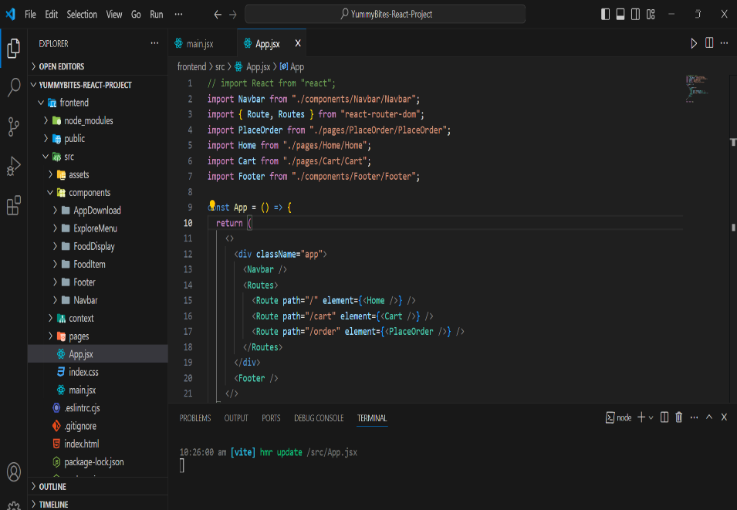
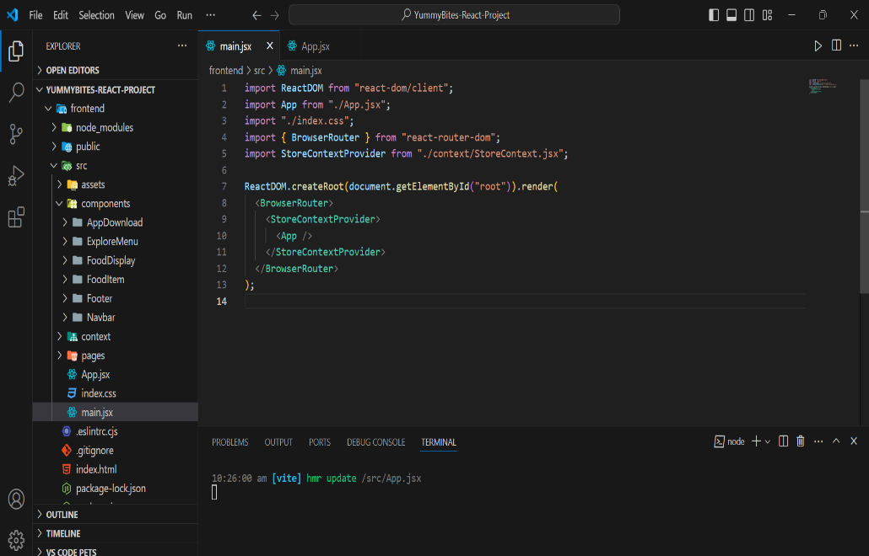
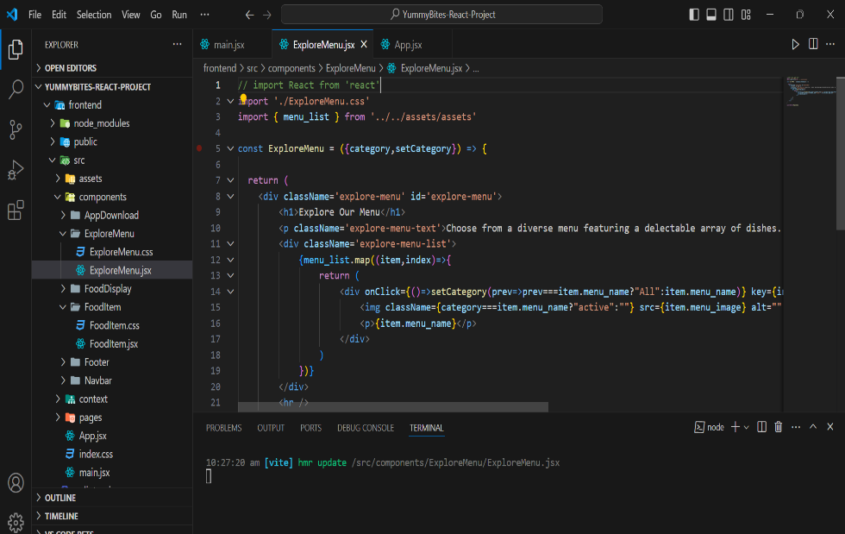
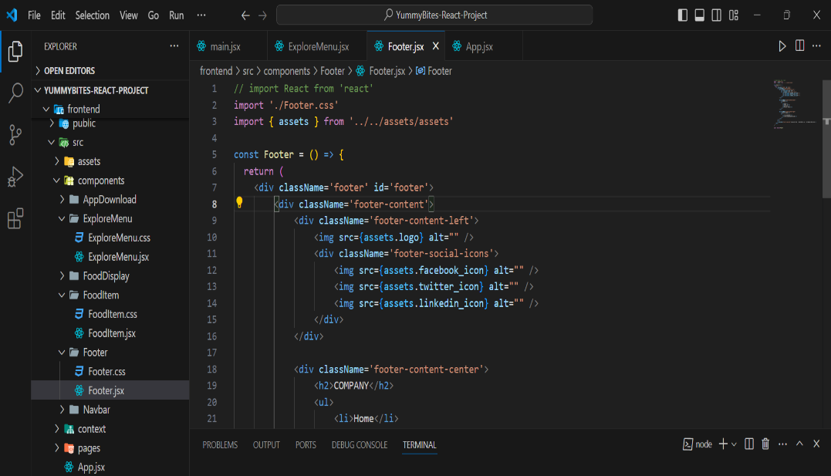
Code Snippets

Slide 9
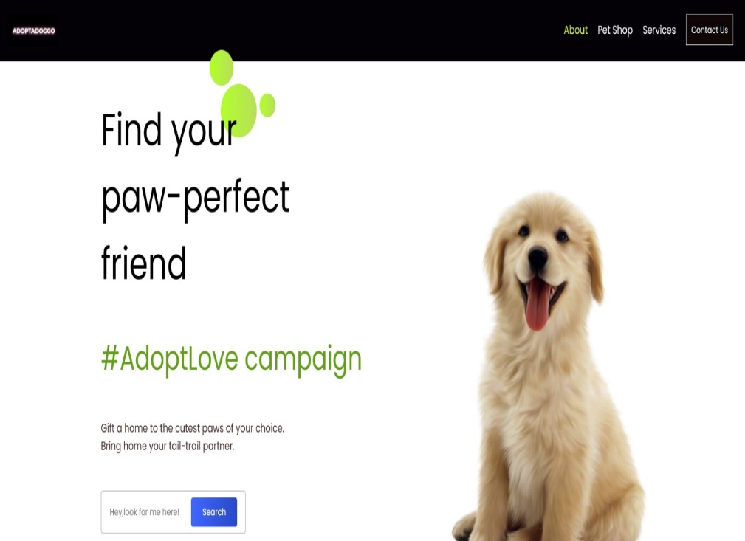
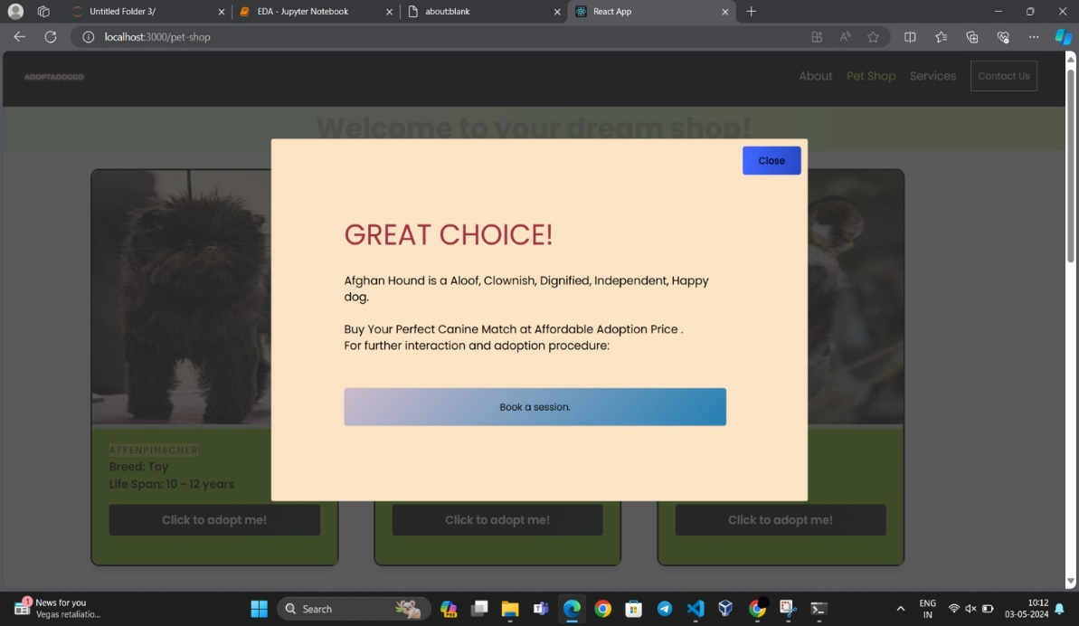
Project Snapshots

Slide 10
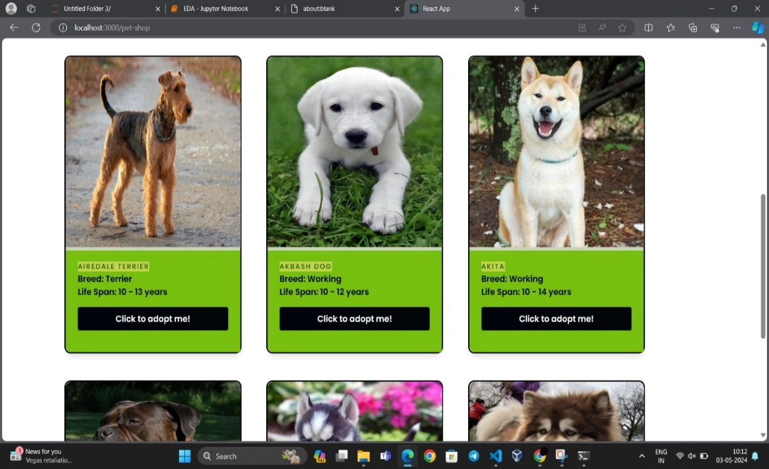
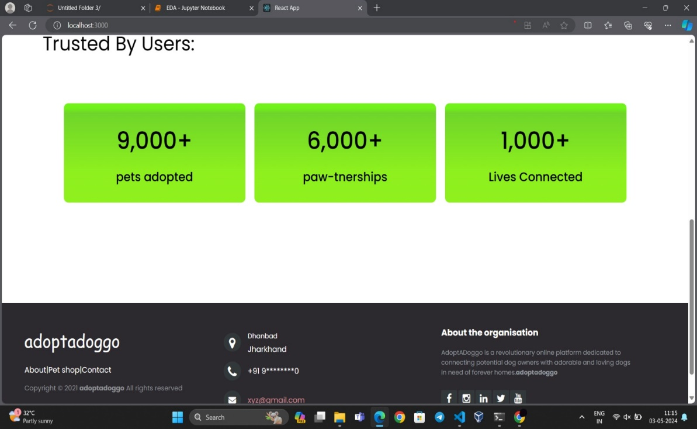
Continued…

Slide 11
Conclusion
In conclusion, our pet adoption website stands as a testament to the power of technology in making a positive impact on the lives of animals and humans alike. Through our platform, we've not only facilitated countless adoptions but also fostered a sense of community among pet lovers, shelters, and volunteers. By promoting responsible pet ownership, celebrating success stories, and embracing innovation, we've created a space where compassion and empathy thrive.

Slide 12
References
We have taken reference from :
W3Schools → www.w3schools.com
ChatGPT → https://chat.openai.com/
YouTube: →https://www.youtube.com/watch?v=Xe8CkYZvCig&t=4237s
→https://www.youtube.com/playlist?list=PLu0W_9lII9agx66oZnT6IyhcMIbUMNMdt

Slide 13


