Slide 1

“HRIDAYUKTI“ THE ELECTRONIC HANDY STETHOSCOPE
HEALTHTECH – ADVANCING ACCESSIBLE AND
AFFORDABLE HEALTHCARE THROUGH TECHNOLOGY

Slide 2

CONTENTS
THE AI PROJECT CYCLE USAGE: SCOPING THE ISSUE
INTRODUCING “HRIDAYUKTI”
INNOVATIONS
FEASIBILITY
SCALABILITY
MARKET POTENTIAL

Slide 3

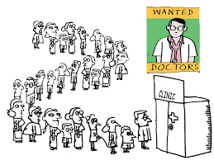

THE AI PROJECT CYCLE USAGE: SCOPING THE ISSUE
THE SUFFERERS?: The sufferer is majorly the rural population of the nation, who hardly can get access to good healthcare facilities.
THE ISSUES?: The issue is about the poor doctor-patient ratio in India , being 1:834, which is not as it should be. Taking the previous pandemic in mind, the condition this ratio caused was worse and hence much improvement needs to be there in this field.
THE PROBLEM FACED?: The problem is faced throughout the country, majorly the rural areas having very less hospital facilities and getting a good doctor is just next to impossible.
IS AN EFFECTIVE SOLUTION NEEDED? :The situation demands an effective solution so as to prevent frequent doctor visits to distinct places and at the same time provide top level healthcare facilities to the rural population based on the data collected by the AI model.

Slide 4

HENCE, INTRODUCING “HRIDAYUKTI” !!
HRIDAYUKTI is a modern variation of the traditional acoustic stethoscope that doctors and healthcare professionals use to listen to analyze the vitals . It will incorporate technology to enhance and transmit the auscultated sounds of heart , providing several advantages over their acoustic counterparts.
Some key uses and benefits of HRIDAYUKTI Include Amplification of Sounds, Recording and Playback, Filtering and Noise Reduction, Telemedicine and Remote Monitoring, Comfort and Ergonomics, Visual Display and a lot more!!

Slide 5
INNOVATIONS
Bluetooth Connectivity: Electronic stethoscopes with Bluetooth connectivity will enable wireless transmission of auscultation data to smartphones, tablets, or other devices.
Visual Display: our device will be equipped with visual displays that provide waveforms or spectrograms of the auscultated sounds, offering a visual representation
Artificial Intelligence (AI) Integration and decision support- AI algorithms to analyze auscultation data in real-time and provide healthcare professionals with additional insights or recommendations, contributing to more accurate and efficient decision-making.
Smartphone Apps: Companion smartphone apps allow for data storage, analysis, and sharing. Some apps may provide additional features such as trend tracking, patient profiles, and integration with electronic health records.
Wireless Charging: Integration of wireless charging technology eliminates the need for traditional batteries, providing convenience and ensuring that the stethoscope is always ready for use.
Ergonomic Design: Innovations in design focus on comfort and usability, with features such as lightweight materials, adjustable earpieces, and ergonomic chest pieces to enhance the overall user experience.

Slide 6
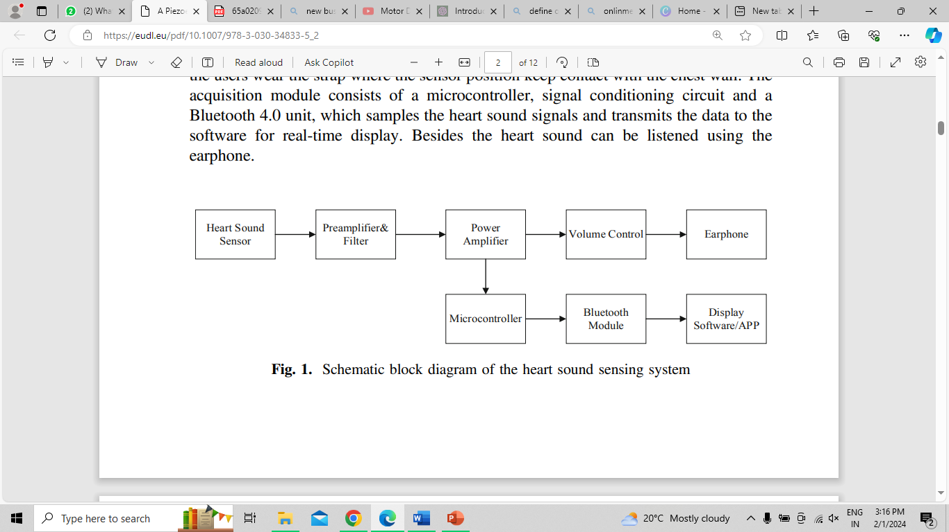
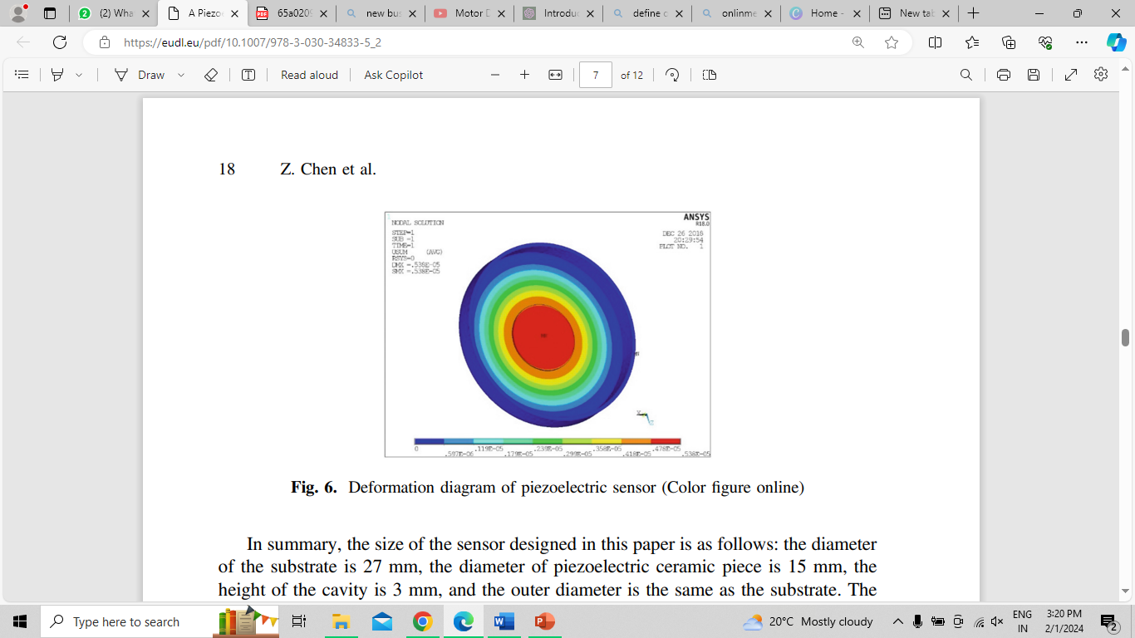
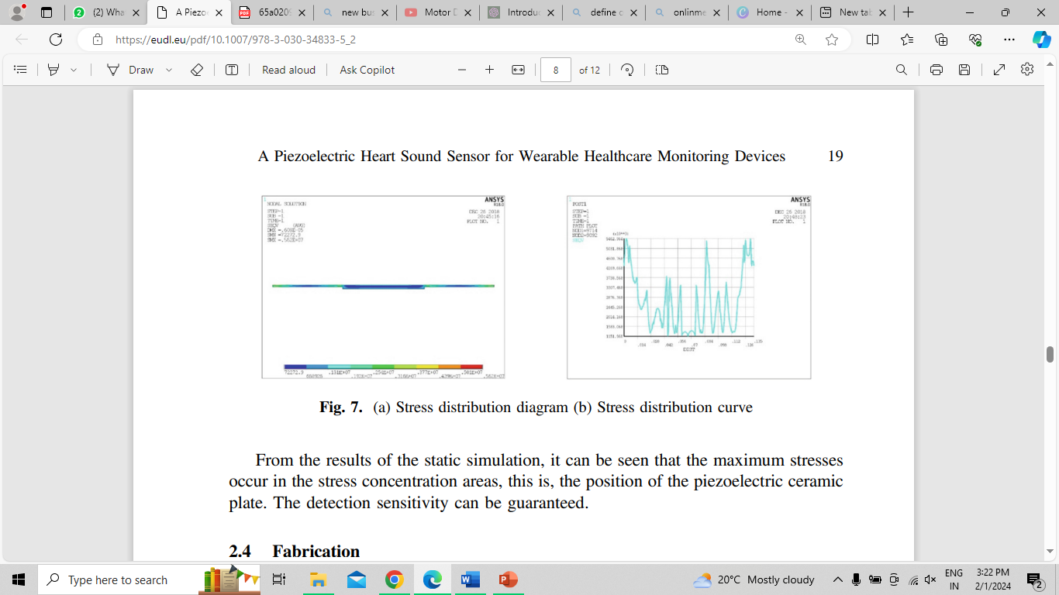
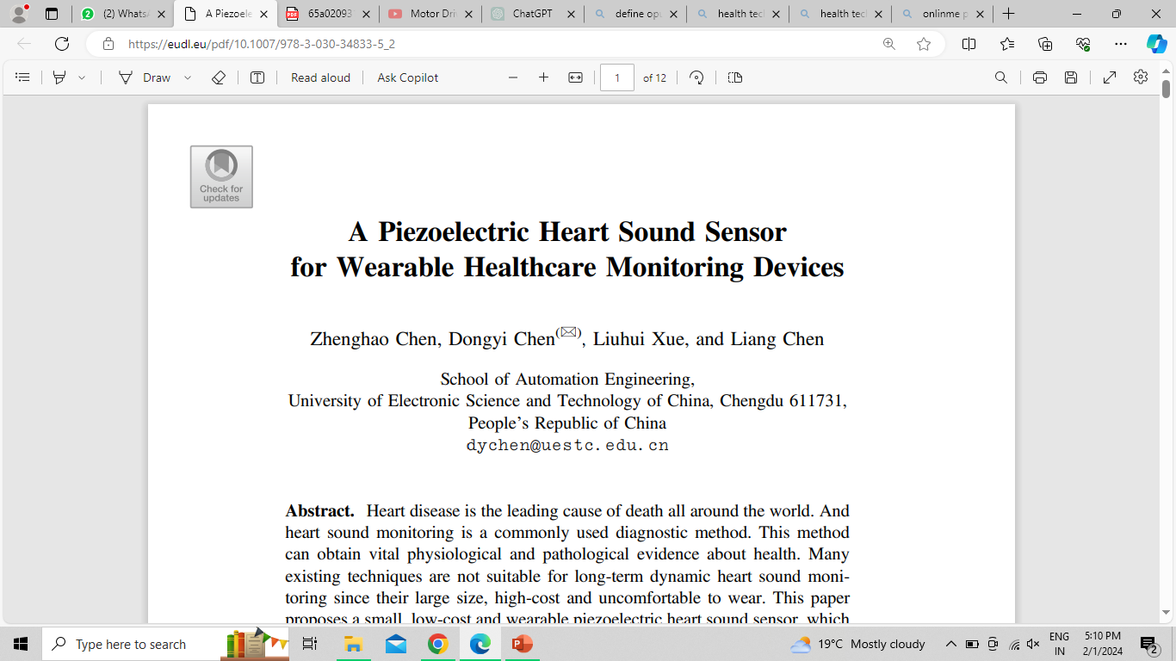

Slide 7
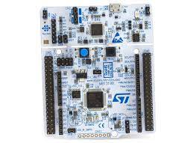
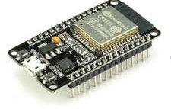
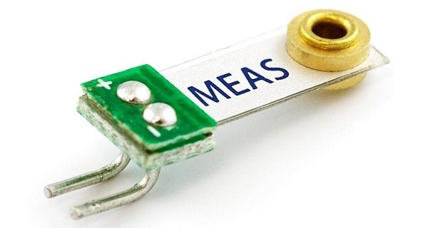
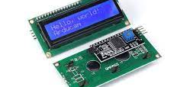
FEASIBILITY
Electronic stethoscope sensor: The HS signals are directly collected from patients by using an electronic stethoscope. Some commonly used transducers in the stethoscope are microphone, piezoelectric sensors, etc. The sound signals from the heart are converted to analog electrical signals.
One of the main advantages of piezoelectric sensors in stethoscopes is their sensitivity. They are capable of detecting even the faintest sounds and vibrations, allowing for more accurate diagnoses.
Oher materials used will include STM32 Nucleo-64 MCU Development Board , ESP32 Development Board with Wi-Fi and Bluetooth ,1602 (16x2) LCD Display with I2C/IIC interface - Blue Backlight, Piezoelectric sensor (TSD 108B) and Piezo Vibration Sensor (EC-5338)

Slide 8
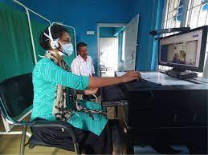
SCALABILITY
Usage Across Diverse Patient’s :- It would be designed to perform effectively across diverse patient populations for variations in body types, ages, and different medical conditions.
Compatibility with Multiple Devices:-It would be compatible with a variety of devices, such as smartphones, tablets, and computers.
Remote Monitoring and Telemedicine:- it will support remote monitoring capabilities and telemedicine applications, allowing healthcare professionals to conduct auscultations and consultations from a distance.
Expandable Features and Capabilities:- should be designed with the capability to incorporate additional features and functionalities through software updates or modular attachments.
Data Storage and Processing:-As the use of digital stethoscopes will generate data, scalability involves the ability to handle increased data storage and processing requirements.

Slide 9

MARKET POTENTIAL
The model will have a great market potential in the rural areas having the worst doctor – patient ratio. This includes:
Affordability- the product will be at a minimal cost of Rs. 200 per use, having the initial manufacturing cost of Rs. 7100, hence making it easily usable by the public.
Training and Education: requires less prior knowledge, just the way to use needs to be known so as to provide right data and readings directly to the doctors.
Power Supply- since it will have lesser recharge need because of the use of Bluetooth WIFI module , the device will be highly power efficient and hence will have a greater potential in the market.
Usability- it will require just the putting of the device at the chest area in order to analyses the beats correctly and to make it more human understandable . AI will be used for analyzing the waves and displaying the stats and then can be analyzed by the doctor in decreasing sequence based on priority.

Slide 10
TEAM DEVDUDES
KRITI RASTOGI
NISHTHA MALHOTRA
TANYA GUPTA
AMAN GUPTA
UNIVERSITY SCHOOL OF AUTOMATION AND ROBOTICS, GGSIPU EDC

Slide 11


