Slide 1
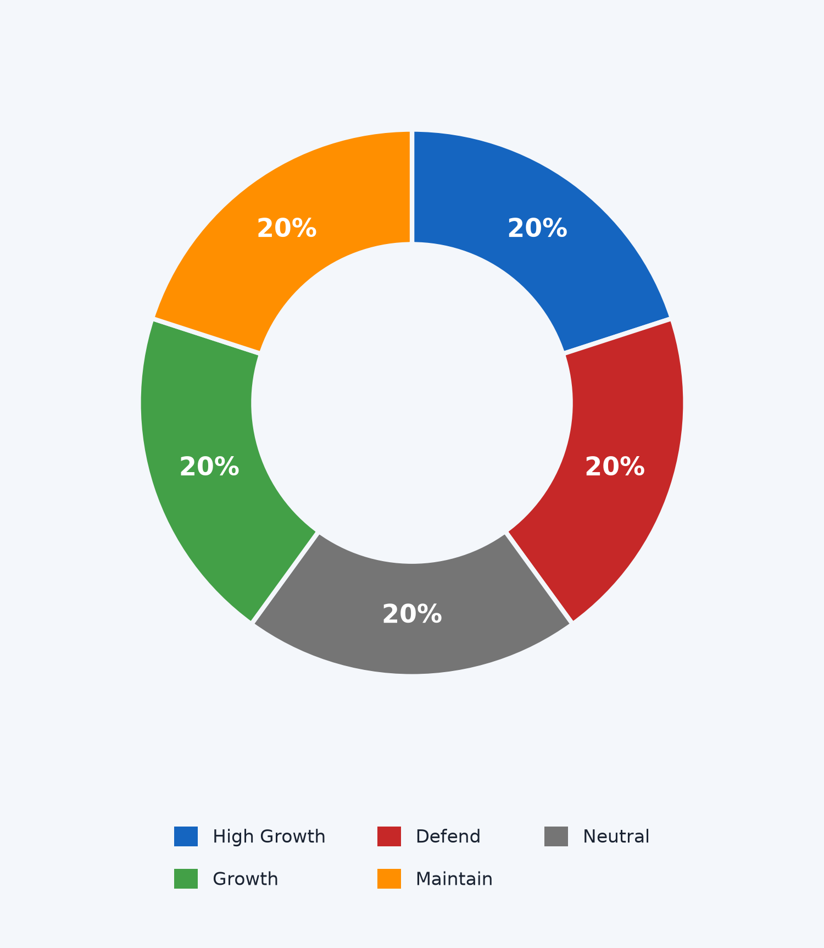
SECTION 06 · RESULTS
Role-of-Store — one model, five planning playbooks
Every store gets a planning role based on growth signals + model bias
High Growth
Expanding market + store outperforming → raise targets aggressively
Growth
Positive market signals + store running ahead of pace → push target up moderately
Neutral
Balanced profile, no strong signal either way → use the standard data-driven target
Maintain
Aging market, steady demand → hold targets, monitor for change
Defend
High competition + underperforming → conservative target, protect share
1,727 stores · ~20% each — quantile-based segmentation
Capstone 8 · Group 8 · IIM Calcutta APAL02
Role-of-Store · improved

