Slide 1
Interrupt-Zero
Voice Based Assistant with Authentication

Slide 2

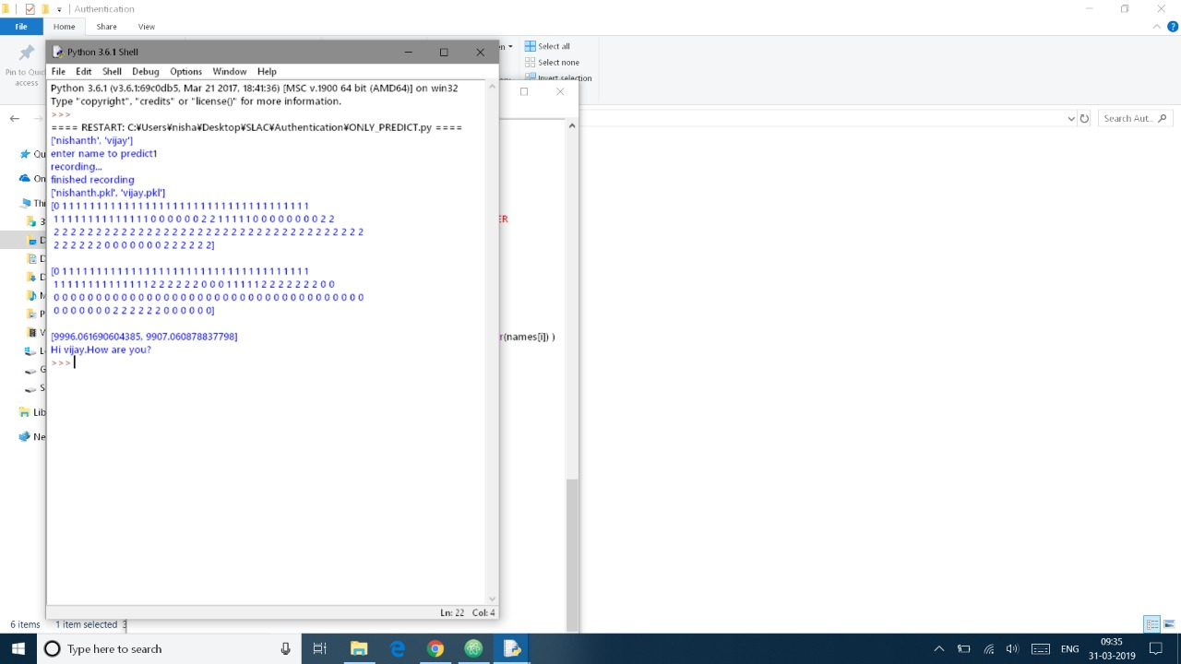
Results(authentication)

Slide 3
Problem statement
Compatible System Assistant:
Similar to Alexa, Siri, develop a voice control package which could run on System without connecting to Internet with a very limited voice command set to authenticate user and authorize him/her to control the System. Also, this package should be customizable for each product which should accept its command set as an input and also should be fault-proof as it frustrates the user to repeat the commands when the product doesn’t recognize them.

Slide 4
Solution proposed
Multi-platform (Windows PC, Android App) voice assistant, responding to voice commands by a specific user
Authentication
Using Hidden Markov Model, the hidden Markov model can be represented as the simplest dynamic Bayesian network.
Hidden Markov models are especially known for their application in reinforcement learning and temporal pattern recognition such as speech, handwriting, gesture recognition, part-of-speech tagging, musical score following, partial discharges and bioinformatics
Voice Commands
On re-training TensorFlow’s Simple Audio Recognition, one can easily recognize words such as “on”, “off” ,“start”, “stop” etc. , offline

Slide 5
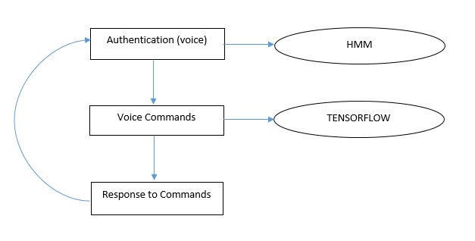
Block diagram (methodology)

Slide 6
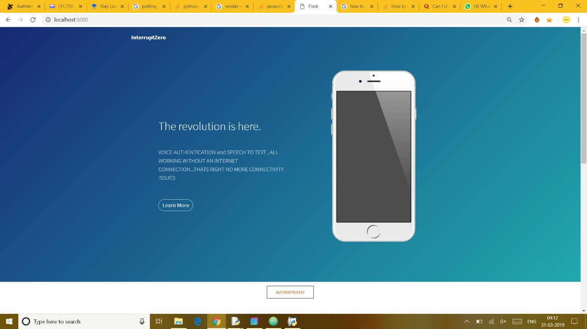
Results (Web app)

Slide 7
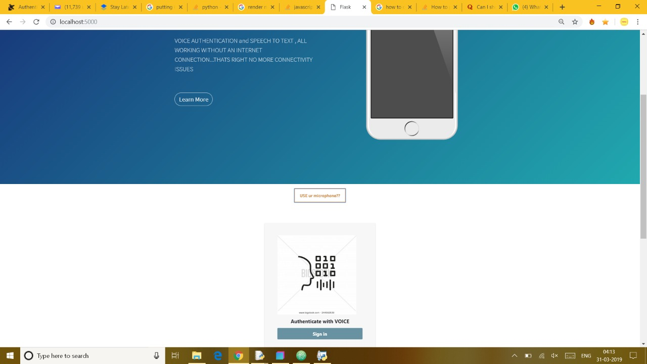
results(WEB APP)

Slide 8

results(WEB APP)

Slide 9
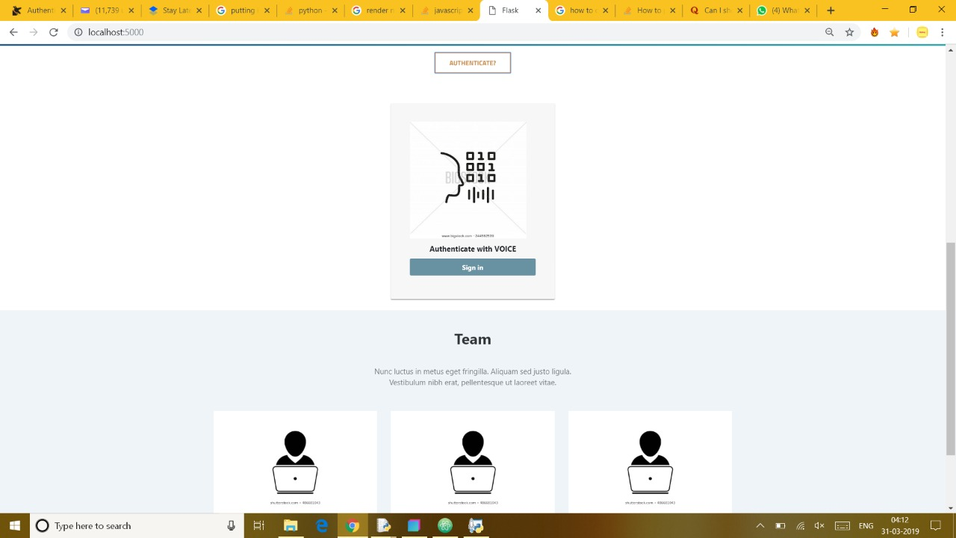
results(WEB APP)

Slide 10
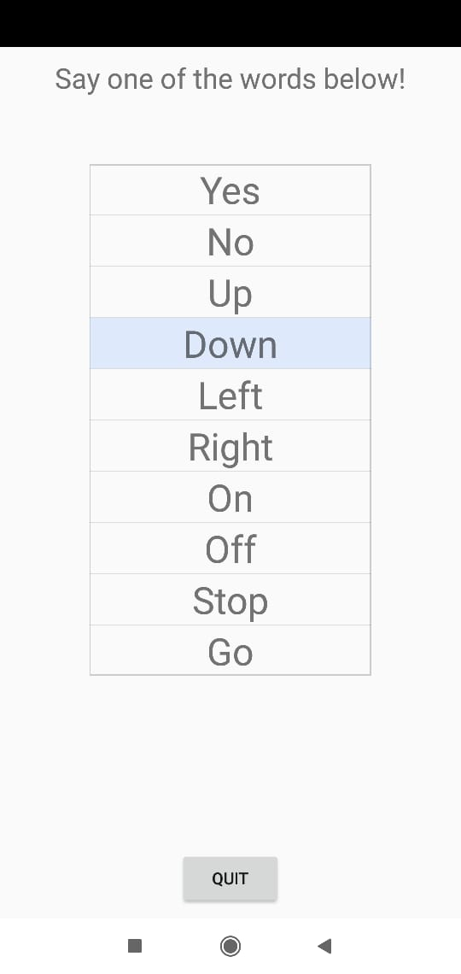
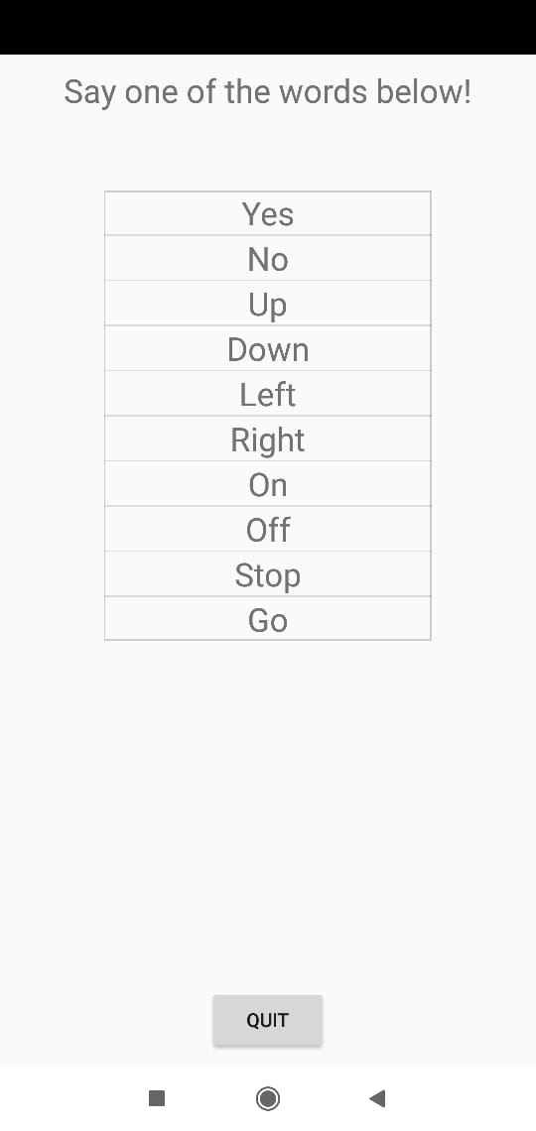
Results (android app)

