Slide 1

Rule Based Expert System Application for Food Recognizer
Presented by-
Joynab bibi nishu binte jamal
Id- 17701061
Session- 2016-17

Slide 2

Contents
Introduction
Problem Statement
Aims
Objectives
Design
Core Components
Event List
Implementation
Dialogue Modules
Snapshots
Conclusion

Slide 3
Introduction
Food Recognizer is an expert system . By this system anyone can find the food name. In this system, user have to interact with the system and give some inputs. The system will response according to user’s input .

Slide 4
Problem Statement
The main purpose of this project is to create a Expert System to replace the manual system for recognizing some dishes . The system will provide a comfortable environment where user can interact with the system easily . It provides instant help for recognizing food that is accurate, and error free. In the manual system , a person needs to think and decides the food name. Sometimes, a person may find it difficult to guess the food name as there are so many foods . Moreover some foods look same but taste different.

Slide 5
Aims & Objectives
The aims of this expert system are given below:
Revealing food name according to user’s input.
Giving an automatic environment.
Giving error free output.
The objective of this expert system is to reveal food name according to user’s input.

Slide 6
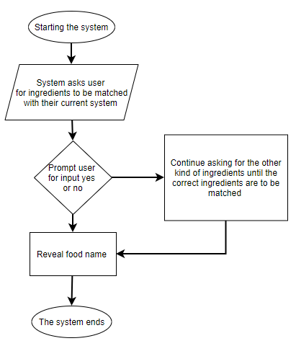
Design
Design describe how the expert system react according to commands given to prolog environment for identifying the food according to user’s input.

Slide 7
Design
No | Indications
1 | Asian
2 | Rice
3 | Sambal
4 | Coconut milk
5 | Vegetables
6 | Fried
7 | Noodle
8 | No soup
9 | China origin
10 | Eastern
11 | Use wrap
12 | Meat
13 | Heavy
14 | Meatball shape
15 | Western
16 | Pastry
17 | French origin
18 | Bread
19 | Spicy
20 | Italian

Slide 8
Design
Rules No. | Indications | Food Name
Rule 1 | Asian, rice, sambal, coconut milk | Nasi lemak
Rule 2 | Asian, vegetables, fried | Fried rice
Rule 3 | Noodle, no soup, China origin | Dandan noodle
Rule 4 | Eastern, meat, rice, heavy | Biryani
Rule 5 | Eastern, meatball shape, vegetables | Falafel
Rule 6 | Western, pastry, French | Croissant
Rule 7 | Western, bread, French | Baguette
Rule 8 | Western, spicy, Italian | penne

Slide 9
Core Components
This expert system has been typically designed to provide capabilities similar to those of a human expert when performing a task. This expert system usually has two core components:
Knowledge base: This component consists of data, facts and rules for a certain topic, industry or skill, usually equivalent to that of a human expert.
Interference engine: This component uses the facts and rules in the knowledge base to find and learn new knowledge or patterns.

Slide 10
Event Lists
The first matter that we should do in designing the system is making a list of every existing event. The events are: a) We enter any data of indication that related to the food. b) The application does the analysis based on the user’s data. The results of analysis will
determine the indication list . c) Admin will cultivate the data on the system. d) Admin obtains information from the data at the system. e) The experts take over management of the system. f) The experts get information from data management at the system.

Slide 11
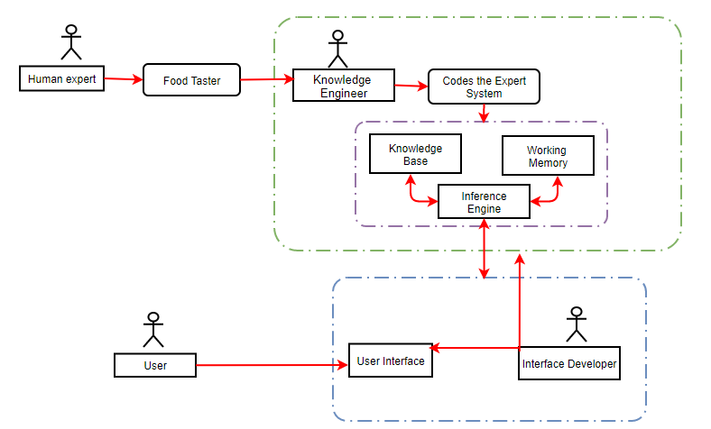
Expert System Architecture

Slide 12
Implementation
The source code has been provided in the google classroom.
G:\prolog\food.PRO

Slide 13
Dialogue Modules
User | Why module
system | Is it an Asian food (y/n) ?
User | Yes
system | "Does the food contain rice (y/n) ?
User | Yes
system | Does the food has sambal(y/n) ?
User | Yes
system | Does the food contain coconut milk (y/n) ?
User | Yes
system | Does the food contain vegetables (y/n) ?
User | Yes
system | Is the food fried (y/n) ?
User | Yes
System | Does the food contain noodle (y/n) ?
User | Yes
System | Does the food contain no soup (y/n) ?
User | Yes
System | "Does the food belong to China (y/n) ?
User | Yes
System | Is it an eastern food (y/n) ?
User | Yes

Slide 14
Dialogue Modules
System | Does the food served with a wrap (y/n) ?
User | Yes
System | Does the food contain meat (y/n) ?
User | Yes
System | Does the food contain heavy portion (y/n) ?
User | Yes
System | Does the food look like meatballs (y/n) ?
User | Yes
System | Does the food belong to western contries (y/n) ?
User | Yes
System | Does the food contain pastry (y/n) ?
User | Yes
System | Does the food belong to French (y/n) ?
User | Yes
System | Does the food contain bread (y/n) ?
User | Yes
System | Is the food very spicy (y/n) ?
User | Yes
System | Does the food belong to Italy (y/n) ?
User | Yes

Slide 15
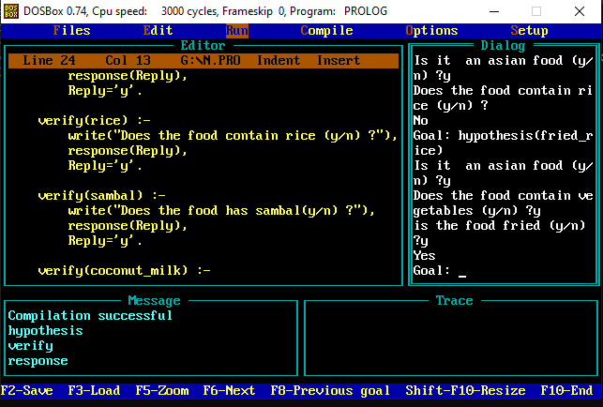
Snapshots

Slide 16
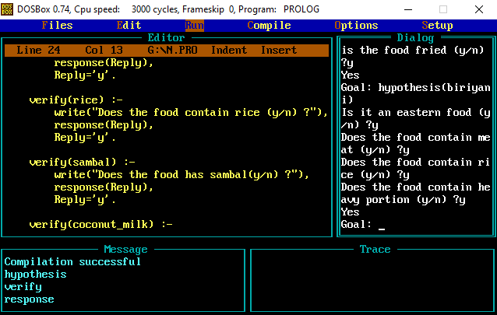
Snapshots

Slide 17
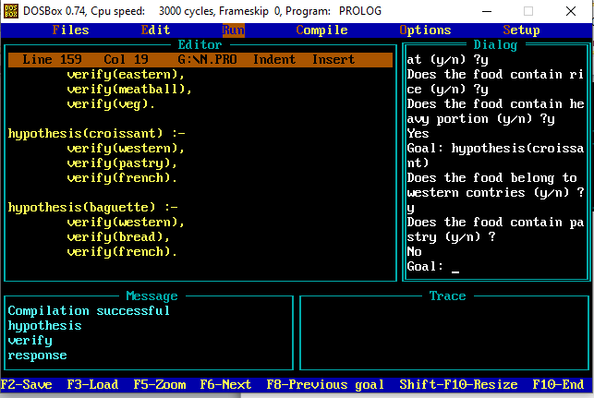
Snapshots

Slide 18
Conclusion
The prolog program that I built is very simple to use and efficient. It's pretty accurate too. This system can verify the food name. This expert system has been typically designed to provide capabilities similar to those of a human expert when performing a task. The program asks a few yes/no questions to the user to note down which ingredients the user is watching. Then after knowing all the indications that the user is watching the expert system searches up on its knowledge base and then generates the most probable answer i.e. in this case the accurate food name . It is to be noted that the knowledge base is also accompanied with an interference base. Thus the expert system is more enriched and learns from experience bit by bit.

Slide 19





Thank You

