Slide 1


MEGATHON X
meet · ideate · hack
QUALCOMM PROBLEM STATEMENT
AI Incident
Report Assistant
ON-DEVICE AI CHALLENGE
Voice in. Structured report out.
End-to-end voice-driven incident reporting using
on-device Generative AI and function calling.
IN COLLABORATION WITH
E-Cell, IIIT Hyderabad
MEGATHON X
Notes:
Good morning everyone. Welcome to Megathon X at IIIT Hyderabad. Let me introduce Qualcomm’s problem statement: AI Incident Report Assistant. The goal is to make incident reporting as simple as speaking naturally to a device.

Slide 2

How many of you enjoy filling out forms?
Let us replace manual entry with a natural conversation.
Probably not many.
Imagine an incident happens. Instead of opening a portal and typing every detail, you simply talk to the device.
“There was a water leak near Conference Room 2 around 10 AM. Maintenance has already isolated the area.”
JUST SPEAK NATURALLY
MEGATHON X • QUALCOMM PROBLEM STATEMENT
02
Notes:
How many of you enjoy filling out forms? Probably not many. Imagine there is a water leak near a conference room. Instead of opening a form, the user simply describes the incident. The system should understand that sentence and do the hard work.
[Sources]
- Visual on this slide was generated with Microsoft Copilot.
[/Sources]

Slide 3
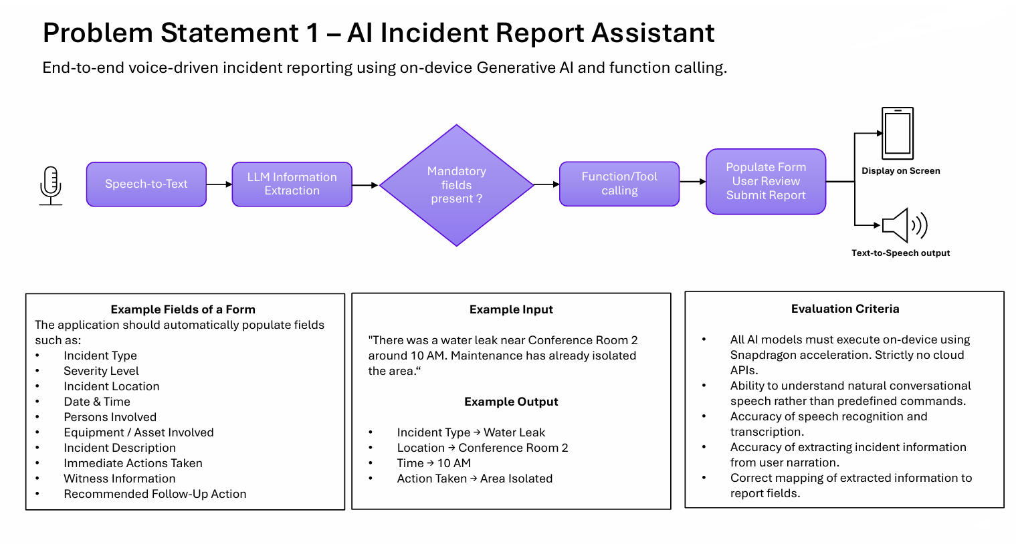
Problem Statement
AI Incident Report Assistant
MEGATHON X • QUALCOMM PROBLEM STATEMENT
03
Notes:
This is the complete problem statement. The system listens to the user, converts speech to text, extracts the incident information, checks mandatory fields, calls the required function, and lets the user review before submission. The main requirement is that the AI models execute on-device using Snapdragon acceleration.

Slide 4
Build with the Qualcomm® Innovators Development Kit (QIDK)
Start with these resources for models, SDK setup, and QIDK development.
QIDK Documentation
QIDK GitHub Repository
01
02
Release notes and platform overview
Source code, examples, and project resources
Open resource →
Open resource →
Qualcomm AI Hub
QAIRT SDK Setup Guide
03
04
Models compatible with Snapdragon mobile chipsets
Environment and SDK setup documentation
Open resource →
Open resource →
MEGATHON X • QUALCOMM PROBLEM STATEMENT
04
Notes:
These are the key resources. Use the QIDK documentation and GitHub repository for the development framework, Qualcomm AI Hub for compatible models, and the QAIRT setup guide for the SDK environment.

Slide 5
YOUR CHALLENGE
Make incident reporting
as easy as speaking.
Thank you
Natural conversation • Accurate extraction • On-device execution
We look forward to
your ideas.
SPEAK → UNDERSTAND → EXTRACT → REVIEW → SUBMIT
MEGATHON X
Qualcomm × IIIT Hyderabad
Notes:
In one line: voice in, structured incident report out. Make the experience natural, accurate, and completely on-device. We look forward to seeing how creatively you solve the challenge. All the best.

