Slide 1



Project : Multi-Class Animal Recognition for Wildlife Conservation
Name : Nishu Mittal
AICTE Internship Student ID : STU67acb9c3ded241739372995

Slide 2

Learning Objectives
Gained practical understanding of Convolutional Neural Network (CNN) architecture in this context.
Learned to implement and fine-tune the MobileNetV2 model, optimized for efficient performance on limited-resource devices.
Successfully explored and built a deep learning model to classify 90 distinct animal classes, enhancing multi-class classification skills.
Analyzed model accuracy and performance metrics to evaluate its effectiveness in real-time classification scenarios.
Understood the real-world applications of AI in wildlife monitoring and surveillance, highlighting its role in ecological research and conservation efforts.
GOAL
Source :
www.freepik.com/

Slide 3
Tools and Technology used
Programming Language: Python
Frameworks & Libraries: TensorFlow and Keras
Pretrained Model: MobileNetV2
Development Environment: Google Colab
Dataset: https://www.Kaggle.com/datasets/iamsouravbanerjee/animal-image-dataset-90-different-animals/data
Other tools: numpy, matplotlib, seaborn

Slide 4
Methodology
Data Collection: Acquired a comprehensive dataset containing images of 90 different animal classes.
Data Processing: Preprocessed the images by resizing, normalizing, and organizing them for model training.
Model Selection: Chose MobileNetV2 as the pretrained model for its efficiency and accuracy in image classification.
Model Training: Trained the model using labeled data to recognize and classify various animal species.
Model Evaluation: Assessed the model’s performance using accuracy and loss metrics to ensure reliability.
Testing: Tested the model on unseen data to validate its generalization and real-world applicability.

Slide 5
Problem Statement:
Multi-Class Animal Recognition for Wildlife Conservation
Wildlife Monitoring Need: Difficulty in manually tracking and identifying animals in their natural habitat for research and conservation.
Surveillance Extension: Requirement for automated systems that support wildlife surveillance and ensure minimal human intervention.
Multi-Class Categorization Challenge: Need for an intelligent model capable of accurately classifying 90 different animal species for detailed analysis.

Slide 6
Solution:
MobileNetV2 (Pretrained): Utilized MobileNetV2 for its lightweight architecture and strong performance in image recognition tasks.
90-Class Softmax Layer: Integrated a Softmax layer to enable classification across 90 distinct animal categories.
Efficient Animal Recognition: Enabled accurate and efficient recognition of multiple animal species using deep learning.
Optimized for Mobile Resources: Designed the solution to be deployable on mobile and edge devices for real-time, resource-efficient use.
Scalable and Real-World Ready: The model architecture is scalable and can be extended to more classes, making it suitable for real-world applications like wildlife monitoring and smart surveillance systems.

Slide 7
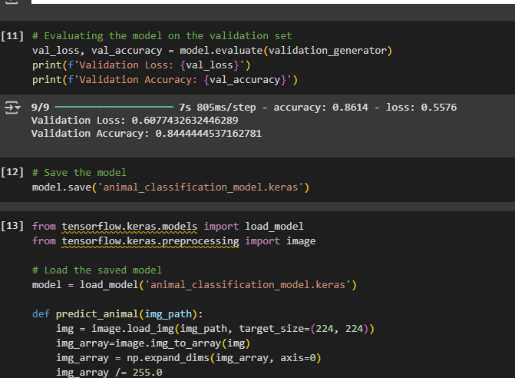
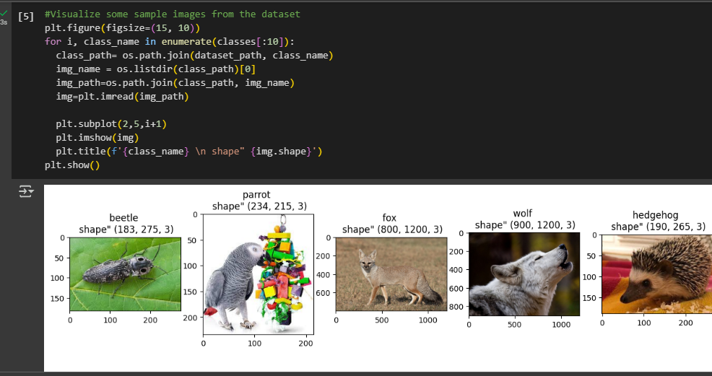
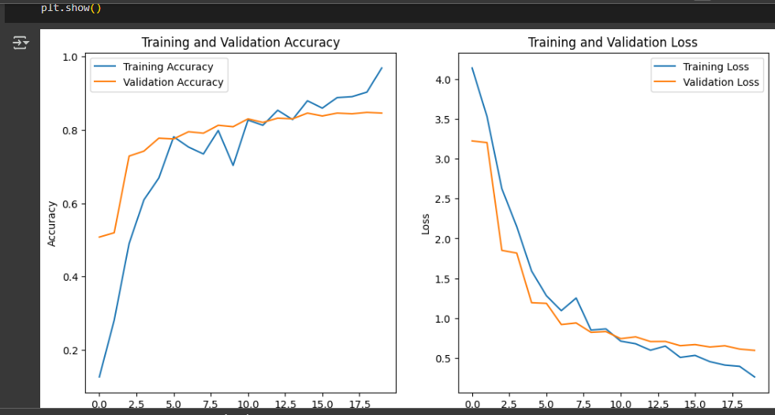
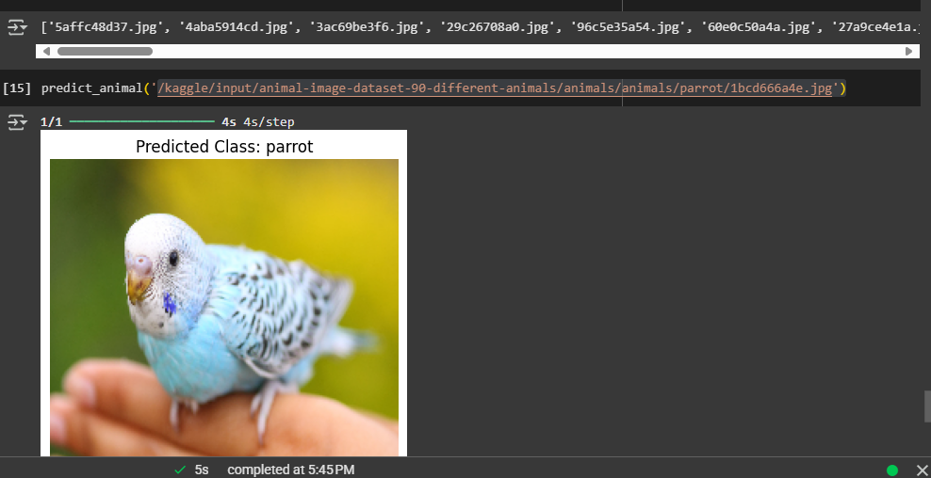
Screenshot of Output:

Slide 8
Conclusion:
Achieved a successful accuracy of 84% using the pretrained MobileNetV2 model for multi-class animal recognition.
Effectively handled high-class count classification with 90 distinct animal categories.
The model demonstrates strong potential for real-time deployment in wildlife monitoring and smart surveillance systems.
Future Scope: Incorporating techniques like Early Stopping and implementing real-time object detection to enhance performance and efficiency.
Github link: https://github.com/nishumital3103/MultiClassAnimalRecognition.git
Model: https://1drv.ms/u/c/9ad7afdcf7081cb3/EQSJ6Y9QFt5En5dsYqPYMZUBTYE02PysYS0inoShFIkVNg?e=oiM0Dv

