Slide 1
Presentation on
“Online Tutor”
Presented by:
Thani sara Gaha
Nishu Sapkota

Slide 2
Table of content:
Introduction
Statement Of Purpose
Objective
Methodology
Requirement Engineering
Feasibility Study
Requirement collection
Requirement Analysis And Validation
Software Requirement And Specification
Design
Implementation
Testing
Risk And Mitigating Practices

Slide 3
Introduction
Online tutor is a web based application where physical classroom extends to digital classroom.
Aims to reduce the time of searching notes, old questions during exam time.

Slide 4
Statement Of Purpose
We will include the feature of uploading the notes, assignment and other study materials.
Uploading and downloading files can be done by the user.
Notes and old questions will be provided at a single place.

Slide 5
Objective
To digitize the classroom.
To create appropriate aid supporting educational purposes.
To provide information in a categorized way.
To build communication by sharing ideas on discussion forum section

Slide 6
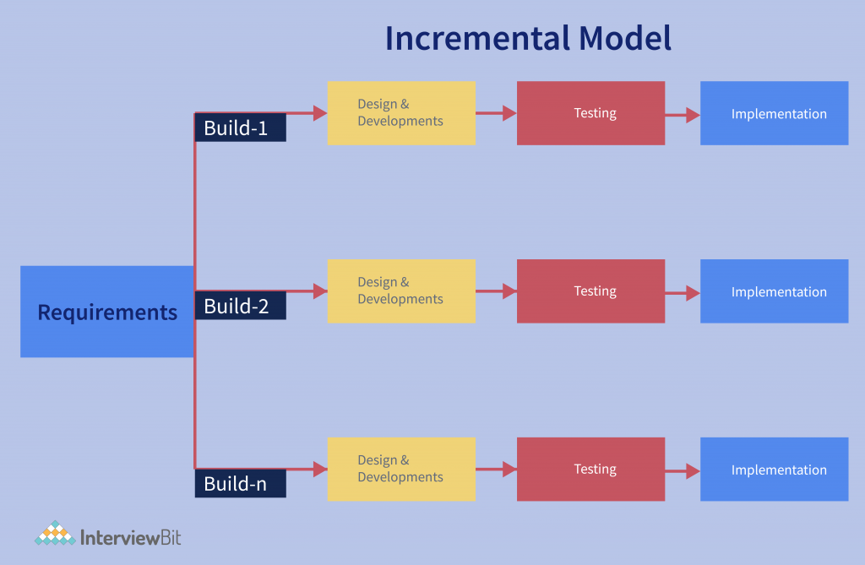
Methodology
Fig : Incremental Model

Slide 7
Requirement Engineering
Feasibility study
Technical feasibility
Operational feasibility
Cost feasibility
Schedule feasibility
Requirement Collection
Interview
Expert help

Slide 8
Requirement analysis and validation
Hardware Requirement
RAM: 4GB+
Processor: Intel Pentium 4 or above
Available Disk Space: 10GB+
Server
Software Requirement
Platform support: Windows7 and later / Web
Language: PHP (Laravel), Bootstrap, HTML ,CSS , Javascript
Software: Visual Studio, SQL Server Management Studio

Slide 9
Software Requirement Specification
Functional Requirement
User are required to authenticate their roles and choose either they are teacher , admin or student.
Admin have full access to manage the site including adding , deleting and editing all the pages and module.
Teachers are able to post notices, schedule exams, grade marks, upload assignments, provide pdf, video tutorial and so on.
Student are able to see notices, take online exams , view evaluation marks, submit assignments ,download or view learning materials.
Nonfunctional Requirement
Security
Usability
Maintainability
Scalability

Slide 10
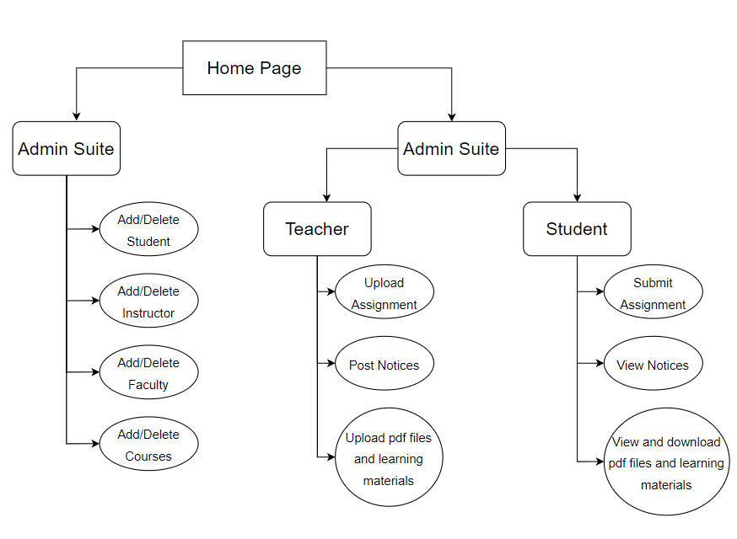
Design
Architectural Design: Defining the hardware and software and their interfaces to establish the framework of the system.

Slide 11
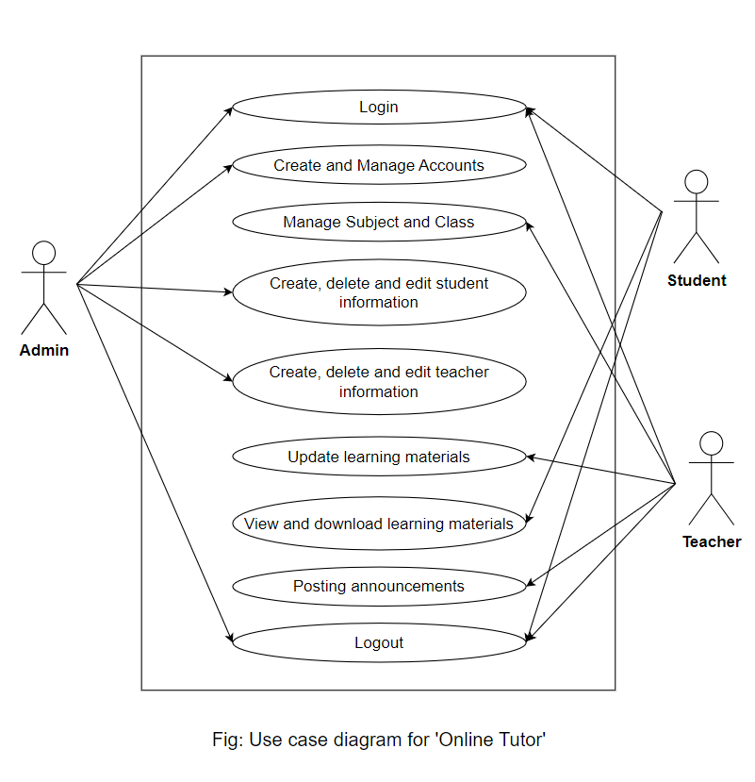
Use-Case Diagram: To capture the dynamic aspect of the system ,shows the interaction between requirements and actors

Slide 12
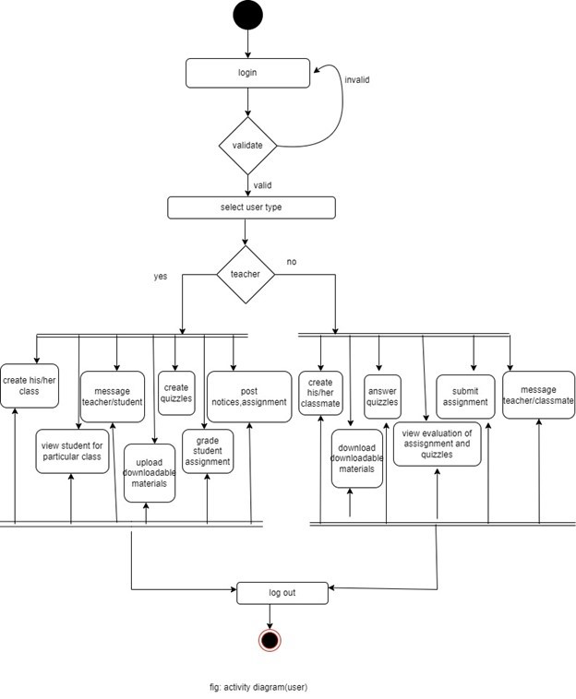
Activity Diagram: Flowchart to represent the flow.

Slide 13
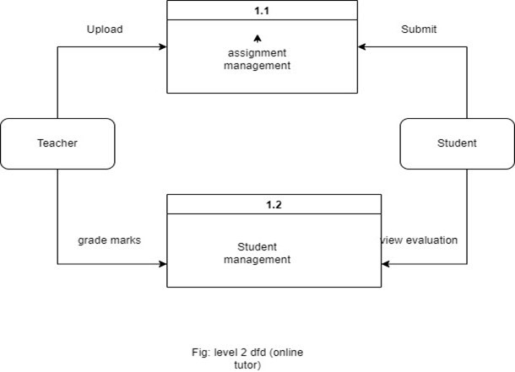
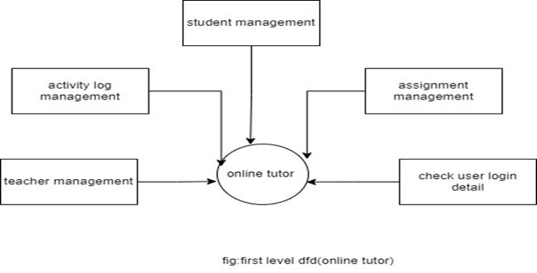
Data flow Diagram: Graphical representation of flow of data in system

Slide 14
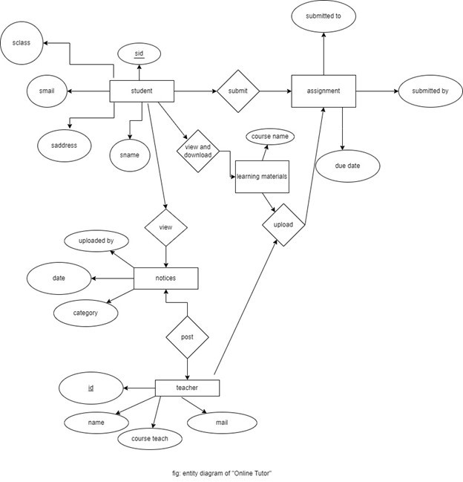
ER Diagram: Entity Relationship diagram displays the relationship of entity sets.

Slide 15
Implementation
Front-end development:
HTML
CSS
Javascript
Bootstrap
Back-end development:
PHP
Laravel
Database:
MYSQL Server

Slide 16
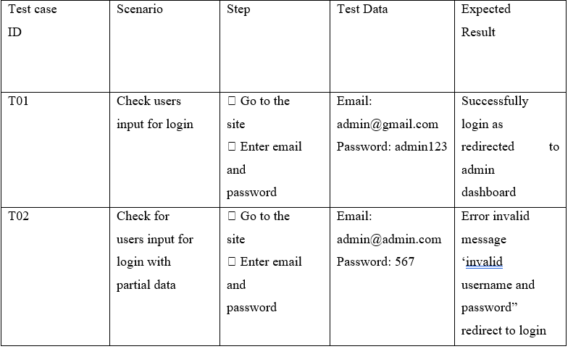
Testing
Unit Testing: Used to test the functionality of a system and its various component.
Fig: Admin Login Test

Slide 17
Acceptance Testing:
It includes overall system with real data.
Alpha testing is acceptance testing with single user.
Beta testing involves distributing system to certain users to use and provide feedback. With the help of feedback, we would know errors and any changes that has to be made

Slide 18
Risks And Mitigating Practices:
Risks1: Assuming that our application is perfect.
Mitigating Practices1: Launch the application and wait for the feedback.
Risks2: Risk of getting denied.
Mitigating Practices2: Make sure about the requirement of the target user.
Risk-3 Time management risk
Mitigating Practice3: Dividing work load properly among the team member during development of system so that we can meet deadline.

Slide 19
Thank you!

