Slide 1
Digital Portfolio
STUDENTNAME:V.M.NISHWANTHH REGISTER NO :20324u09059
NMID :29B5D44ABDA228EB77A438CEA1292CE0 DEPARTMENT :BCA COLLEGE:Dr.M.G.R.CHOCKALINGAM ARTS COLLEGE UNIVERSITY :THIRUVALLUR UNIVERSITY

Slide 2
PROJECT TITLE
STUDENT DIGITAL PORTFOLIO WEBSITE USING WEB DEVELOPMENT

Slide 3


AGENDA
Problem Statement
Project Overview
End Users
Tools and Technologies
Portfolio design and Layout
Features and Functionality
Results and Screenshots
Conclusion
Github Link
3/21/2024 Annual Review

Slide 4
A digital portfolio serves as a dynamic solution, allowing users to present their personal information, educational background, technical skills, projects, certifications, and achievements in an interactive format. However, many existing digital portfolios lack personalization, responsive design, and user-friendly navigation, which reduces their effectiveness.

Slide 5

PROJECT OVERVIEW
The main objective of this project is to design and develop a personal digital portfolio that showcases an individual’s skills,
academic background, projects, achievements, and professional experiences in a structured and visually appealing format.

Slide 6

WHO ARE THE END USERS?
The end users of a digital portfolio include recruiters and employers (for hiring), college/university admission panels (for academic evaluation), clients (for freelancing or business opportunities), teachers/mentors (for guidance and assessment), peers and networking contacts (for collaboration), and the individual themselves (for personal branding and career growth).

Slide 7

TOOLS AND TECHNIQUES
The digital portfolio is developed using HTML, CSS, and JavaScript with the help of tools like VS Code, browsers, GitHub, and design platforms. Techniques such as responsive design, interactive features, clear navigation, content organization, and cross-browser testing are applied to ensure a professional and user-friendly portfolio.

Slide 8
POTFOLIO DESIGN AND LAYOUT
The digital portfolio follows a simple, professional, and responsive design with user-friendly navigation. The layout includes a header, homepage, about, education, skills, projects, achievements, contact, and footer. It uses a clean color scheme, consistent typography, grid/card layouts, and interactive effects to ensure clarity, visual appeal, and accessibility.

Slide 9
FEATURES AND FUNCTIONALITY
The digital portfolio includes sections like home, about, education, skills, projects, achievements, and contact, with features such as responsive design, easy navigation, interactive UI, and clickable links. Its functionality ensures cross-browser compatibility, user engagement through animations, and contact form handling for communication.

Slide 10
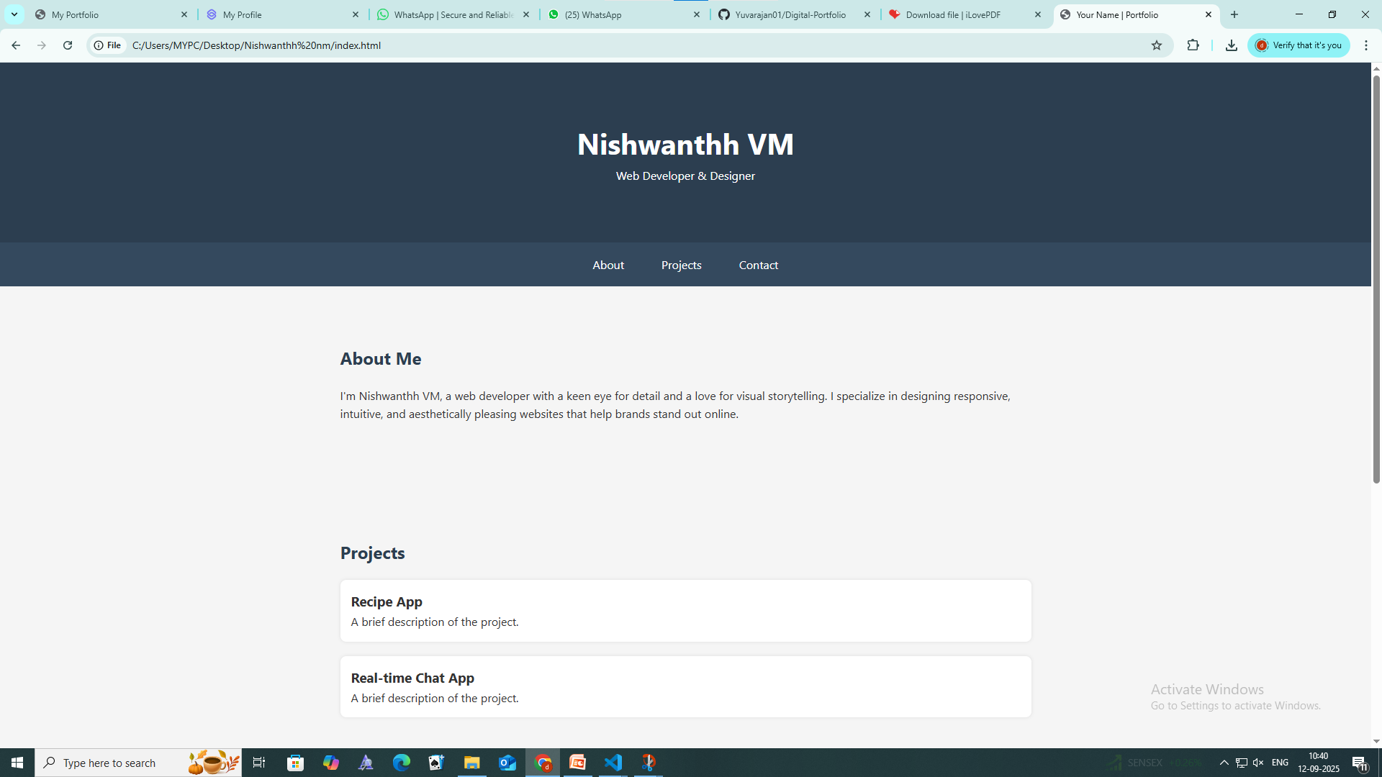

RESULTS AND SCREENSHOTS
3/21/2024 Annual Review

Slide 11
CONCLUSION
The digital portfolio project successfully demonstrates how personal and professional information can be presented in an interactive and visually appealing format. By using HTML, CSS, and JavaScript, the portfolio provides a responsive, user-friendly, and well-structured platform that showcases education, skills, projects, and achievements effectively.

Slide 12
GITHUB LINK: https://github.com/nishwanthh/digital-portfolio.git

