Slide 1
PDIoT 2023
Introduction to Sensor Platforms for Human Activity Recognition

Slide 2
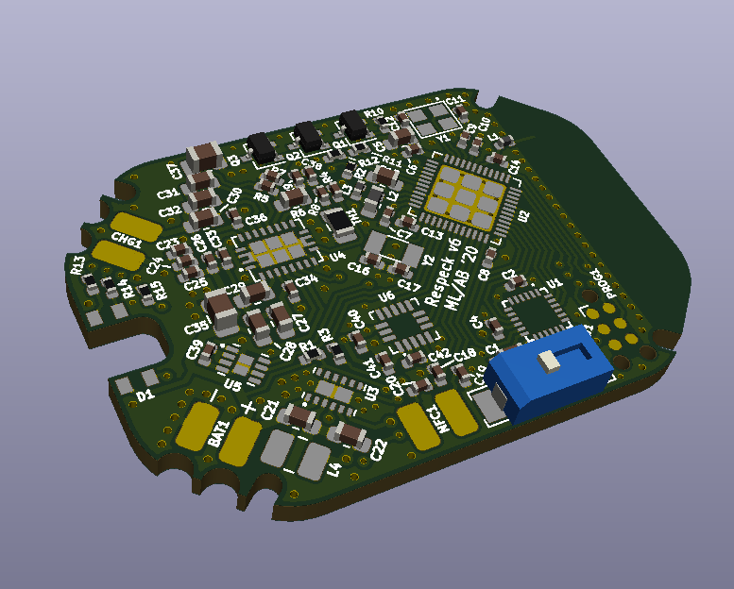
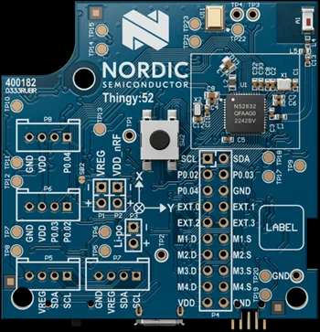
Sensor Platforms
Respeck
A custom-designed platform to collect human activity and respiratory data
Thingy
A prototyping platform made by Nordic Seniconductor
Both devices are based around the Nordic Semiconductor NRF52 SoC, provide on-board processing and
BLE communication

Slide 3
IMU Sensors
Both platforms include an Invensense inertial measurement unit (IMU)
3 axis gyroscope
Measures rotational rate
High power consumption
Cannot detect linear motion
Reacts quickly to changes in orientation
3 axis accelerometer
Measures linear acceleration and the direction of gravity
Low power consumption
Useful for determining static orientation
Rotation can be detected by tracking changes to the direction of gravity
3 axis magnetometer
Measures the magnetic field strength and direction
Not recommended to use for PDIoT as the magnetic field will be crazy in the lab!

Slide 4
Bluetooth Low Energy (BLE)
You can read data from the sensors using BLE
BLE devices expose services, which contain characteristics
Read characteristics to obtain single sensor readings
e.g. battery level
Notify characteristics to stream data
e.g. IMU data
Write to characteristics to configure the sensor platform
e.g. switch individual sensors on or off
control an LED
BLE can send and receive single bytes or a byte array in each transmission
By using a custom packet format, we can send complex data
E.g. {timestamp, accel_x, accel_y, accel_z, gyro_x, gyro_y, gyro_x, battery_level}

Slide 5
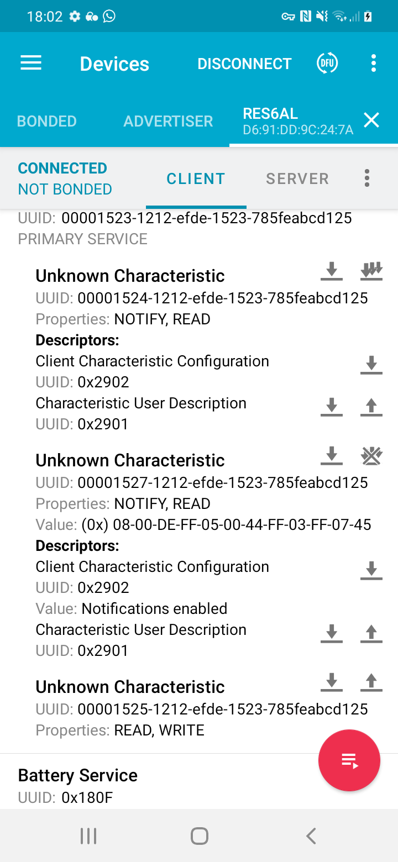
Android App
The Nordic NRF Connect app is a good starting point to learn about communicating with BLE devices on Android
The Thingy has a supporting app, which allows you to configure the sensor platform
We will provide a data collection app for Coursework 1, which will store data in CSV files for later analysis
During Coursework 3 you will extend this to perform Human Activity Recognition in real-time

Slide 6
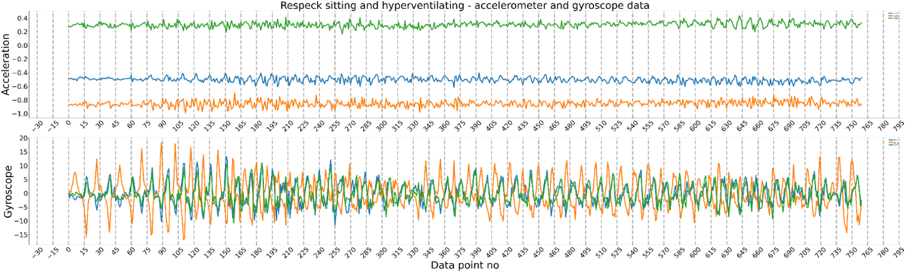
IMU Data Analysis
Accelerometer and gyroscope data are often complimentary
Position of accelerometer lines useful to detect posture
Gyroscope provides cleanest respiratory signal

