Slide 1
Online Household Service
Course: Software Engineering
Section: A
Group: 4

Slide 2
Group Members
Tousif Sadeque Chowdhury 20-43071-1
Mahdiya Islam Arbina 20-42719-1
Nisma Hossain 20-41982-1
Anny Saha 20-43417-1

Slide 3
Contents at a Glance
1. Idea Generation
2. Use Case Diagram
3. Activity Diagram
4. Class Diagram
5. User Story Card
6. UI Design
7. Jira
8. Git
9. Timeline Chart
10. Project Estimation

Slide 4
Idea generation
People can get every possible service regarding the house hold pretty much easily. Apart from that they can order stuff even sitting in their residence. In that case they can get the best service by spending a pretty limited amount of money. The clients will have the chance to provide the feedback which would come really handy for the folks to decide whether they should go for it or not.
Services
Electricians for Electrical
Plumbing
Home Cleaning
Order Groceries

Slide 5
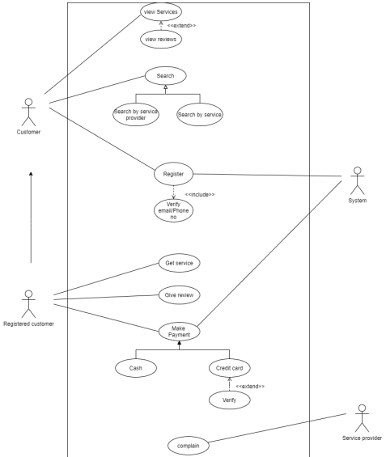
Use Case Diagram

Slide 6
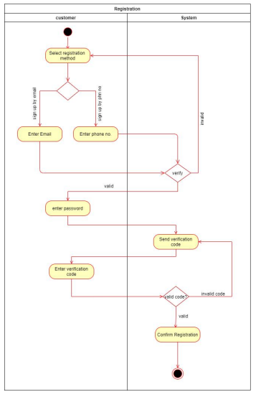
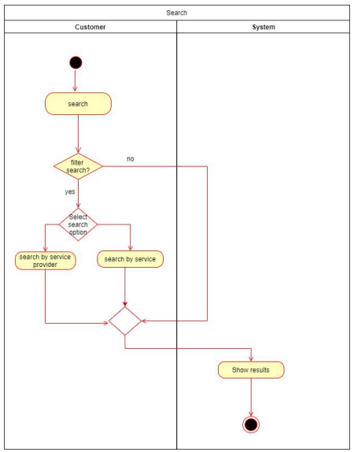
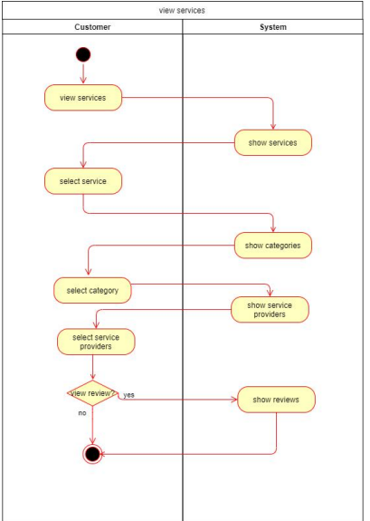
Activity Diagram

Slide 7
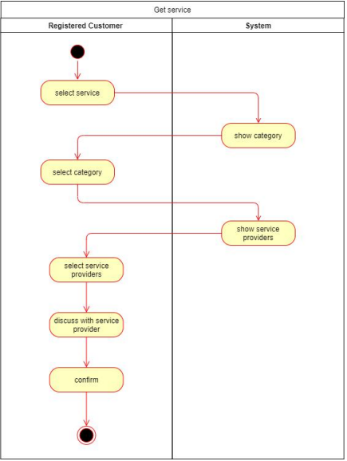
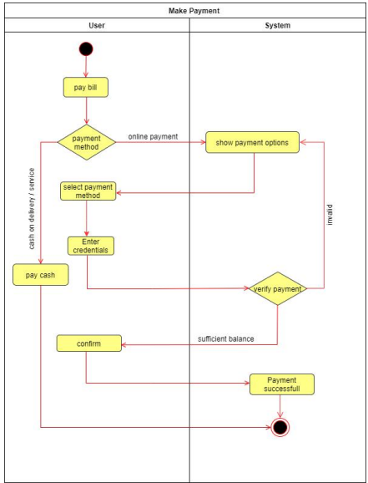
Activity Diagram

Slide 8
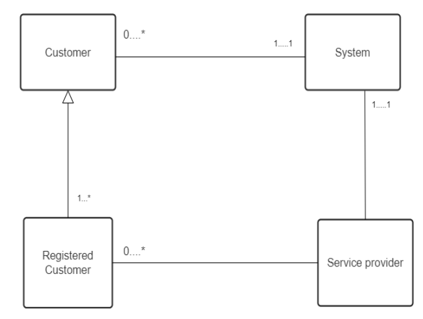
Class Diagram

Slide 9
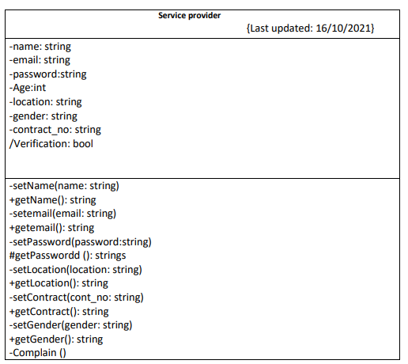
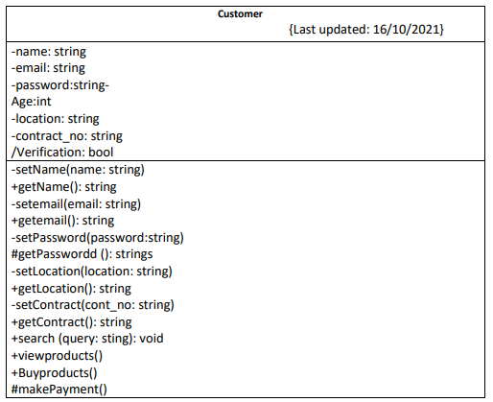
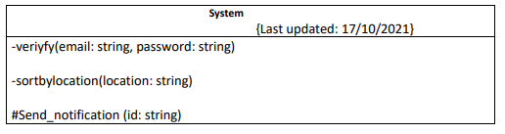
Class Compartment

Slide 10
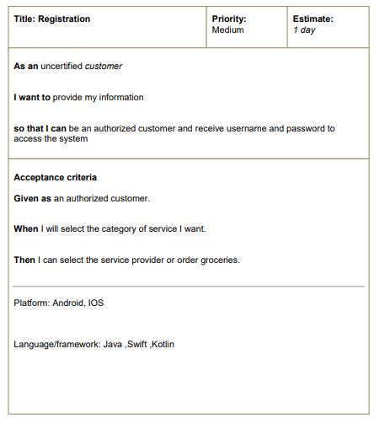
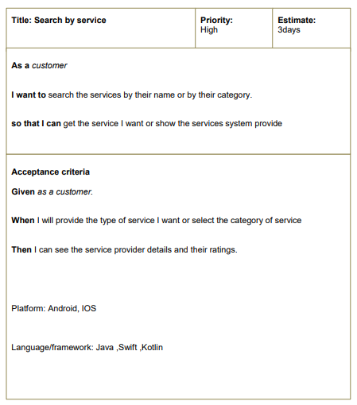
User Story Card

Slide 11
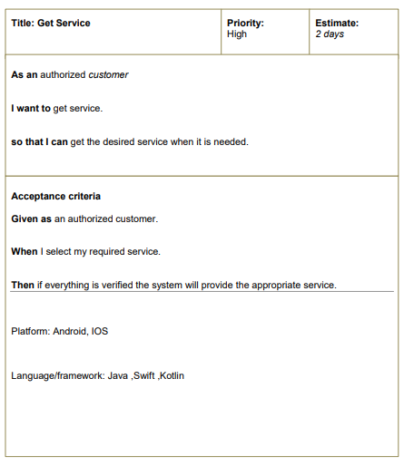
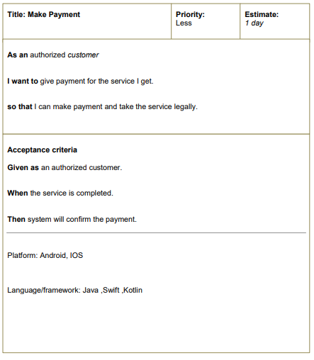
User Story Card

Slide 12
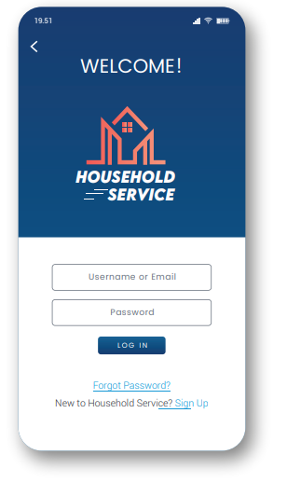
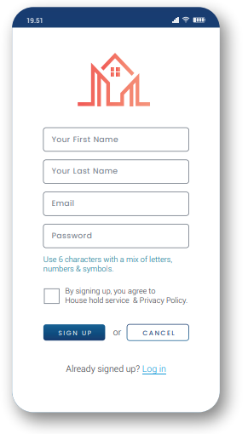
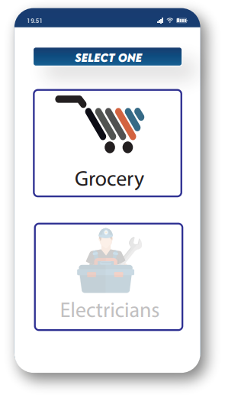
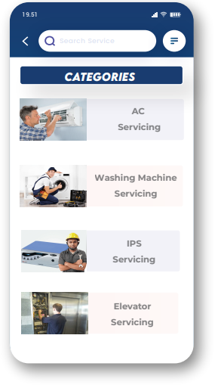
UI Design

Slide 13
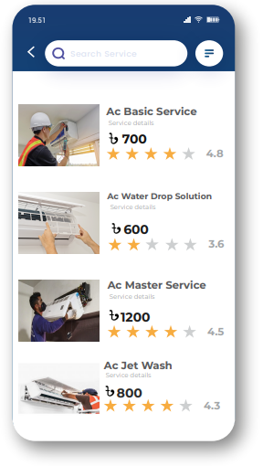
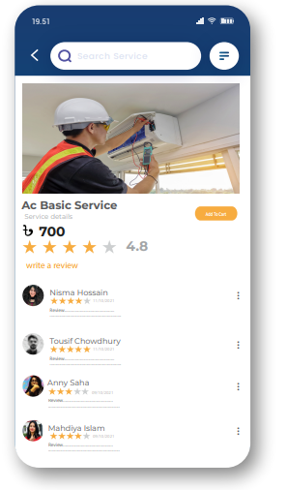
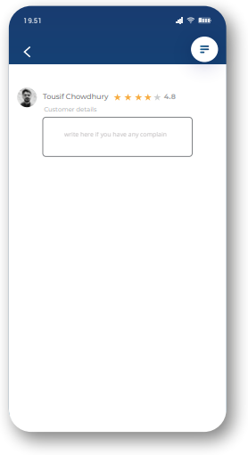
UI Design

Slide 14
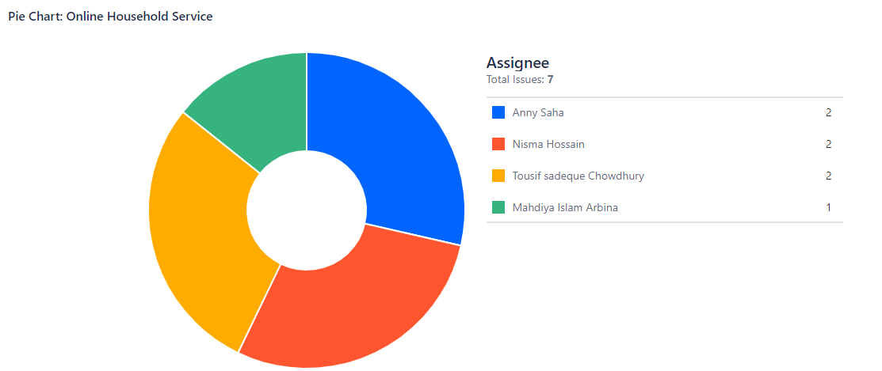
Jira

Slide 15
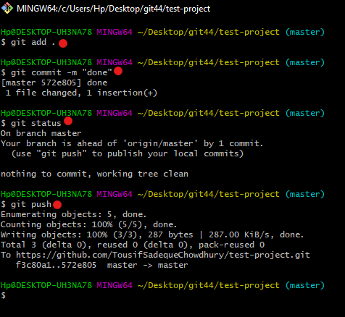
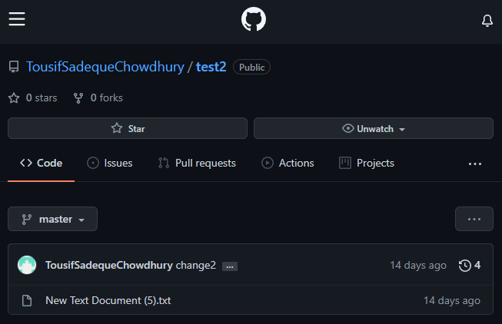
Git

Slide 16
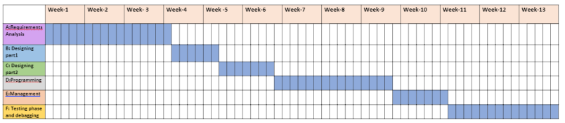
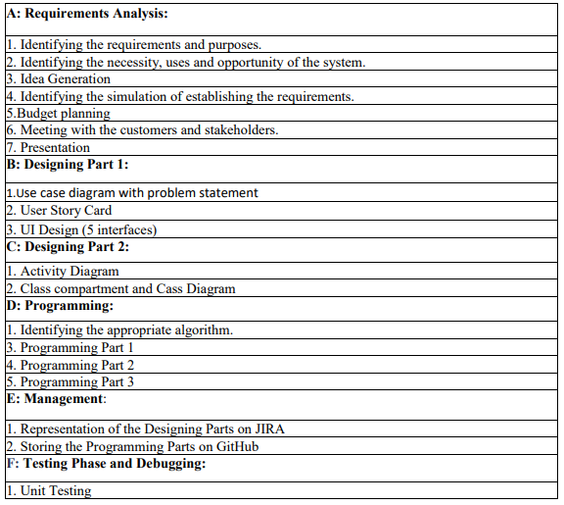
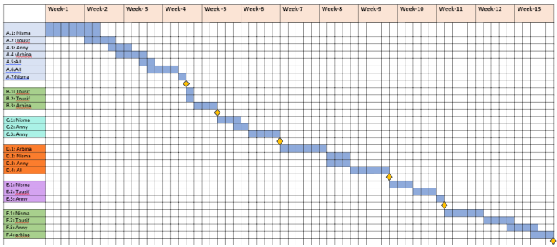
Timeline Chart

Slide 17
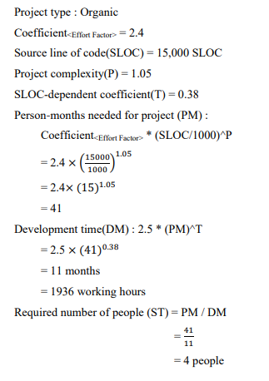
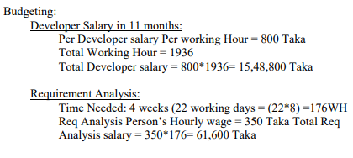
Project Estimation

Slide 18
Conclusion
To sum up, The skill we have gathered regarding Use Case Diagram , Activity Diagram , Class Diagram, User Story Card, UI Design , Jira , Git ,Timeline Chart , Project Estimation. That would come in handy to generate an effective project.

Slide 19
Thank You

