Slide 1
ROCKS
Lithos means Rock
Different colours and hardness
The constituents of rocks are called minerals silica,mica,hematite,bauxite,etc

Slide 2
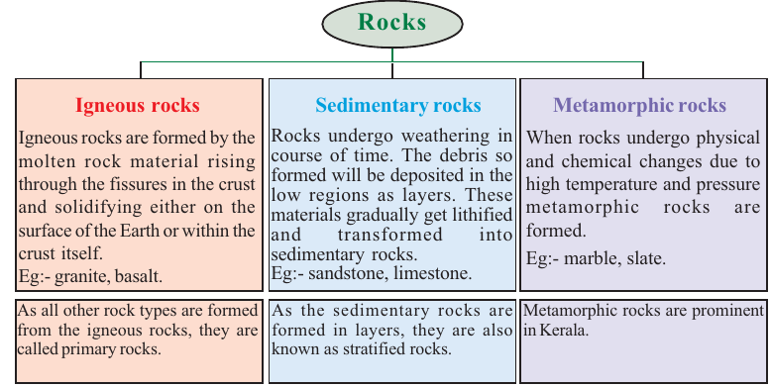

Slide 3
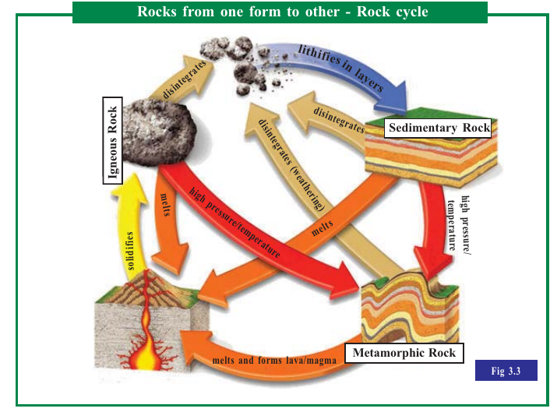

Slide 4
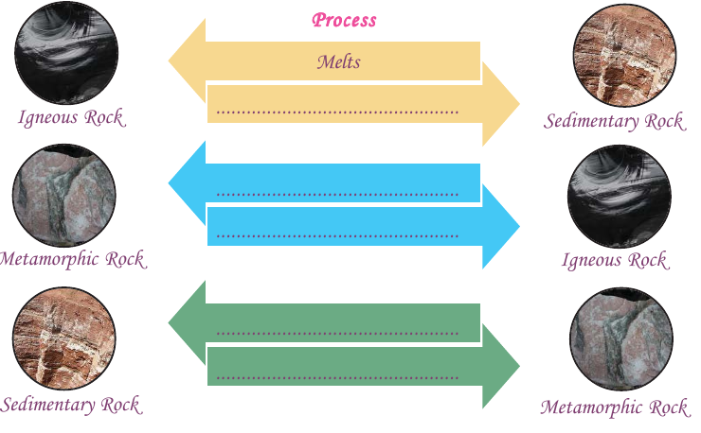

Slide 5
READ MORE

Slide 6
Weathering
Disintegration or dicomposition of rocks change

Slide 7
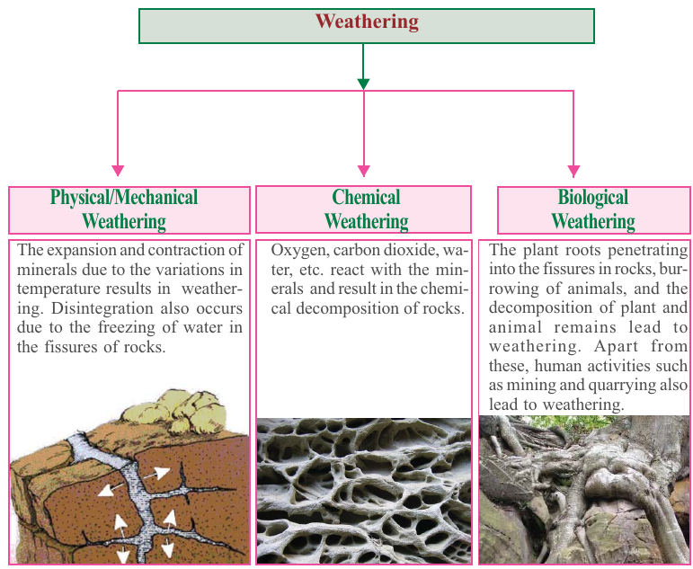

Slide 8
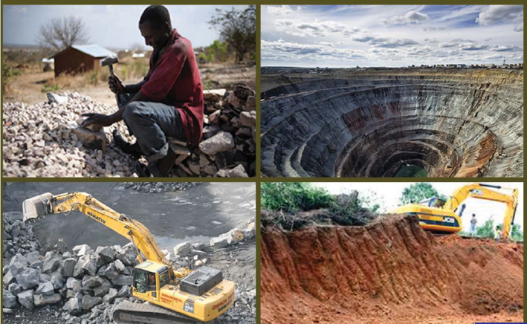

Slide 9
Weathering helps human in many ways
Minerals in rocks get extracted
Helps in mining
Causes soil formation

Slide 10

Visit various places in your locality and identify the human activities that result in weathering...

Slide 11


