Slide 1
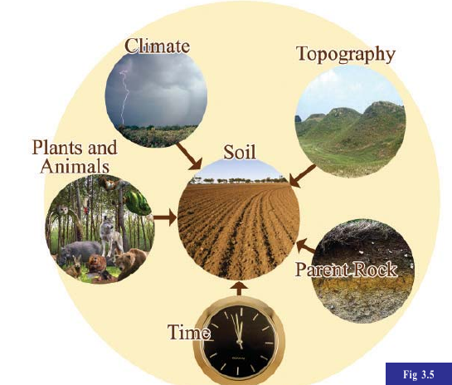
Soil formation

Slide 2
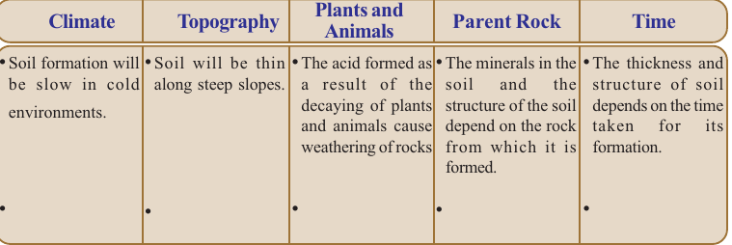

Slide 3
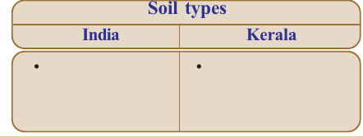

Slide 4
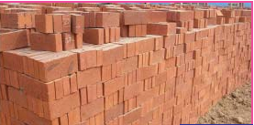
Uses of soil

Slide 5
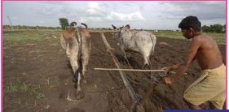

Slide 6
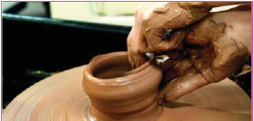

Slide 7
Uses of soil
For construction purposes
Farming

Slide 8
Perishing soil: soil gets perished due to varrios human activities
Deforestation
Deconstruction of hills
Unscientific agricultural activities

Slide 9
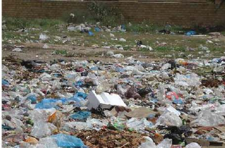

Slide 10
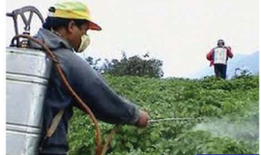

Slide 11
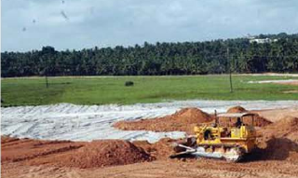

Slide 12
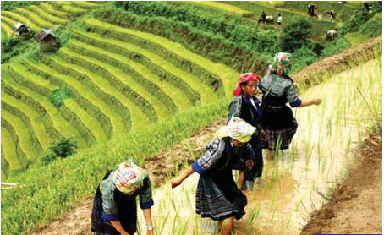
Conservation of soil-terrace farming

Slide 13
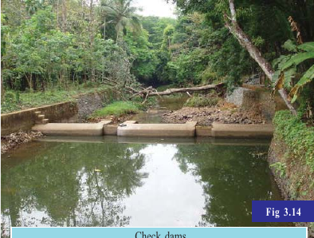

Slide 14
Conservation of soil
check deforestation
Crop rotation
Terrace farming along hill slops
Construction of check dams

Slide 15
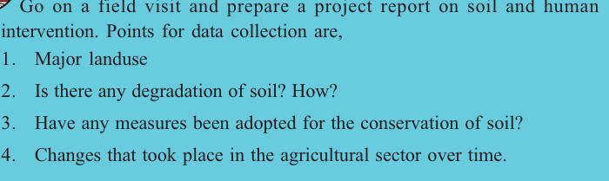

Slide 16
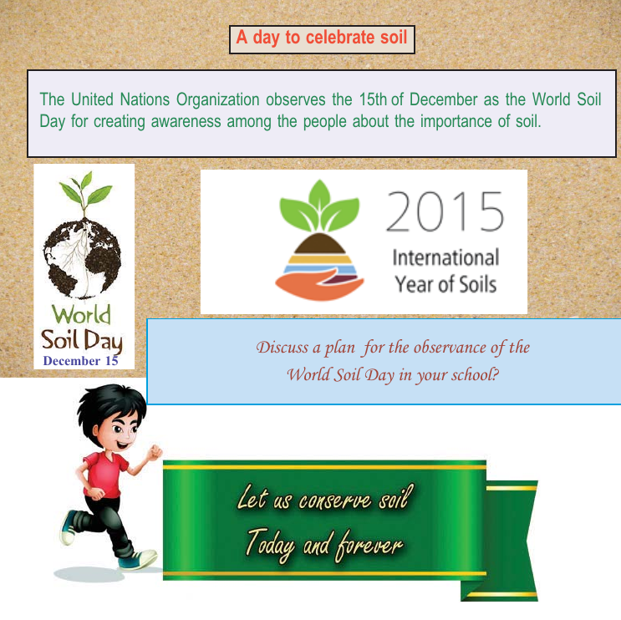

Slide 17
READ MORE

Slide 18
