Slide 1
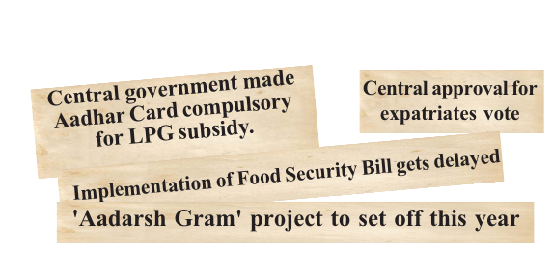
EXECUTIVE
The organ of the government which impliments law and administers the country is called executive

Slide 2
Executive in India
Two types of Executive
The central Executive & State Executive
The President
Central Ministers
Bureaucracy

Slide 3
The political Executive
The President and Ministers are elected
Permanent executive
Appointed on the basis of certain qualifications

Slide 4
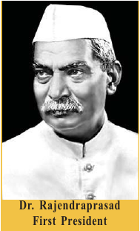
PRESIDENT
The head of the Indian Republic
Elected by an electoral college for a team of five years
Read More
Who is the current president of India?

Slide 5
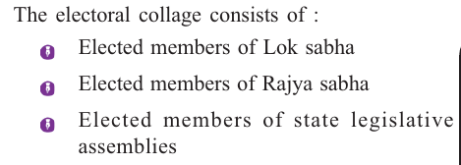

Slide 6
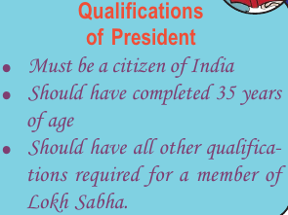

Slide 7
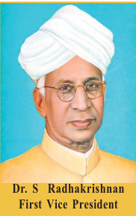
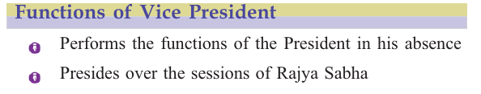
VISE PRESIDENT

Slide 8
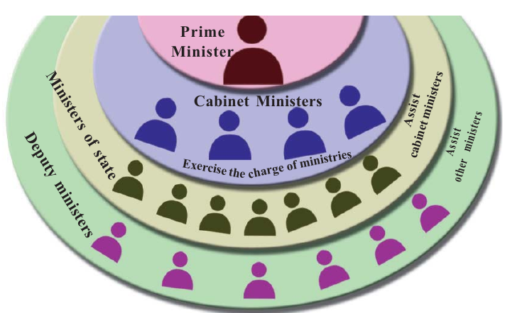
Union Council of Ministers

Slide 9
The Union council of Ministers
work under the leadership of Prime Minister
council of Ministers,which consists of cabinet ministers,ministers of state,and deputy ministers

Slide 10
FIND OUT THE NAME AND PORTFOLIOS OF THE CENTRAL CABINET MINISTERS

Slide 11
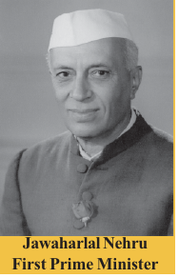
Prime Minister
The leader of the majority party or coalition in the
Lokh Sabha

