Slide 1
JUDICIARY interprets the law passed by the Legislature

Slide 2
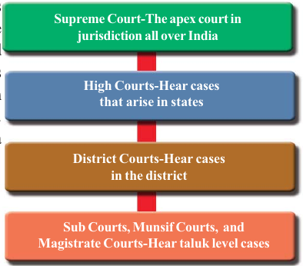
Structure of the Judicary

Slide 3
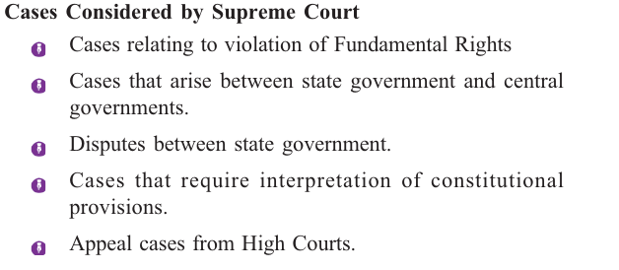

Slide 4
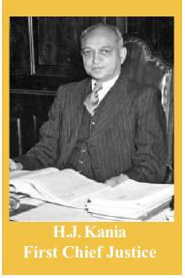
Judiciary in india
Supreme Court
The apex court in India
Consists of a Chief Justice and judges appointed by the president
At present the supreme court has a Chief Justice and 30 judges

Slide 5
High Court
The highest court in a state .
Consists of the chief justice and other judges appointed by the state.
Supervises the working of district courts and other subordinate courts.

Slide 6
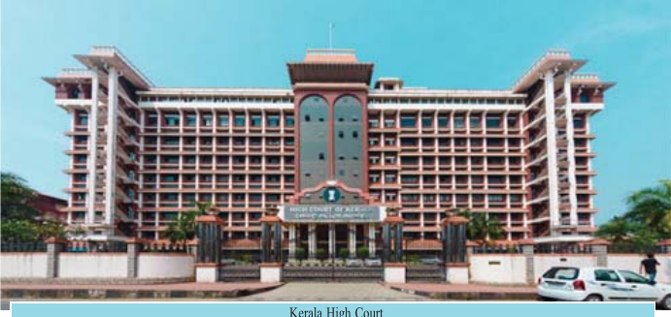
Kerala High Court

Slide 7
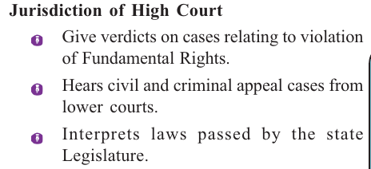

Slide 8
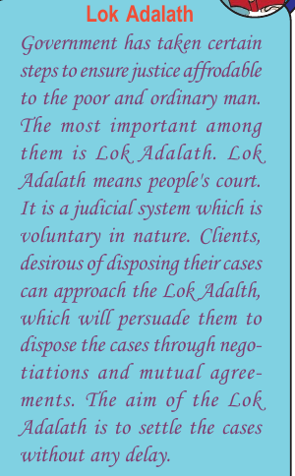

Slide 9
Subordinate Courts
consists of District Courts,Sub Courts,and Magistrate courts
Give verdicts on civil and criminal cases

Slide 10
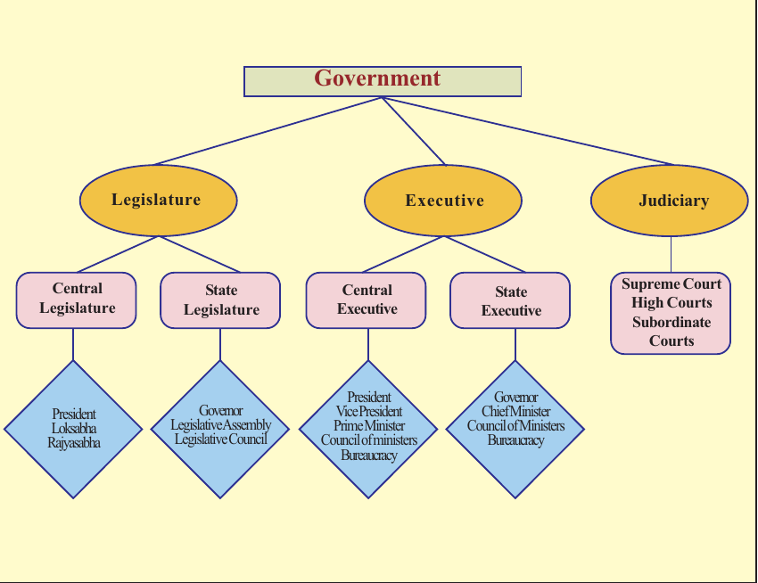

Slide 11
Conduct a model parliament in school to explain the legislative procedure

