Slide 1
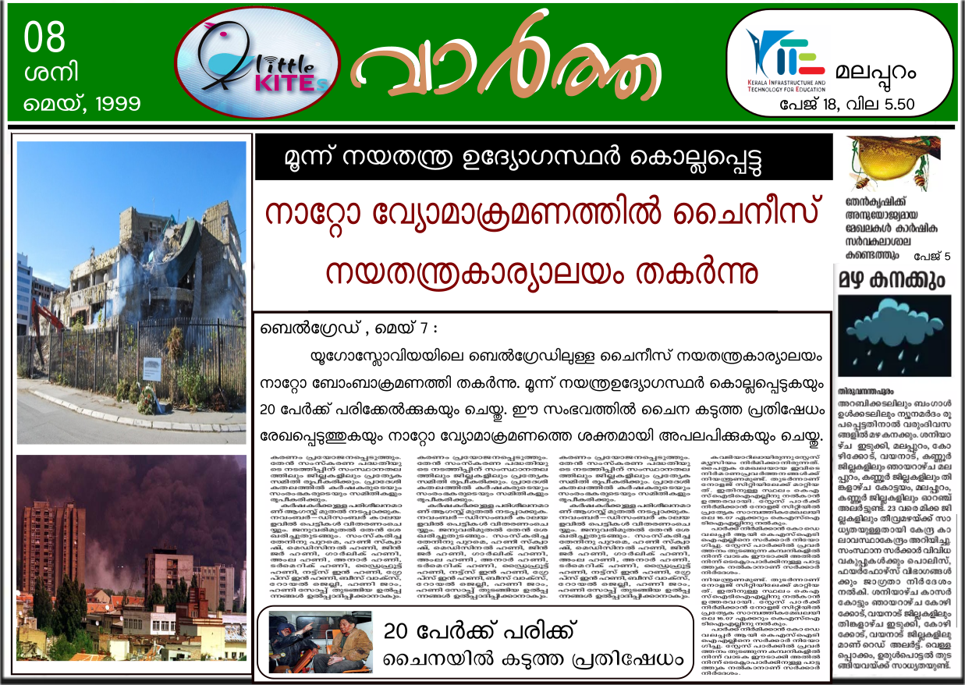

Slide 2
Why did NATO destroyed The Chinese
Embassy ?
Did it actually aimed at The Chinese
Embassy ?
Or was it a misfire ?

Slide 3
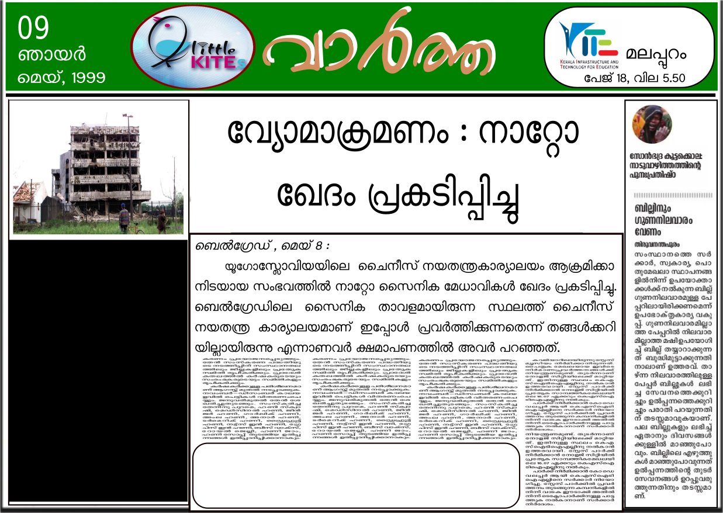
പേജ് 7
ബെല്‍ഗ്രേഡിലെ ചൈനീസ് നയതന്ത്ര
കാര്യാലയം നിലവില്‍
വരുന്നതിന് മുമ്പുള്ള
ഭൂപടമാണ് നാറ്റോ
സൈനിക നടപടിക്ക്
ഉപയോഗിച്ചത്
ഇതാണ് സൈനിക കേന്ദ്രമെന്ന് കരുതി
തയതന്ത്ര കാര്യാലയം
ആക്രമിക്കാന്‍ കാരണം
ഭൂപടങ്ങള്‍ കാലാനുസൃതമായി പരിഷ്ക്കരി
ക്കേണ്ടതിന്റെ ആവശ്യകതയിലേക്ക് മേല്‍
സംഭവം വിരല്‍ ചൂണ്ടുന്നു

Slide 4
Different Types of Maps‍

Slide 5
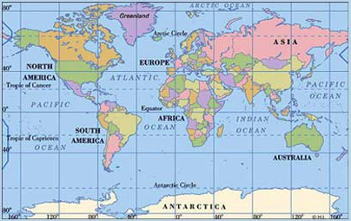
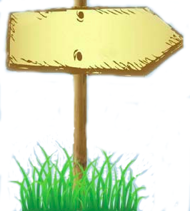
Political Map

Slide 6
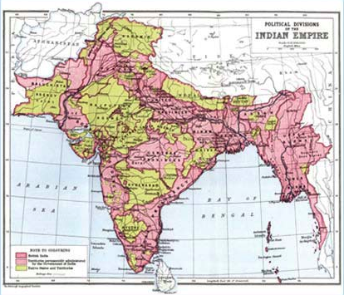
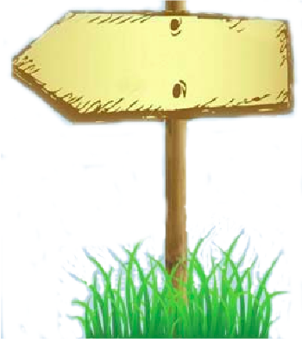
Historical Map

Slide 7
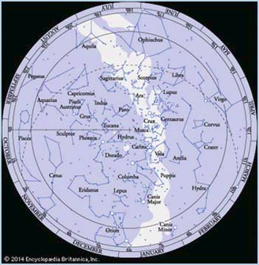
Astronomical Map

Slide 8
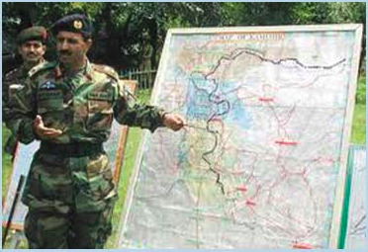
Military Map

Slide 9
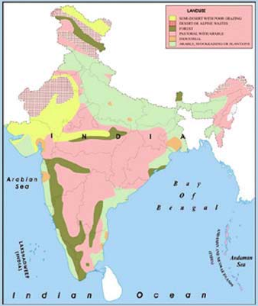
Land use Map

Slide 10
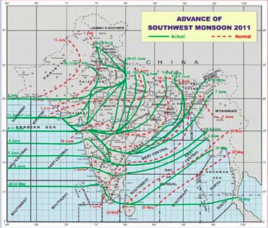
Weather Map

Slide 11
Maps and their uses are given.
Arrange the table suitably

Slide 12
Maps | Uses
Political Map | For understanding the landuse
Military Map | For the study of celestial bodies
Astronomical Map | For meteorological studies
Historical Map | For military purposes
Landuse Map | For understanding the political boundaries
Weather Map | For the study of history

Slide 13
Maps | Uses
Political Map | For understanding the political boundaries
Military Map | For military purposes
Astronomical Map | For the study of celestial bodies
Historical Map | For the study of history
Landuse Map | For understanding the landuse
Weather Map | For meteorological studies

Slide 14
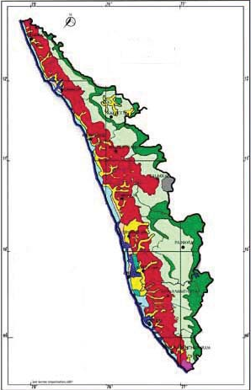
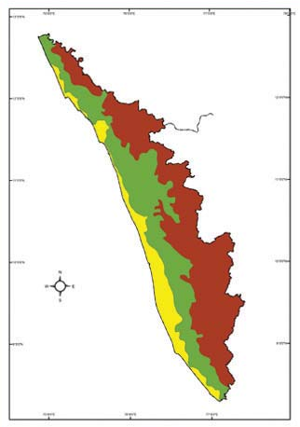
Compare the given maps of Kerala. Are the information included in both the maps the same?
Kerala
Soils
Kerala
Physiography

Slide 15
Why different Maps for different purpose ?
What might happen if both soil types and physiography
are incorporated in the same map?

Slide 16
Including different information in the same map will create confusion in reading it. That is why different information are plotted in different maps

Slide 17
Thematic Maps
Maps depicting specific themes are
known as Thematic Maps.‍

Slide 18
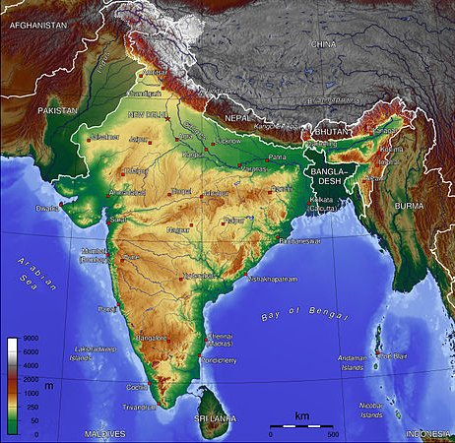
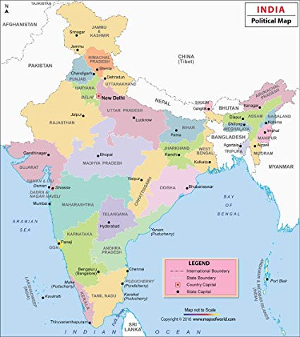
Classification of Maps based on function
Physical Maps
Cultural Maps

Slide 19
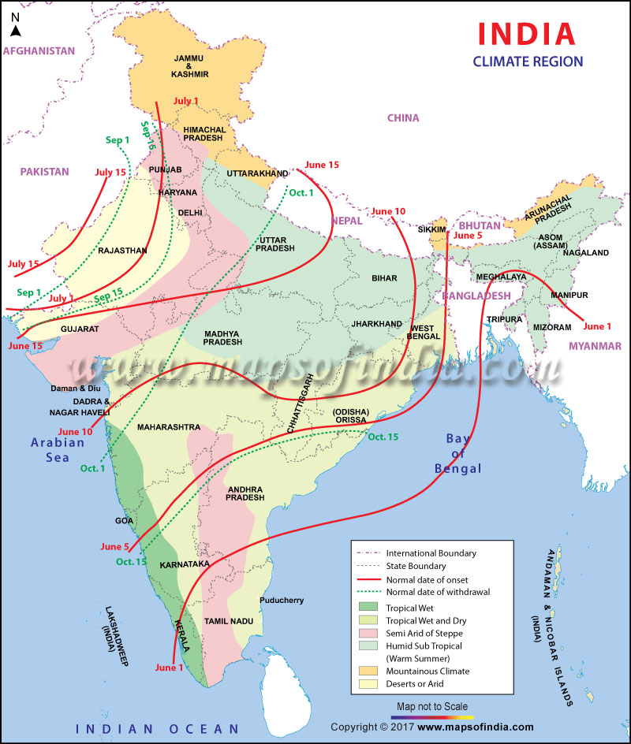
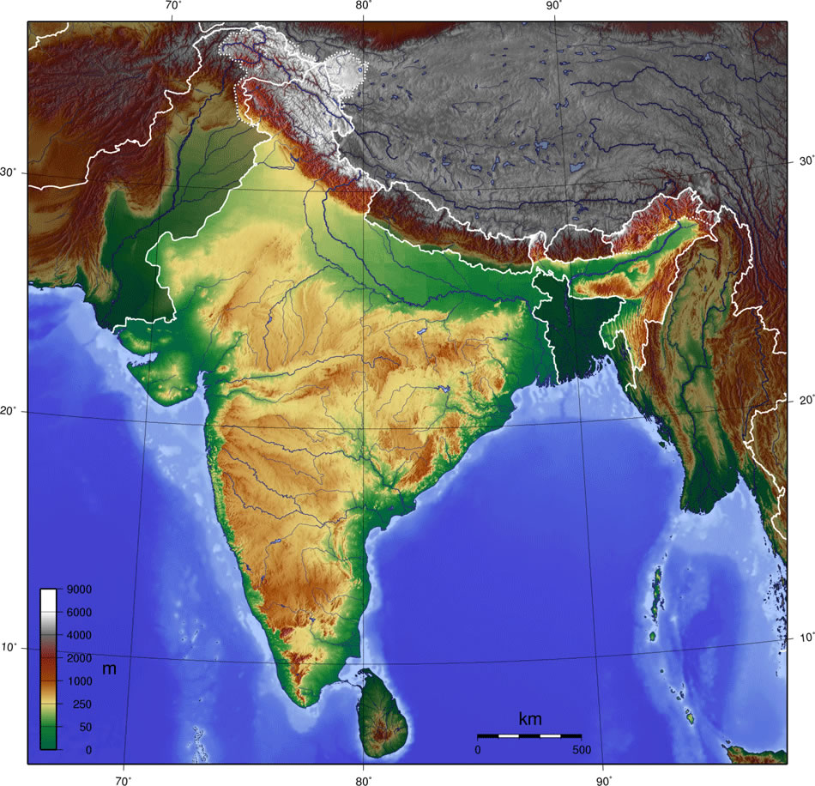
Physical Maps‍
Maps representing
natural features such as
physiography, climate, etc.
are called physical Maps

Slide 20
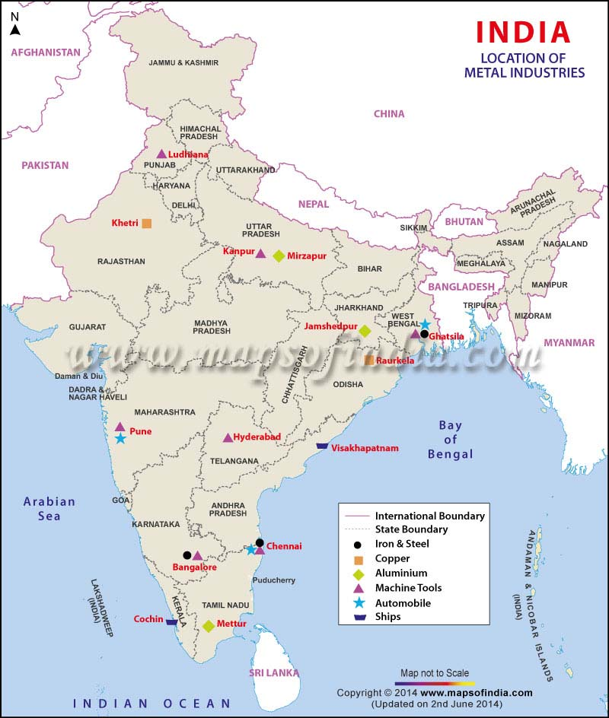
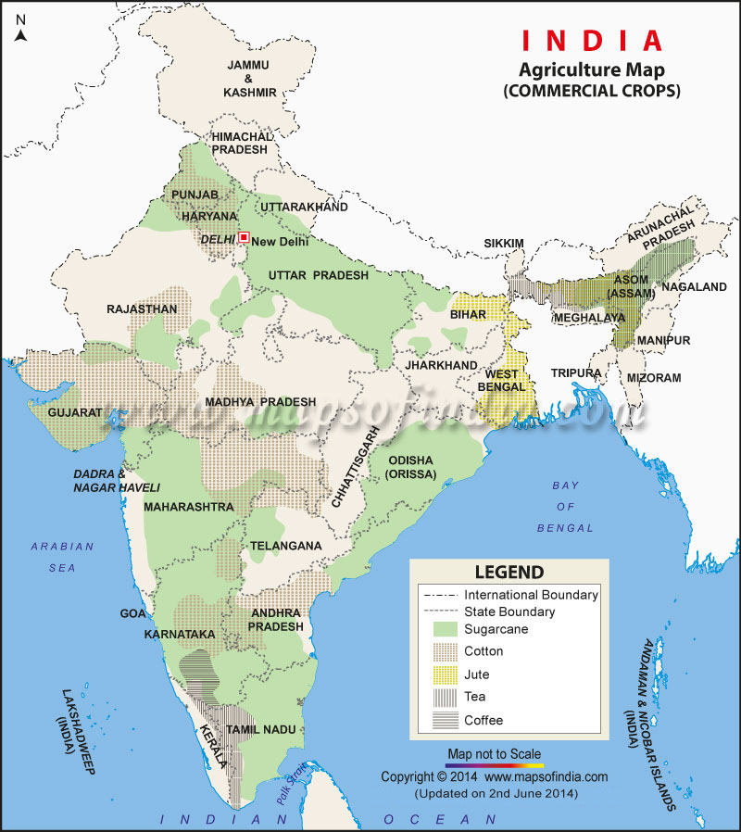
Cultural Maps‍
Maps representing man-made features such as agriculture, industry, and political boundaries are called cultural maps.‍

Slide 21
List of Maps are given based on their content
Arrange suitably

Slide 22
Table the different types of Maps based on
their content Table them suitably
Political Map | Astronomical Map
Agricultural Map | Military Map
Soil Map | Weather Map
Industrial Map | Landuse Map
Climatic Map | Physiography Map
Natural Vegetation Map | Historical Map

Slide 23
Physical Maps | Cultural Maps
Soil Map | Political Map
Astronomical Map | Agricultural Map
Climatic Map | Military Map
Physiography Map | Industrial Map
Natural Vegetation Map | Landuse Map
Weather Map | Historical Map

Slide 24
Physical Maps | Uses‍ / Importance
Soil Map | For meteorological studies
Astronomical Map | For the study of physiography of a country
Climatic Map | For understanding different soils and their distribution
Physiography Map | For the study of celestial bodies
Natural Vegetation Map | For the study of weather change
Weather Map | For understanding the distribution of Natural Vegetation

Slide 25
Cultural Maps | Uses‍ / Importance
Political Map | For military purposes
Agricultural Map | For the study of history
Military Map | For understanding the political boundaries
Industrial Map | For understanding the distribution of different crops
Landuse Map | For understanding the distribution of Industries
Historical Map | For understanding the landuse

Slide 26
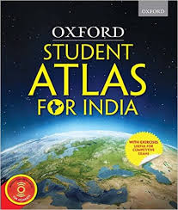
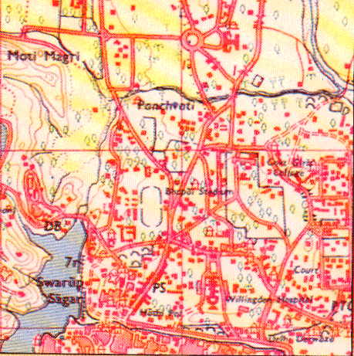
Classification of Maps based on Scale
Small scale maps‍‍
Large scale maps‍‍

Slide 27
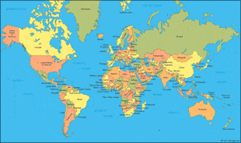
Small Scale Maps‍
Atlas Maps
Maps showing only the important information of larger areas are called small scale maps
Only a little information can be incorporated into it
Maps of such as the world, continents, countries, and states
Wall Maps‍

Slide 28
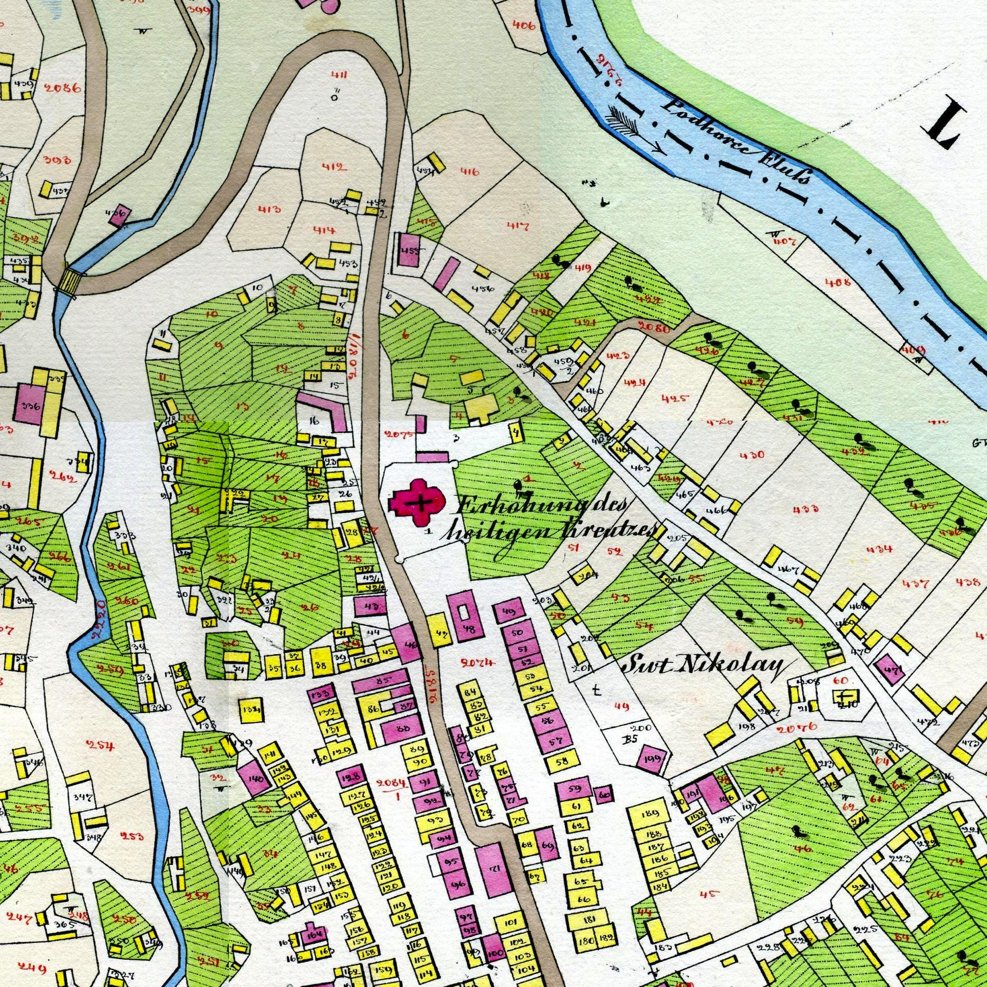
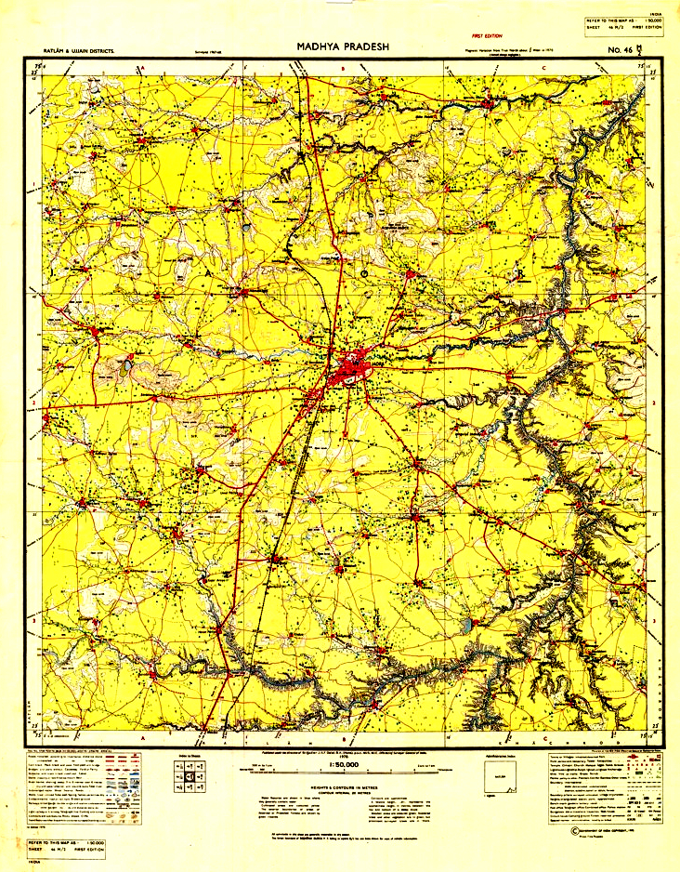
Large Scale Maps
Maps representing detailed information of a small area are called large scale maps.‍
More information can be incorporated into it
ward or village Maps are examples
Topographical Maps‍
Cadastral Maps

Slide 29
Map reading
Map reading requires a good knowledge of its scale,
direction, and the signs and symbols used in them.

Slide 30
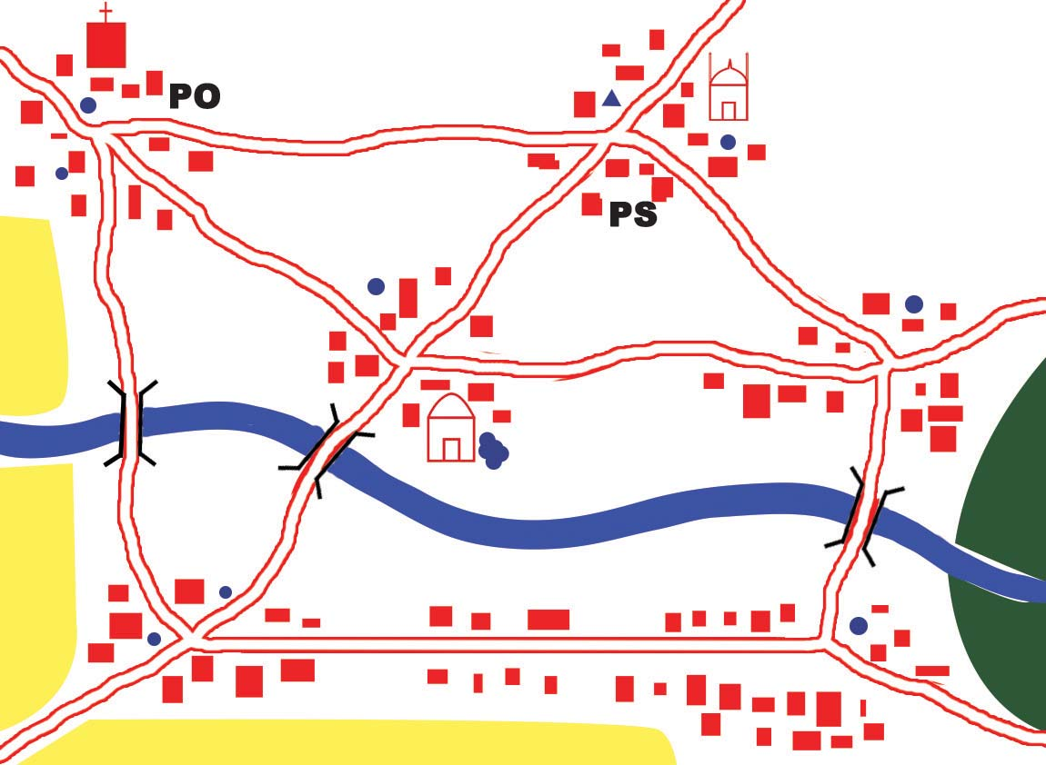
Mutholapuram
Mukkadavu
Kallupalam
Mariyapuram
Valiyapara
Udhyagiri

Slide 31
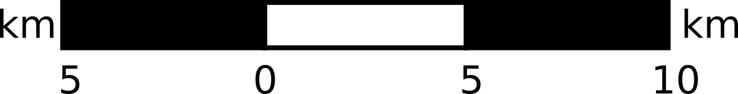
1 centimetre to 5 kilometre
Mutholapuram
Mukkadavu
1:500000
Kallupalam
Mariyapuram
Valiyapara
Udhyagiri

Slide 32
1 centimetre to 5 kilometre
1:500000

Slide 33
1 centimetre to 5 kilometre
Statement of scale

Slide 34
Statement of scale
It shows 1 cm to 5 km. This method of representing the scale
is the statement of scale
It means one centimetre on the map represents 5 km on
earth‍
The merit of this method is that even a layman can easily
understand this

Slide 35
1:500000
Representative fraction

Slide 36
Representative fraction
It is the ratio between the map distance and corresponding ground
distance expressed in fractional form
For example, the statement of scale 1 cm to 5 kilometres, can be
represented as 1 : 500000 in representative fraction
This proportionate distance can be read in accordance with the units
followed in each country
While the Indians read this as 1 centimetre to 500000 centimetres, the
Europeans can read this as 1 inch to 500000 inches

Slide 37
Linear scale

Slide 38
Let us have a work before understanding
the leaner scale.

Slide 39
Let us measure distance
Let us study the method of measuring distance in a map

Slide 40
Requirements
Scale
Pencil
Paper folded like a scale
Thread
Divider

Slide 41
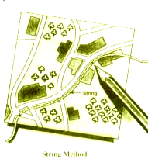
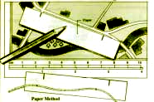
The Methods of Measuring Distance in a Map
Paper Method
String Method

Slide 42
To measure straight distance‍
Place the paper, folded like scale, parallel to
the places to be measured
Mark the places on the paper as shown in the
picture
Find the distance with the help of a scale
This can be done by using divider too

Slide 43
To measure a curved distance‍
First measure the curved distance like river or road using a thread
Mark the places on the thread with a pncil
then measure the length of the thread with a scale
Now you have the map distance

Slide 44
Now you have the map distance. What should be
done to find the actual distances ?

Slide 45
The map distance should be multiplied with the
proportionate ground distance shown in the map scale.
Example :
Scale of the map is 1 cm to 5 km‍
Suppose the distance from A to B in the map is 4 cm
Then the actual distance from A to B = 4 x 5 km = 20 km

Slide 46
Let have a work

Slide 47
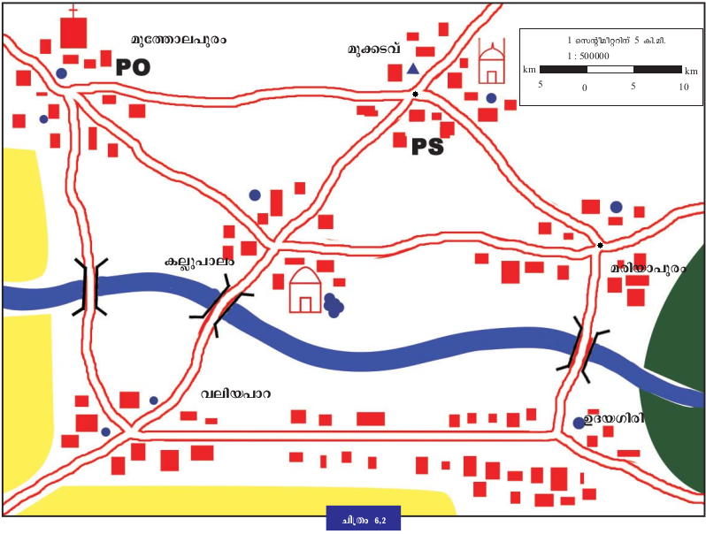
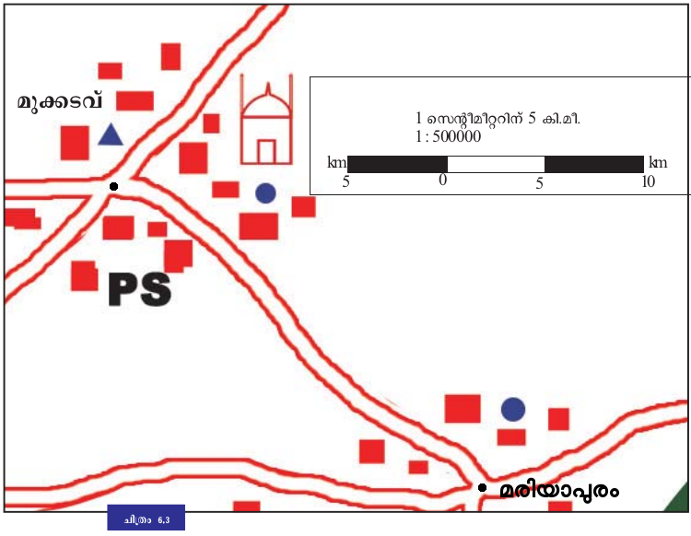
Find the distance from Mukkadavu to Mriyapuram
Fig. 6.2 ( Page : 93 )
Fig. 6.3 ( Page : 95 )

Slide 48
Find the map distance between the two places with the
help of a thread
The map distance should be multiplied with the
proportionate ground distance shown in the map scale.
Use the three scales. Which scale shows the same
distance in two maps
What can be understand from this ?

Slide 49
Linear scale
The linear scale will change in proportion with the change in the
map
When a map is subjected to enlargement or reduction, the linear
scale will also change accordingly. So distance will be same in two
maps according to the leaner scale
But the scales represented by the other two methods (statement
of scale and representative fraction) will not changed in accordance
with the change in the map

Slide 50
Try to answer the following questions based on the map fig 6.2 ( Page N0. 93 )
Which is the shortest route for Gopu, who resides at Kallupalam, to
reach his uncle's home in Udayagiri?
How long should he travel from Udayagiri to Mutholapuram market
via Valiyapara?
How much distance should he cover from Mutholapuram back to
his home at Kallupalam via Mukkadavu?

Slide 51
1 centimetre to 5 kilometre
Mutholapuram
Mukkadavu
1:500000
Kallupalam
Mariyapuram
Valiyapara
Udhyagiri

Slide 52
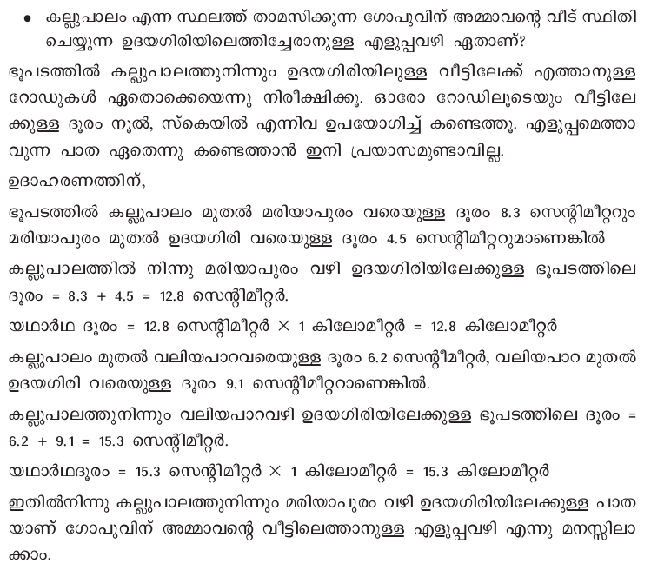

Slide 53
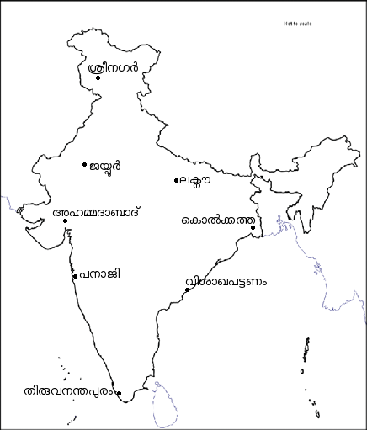
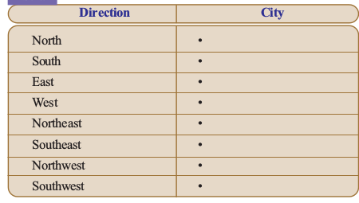
Directions in maps
A few cities in India are marked on the map (Fig 6.4). Try to identify the location of these cities based on direction

Slide 54
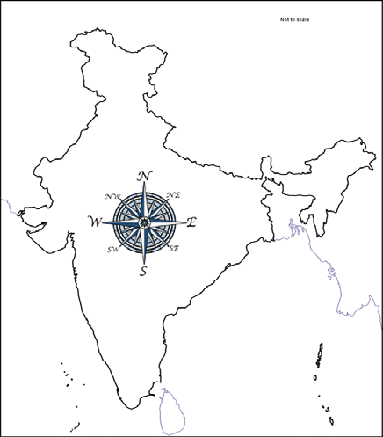
Directions in maps
If you feel difficult complete the table with the given map

Slide 55
Signs and symbols used in maps
Read the following descriptions about an area:
Length and breadth of the area are 1500 m and 1000 m
respectively.
A river flows from between the north and northwest towards
the south-southeast.
A road runs across the river from west to east and there is a
railway line just north of the road running parallel to it.

Slide 56
The north eastern part consists of paddy fields which extend to about
500 m towards the west and 400 m towards the south from the north east corner. Between the paddy field and the river, there is a temple near the former about 200 m to the south and a pond immediately south of it
The south western part is a forest extending 450 m to the east and 400 m to the north from the south west corner. There is a fort located close to the forest at a distance of 150 m from the south to the north.
Between the south and southeast there are settlements close to the river and a post office and a police station close to the road.
Prepare a sketch based on the above description

Slide 57
Did ? Is there any uniformity in the sketches ?

Slide 58
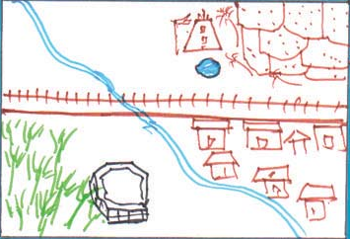
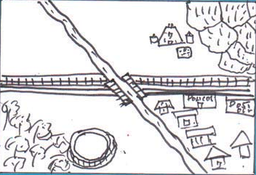
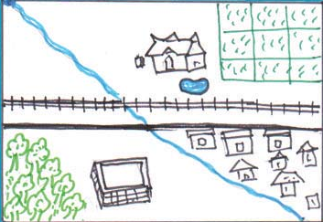
The given sketches were prepared by three students based on the above description.

Slide 59
There is no uniformity in this the sketches too. Why ?
Is it the same signs and symbols used by the three
students in their sketches ?
Map reading will be confusing if different countries use
different signs and symbols for map making
That is why internationally accepted signs and symbols
are used for making maps.
Get familiarised with a few conventional signs and
symbols

Slide 60
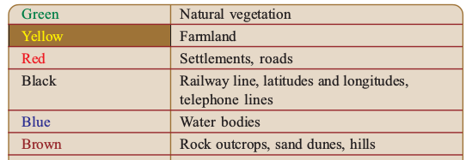

Slide 61
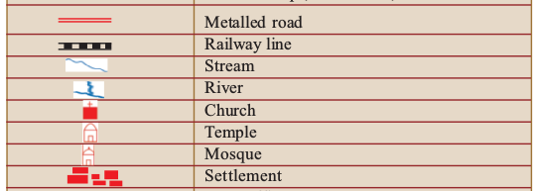

Slide 62
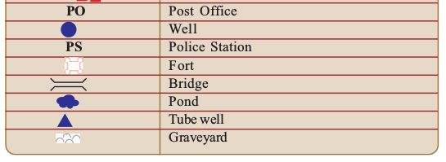

Slide 63
Prepare a sketch based on the earlier descriptions.
Make use of the conventional signs and symbols.

Slide 64
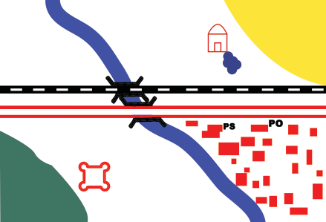
Look at the map It has been prepared based on the earlier description using conventional signs and symbols.
Scale: 1cm to 2 km‍
Compare it with the ones prepared by you

Slide 65
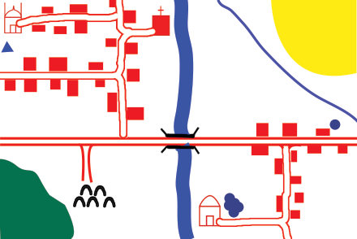
Observe the map ( Fig 6.8 ) and answer the questions.
What is the scale of this map?
In which directions are the places of worship situated?(Mosque, temple, church)
How far is the temple from Arya's home?
Scale: 1cm to 2 km‍

Slide 66
Observe the map ( Fig 6.8 ) and answer the questions.
How far is the graveyard from the church?
To which direction from the temple is the pond?
How long is the canal from the northern end to the bridge?
Scale: 1cm to 2 km‍

Slide 67
Observe the map ( Fig 6.8 ) and answer the questions.
In which direction are the forest and agricultural field located ?
What is the length of the stream flowing west of the agricultural field ?
Scale: 1cm to 2 km‍

