Slide 1



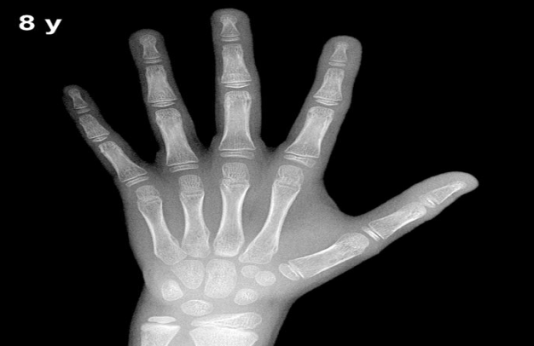
M.Salar rahim
Prepared by:
Nisreen bako

Slide 2
package project;
import java.util.Scanner;
public class Project {
static Scanner in=new Scanner(System.in);
private int fatherHigh;
private int motherHigh;
private int age;
private String s="male";
private int result;
private boolean xRay=true;
private boolean blood=true;

Slide 3
public int getAge(){
return age;
}
public String getS(){
return s;
}
public int getFatherHigh(){
return fatherHigh;
}
public int getMotherHigh(){
return motherHigh;
}

Slide 4
public void setAge(int newAge){ age=newAge; } public void setS(String newS ){ s=newS; } public void setFatherHig(int newFatherHig){ fatherHigh=newFatherHig; } public void setMotherHigh(int newMotherHigh){ motherHigh=newMotherHigh; }

Slide 5


Slide 6
Do you have any question

Slide 7
public static void main(String[] args) {
Project ob=new Project();
ob.setAge(18);
ob.setS("male");
ob.setFatherHig(170);
ob.setMotherHigh(160);
System.out.println(ob.getAge());
System.out.println(ob.getS());
System.out.println(ob.getFatherHigh());
System.out.println(ob.getMotherHigh());

