Slide 1



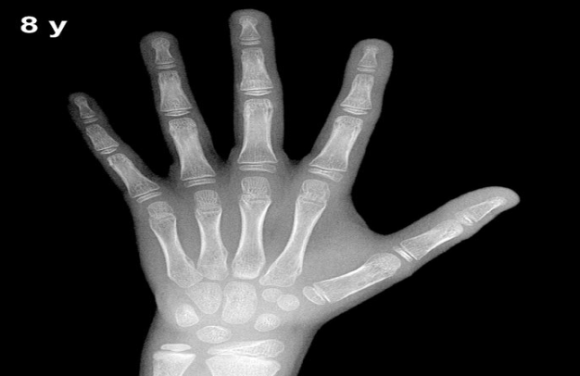
M.Salar rahim .
Prepared by:
Nisreen bako

Slide 2
Endocrinologist
Endocrinologist

Slide 3
package doctor; import java.util.Scanner; public class Doctor { public static void main(String[] args) { Scanner in=new Scanner(System.in); int fatherHigh; int motherHigh; int age=18; int result; boolean xRay=true; boolean blood=true;

Slide 4
System.out.println("please enter the length of your fatherHigh "); fatherHigh=in.nextInt(); System.out.println("please enter the length of your motherHigh "); motherHigh=in.nextInt(); System.out.println("please enter your age"); age=in.nextInt(); System.out.println("please enter your gender "); String gender=in.next();

Slide 5
if(gender=="male"&&age<18&&xRay==true&&blood==true){
System.out.println("you can start treatment ");
result=fatherHigh/2+motherHigh/2+13/2;
System.out.println("expected growth for you "+result+"cm");
}else if(gender=="male"&&age>=18&&xRay==true&&blood==true){
System.out.println("sorry stopped growth ");
System.out.println("you have only one solution surgery");

Slide 6


Slide 7
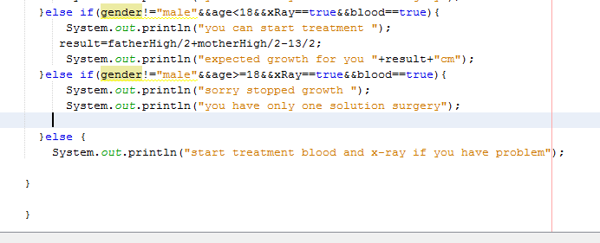

Slide 8


Slide 9
Do you have any question

