Slide 1




DSF 36.0 - Data Science
BREAST CANCER CLASSIFICATION ANALYSIS USING K-NEAREST NEIGHBORS (KNN)
This project aims to analyze the classification of malignant and benign breast cancer tumors using a Machine Learning algorithm, namely K-Nearest Neighbors (KNN).
by Nisrina Asyifa Nur Azizah

Slide 2








TOOLS AND LIBRARIES

Slide 3
OUTLINE OF DATA ANALYSIS
01
Load Data
Model Performance Evaluation
04
02
Preprocessing Data
Data Visualization
05
03
Machine Learning Model
Conclusion
06

Slide 4
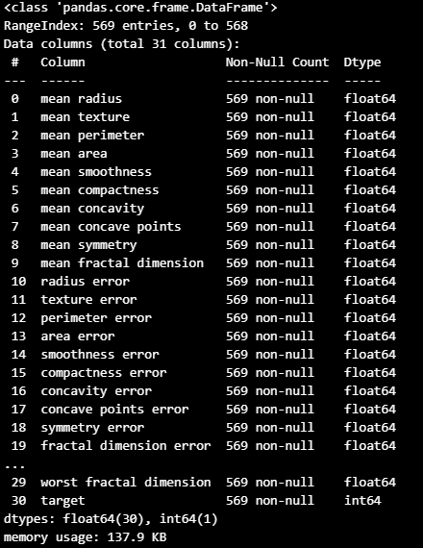

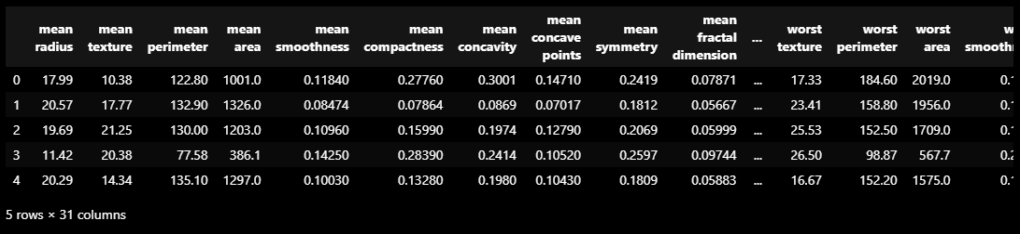
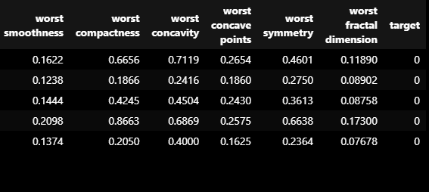
LOAD DATA
Breast Cancer Wisconsin (Diagnostic) dataset from the scikit-learn library.
It has 30 numerical features related to tumor characteristics.
Target (Class Label):
0: Malignant
1: Benign
A total of 569 samples, consisting of 357 benign and 212 malignant.

Slide 5
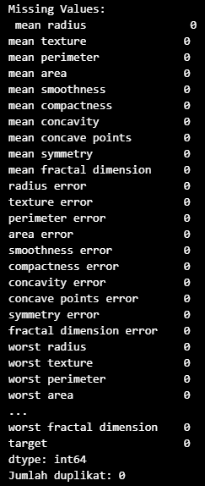

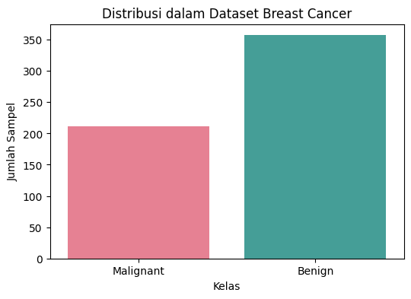
PREPROCESSING DATA
Checking for missing values and data duplication.
1
Feature normalization using StandardScaler
2
Divide the dataset into training data (80%) and testing data (20%)
3
Visualisasi distribusi data
4

Slide 6
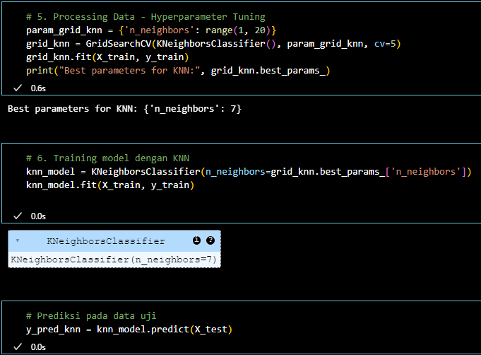
MACHINE LEARNING MODEL
The K-Nearest Neighbors (KNN) model was chosen for its simplicity and effectiveness in classification.
Determining the optimal number of neighbors with GridSearchCV.
Main parameters: k = 7

Slide 7
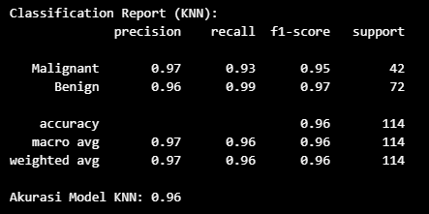
MODEL PERFORMANCE EVALUATION
Malignant
Precision = 0.97 → 97% of predicted Malignant cases are correct.
Recall = 0.93 → 93% of actual Malignant cases are correctly identified.
F1-score = 0.95 → 95% Balanced measure of precision & recall.
Benign
Precision = 0.96 → 96% of predicted Benign cases are correct.
Recall = 0.99 → 99% of actual Benign cases are correctly identified.
F1-score = 0.97 → 97% Excellent classification performance.
Overall Model Performance
Accuracy = 96%, meaning the model correctly classifies 96% of all cases.
Macro & Weighted Averages confirm balanced performance across both classes.
Slightly lower recall for Malignant cases (0.93) means some malignant cases are misclassified.
Classification report shows evaluation metrics (Accuracy, Precision, Recall, F1-Score)
Model accuracy, i.e. the percentage of correct predictions compared to the total test data

Slide 8
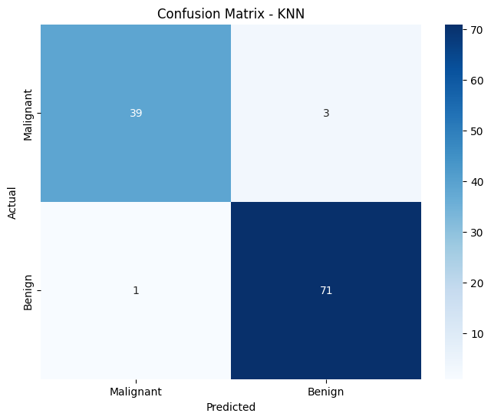
DATA VISUALIZATION
Confusion matrix, which shows the number of correct and incorrect predictions for each class
Interpretation of the Confusion Matrix
True Positives (Malignant correctly classified): 39 samples
False Negatives (Malignant misclassified as Benign): 3 samples
True Negatives (Benign correctly classified): 71 samples
False Positives (Benign misclassified as Malignant): 1 sample

Slide 9
CONCLUSION
High Accuracy
The KNN model achieved 96% accuracy, indicating excellent performance in classifying cancer data.
Performance on Malignant and Benign Classes
High precision & recall for both classes.
The recall for Malignant (0.93) is lower than Benign (0.99), meaning some cancer cases were misclassified.
Confusion Matrix Insights
3 Malignant cases were misclassified as Benign, which could be risky in medical diagnosis.
1 Benign case was misclassified as Malignant, potentially causing unnecessary anxiety for the patient.

Slide 10
THANK YOU
More information nisrinaasyifa56@gmail.com

