Slide 1

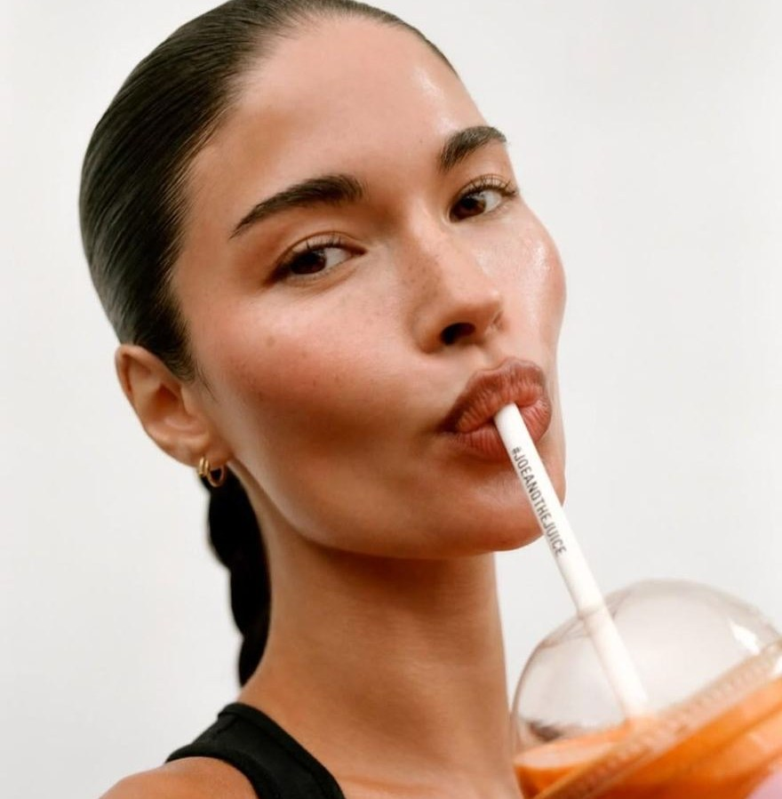
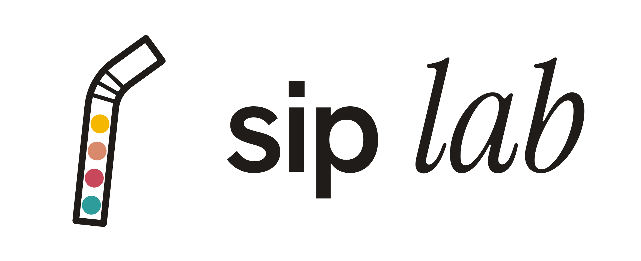


mini
active
one sip for every age
The active straw: food supplements you drink, in 4 ranges, for ages 4 to 104.
Nisrine Margoum · founder · investor pitch
luna
silver
Notes:
[0:00 – 0:25] Good morning. My name is Nisrine Margoum, and I am here to present sip lab, the active straw. Let me start with a simple question: who here has ever bought a food supplement… and forgotten it at the back of a cupboard? That is exactly where sip lab begins.

Slide 2
the problem isn't the ingredient, it's the habit
THE PROBLEM
2 in 3
who is affected?
French people take food supplements
Children refuse syrups and capsules.
15 to 20%
Seniors struggle to swallow their pills.
of adults find it hard to swallow a pill
1 in 2
Women buy with the best intentions, then forget the jar.
patients actually stick to a long-term treatment
Sources: Synadiet / Toluna Harris Interactive (2026) · literature review on pill dysphagia (PMC) · WHO, Adherence to long-term therapies (2003).
Notes:
[0:25 – 1:05] Two in three French people take food supplements. But the habit doesn't follow. Between 15 and 20% of adults find it hard to swallow a pill, and according to the WHO, only one patient in two really sticks to a long-term treatment. In real life, children refuse syrups, seniors struggle with capsules, and the rest of us simply forget the jar. The problem isn't the ingredient. It's the habit.

Slide 3
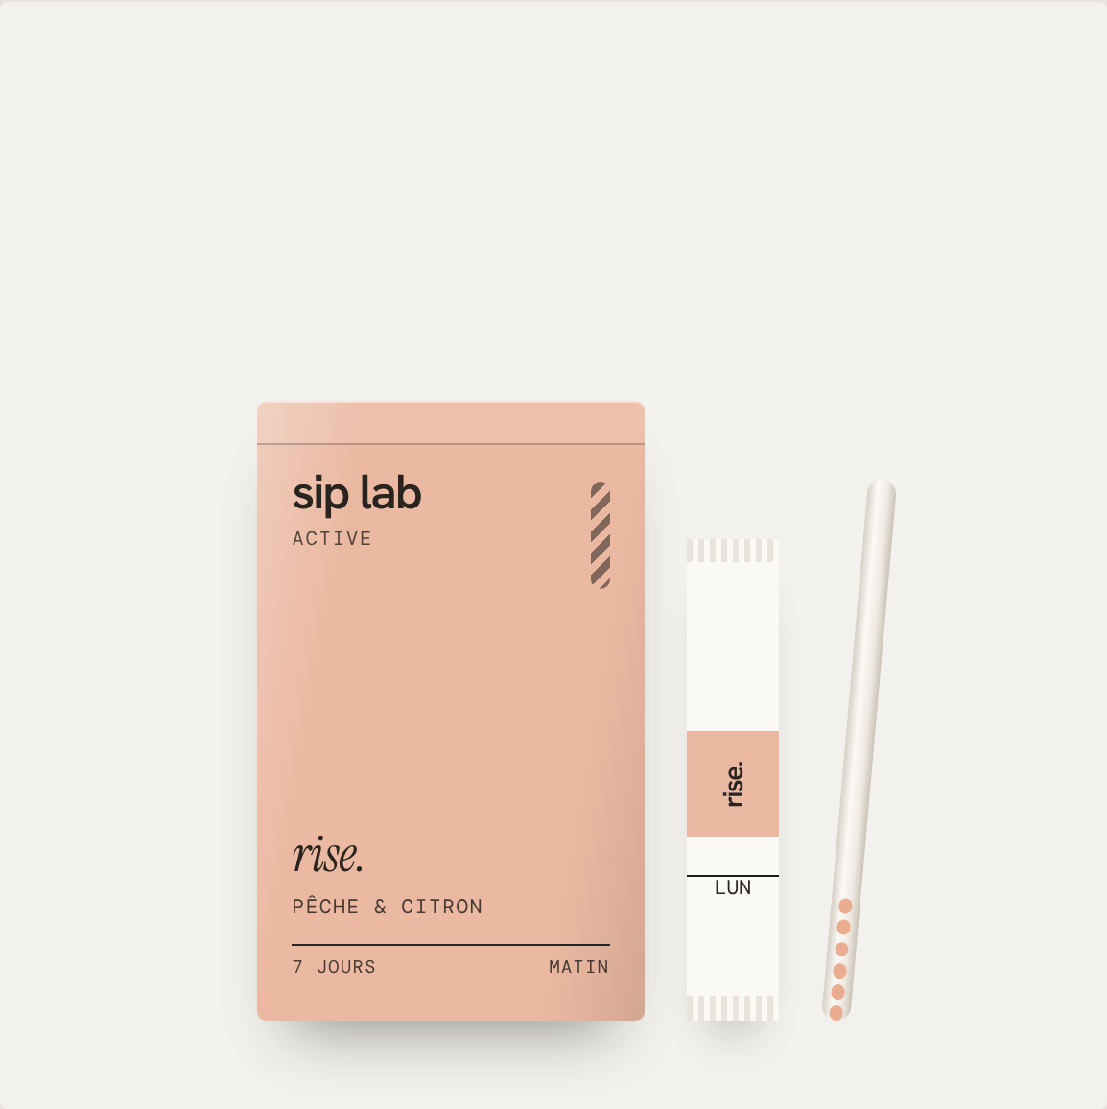
sip lab, the active straw
THE SOLUTION
1
pick a drink
Water, milk, juice, iced tea. The one you already drink.
2
drink as usual
The liquid dissolves the flavoured active micro-beads inside the straw.
3
the dose is taken
Beads gone = full dose. Easy to see, even for a child.
nothing to swallow
no added sugar
visible dose
1 box = 1 week
Notes:
[1:05 – 1:40] My solution is sip lab, a straw filled with flavoured micro-beads of active ingredients. You put it in the drink you already have, you drink as usual, and once the beads are gone, the dose is taken. Nothing to swallow, no added sugar, and you can see the dose. Each box holds 7 straws: one week of routine. The straw technology already exists, and I am working with a manufacturing partner.

Slide 4
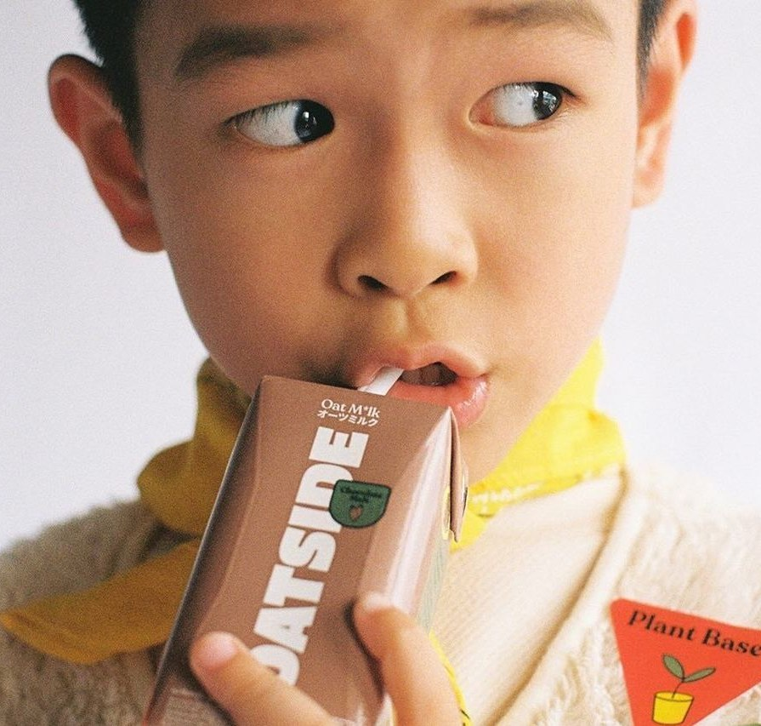
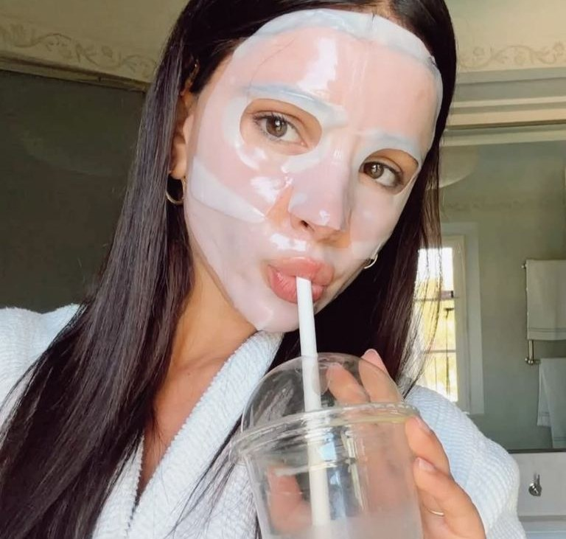


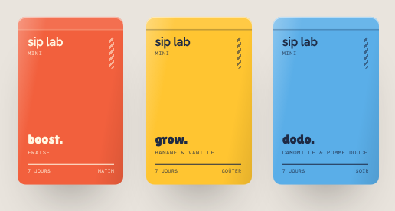
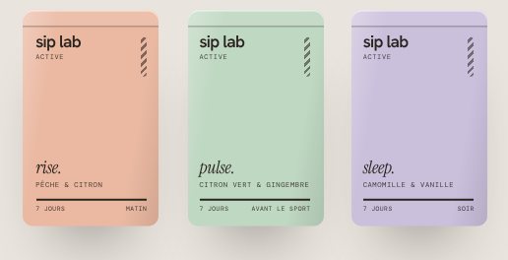
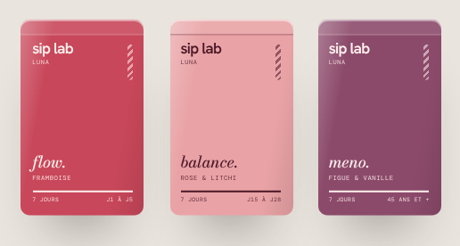
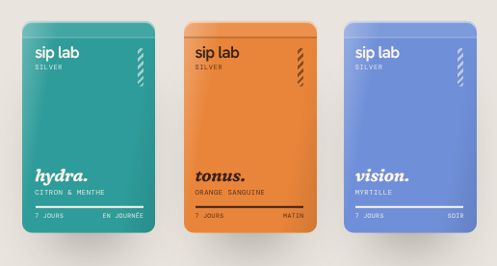
one brand, four ranges
THE INNOVATION
sip lab mini
sip lab active
sip lab luna
sip lab silver
kids · ages 4 to 11
active women · ages 20 to 45
women's health · cycle → menopause
seniors · 65 and over
boost · grow · focus · dodo
rise · pulse · move · sleep
flow · balance · bloom · meno
hydra · tonus · mobil · vision
Notes:
[1:40 – 2:20] And because drinking is universal, sip lab comes in four ranges: the same straw and the same box, but ingredients dosed for every age. mini for children, with a sticker chart. active for busy women: morning, workout and sleep. luna for women's health: periods, pregnancy and menopause. And silver for seniors, with a straw that also helps them drink more. Sixteen straws in total, and only health claims authorised in the European Union.

Slide 5
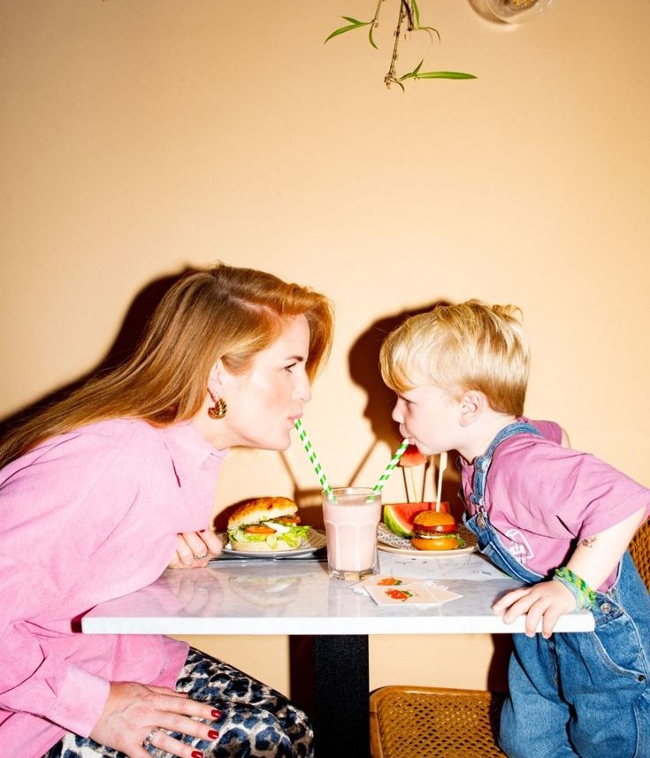
a solid market, still growing
THE MARKET
≈ €3bn
2 / 3
in food supplement sales in France in 2025 (+2.6%)
of French people take them
55%
× 2
of sales happen in pharmacies, the #1 channel
consumption doubled in 10 years (children and adults)
What drives the market: energy, immunity, stress and sleep.
Sources: Synadiet / Toluna Harris Interactive (2026) · Le Quotidien du Pharmacien / IQVIA · Anses, INCA 2 and INCA 3 studies · Kantar (2025).
Notes:
[2:20 – 2:55] The market is there. Food supplements are worth about 3 billion euros in France, and they keep growing. Two in three French people take them, consumption has doubled in ten years, and pharmacies remain the number one channel. What drives the market: energy, immunity, stress and sleep. Exactly the needs our straws cover.

Slide 6
four targets, four opportunities
THE TARGETS
sip lab mini
sip lab active
sip lab luna
sip lab silver
19%
57%
14 M
22%
of 3 to 17-year-olds take supplements (12% ten years earlier)
of supplement users are women
women affected by menopause in France
of French people are 65 or over
+40%
#1 need
+9%
14%
for gummies in pharmacies: fun formats sell
mental well-being: stress, fatigue, sleep
growth in menopause sales in pharmacies in 2024
of seniors living at home struggle to swallow a pill
Sources: Anses INCA 3 · Le Quotidien du Pharmacien · Synadiet · Les Échos Études / GERS · INSEE 2025 · dysphagia studies (details in appendix).
Notes:
[2:55 – 3:40] Each range answers a significant target. Among children, almost one in five already takes supplements, and parents look for fun formats. Women are the majority of supplement users, and their first need is stress, fatigue and sleep. Menopause affects 14 million women in France, and sales in this category are growing. And 22% of French people are over 65, often with difficulties swallowing. Four targets, one single product.

Slide 7
why a straw rather than a capsule?
THE COMPETITION
 | sip lab | capsules | gummies | powders
to swallow | nothing, just drink | 1 to 3 capsules | to chew | to dissolve
children & seniors | same habit at any age | difficult | mistaken for sweets | taste often refused
sugar | no added sugar | no | 2 to 4 g | often
visible dose | yes, the beads disappear | no | no | no
enjoyable | your favourite drink | no | yes | so-so
Our edge: the only format that works just as well for a 6-year-old as for their grandfather, and adds a glass of water with every dose.
Notes:
[3:40 – 4:10] Compared with capsules, gummies and powders, sip lab is the only format with nothing to swallow, no added sugar and a visible dose. Above all, it is the same habit for a 6-year-old and for their grandfather. And every dose also means a glass of water: a real benefit for seniors' hydration.

Slide 8
what is done, what is left to prove
VALIDATION
already done
next steps
Market research (Synadiet, Anses, INSEE)
Consumer interviews in each target
Personas and empathy map
Taste and dissolution tests
Perceptual map against competitors
Quote and prototype with the manufacturer
Brand identity and 16 straws defined
Regulatory approval of the formulas
Showcase website with a waiting list
First sign-ups on the waiting list
Notes:
[4:10 – 4:40] Where am I today? The market research, the personas, the positioning and the identity of the four ranges are done, and the showcase website is ready with a waiting list. Next steps: interviews in each target, taste and dissolution tests, a prototype with the manufacturer, and regulatory approval of the formulas.

Slide 9
how sip lab makes money
BUSINESS MODEL
online subscription
indicative prices
The core of the model: recurring revenue, delivered monthly, pause in one click.
€8.90 – €9.90
per box of 7 straws
gift sets
Discovery set, family box: a format people give as a gift.
≈ €1
per straw on subscription
pharmacies
Prices are hypothetical for now: production costs will be known once the manufacturer sends quotes.
In a second phase: the #1 channel for supplements in France.
Notes:
[4:40 – 5:10] The model relies first on an online subscription, which brings recurring revenue. Then come gift sets, and later pharmacies, the number one channel for supplements in France. The prices you see are indicative: around 9 euros per box, about one euro per straw on subscription. To be clear, they are hypothetical until I receive the production quotes.

Slide 10
one range first, then the whole family
GROWTH STRATEGY
STEP 1
STEP 2
STEP 3
STEP 4
sip lab active
sip lab luna
sip lab mini
sip lab silver
Online launch of sip lab active: community and micro-influencers.
sip lab luna for the same customers, at every life stage.
sip lab mini: customers who are mothers buy it for their children.
sip lab silver, through pharmacies and senior residences.
acquisition wellness micro-creators · family referrals · pharmacist advice · "a day with sip lab" content
Notes:
[5:10 – 5:45] I am not launching everything at once. We start with sip lab active, online, with a community and micro-creators. Then luna, for the same customers. Then mini, because many of these women are also mothers. And finally silver, through pharmacies and senior residences. The family becomes the growth channel: one customer brings in her whole family.

Slide 11

one founder, key partners
THE TEAM
the skills to bring on board
Nisrine Margoum
founder · product, brand, development
manufacturing partner
straw technology, production
regulatory expert
compliant formulas and claims
Master’s in Biology & Health, product development
Former cosmetics product manager (active ingredients)
Master’s in Entrepreneurship & Innovation, IAE Clermont-Auvergne
Organised national healthcare conferences
health advisory board
paediatrician, midwife, geriatrician
e-commerce & growth
website, subscription, acquisition
Notes:
[5:45 – 6:15] I am leading this project on my own, with a dual background: science, through my master's in Biology and Health, active ingredients, through my experience as a cosmetics product manager, and entrepreneurship, through my master's at IAE. To go further, I am building a network: a manufacturer for the straw, a regulatory expert, a health advisory board with a paediatrician, a midwife and a geriatrician, and an e-commerce profile.

Slide 12
the funding need
FINANCIAL OUTLOOK & ASK
≈ €150k
where the funding comes from
personal contribution
The founder invests in her own project
NOW
in seed funding for: product tests → sip lab active launch → first subscribers
love money
Family and friends, the first circle of trust
NOW
honour loans & grants
Initiative France, Réseau Entreprendre, Bpifrance
NEXT
Hypothetical, indicative amounts: production costs are not known yet. Profitability will rely on the subscription and will be calculated once quotes come in.
Notes:
[6:15 – 6:45] To launch sip lab active, I estimate a seed funding need of about 150,000 euros: first R&D and product tests, then a first stock, launch marketing and regulatory work. To get started, I am relying on my personal contribution and on love money from my family and friends. After that, I will apply for honour loans and public grants, such as Initiative France, Réseau Entreprendre or Bpifrance. To be transparent, these amounts are indicative, because I don't know the production costs yet. Profitability will come from the subscription, and I will calculate it as soon as I receive the quotes.

Slide 13

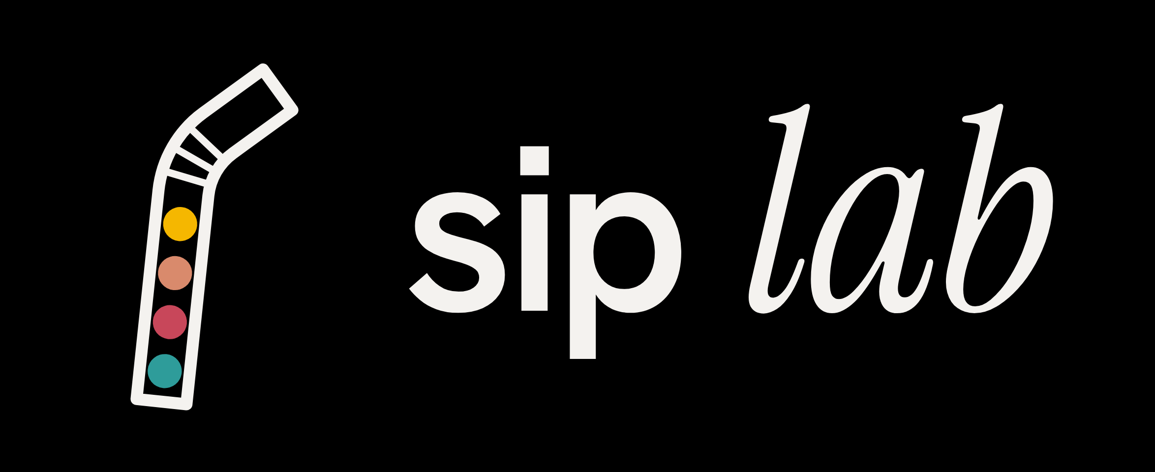
so, would you take another sip?
sip lab, the active straw: one habit, four ranges, the whole family.
Thank you · Nisrine Margoum, founder
Notes:
[6:45 – 7:00] The problem was never the ingredient; it was the habit. With sip lab, that habit is drinking: something the whole family already does, from age 4 to 104. So, would you take another sip? Thank you.

Slide 14
sources for the figures
APPENDIX
Synadiet / Toluna Harris Interactive, barometer and 2025 market figures (Claude Bernard press release, March 2026): sales +2.6%, about 2/3 of French people are consumers.
Le Quotidien du Pharmacien / IQVIA: pharmacies account for 55% of sales; gummies +40% (first 5 months of 2023); Synadiet Observatory 2021: 57% of consumers are women.
Anses, INCA 2 and INCA 3 studies: 19% of 3 to 17-year-olds and 29% of adults take supplements or nutrient-based medicines; consumption has doubled.
Les Échos Études / GERS Data, via Valbiotis (2026): menopause supplement sales in pharmacies €21.4M in 2024 (+9%); 14 million women affected.
INSEE, 2025 demographic report: 22% of the population is 65 or over.
Literature reviews on pill dysphagia (PMC): 15–20% of adults; about 14% of seniors living at home.
WHO, Adherence to long-term therapies (2003): about 50% adherence in developed countries. Kantar (2025): energy, immunity, stress and sleep.
Notes:
Appendix slide: show it only if the panel asks about the figures.

