Slide 1
Exploring Crime Patterns in Baltimore
Safe Neighborhood Project
IS 733 Data Mining Homework 1
09/28/2024
Nisarg Patel

Slide 2
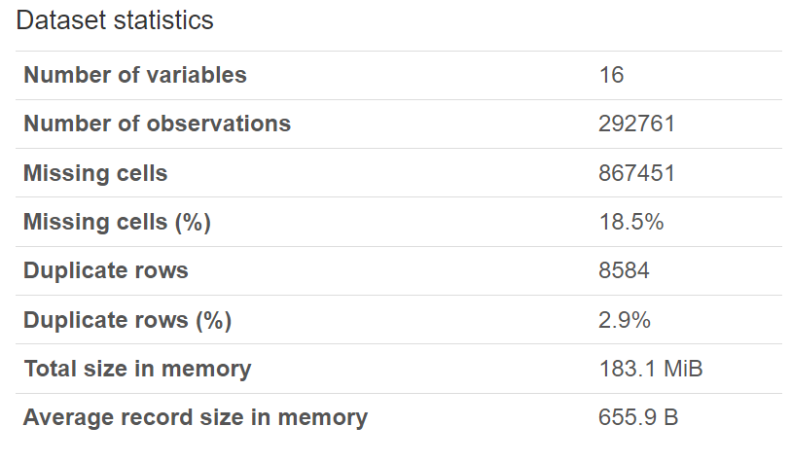
Data Summary
911 call reports over the last decade (2014–2024)
281,321 total crime incidents
16 features, including time, location, and crime type
More detailed summary can be found in file Baltimore_911_Data_Profile_Report.html
This project leverages 911 call data from the past decade to identify trends in crime and inform public safety initiatives in Baltimore. The goal is to assist resource allocation and crime prevention through data analysis.

Slide 3
1.b Observation from Data Profile
CrimeDate & CrimeTime: Stored as discrete/symbolic variables, not temporal. Likely stored as strings, limiting chronological sorting and temporal analysis.
Missing Data: Minimal missing data, less than 0.5% in location data, potentially important for spatial analysis.
Location Data: Over 27,000 unique locations, indicating highly specific data, useful for localized analysis.

Slide 4
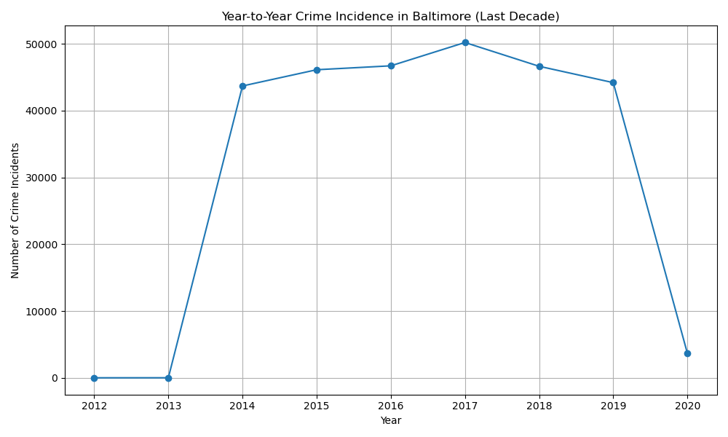
2.a Year-to-Year Crime Trends
Crime trends fluctuate over the years, with noticeable spikes in certain periods. Interestingly, the data shows a decline in crime incidents in the last three years, which could signal the effectiveness of current prevention measures.

Slide 5
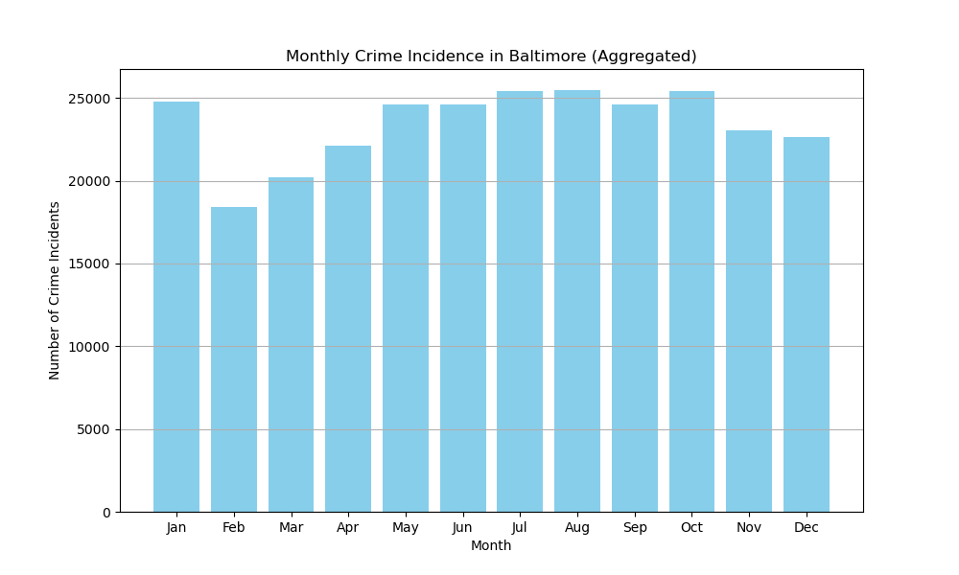
2.b Monthly Crime Trends
There’s a clear seasonal pattern, with crime peaking in the summer months, especially between June and August. This suggests that crime prevention strategies should be intensified during these months.

Slide 6
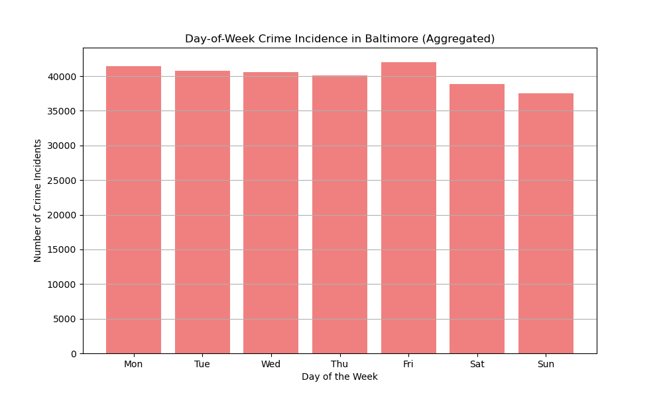
2.c Day-of-Week Crime Trends
Mid-week sees the highest number of incidents, with Sunday showing a significant drop in crime. This pattern indicates that law enforcement resources could be reallocated to prioritize high-crime days.

Slide 7
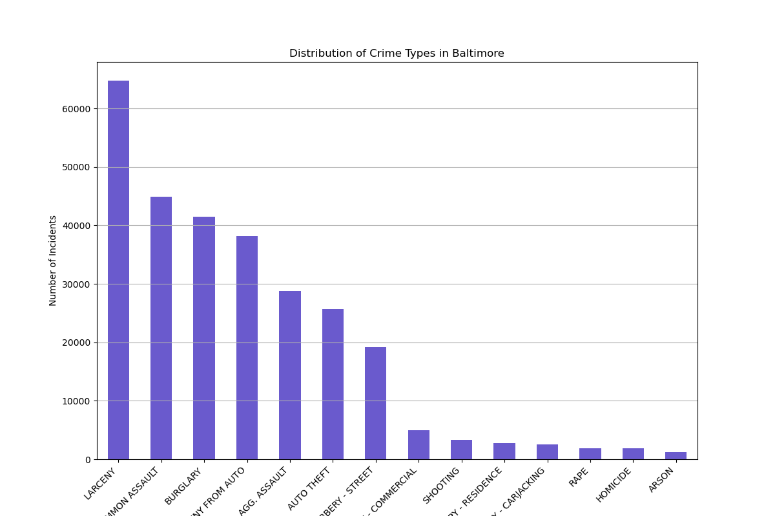
3. Crime Type Distribution
The most common types of crime in Baltimore are larceny, assault, and burglary. This distribution suggests that resources could be targeted at addressing these particular crimes.

Slide 8
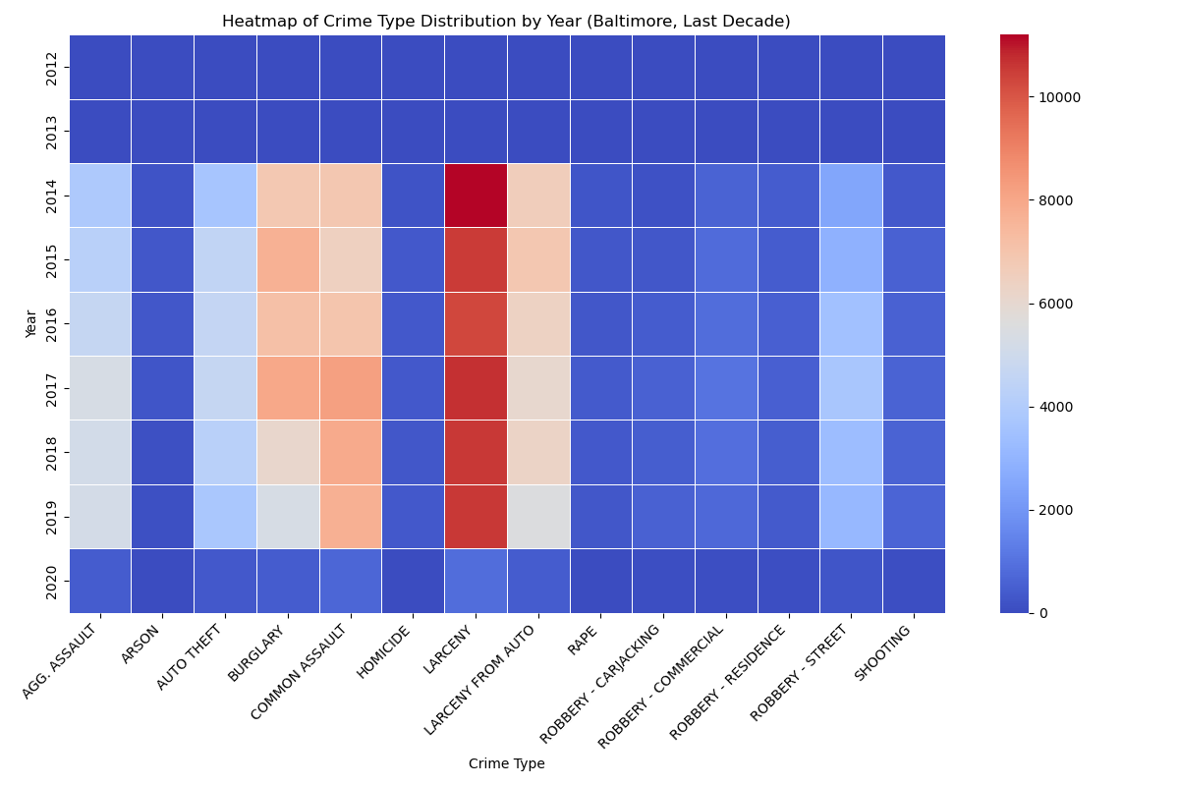
4.a Temporal Crime Patterns (Heatmaps)
Heatmap for year-to-year
The heatmaps provide an intuitive view of when crime incidents peak, highlighting specific months or days where certain crimes are more frequent. This visual makes it easier to allocate resources where they are needed the most.

Slide 9
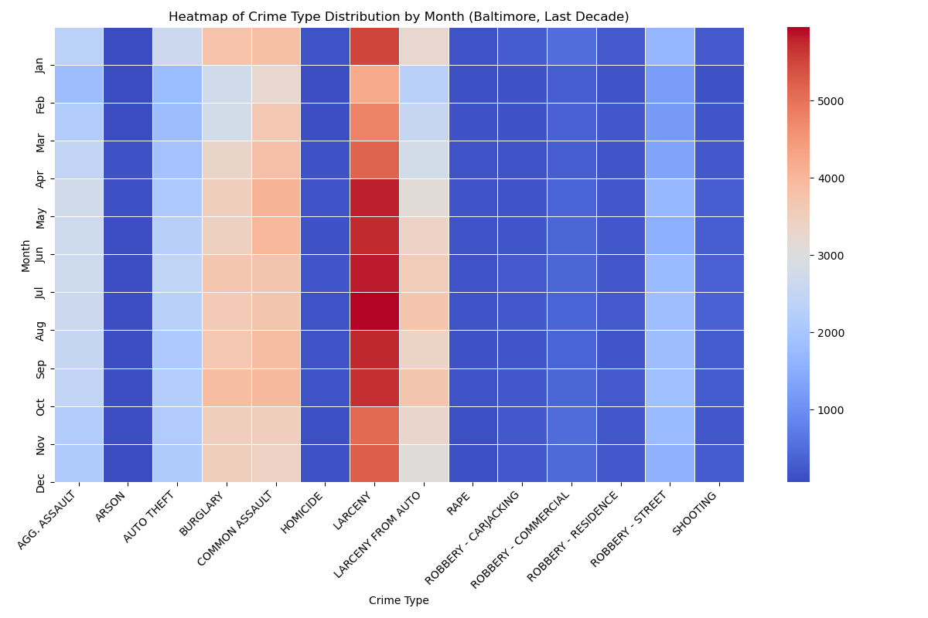
4.b Heatmap for month-to-month

Slide 10
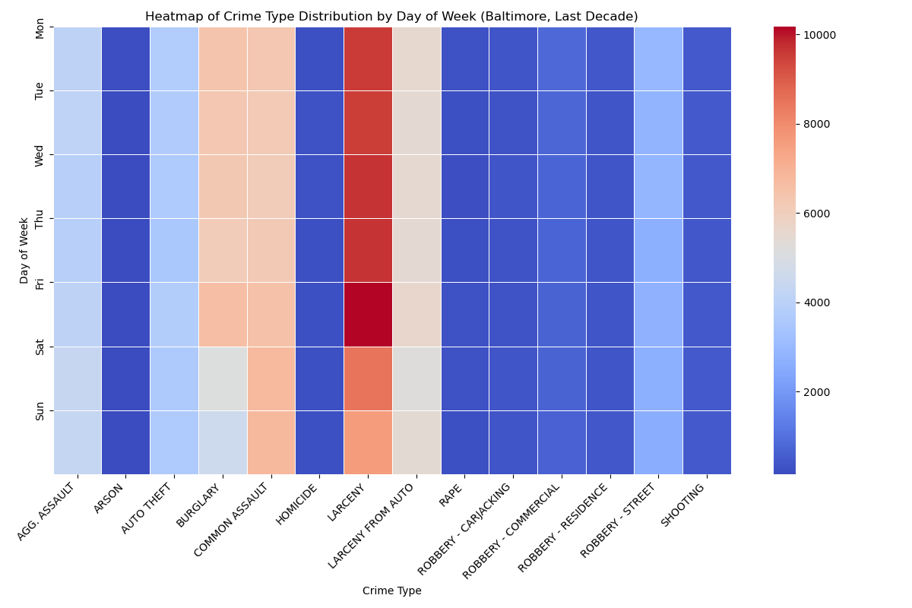
4.c Heatmap for day-of-week

Slide 11
5. Dashboard
Created a dashboard that allows users to explore the spatial and temporal patterns of crime.
Created a real dynamic dashboard that allows users to change parameters such as location and time period.
You can find dashboard in Nisarg_Patel_HW1.ipynb

Slide 12
Conclusion
Summary: Crime trends are highly temporal and location-dependent. This analysis suggests that targeted intervention in specific areas and times can help improve safety in Baltimore.
Recommendation: Use this data-driven approach to allocate police resources more effectively and implement community programs in high-crime areas.

