Slide 1

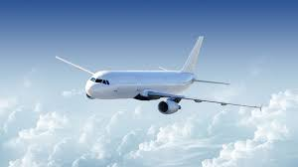
Fps “Flight Planning System”
Group one
Presented by :
Lamghari Younes
Saffar Léa
Marcel Yildiz

Slide 2
Introduction
In this following presentation, we are going to show you the procedure we attend to answer to your different questions during the course “ Génie logiciel avancée “.
This presentation shows the different steps that we followed to realize the project named “ Flight Planning System “ from the beginning to the end.
It will be also the support for our last presentation with you.

Slide 3
Plan
I- First lesson
II- Second lesson
III- Third lessen

Slide 4
First lesson
General presentation :
Flight Planning System its a software that :
Index all the coming flight of the company
Match crews and planes
And primarily used by the OCC (Operations Control Center)
Firstly we can mention some technical features :
A server implementation :
Data base containing the list of flights and users ( with their respective rights )
Email warning system for OCC
A web responsive interface ( respecting REST standard ) with personalized display for team flight or
OCC.

Slide 5
First lesson
Users of the system :
Each members of the occ is specializes in one fields of expertise :
Flight operations control crew
Ground operations control crew
Crew dispatcher
Flight dispatcher :
captain en the ground who handle with weather and technical difficulties, he has to be a part meteorologist, aircraft technicien, air traffic control dispatcher, and he prepare flight plan with precision.
Flight dispatch support specialist
paperwork for a flight plan "overflight, landing permit he have to be negociated with other countries).
Ground operations coordinator
responsible of passengers, make sure that people arrive to their destination on time.
Flight operations coordinator
handle with gas, pilot, hangar, fuel status, incoming, connecting, awaiting permits, updating schedule).

Slide 6
First lesson
Users of the system :
Operations duty officer
the head problem solver.
Crew dispatcher
handle with the crew members.
Flight dispatcher manager
manage the team
Acces level ( Toujours pas fait !)

Slide 7
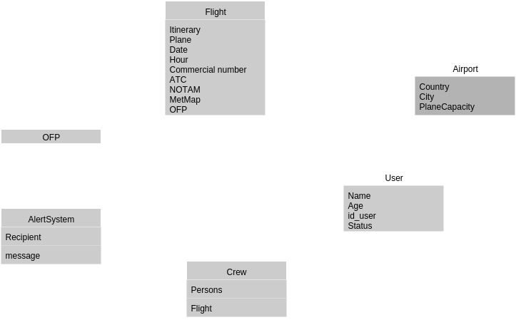
First lesson
The business subject :
In this picture, we have all business subjects for our system with their definitions

Slide 8
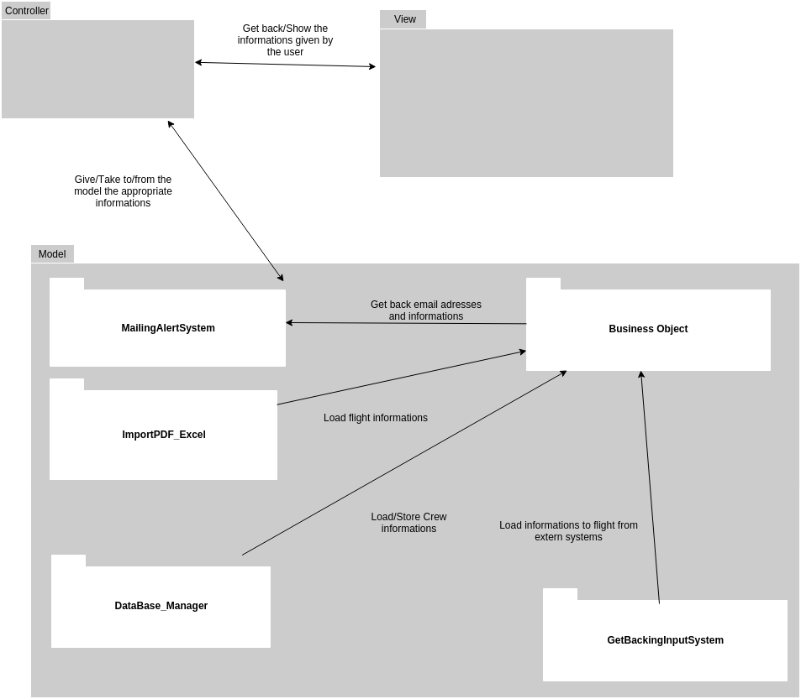
First lesson
The MVC model :
This is the MVC model for our system, it shows the various subsystem and relation between them

Slide 9
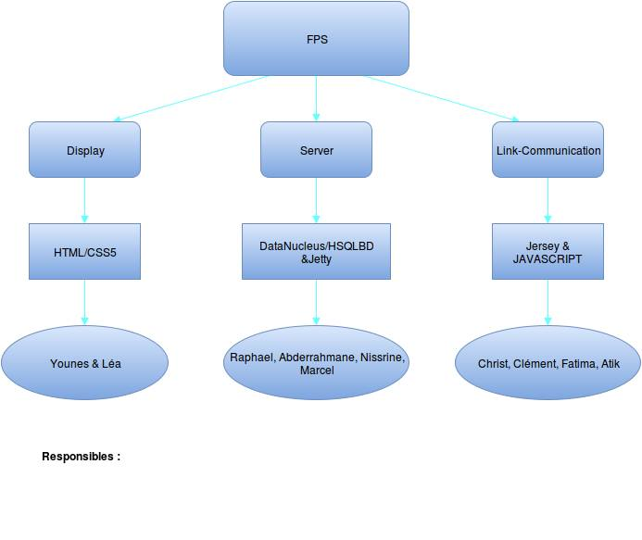
II. Second lesson
The organigram of our is :
We are going to work by three groups composed of 4 people for server part, 4 again for
communication part and then two persons for the display part.
Lea for display part, Raphael for server & Christ for communication part

Slide 10
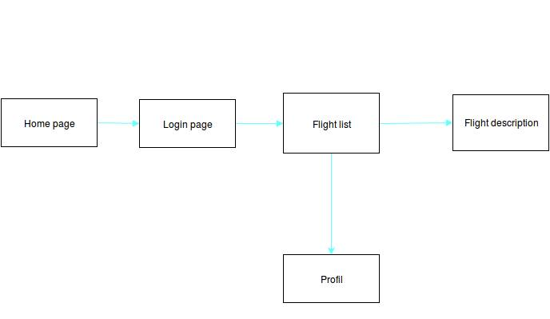
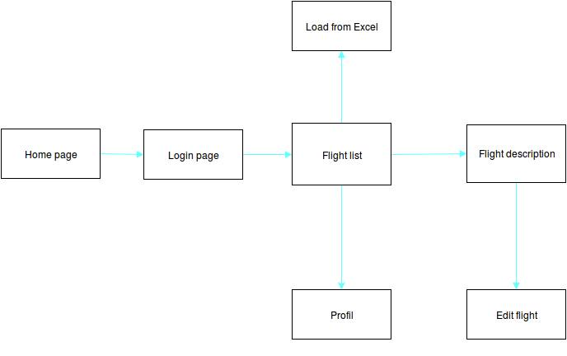
II. Second lesson
The navigation scheme :
We have decided to use two navigation scheme as requested.

Slide 11
II. Second lesson
Our mock-ups:
For our mock-ups, we decided to do it with Invasion as Mr. Tekkal advices us.
so here’s the link for it :
https://projects.invisionapp.com/share/M85WPXUA9#/screens

Slide 12
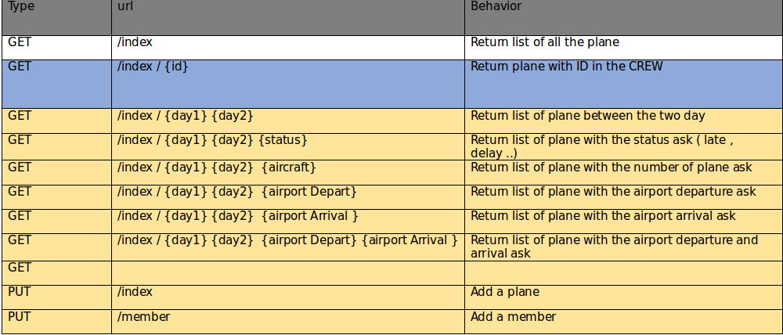
II. Second lesson
Web-services:
from our mock-ups, we have defined our necessary web services for loading data.
This is the web-services for our home page.

Slide 13
II. Second lesson
Web-services:
This is the web-services for our members page.
Every Web-service has his type, url and behavior as the board shows.
GET | /member /{id} | Return list of all details of the member
POST | /member / {id} | Modify details of member for the corresponding ID
DELETE | /member / {id} | DELETE a member

Slide 14
II. Second lesson
Web-services:
This is the web-services for our flight page.
Every Web-service has his type, url and behavior as the board shows.
GET | /flight /{id} | Return list of all details of the flight
POST | /flight / {id} | Modify details of flight for the corresponding ID
DELETE | /flight / {id} | DELETE a flight

Slide 15
III. Third lesson

Slide 16
III. Third lesson

