Slide 1


Group one
Presented by :
Lamghari Younes
Saffar Léa
Marcel Yildiz
Fps “Flight Planning System”

Slide 2
Introduction
In this following presentation, we are going to show you the procedure we attend to answer to your different questions during the course “ Génie logiciel avancée “.
This presentation shows the different steps that we followed to realize the project named “ Flight Planning System “ from the beginning to the end.
It will be also the support for our last presentation with you.

Slide 3
Plan
I- First lesson
II- Second lesson
III- Third lessen

Slide 4
First lesson
General presentation :
Flight Planning System is a software that :
Index all the coming flight of the company
Matches crews and planes
And primary used by the OCC (Operations Control Center)
Firstly we can mention some technical features :
A server implementation :
Database containing the list of flights and users ( with their respective rights )
Email warning system for OCC
A web responsive interface ( respecting REST ) with personalized display for OCC.

Slide 5
First lesson
Users of the system :
Each members of the occ is specializes in one fields of expertise :
Flight operations control crew
Flight dispatcher :
Manager, captain on the ground, meteorologist, aircraft technicien, air traffic control dispatcher.
Flight dispatch support specialist
paperwork for a flight plan "overflight”.
Ground operations coordinator
responsible of passengers.
Flight operations coordinator
handles with gas, pilot, hangar, fuel status, incoming, connecting, awaiting permits, updating schedule.

Slide 6
First lesson
Users of the system :
Operations duty officer
the head problem solver.
Crew dispatcher
handle with the crew members.
Flight dispatcher manager
manage the team
Acess level:
OCC
Who can changes the crews members & departure and arrival time also departure and arrival airport.
Crew members
Who can see their next flights without changing the informations, they can also contact the OCC by email.

Slide 7
First lesson
The business subject :
In this picture, we have all business subjects for our system with their definitions

Slide 8
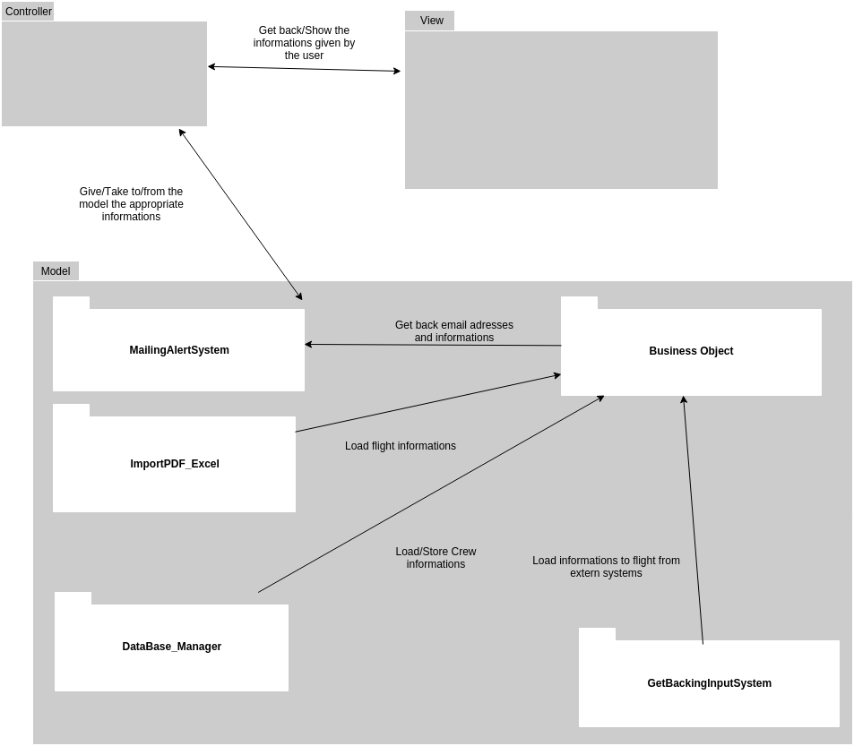
First lesson
The MVC model :
This is the MVC model for our system, it shows the various subsystem and relation between them

Slide 9
II. Second lesson
Organization chart encompassing the four components of the system :

Slide 10
II. Second lesson
The navigation scheme :
We have decided to use two navigation scheme as requested.
for OCC:

Slide 11
II. Second lesson
The navigation scheme :
for the crew:

Slide 12

II. Second lesson
A prototype of the web-application :
https://invis.io/VW60KMLEY

Slide 13
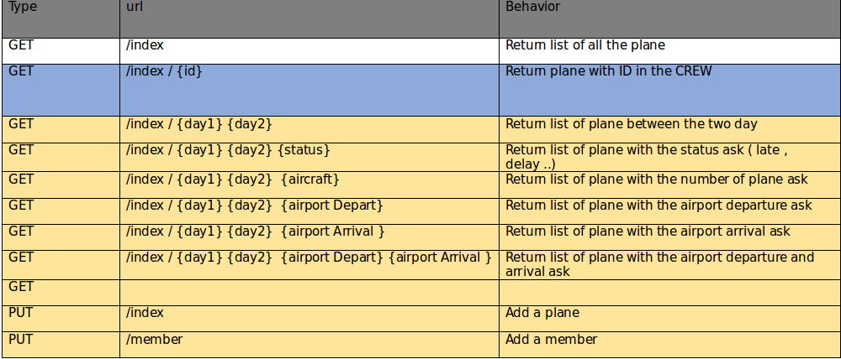
II. Second lesson
Web-services:
from our mock-ups, we have defined our necessary web services for loading data.
This is the web-services for our home page.

Slide 14
II. Second lesson
Web-services:
This is the web-services for our members page.
Every Web-service has his type, url and behavior as the board shows.
GET | /member /{id} | Return list of all details of the member
POST | /member / {id} | Modify details of member for the corresponding ID
DELETE | /member / {id} | DELETE a member

Slide 15
II. Second lesson
Web-services:
This is the web-services for our flight page.
Every Web-service has his type, url and behavior as the board shows.
GET | /flight /{id} | Return list of all details of the flight
POST | /flight / {id} | Modify details of flight for the corresponding ID
DELETE | /flight / {id} | DELETE a flight

Slide 16

III. Third lesson
Join us on GitHub
https://github.com/Medatik/Preplane

Slide 17
III. Third lesson

