Slide 1
Parameters for the population model:
Initial stock numbers 1 – 10 for long-lived example and 0-3 for a short-lived example
Constant F, constant selectivity (need to be tweeked so we get sensible results)
Variable M, constant selectivity (drawing a random number from a normal-dist each year with mean M and CV)
Maturity ogive (select one for a typical short-lived and one from a typical long-lived among the case study stocks)
Constant weight-at-age (select one for a typical short-lived and one from a typical long-lived among the case study stocks)
Stock-recruitment-model see below
Parameters for stock-recruitment model:
Alpha and beta for a Ricker SR-model or B&H-model (select one for a typical short-lived and one from a typical long-lived among the case study stocks). There should be a parameterization for a low and high productivity regime, respectively (see next slide)
CV for environmental variability (see next slide)
Magnitude of the effect of the proportion of old spawners, λ
Other specifications:
Run the model for a short-lived and a long-lived case
Run the simulations for 100 years, and use the last 50 years of SSB and recruitment and proportion of old spawners (as calculated in the data-analysis.
Repeat the simulations for different effects of the proportion of old spawners, λ, (Incl. a control-run, where the effect is 0) measured as relative to the effect of environmental variability
Analysis of output:
The same analyses as made on the ”real” data; for example, plot the residuals from a SCAM stock-recruitment fit against proportion of old spawners and caclulate the correlation coefficient
A total of 12 different scenarios-runs

Slide 2
Stock recruitment module of the age-based population-model
Environmental variability, log-norm dist with median and CV_{E}
Effect of proportion of old spawners
High productivity scenario
Medium productivity scenario
R
λ
Deviation from predicted SR-model
0
Low productivity scenario
λ
Deviation from predicted SR-model
0
SSB

Slide 3
Productivity regime
residuals
50 years of R, SSB, and spawners quality
Residuals
R
Correlation coefficient
Year
0
Year
Year 100
SSB
Spawner quality
residuals
50 years of R, SSB, and spawners quality
Residuals
R
Correlation coefficient
Year
0
Year
Year 100
SSB
Spawner quality
# Carry out the above for = 0 and = CV larger than CV_{E} and = CV equal to CV_{E}
λ
λ
λ
# Carry out the above for typical short-lived and typical long-lived species (by selecting among the stocks we use in the data-driven analysis)

Slide 4
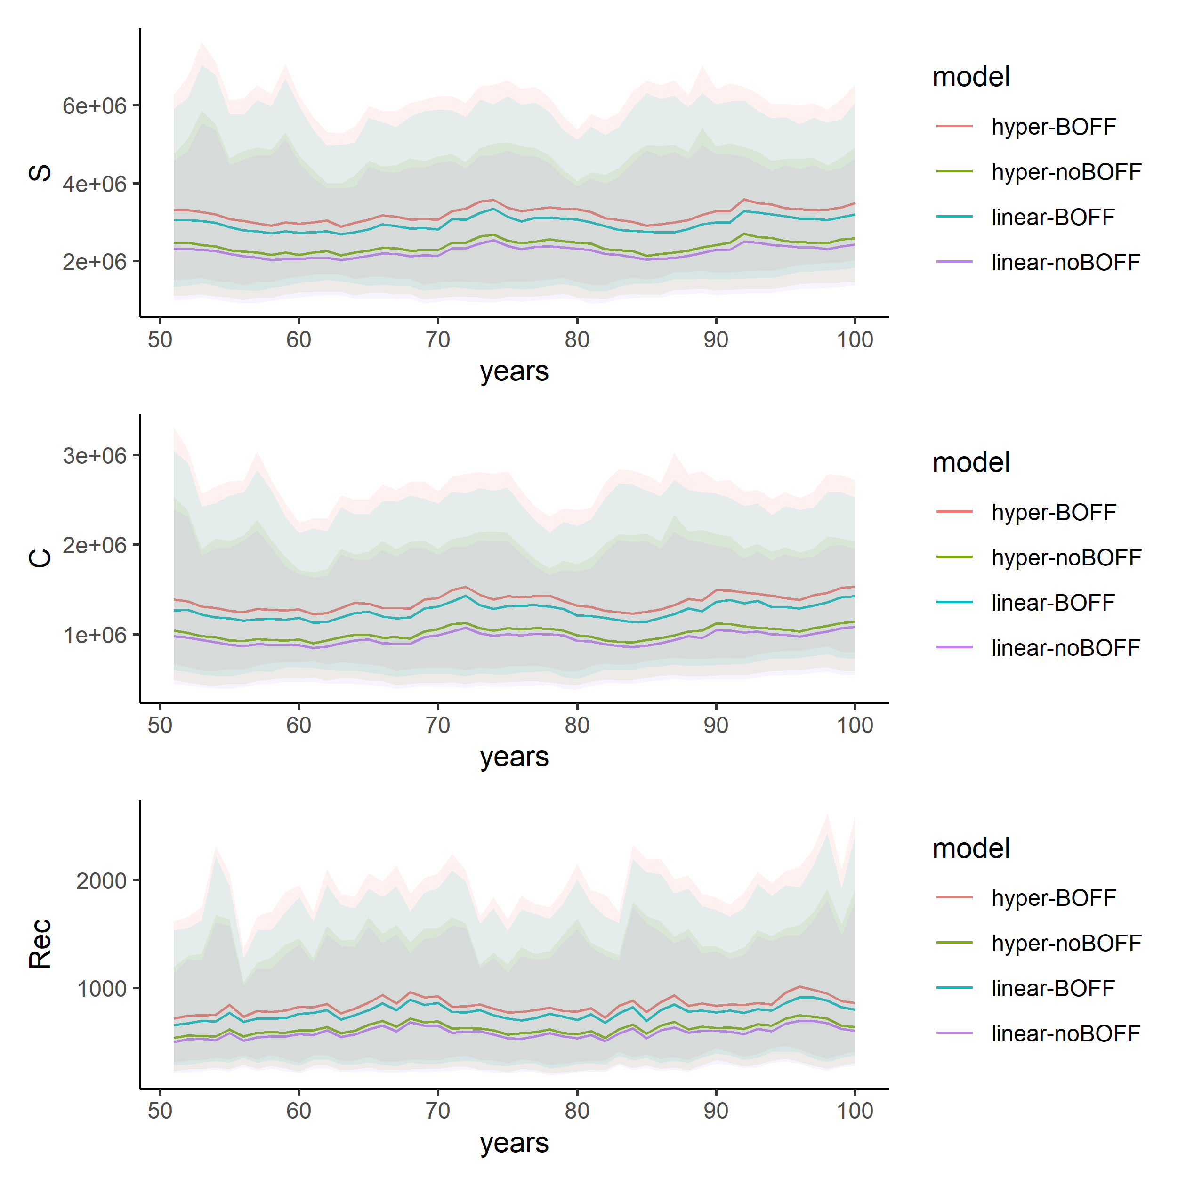

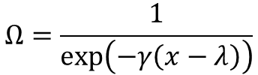
Resultater
$$Ω=\frac{1}{\exp\left(−γ\left(x−λ\right)\right)}$$
$$R_{0}=ΩR_{0}$$
BOFF: increase in capacity of spawning with more older fish. Decrease in capacity with younger (can be disabled). Gamma controls the magnitude, and lambda the fraction of spawners the function begins.

