Slide 1
TeleBank Term deposits Analysis and Prediction
Presented By
Nissi Grace Chinamuttevi
Ranveer Singh

Slide 2
Contents
Introduction
EDA
Visulizationas
Making models
Prediction
Conclusion

Slide 3
Introduction
In this project, we aim to predict whether a bank client will subscribe to a term deposit based on their interaction with previous marketing campaigns. The goal is to effectively target customers for future campaigns, reducing costs and improving conversion rates.“

Slide 4
EDA(Exploratary Data Analysis)
Exploratory Data Analysis (EDA) was conducted to understand the dataset, check for missing values, and identify trends. Key steps included:
Data Summary: Columns analyzed include client demographics, contact details, and marketing campaign results.
Data Cleaning: Handled missing values and outliers, and transformed categorical variables into numerical formats for modeling.
Visualizing Relationships: We used Python to generate visualizations like histograms, box plots, and correlation heatmaps to identify patterns and dependencies."

Slide 5
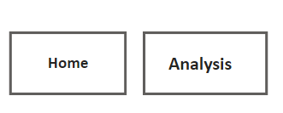
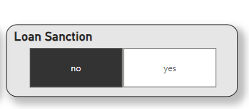
Insights
"To better understand the results and present them to stakeholders, we created interactive dashboards in Power BI. Key visualizations included:
Created two buttons for easy navigation between the pages
Used a slicer for easy data access

Slide 6
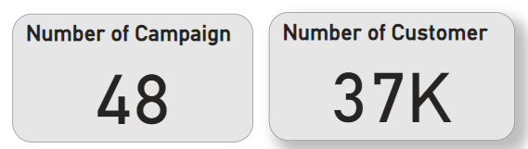
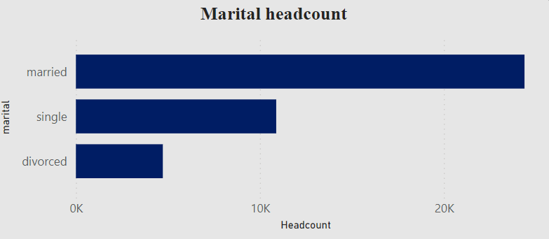
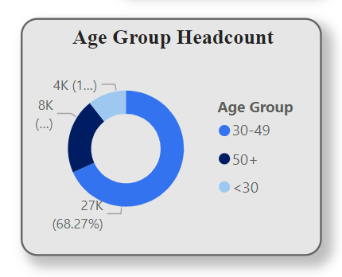
Campaign Performance:
The bank conducted 48 campaigns, targeting 37,000 customers.
A significant observation is the low rate of loan sanctions compared to total campaigns.
Customer Demographics:
Marital Status: The majority of customers are married, followed by singles and a smaller group of divorced individuals.
Age Groups: Most customers fall within the 30–49 age bracket, which forms the primary target group.

Slide 7
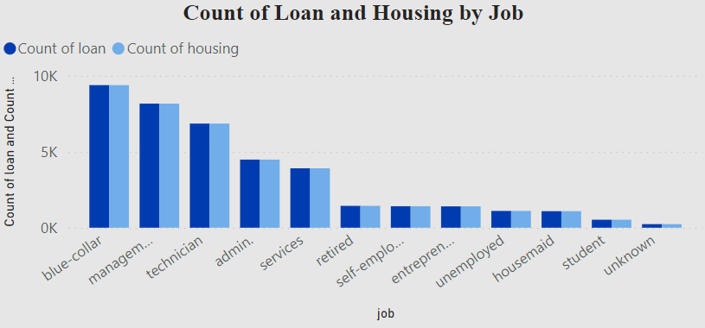
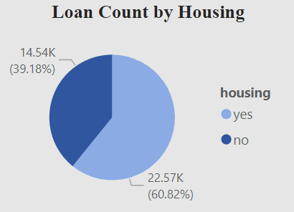
Loan and Housing Statistics:
The count of loans is highest among customers in blue-collar jobs, followed by management and technician roles.
Housing loans show that 60.82% of customers do not own homes, indicating potential for future campaigns targeting housing loans.

Slide 8
Making model:
"For predicting whether a client will subscribe to a term deposit, we used Random Forest as our classification model. The process included:
Data Preprocessing: Encoding categorical variables, handling missing values, and scaling numerical features.
Model Training: We trained the Random Forest model using the processed training data, ensuring proper cross-validation to avoid overfitting.
Model Evaluation: Performance was evaluated using metrics such as accuracy, precision, recall, and AUC-ROC."

Slide 9
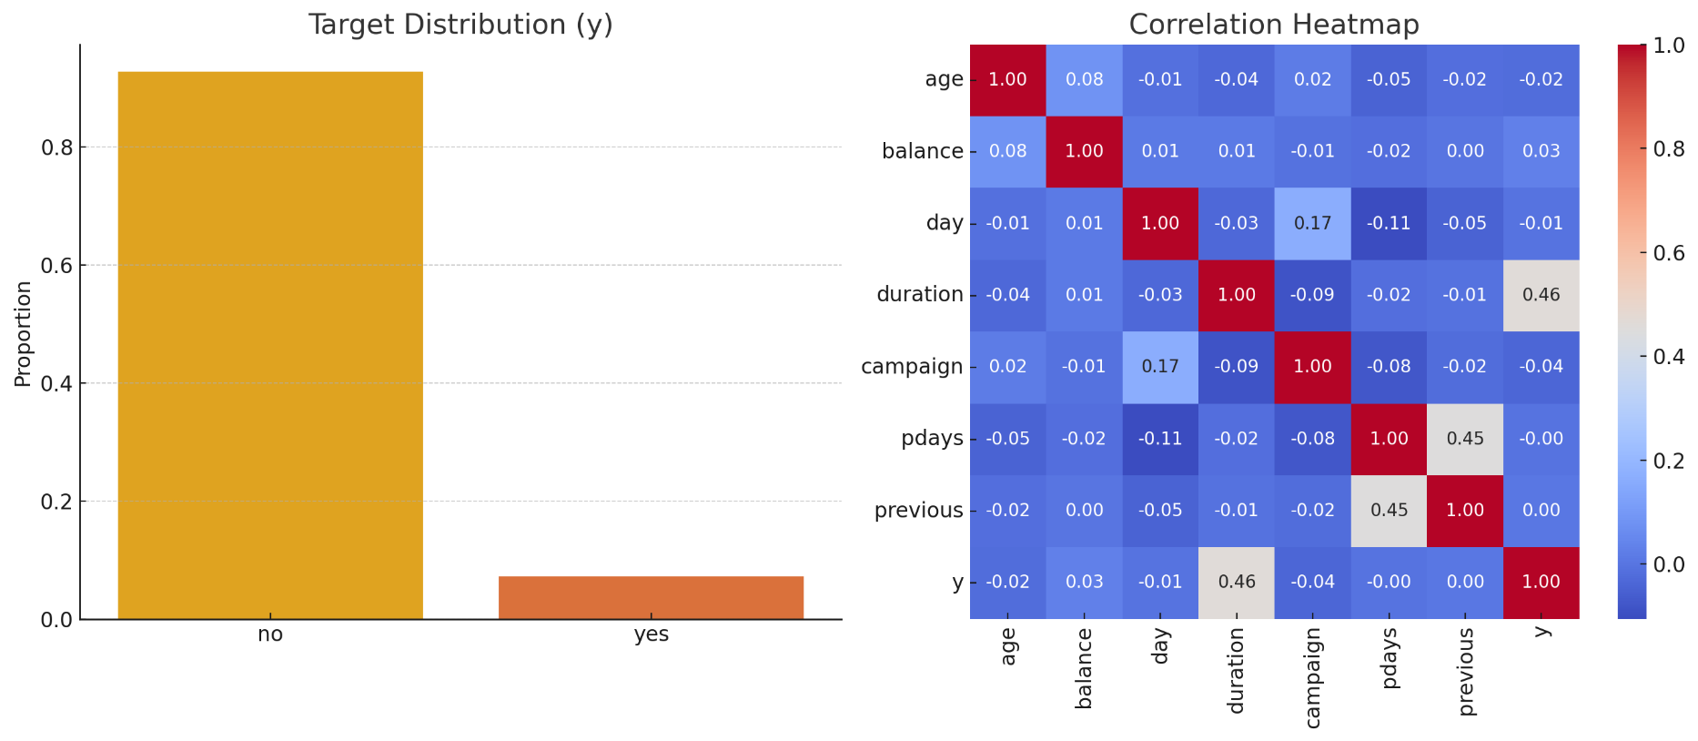
Correlation between variables:

Slide 10
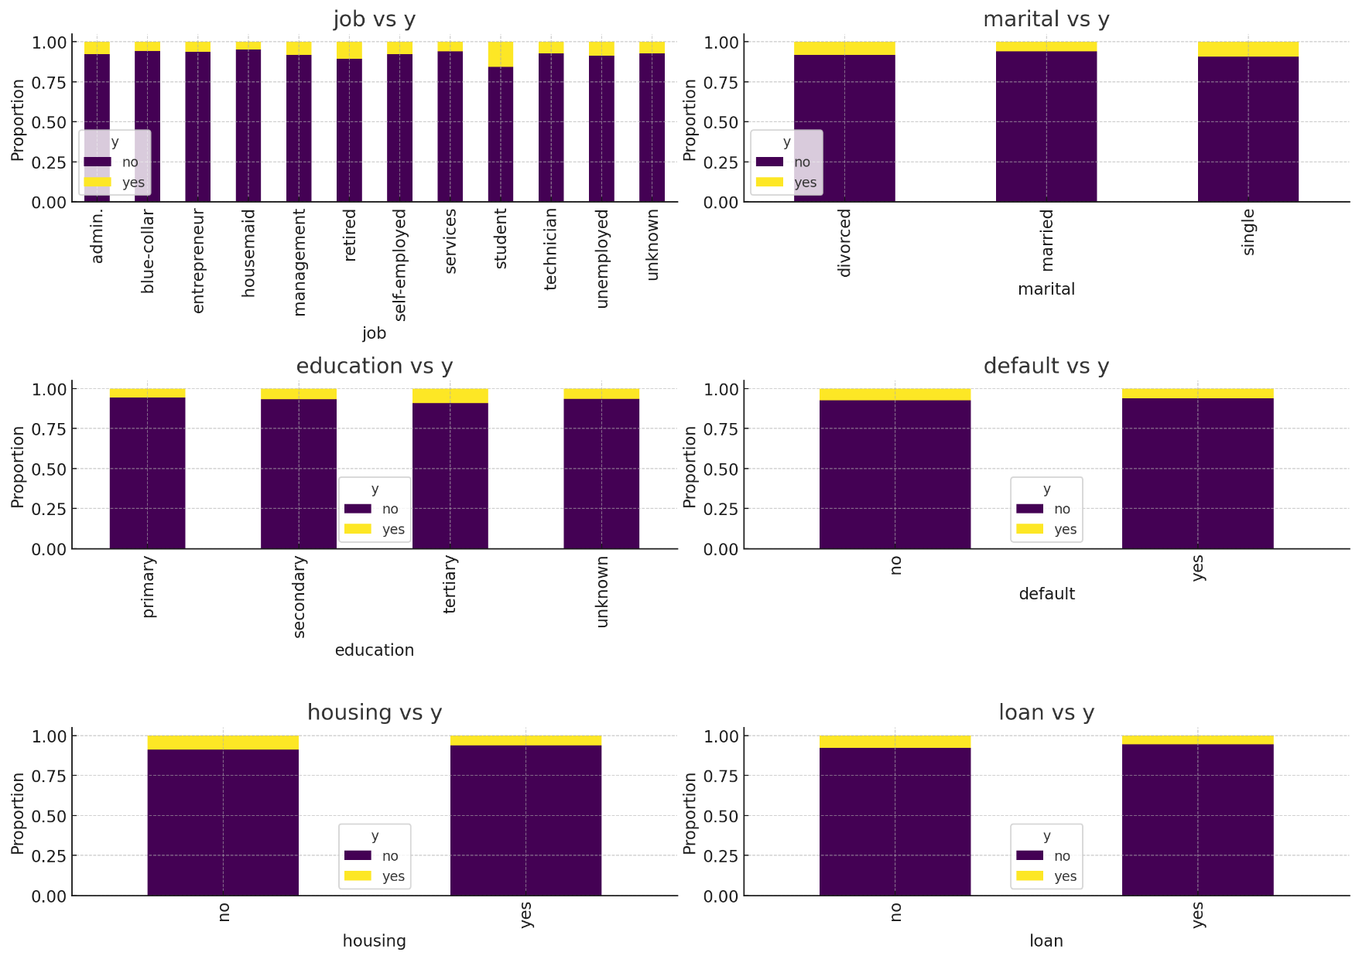
Categorical features Analysis

Slide 11
Prediction:
After training the model, we used it to predict the Loan(y variable) on the test dataset
Predictions: The model predicted whether clients in the test set would subscribe to the term deposit.
Model Performance: The Random Forest model achieved a strong performance with a high accuracy of [insert accuracy] and other key metrics like [insert other metrics].
The model performs very well and given the very near predictions

Slide 12
Thank you

