Slide 1

Serverless und Event-Driven Architecture
Roland Krummenacher, Swisscom B2B Cloud Advisory

Slide 2

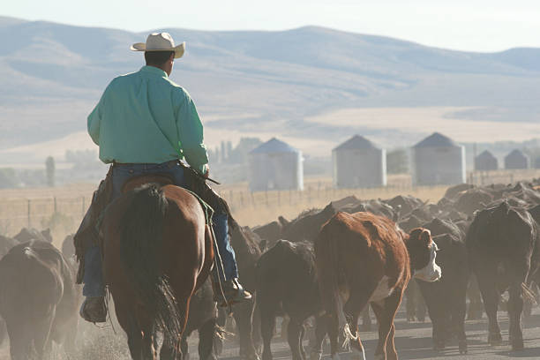
Pets vs. Cattle

Slide 3
Pets or Cattle?
44 % not scaling
44% of the AKS Node Pools for a major Azure client are configured to operate without auto-scaling, meaning they maintain a fixed number of virtual machines running 24/7.

Slide 4
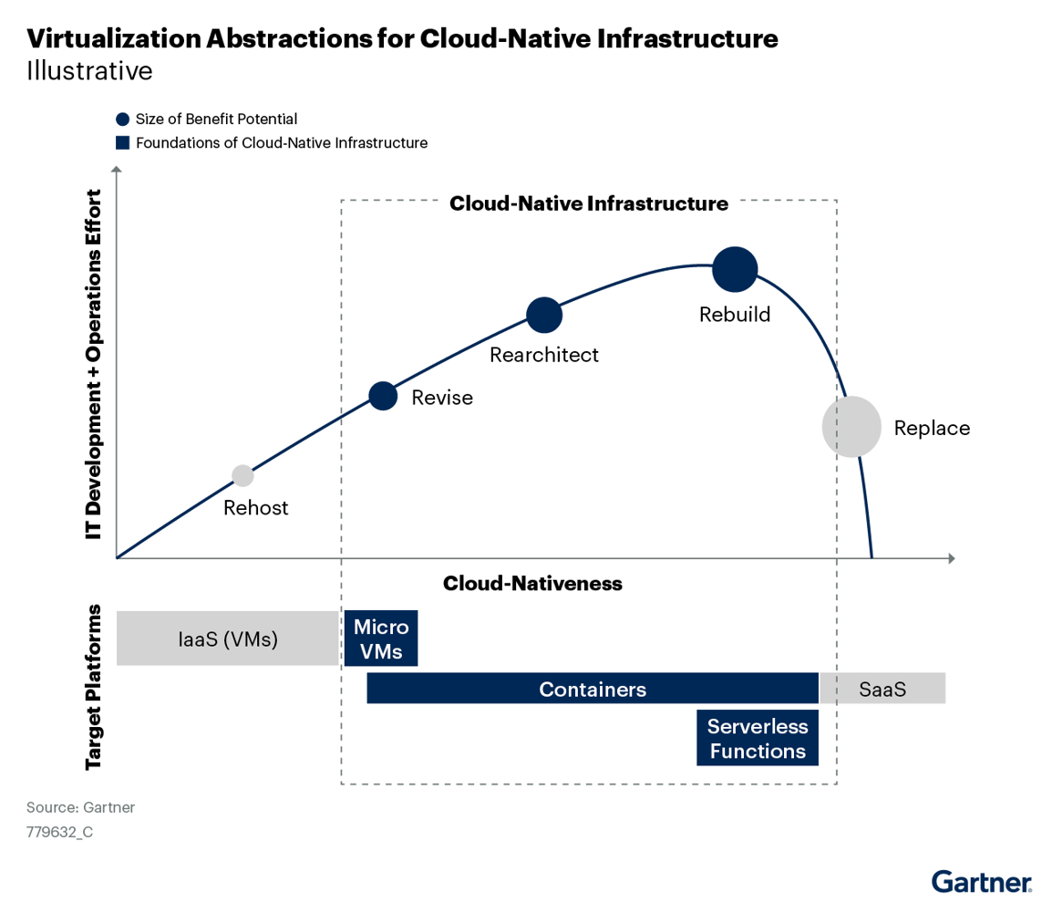
Serverless means rebuild

Slide 5
Serverless is more than just FaaS
Azure Functions
Azure Logic Apps
Azure App Service (with Consumption Plan)
Azure Cosmos DB
Azure Event Grid
Azure SQL Database Serverless
Azure SignalR Service
Azure Cognitive Services (some features can be used in a serverless manner)
Azure Key Vault
Azure Search
Azure API Management (Consumption Tier)
Azure Notification Hubs
Azure IoT Hub
Azure Machine Learning Service (in certain serverless configurations)
Azure Container Instances (ACI)
Azure Durable Functions
Azure Stream Analytics
Azure Cognitive Search
Azure Data Lake Analytics
Azure Data Factory (V2)
Azure DevOps (Azure Pipelines)
Azure Service Bus (Auto-Inflate feature for scaling)
Azure WebJobs
Azure App Configuration
Azure Static Web Apps
Azure API Apps
…
Serverless is an entire stack of services that can respond to specific events or requests, and scale to zero when no longer in use—and for which provisioning, management and billing are handled by the cloud provider and invisible to developers.
Function-as-a-service, or FaaS, is a cloud computing service that enables developers to run code or containers in response to specific events or requests, without specifying or managing the infrastructure required to run to code.
FaaS is the compute model central to serverless, and the two terms are often used interchangeably. But serverless is much more than FaaS.
Source: https://www.ibm.com/topics/serverless

Slide 6
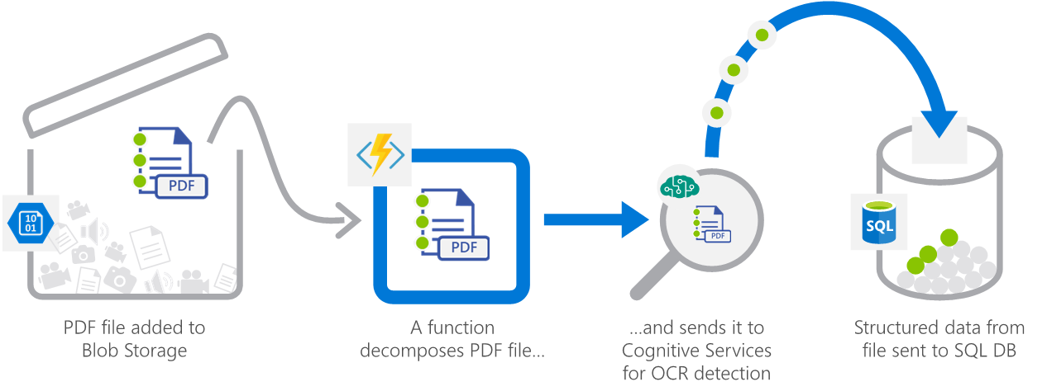
Serverless scenario: File upload and document processing
Real-time file processing for the healthcare scenario: The solution securely uploads patient records as PDF files. The solution then decomposes the data, by processes it using OCR detection, and it adds the data to a database for easy queries.
Source: https://learn.microsoft.com/en-us/azure/architecture/serverless-quest/reference-architectures

Slide 7
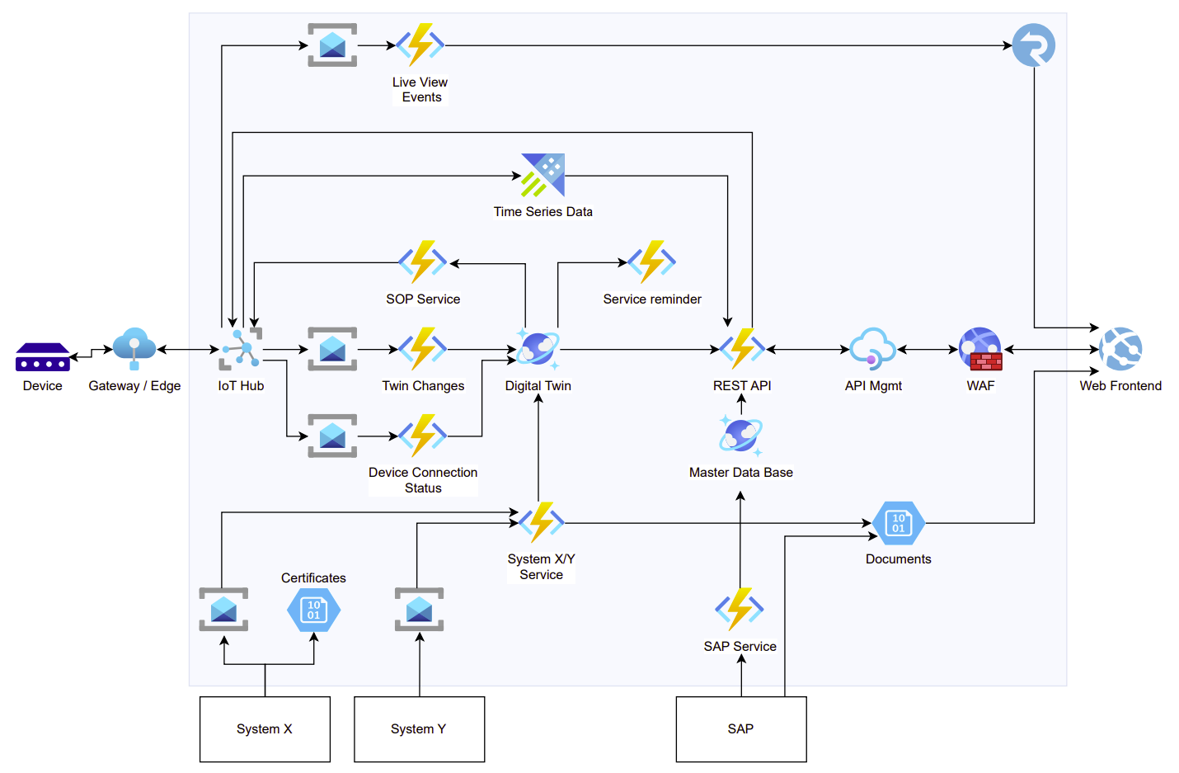
Serverless scenario: IoT

Slide 8
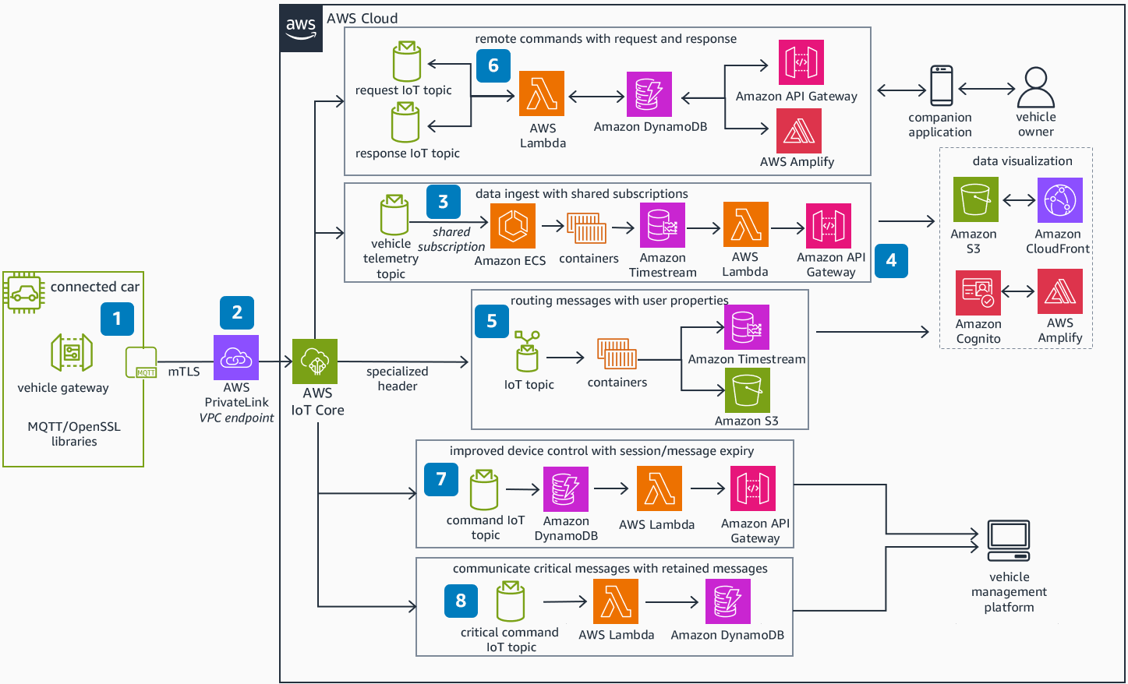
Serverless scenario: AWS Connected Vehicle – Reference Architecture
Source: https://docs.aws.amazon.com/architecture-diagrams/latest/aws-connected-vehicle/aws-connected-vehicle.html

Slide 9
Serverless scenario: IoT

Slide 10
Challenges and solution approaches
Security
Adding Infrastructure to re-establish Perimeter-Security vs. implementing SaaS-style Zero-Trust.
Cloud Automation
For serverless, cloud automation (aka. IaC) needs to focus on the application, the relationships between component and the configuration instead of the infrastructure.
What I have learnt from building and running serverless and event-driven systems on Azure.
1
2
Operations
Complexity has moved from code to relationships between the components. Monitoring serverless and event-driven systems end-to-end is complex.
Architecture
Reconsider traditional Software Design Patterns for serverless architecture, e.g. Messaging (Pipes-and-Filters), Hexagonal Architecture and CQRS.
3
4

Slide 11


Questions and Answers
Roland Krummenacher
Cloud Advisor
www.linkedin.com/in/rolandkrummenacher

Slide 12

Questions and Answers

Slide 13
Serverless scenario: IoT
Internet of Things (IoT) systems are particularly well-suited for serverless computing for several reasons:
Greenfield or «rebuild» projects: The cloud part of IoT systems are often build from scratch without legacy dependencies.
Scalability needs: IoT systems need to handle large volumes of data from various devices.
Cloud lock-in is already given: By using IoT PaaS services for Device Management, Vendor lock-in is already given.
Event-Driven Nature: IoT systems are highly event-driven as they respond to data events from connected devices.
Asynchronous Nature: Device connectivity is not reliable, therefore the architecture has to be asynchronous by design.
Geographic Distribution: IoT applications often require geographic distribution to process data from devices located in various regions.
CQRS
Cost Efficiency for Bursty Workloads: IoT systems can experience bursts of activity when a large number of devices report data simultaneously
Integration with Other Cloud Services: Serverless platforms easily integrate with other cloud services and APIs
Speed
Plus alle Vorteile von Serverless: Testability,

Slide 14
Serverless scenario: IoT
Internet of Things (IoT) systems are particularly well-suited for serverless computing for several reasons:
Greenfield or «rebuild» projects:
Scalability needs and Cost Efficiency for Bursty Workloads
Cloud lock-in is already given
Event-Driven and Asynchronous Nature
Geographic Distribution
CQRS
Integration with Other Cloud Services
Speed und Agilität
Plus, alle anderen Vorteile von Serverless: Composability, Testability, Reliability

Slide 15
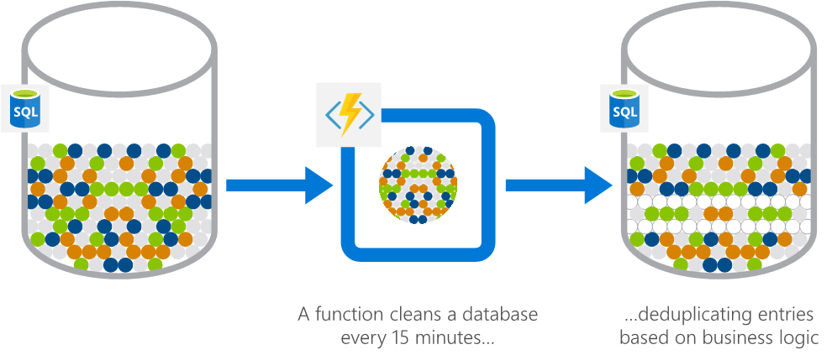
Serverless scenario: Automation
Scheduled task automation for the financial services scenario: The app analyzes a customer database for duplicate entries every 15 minutes, to avoid sending out multiple communications to the same customers.

Slide 16
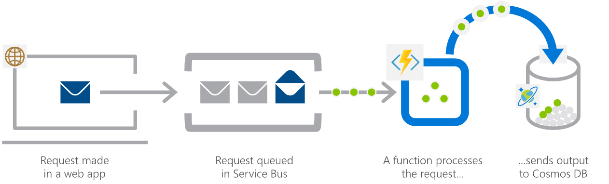
Serverless scenario: Serverless APIs, mobile and web backends.
Web application backends the retail scenario: Pick up online orders from a queue, process them, and store the resulting data in a database.

Slide 17
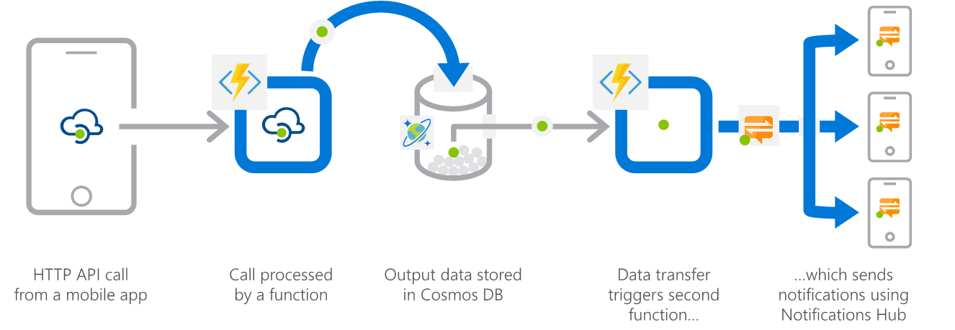
Serverless scenario: Serverless APIs, mobile and web backends.
Mobile application backends the financial services scenario: Colleagues use mobile banking to reimburse each other for lunch. Whoever paid for lunch requests payment through a mobile app, which triggers a notification on the colleagues' phones.

Slide 18
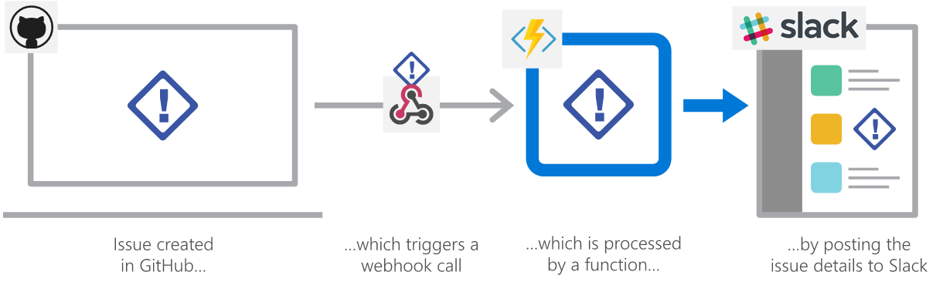
Serverless scenario: Extending SaaS applications
Extending SaaS applications in the professional services scenario: A SaaS solution provides extensibility through webhooks, which Azure Functions can implement to automate certain workflows.

Slide 19
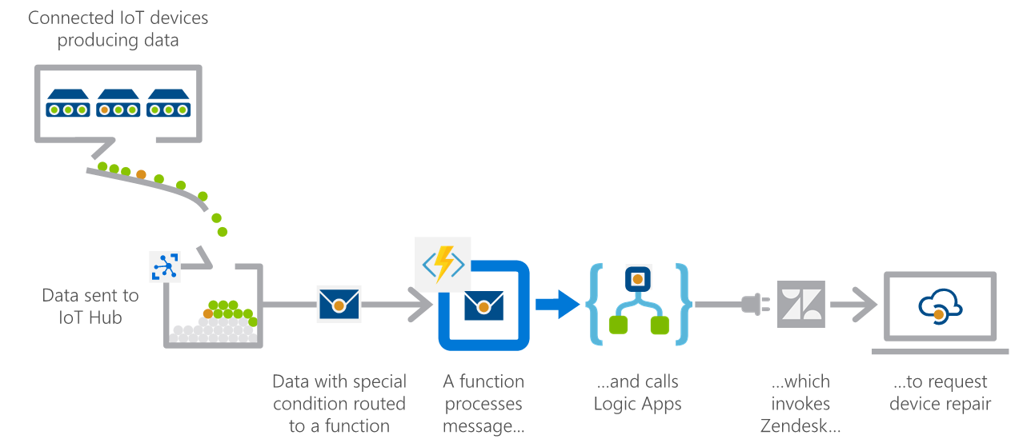
Serverless scenario: IoT
IoT-connected backends in the manufacturing scenario: A manufacturing company uses IoT to monitor its machines. Functions detects anomalous data and that triggers a message to the service department when a repair is required.
Source: https://learn.microsoft.com/en-us/azure/architecture/serverless-quest/reference-architectures

Slide 20
More resources
Application Architecture as Code - The Architect Elevator
Serverless Hexagonal Architecture — Python | by Muthu Venkatachalam | Medium
Refactoring to Serverless | Serverless Land

