Slide 1
The Problems
I'm addicted to news feeds
Google Reader is getting killed
I don't want to admin a server
Same Origin Policy :-(

Slide 2
Same Origin Policy
Protecting browser users everywhere
Prevents cross domain xmlHttpRequest
Allows cross domain scripts (tracking)
Allows cross domain image and video (ads)
Why does xhr always send cookies?
CORS requires a change to every server you want to talk to (not your servers)

Slide 3
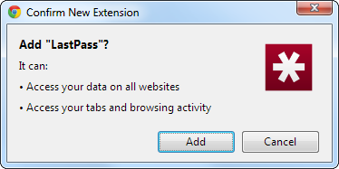
Extensions relax policy
“permissions”: [“http://*”, “https://*”]

Slide 4
Proposed Alternatives
XHR anonymous flag: http://www.w3.org/TR/XMLHttpRequest/#anonymous-flag
UMP: http://www.w3.org/Security/wiki/Comparison_of_CORS_and_UMP
Confused deputy?

Slide 5
Brass Reader
Chrome extension
  All client side code
  No server operator to shut it down
  Stores data in IndexedDB
  Multiple potential sync servers
  Offline capability

Slide 6
Brass Reader
Downsides
  Syncing is complicated
  Must stay running somewhere to download all feeds
  Your storage

Slide 7
Brass Reader
Next Steps
  Syncing
  Firefox version
  Mobile apps

