Slide 1
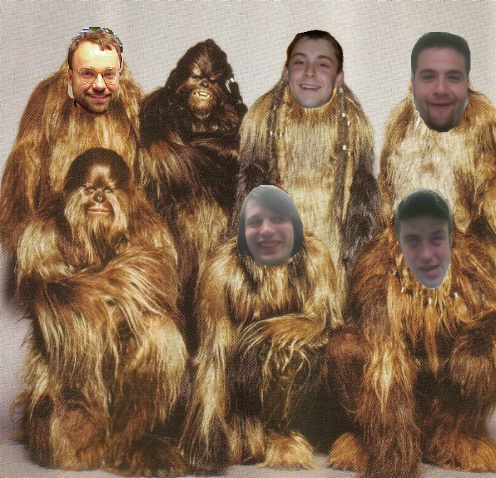


Funny Factory
Mike
Cialowicz
Zeid
Rusan
Matt
Gamble
Keith
Harris

Slide 2

Our Missions:
1- To explore strange new worlds.
2- Given an inputed sentence, output the statistically funniest response based on comedic data.
Our Approach:
1- Learn from relationships between
words in jokes.
2- Learn from sentence structures
of jokes.
“On Screen!”

Slide 3
Step 1: Collect data (2.5 MB)
.
.
.
Setup 1: “I feel bad going behind Lois' back.”
Setup 2: “Don't feel bad Peter.”
Zinger!: “Oh I never thought of it like that!”
.
.
.

Slide 4
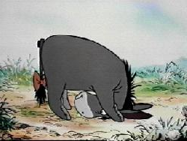
Step 2: Tag the jokes (Size = 3.5MB)
“I feel bad going behind Lois' back.”
“Don't feel bad Peter.”
/VB /NN /JJ /NNP
“Oh I never thought of it like that!”
/UH /PRP /RB /VBD /IN /PRP /IN /DT
Attach:
/PRP /VBP /JJ /NN /IN /NNP /RB
Attach:
Attach:
“Who tagged that there?”

Slide 5
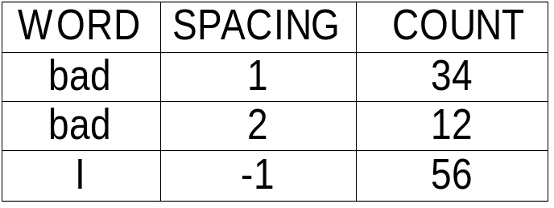
Step 3a: Zinger word counts
(100 MB)
I feel bad going behind Lois' back
For each word :
Count!
For word 'feel' :
Intuition: Word relations in Zingers should help us construct our own!

Slide 6
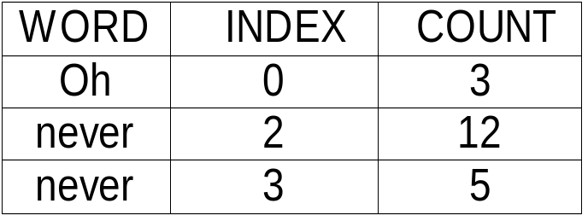
Step 3b: Cross sentence counts
(## MB)
For each adjacent
pair in setups :
Don't feel bad Peter
Count! :
Oh I never thought of it like that!
For 'feel,bad ' :
Intuition: Words in input should help us place a seed word in Zingers we are constructing!

Slide 7
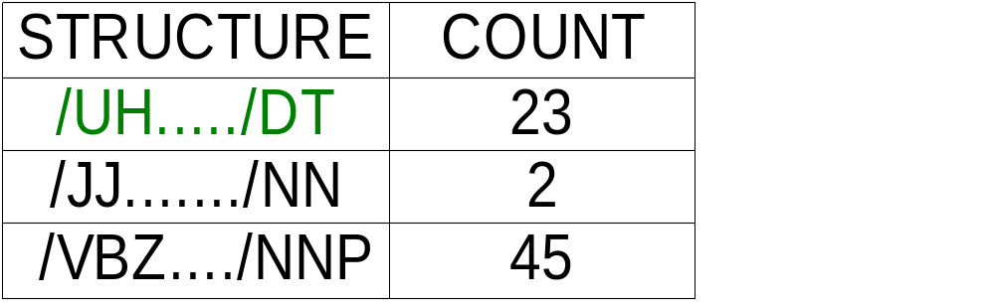
Step 3c: Structure counts (2.2 MB)
Oh I never thought of it like that!
/UH /PRP /RB /VBD /IN /PRP /IN /DT
For each sentence :
Count! :
Intuition: Using known funny Zinger structures should yield funnier constructed Zingers.

Slide 8

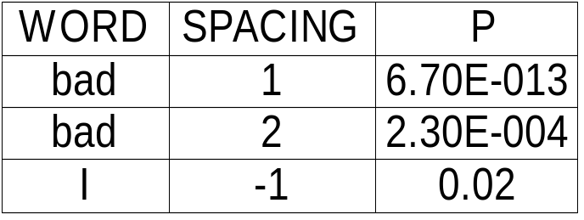
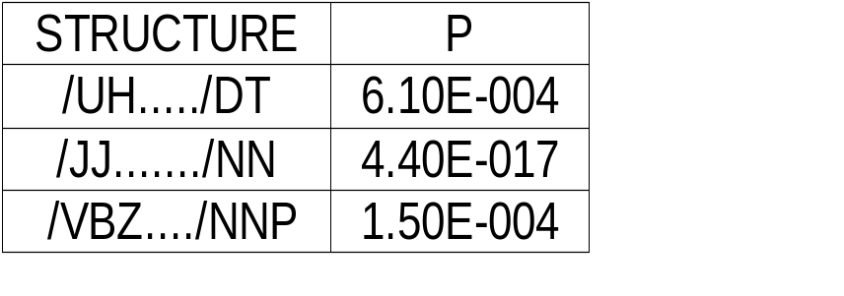
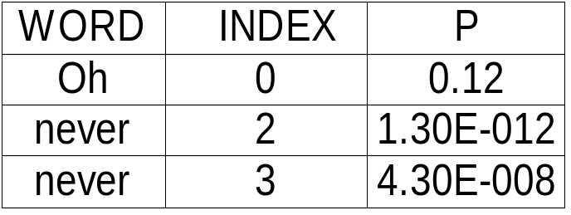
Step 4: Smoothing!
Converted dictionary counts to probabilities using:
Laplace smoothing (k = 1)
Lidstone's law (k = 0.5, 0.05)
“Damn that's smooth”

Slide 9
Step 5: Make a sentence!
Input sentence :
This is an example
sense
makes sense
/DT makes sense
“This makes sense”
Get seed word :
Highest Prob
Generate more words :
Highest Prob
Get a structure :
Highest Prob
Complete sentence :
Highest Prob

Slide 10
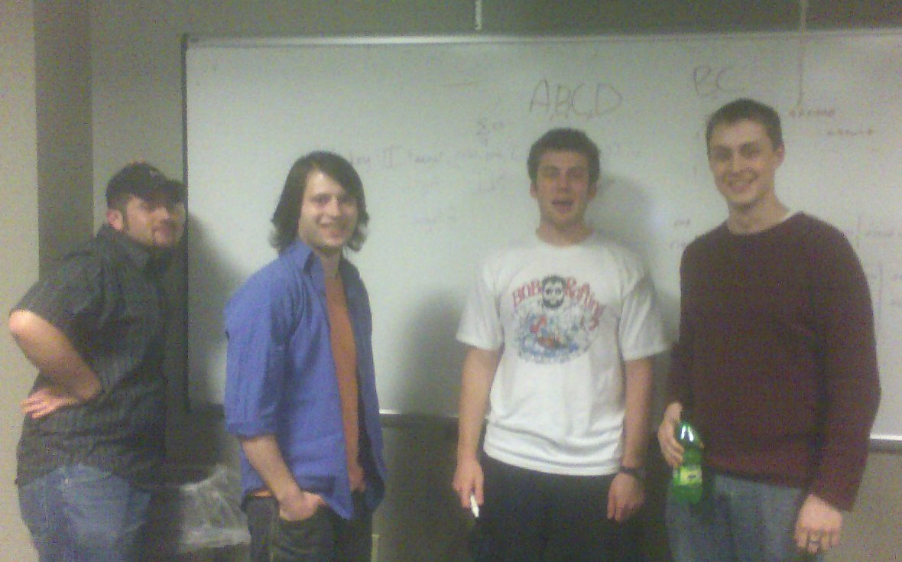
Step 6: DEMO!
5/11/2006 @ 4:13 am in the Linux Lab
“YEAH BOYYYYYYYY!”

Slide 11
Step 7: Future Work
- Incorporate semantics.
- Collect MORE data. (Need a better computer)
- Apply weights to cross sentence counts
- Evaluate using test subjects (mainly Billy) with different combinations of weight and probability (k = #) parameters.
- Do parameters converge along with funny?
- Reevaluate using the (better?) parameters.

