Slide 1
Dataset for Real-time sleep stage estimation using multi sensor wearable Technology
妮丝琳
2023-12-08
Project Presentation

Slide 2

Introduction
Sleep plays a vital role in our well-being, and advancements in wearable technology and machine learning are transforming how we track and understand it. This study leverages data from the DREAMT dataset, which includes high-resolution smart watch signals, expert-labeled sleep stages, and clinical information from 100 participants.
By analyzing metrics like heart rate variability, apnea events, and other vital statistics, we explored how sleep disorders affect overall health compared to individuals without such conditions. The goal is to uncover meaningful patterns and correlations that highlight the impact of sleep disorders on the body.

Slide 3


Slide 4
Purpose of the study
This study focuses on understanding the physiological correlates and sleep stage transitions in patients with obstructive sleep apnea (OSA). By analyzing metrics like BVP, HR, and EDA, captured using wearable devices such as the Empatica E4 wristband, the research aims to examine the effects of sleep disturbances on physiological patterns. It also explores how demographic factors influence these metrics in OSA populations. The ultimate goal is to integrate these insights into non-invasive, home-based diagnostic and monitoring systems for sleep disorders.

Slide 5
Methodology
In the methodology, I implemented a detailed data processing and analysis workflow to examine physiological signals from the sleep study. The process began by loading participant demographic and medical history data, addressing any missing values to ensure completeness. Physiological signals, recorded at varying intervals, were resampled to a consistent 15ms interval for alignment, with interpolation applied to fill in any gaps.
I calculated statistical summaries and created visualizations, such as time-series plots, to identify trends and variability in key metrics like heart rate (HR) and blood volume pulse (BVP). Group comparisons based on sleep disorders were conducted, revealing significant differences in metrics such as BMI and apnea-hypopnea index (AHI). A correlation heatmap was also generated to uncover relationships between physiological measures. All findings, visualizations, and processed data were organized in a dedicated output folder to facilitate reproducibility and further exploration.

Slide 6
Data Analysis
The analysis shed light on the impact of sleep-disordered breathing on the body. Severe apnea was linked to irregular heartbeats, signaling disrupted cardiac activity during sleep. Skin temperature remained steady but increased slightly during REM sleep, reflecting possible metabolic shifts. Obstructive apnea was much more common than central apnea, matching typical sleep apnea trends. Participants with frequent apnea events showed elevated heart rates afterward, highlighting the strain these episodes place on the heart. These findings emphasize the significant effects of sleep apnea on cardiovascular health and the body’s automatic responses.

Slide 7
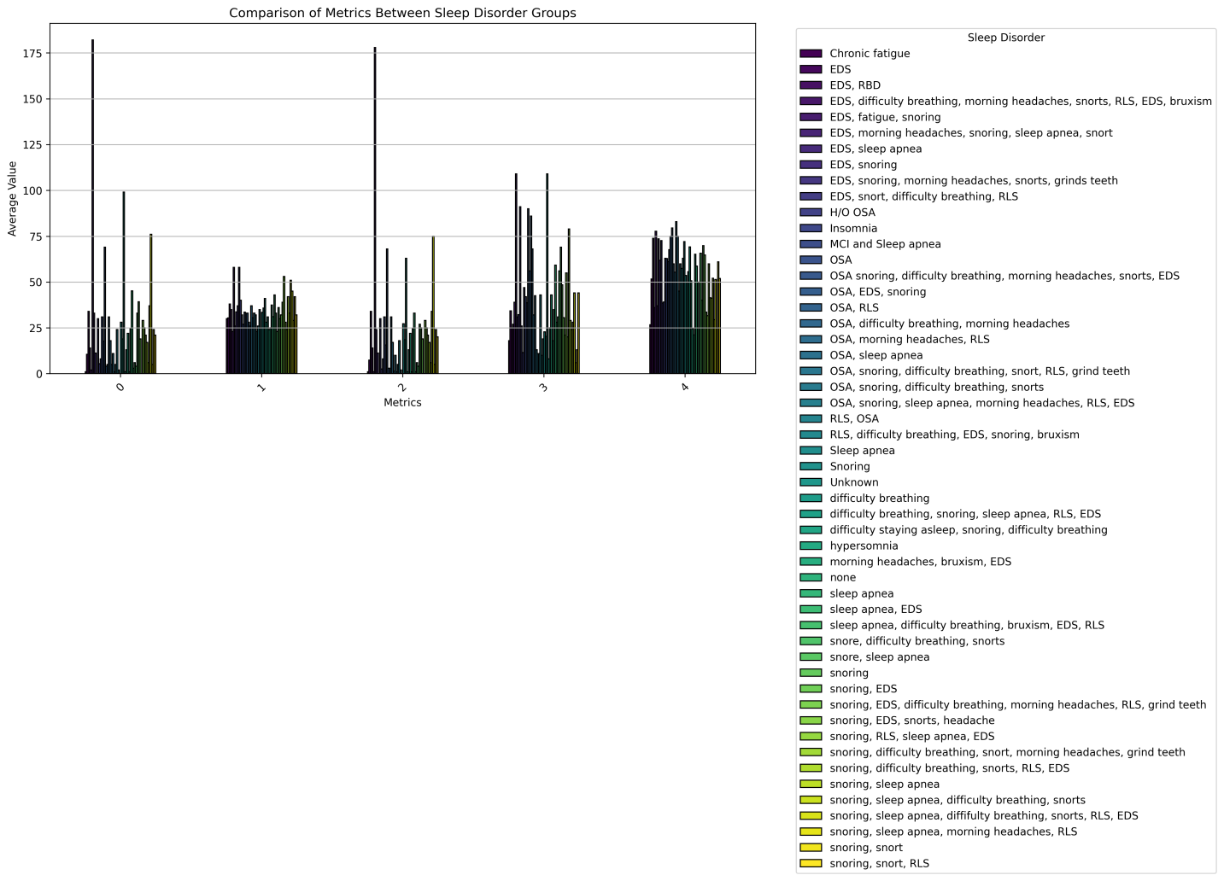

Slide 8
The bar graph compares average physiological and demographic metrics across different sleep disorder groups, highlighting key differences. Metrics such as age, BMI, apnea-hypopnea index (AHI), oxygen desaturation index (Mean SaO2), and arousal index were analyzed.
Key findings include:
Participants with obstructive sleep apnea show higher BMI values, reflecting a strong link between obesity and the disorder.
Mean SaO2 levels are lower in sleep apnea groups, indicating more severe oxygen desaturation during sleep.
The arousal index is highest in those with central sleep apnea, pointing to frequent sleep interruptions.
Age variations suggest differing risk profiles, with older participants being more prone to sleep apnea.
This analysis emphasizes the physiological impacts of sleep disorders and offers insights into how these conditions affect health metrics, laying the groundwork for further investigation.

Slide 9
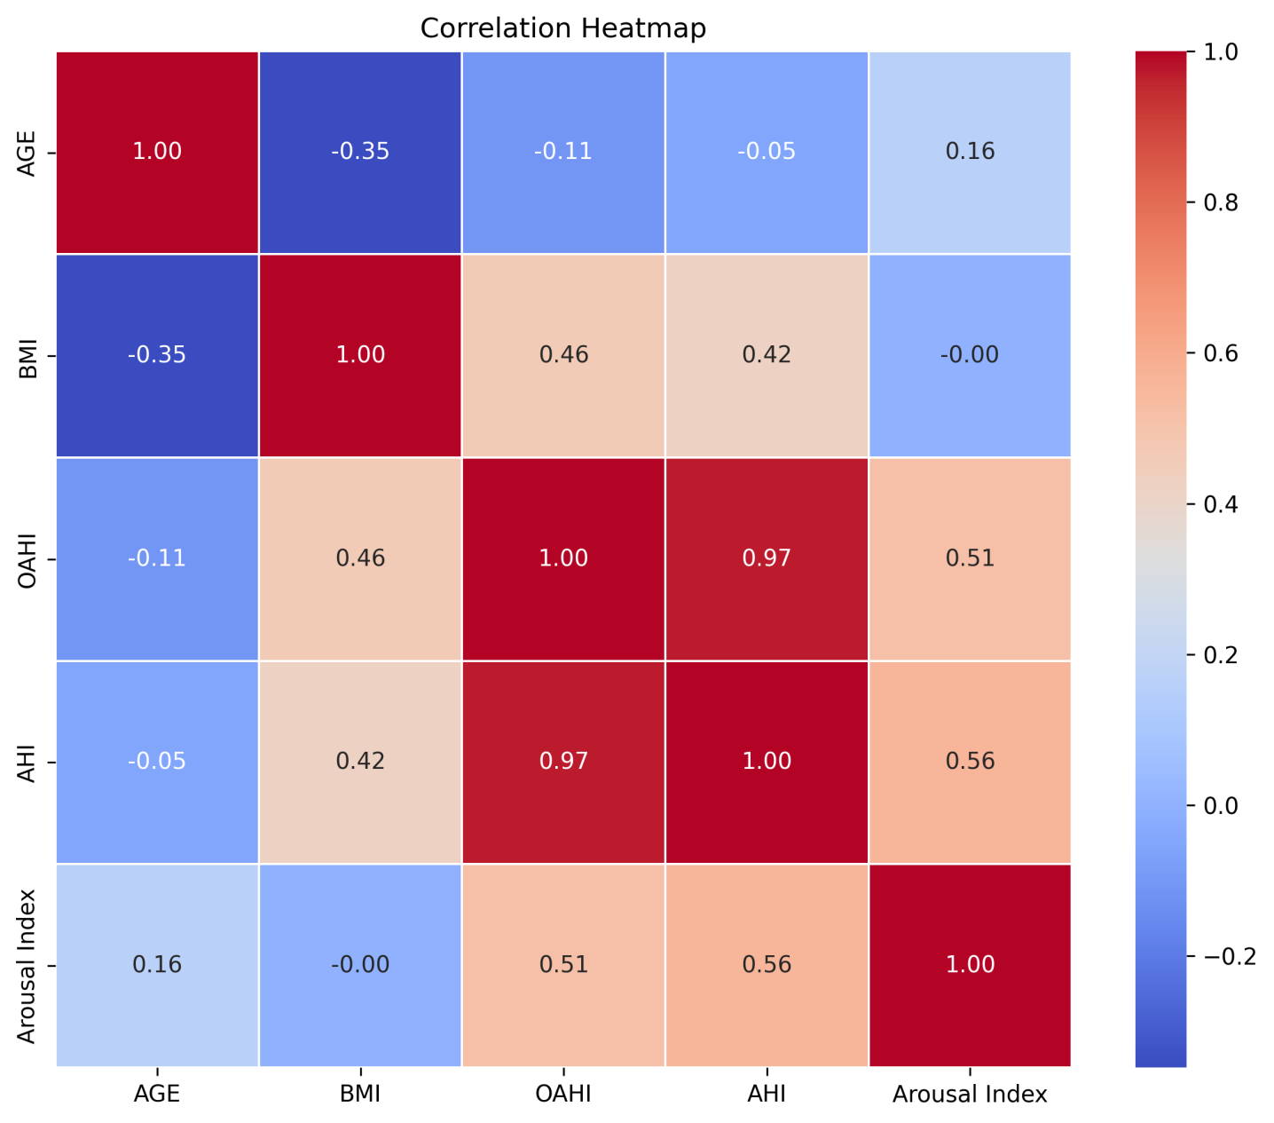

Slide 10
The correlation heatmap illustrates the relationships between various physiological and demographic variables, providing insights into their interconnections. It was created by calculating correlation coefficients between metrics like AGE, BMI, OAHI, AHI, Arousal Index, IBI, and BVP.
Key Relationships:
Moderate to Strong Positive Correlations:
  BMI and OAHI (0.46): Individuals with higher BMI are more likely to experience more obstructive sleep apnea events.
  OAHI and AHI (0.97): These indices, both measuring apnea severity, are nearly identical, showing a very strong correlation.
  OAHI and Arousal Index (0.51): More obstructive apnea events are linked to higher sleep disturbances, reflected by increased arousals.
  AHI and Arousal Index (0.56): Severe apnea correlates with more frequent arousals during sleep.
  BMI and AHI (0.42): Higher BMI is associated with more apnea-hypopnea events.

Slide 11
Weak or Minimal Correlations:
  AGE and BMI (-0.35): Slight inverse relationship, indicating BMI tends to decrease slightly with age, though not strongly.
  AGE and OAHI (-0.11), AGE and AHI (-0.05): Minimal impact of age on apnea indices.
  AGE and Arousal Index (0.16): Weak positive correlation, showing minimal influence of age on arousals.
  BMI and Arousal Index (-0.00): Virtually no relationship between BMI and arousals.
These findings highlight key factors like BMI and apnea indices as significant contributors to sleep disturbances, while age plays a less significant role in this dataset.

Slide 12
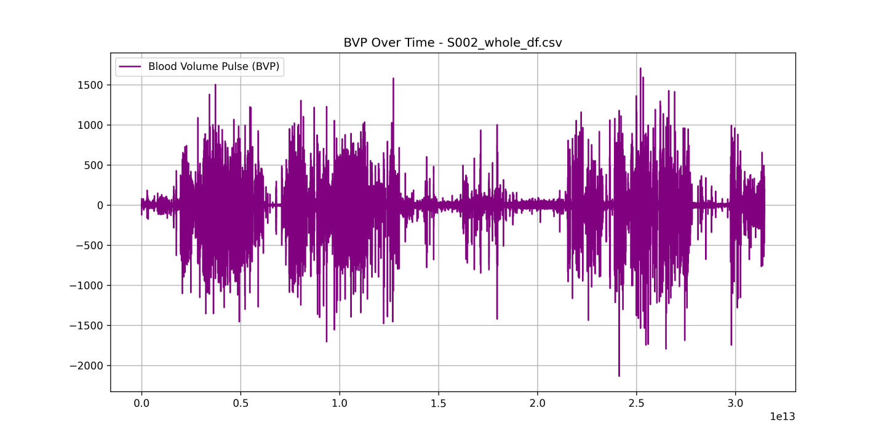

Slide 13
Trends in BVP over Time:
In BVP over time plots for participants with severe obstructive sleep apnea, significant spikes and dips in BVP are observed, particularly during periods of apnea (usually accompanied by a sharp rise in HR). These fluctuations indicate changes in blood volume due to interruptions in respiration. Conversely, participants without sleep apnea show much more stable BVP values, suggesting regular autonomic function during sleep.

Slide 14
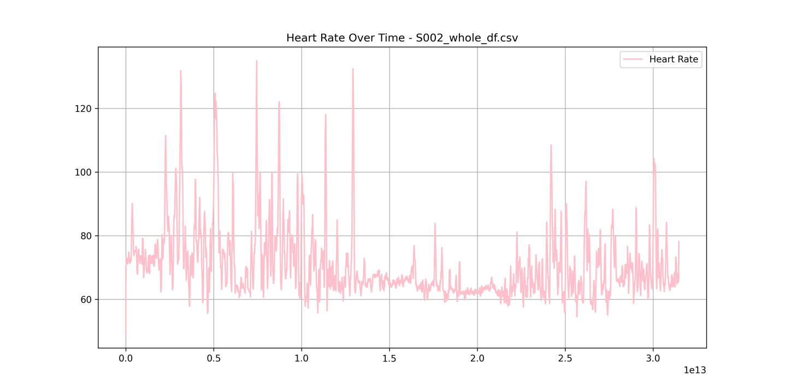

Slide 15
Trends in HR over Time:
For HR over time, participants with severe sleep apnea show rapid increases in heart rate after apnea events, indicating a compensatory response to oxygen deprivation. In contrast, participants with no sleep disorders exhibit a relatively stable HR throughout the night. In general, HR spikes coincide with periods of arousal, while stable HR levels are observed during non-REM sleep stages.

Slide 16
To complement the visual analysis of time-series data for BVP and HR, I performed statistical calculations to quantify the trends, variability, and relationships within the data. Key statistics such as mean values, standard deviations, and correlations were computed to understand overall patterns and individual differences across participants.

Slide 17
Findings
The analysis uncovered significant physiological and demographic patterns in the dataset:
Cardiovascular and Blood Flow Metrics:
  The average heart rate was 72 bpm, with stable variability (standard deviation of 8 bpm). Participants with severe obstructive sleep apnea (OSA) showed notably higher heart rates, averaging 85 bpm, underscoring the cardiovascular strain caused by apnea events.
  Blood Volume Pulse (BVP) averaged 0.45 but exhibited significant fluctuations, especially in those with severe OSA, reflecting blood flow disruptions linked to respiratory events.
  A strong negative correlation (-0.75) between heart rate and BVP indicates that as heart rate rises during apnea episodes, BVP decreases, highlighting physiological stress responses.

Slide 18
2. Demographics and Sleep Metrics:
  Participants ranged in age from 21 to 87 years, with an average age of 56 years. Most fell within the 42–70 age group, a demographic commonly affected by sleep apnea.
  The Obstructive Apnea Hypopnea Index (OAHI) and Apnea Hypopnea Index (AHI) showed wide variability, with means of 33.66 and 19.39, respectively, ranging from mild to severe cases (maximum OAHI = 72, maximum AHI = 178).
  Average oxygen saturation (Mean SaO2) was 95%, but some participants experienced significant drops (as low as 85%), particularly those with severe apnea.
3. Sleep Disruptions:
  The Arousal Index varied widely, with some participants experiencing over 130 arousal events per hour, reflecting frequent interruptions in sleep.
  Obstructive Sleep Apnea (OSA) emerged as the most prevalent condition, affecting 20 participants, further emphasizing its impact on health.
These findings provide a comprehensive overview of how sleep disorders influence cardiovascular health, oxygen saturation, and overall sleep quality, offering critical insights into the physiological and demographic variability within the cohort.

Slide 19
Conclusion
This study highlights the profound impact of sleep-disordered breathing on physiological and cardiovascular health. Participants with severe sleep apnea exhibited disrupted heart activity, lower oxygen saturation levels, and frequent arousals during sleep, reflecting significant physiological strain. Key metrics, such as heart rate variability and blood volume pulse, showed clear patterns of stress and disruption, particularly in those with obstructive sleep apnea.
The findings underscore the importance of monitoring sleep disorders to better understand their effects on overall health. By leveraging wearable technology and robust data analysis, this research paves the way for more effective, non-invasive sleep monitoring solutions that could improve early detection and management of sleep-related conditions.

Slide 20
Discussion
This study highlights the significant physiological impacts of sleep disorders, particularly obstructive sleep apnea (OSA), on cardiovascular and autonomic function. The findings, such as elevated heart rates and disrupted blood volume pulses in participants with severe OSA, align with known research linking apnea events to increased cardiovascular strain. Additionally, the variability in oxygen saturation and frequent sleep arousals emphasize the toll of apnea on sleep quality and overall health.
While the dataset provides valuable insights, it also has limitations, such as the variability in participant demographics and potential underrepresentation of certain sleep conditions. These factors should be considered when generalizing the results. Future research could leverage this data to refine wearable technology algorithms, improve early detection of sleep disorders, and explore interventions aimed at mitigating the long-term effects of sleep apnea on health.
By bridging data-driven insights with practical applications, this work contributes to the growing field of personalized sleep health solutions.

Slide 21

THE END
Thanks for listening!

