Slide 1
Idea/Approach Details
Theme : Health Care
Title of the Project/Idea : Remote patient examination
Team Name : Techies
College Name : VIGNAN’S INSTITUTE OF INFORMATION TECHNOLOGY
SNO | Name of the Candidate | Studying Year | Course | Role
1 | S LOKESWARI LIKHITHA | 2 | CSE | Team Lead
2 | Sk SONA | 2 | CSE | Team Member
3 | S NIKHITHA | 2 | CSE | Team Member
4 | S SRAVANI LAKSHMI | 2 | CSE | Team Member

Slide 2
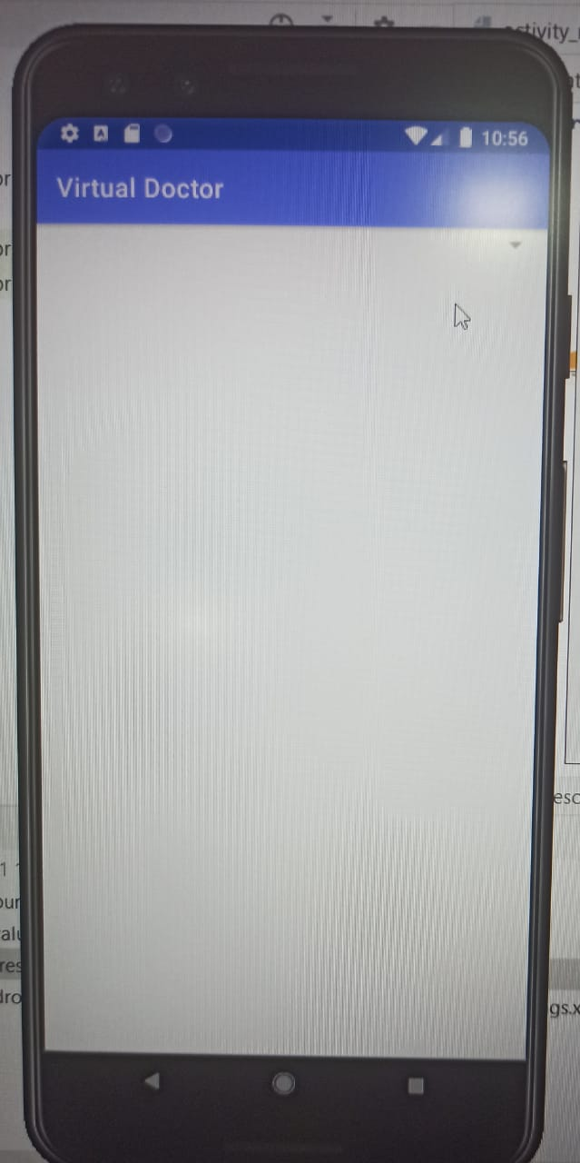
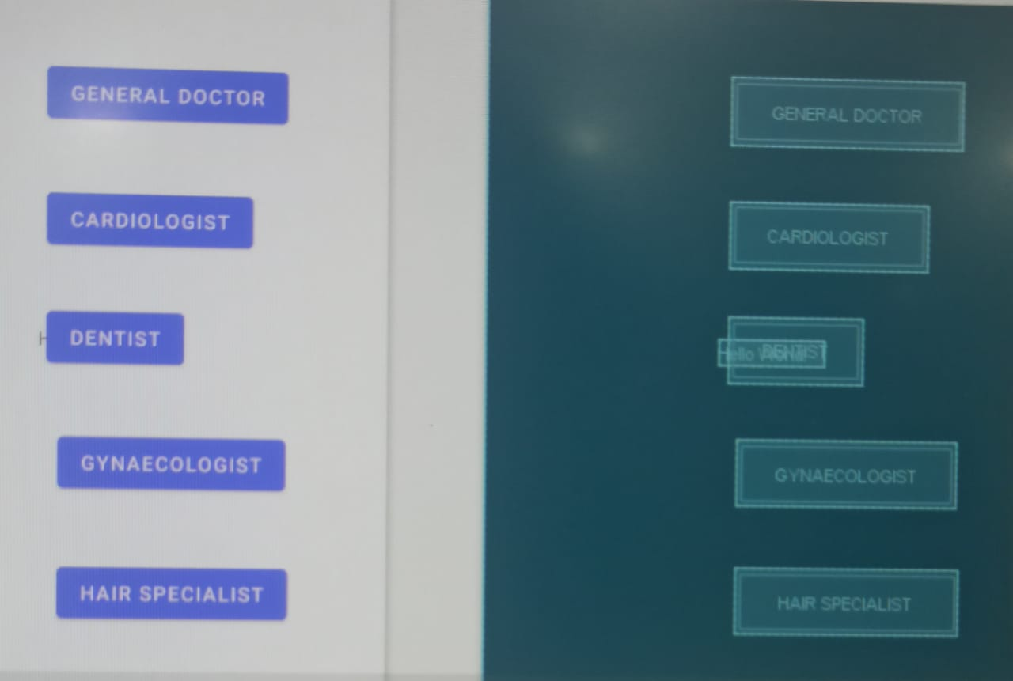
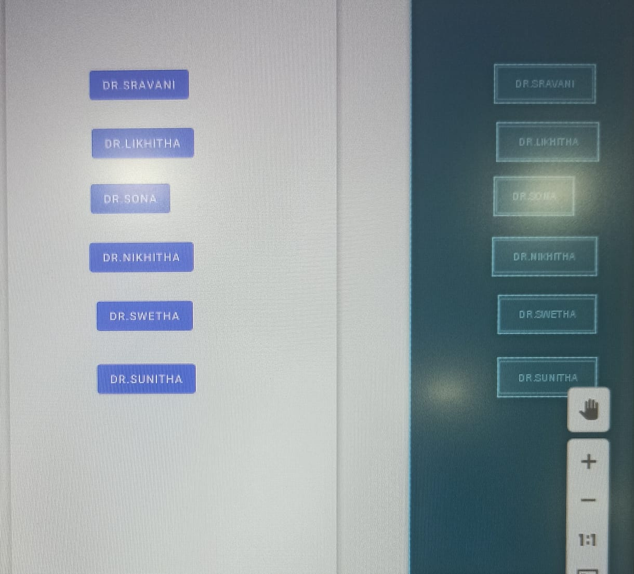
Describe your idea / Solution / Prototype here :
Building a mobile app that enables doctors to gain real-time access to a patient’s conditions from anywhere in the world. The mobile app solution allows the doctors to gauge a patient’s condition to decide whether hospitalization is necessary. This solution provide general assistance and will be useful in case of emergencies.

Slide 3
Problem statement (100-150 words):
Traditional healthcare system always required the patient to visit a clinic or hospital and consult a doctor for treatments for any problems and for general checks. This takes time in terms of appointments for the doctor and the patient unless it is an emergency, and this would also require patient transportation. Due to COVID pandemic, people are afraid of going to hospital for checkups due to spread of virus. The process of diagnosis takes more time. Owing to this there will be less adherence to the medication schedule. Hospitals or familiar premises may not be more amenable for several patients than home. Doctor cannot balance the workload and time in order to assess patients. So, continuous monitoring of patients is not possible.

Slide 4
Describe your Technology stack here:
Toolset-Android studio
Java
Describe your Use Case here:
The app is used when the patient is in need of the doctor. And the patient can be diagnosed easily.

