Slide 1

1st REVIEW
Distributed Video Anomaly Detection in Large-Scale Surveillance Systems Using HDFS and Cluster-Visualized Federated CNN–LSTM Models
Anthony Nissy | 2520030064
P. Anuradha Nandini | 2520030171
K. Shashank Reddy | 2520030215
Under the Guidance
of
Dr. Y Subbarayudu
Assistant Professor
Department of Computer Science and Engineering
KONERU LAKSHMAIAH EDUCATION FOUNDATION

Slide 2
GROUP NUMBER:1
Name of Candidate | Role
Anthony Nissy- 2520030064
P. Anuradha Nandini- 2520030171
K. Shashank Reddy - 2520030215

Slide 3
ABSTRACT
This project presents the design and development of a Generative AI Assistant and Knowledge Base for Pharmaceuticals, a full-stack, microservices-based system that combines large language model (LLM) capabilities with structured and unstructured pharmaceutical data to deliver accurate, context-aware responses to queries related to drug information, interactions, dosage guidelines, and regulatory documentation.
The system employs a polyglot persistence architecture: a normalised relational database (PostgreSQL) stores structured entities such as drugs, manufacturers, prescriptions, and user records with optimised SQL queries and transactional integrity; a NoSQL document store (MongoDB) manages semi-structured data such as drug leaflets, clinical notes, and FAQs; and a vector database (pgvector) enables semantic search and retrieval-augmented generation (RAG) by storing embeddings of pharmaceutical literature, allowing the AI assistant to retrieve contextually relevant knowledge before generating responses.
The backend is architected as a set of independently deployable microservices, built using FastAPI (with Pydantic validation, JWT-based authentication, dependency injection, and OpenAPI documentation) for the AI/RAG and query-processing services, and Node.js/Express or Spring Boot for supporting services such as user management, catalog management, and notification handling. Services communicate via REST APIs and asynchronous messaging (Kafka), decoupling the system into bounded contexts such as authentication, knowledge retrieval, chat/inference, and admin management, evolving from an initial monolithic prototype into a microservices architecture through systematic decomposition.
The complete system is containerised using Docker, orchestrated for local and cloud deployment, and supported by a CI/CD pipeline for automated testing and deployment. System design is documented using the C4 model to capture context, container, component, and code-level views, ensuring maintainability and clarity for future development.
The final deliverable is a live, demonstrable full-stack application where a frontend interface connects to all backend microservices, allowing pharmacists, clinicians, or patients to query a generative AI assistant that grounds its answers in a verified, continuously updatable pharmaceutical knowledge base — reducing the risk of hallucinated medical information while improving accessibility to reliable drug-related knowledge.

Slide 4
INTRDOUCTION
The pharmaceutical industry contains a large amount of complex and continuously changing information about medicines, dosage guidelines, drug interactions, side effects, and clinical documentation. Finding the right information quickly and understanding it correctly can be difficult using traditional search systems.
This project, “Generative AI Assistant and Knowledge Base for Pharmaceuticals,” aims to develop an intelligent assistant that can understand natural-language queries and provide relevant pharmaceutical information. The system combines Generative AI with a verified knowledge base to improve the reliability and usefulness of its responses.
The project uses SQL and NoSQL databases to store structured and semi-structured pharmaceutical data, while a vector database supports semantic search and Retrieval-Augmented Generation (RAG). This allows the AI to retrieve relevant information from the knowledge base before generating an answer, helping to reduce unsupported or inaccurate responses.
The application is developed using REST APIs and microservices, with technologies such as FastAPI, Node.js/Express, and Spring Boot. Kafka can be used for asynchronous communication between services, while Docker and CI/CD support containerization, testing, and deployment. Overall, the project demonstrates the practical integration of Generative AI, databases, semantic search, microservices, APIs, and modern deployment technologies to build a scalable pharmaceutical information assistant.

Slide 5
EXISTING SYSTEM
Existing System
- Uses traditional pharmaceutical databases to store medicine and drug-related information.
- Provides information about medicines, dosage, side effects, and drug interactions.
- Mainly depends on keyword-based search for retrieving information.
- Uses predefined chatbots or basic AI systems for answering common queries.
- Often relies on single or limited data sources.
- Has limited ability to understand the context and meaning of natural-language queries.
- Traditional systems generally do not combine SQL, NoSQL, and vector databases.
- Limited use of semantic search and Retrieval-Augmented Generation (RAG).
- Many systems are developed as monolithic applications, making scalability and maintenance difficult.
- AI systems without a verified knowledge base may produce inaccurate or unsupported information.
- Limited integration of microservices, Kafka, Docker, and CI/CD.
- Therefore, existing systems lack a unified, scalable, and knowledge-grounded Generative AI solution for pharmaceutical information.

Slide 6
PROBLEM
- Keyword-based search may fail to understand the actual meaning and context of user queries.
- Pharmaceutical information is often scattered across different sources.
- Existing systems may have difficulty handling both structured and unstructured data.
- Traditional systems provide limited personalized and context-aware responses.
- Predefined chatbots cannot effectively answer new or complex pharmaceutical queries.
- General AI systems can generate incorrect or hallucinated information without a reliable knowledge base.
- Lack of semantic search can result in irrelevant information being retrieved.
- Many systems have limited integration of SQL, NoSQL, and vector databases.
- Monolithic architectures can make the system difficult to scale and maintain.
- Limited use of microservices and asynchronous communication reduces flexibility.
- Manual deployment and testing can make system updates time-consuming and error-prone.
- Existing systems may not provide a unified platform for accessing comprehensive pharmaceutical knowledge.

Slide 7
SOLUTION(Contribution)
- Develops a Generative AI-powered pharmaceutical assistant for natural-language queries.
- Creates a centralized pharmaceutical knowledge base containing reliable drug-related information.
- Uses PostgreSQL for structured data and MongoDB for semi-structured pharmaceutical documents.
- Uses Vector Database (pgvector) and semantic search to retrieve relevant information based on meaning rather than exact keywords.
- Implements RAG (Retrieval-Augmented Generation) to provide knowledge-grounded AI responses and reduce hallucinations.
- Uses microservices architecture to improve scalability, maintainability, and independent service deployment.
- Provides REST APIs for communication between the frontend and backend services.
- Uses Kafka for asynchronous communication and event processing between services.
- Implements authentication and authorization to protect user and pharmaceutical data.
- Uses Docker containerization for consistent and portable deployment.
- Integrates CI/CD pipelines for automated testing and deployment.
- Provides a user-friendly interface where users can quickly obtain relevant pharmaceutical information from a single platform.

Slide 8
Objectives
- To develop a Generative AI-based pharmaceutical assistant that can understand and respond to user queries.
- To create a reliable pharmaceutical knowledge base for storing drug, dosage, interaction, and medical information.
- To integrate SQL, NoSQL, and Vector Databases for efficient storage and retrieval of different types of pharmaceutical data.
- To implement semantic search and RAG (Retrieval-Augmented Generation) for more relevant and knowledge-grounded responses.
- To reduce AI hallucinations and unsupported answers by using retrieved pharmaceutical information as context.
- To design a microservices-based architecture for scalability, flexibility, and easier maintenance.
- To develop secure and efficient REST APIs for communication between frontend and backend services.
- To use Kafka for asynchronous communication and event processing.
- To implement Docker and CI/CD for automated, consistent, and reliable deployment.
- To provide a user-friendly platform for quick and easy access to pharmaceutical information.

Slide 9
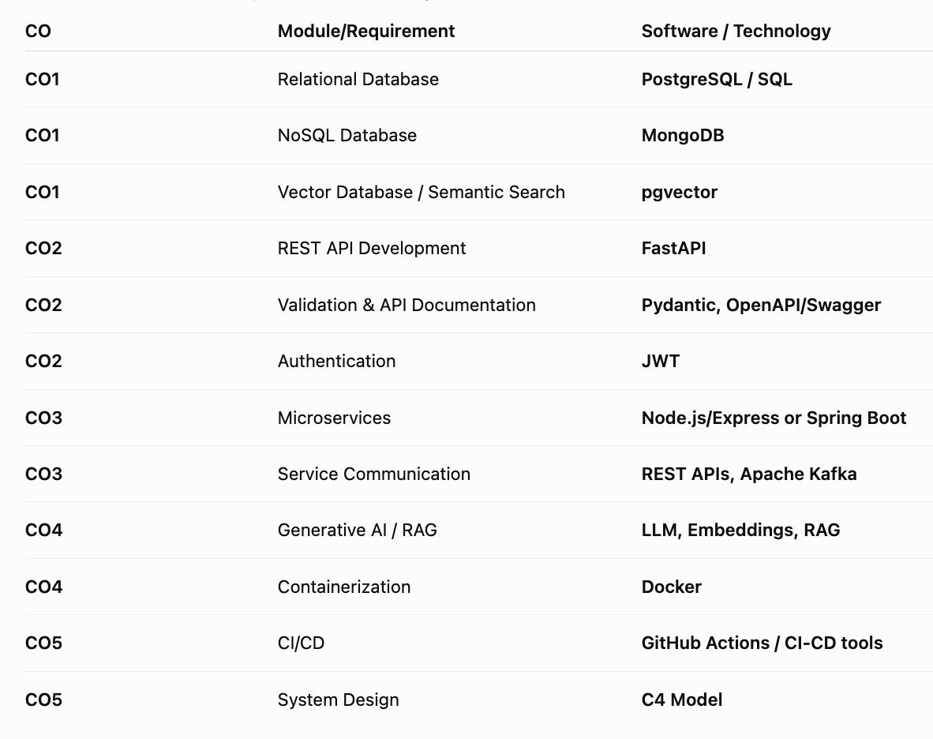
Modules

Slide 10
SOFTWARE REQUIREMENTS
SOFTWARE REQUIREMENTS
Software / Technologies Required:
- Operating System: Windows 10/11, Linux, or macOS
- Frontend: HTML5, CSS3, JavaScript / React.js
- Backend: Python with FastAPI
- Additional Backend: Node.js with Express.js / Spring Boot
- Databases: PostgreSQL and MongoDB
- Vector Database: PostgreSQL with pgvector
- Generative AI: LLM / Generative AI API
- RAG: Embedding model and Retrieval-Augmented Generation framework
- API Testing: Postman
- Messaging: Apache Kafka
- Containerization: Docker and Docker Compose
- Version Control: Git and GitHub
- CI/CD: GitHub Actions
- Documentation: OpenAPI / Swagger and C4 Model
- Development Environment: Visual Studio Code
- Web Browser: Google Chrome / Microsoft Edge / Mozilla Firefox

Slide 11
CONCLUSION AND FUTURE SCOPE
Conclusion
The Generative AI Assistant and Knowledge Base for Pharmaceuticals provides an intelligent and scalable solution for accessing pharmaceutical information. By combining Generative AI, SQL, NoSQL, vector databases, semantic search, and RAG, the system can provide context-aware and knowledge-grounded responses to user queries. The use of REST APIs, microservices, Kafka, Docker, and CI/CD improves scalability, maintainability, communication, and deployment. Overall, the project demonstrates how modern software technologies can be integrated to create a reliable pharmaceutical information assistant.
Future Scope
- Integrate advanced and domain-specific medical LLMs for improved pharmaceutical responses.
- Connect with real-time pharmaceutical and regulatory databases for continuously updated information.
- Add voice-based interaction for easier accessibility.
- Support multiple languages for wider usability.
- Implement personalized medicine recommendations based on user-provided information, with appropriate clinical safeguards.
- Improve security using advanced encryption, access control, and audit logging.
- Add cloud deployment and auto-scaling for handling large numbers of users.
- Extend the system to support pharmacists, clinicians, researchers, and healthcare organizations.
- Incorporate continuous monitoring and evaluation to improve AI accuracy and reduce hallucinations.

Slide 12
THANK YOU

